Slide 1
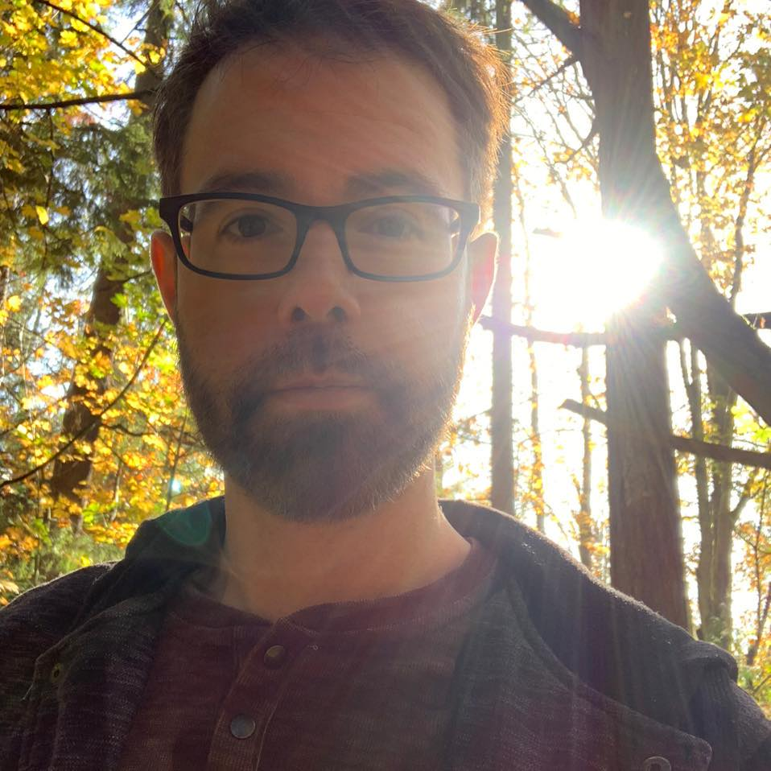
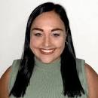
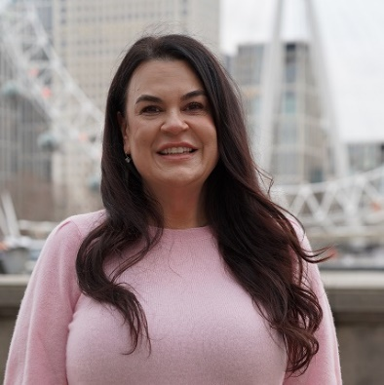
Developing a Virtual Global Exchange (VGE)
Rene Sanchez
Assistant Director, Education Abroad
KC Kirchner,
VGE Coordinator
Wendy Baker
USF World Campus Director, St. Petersburg

Slide 2



What is Virtual Global Exchange?
Adapting Existing Course
Collaborate on Planning & Design for Course Project and Discussions
USF Faculty Member
International Partner Faculty Member
USF Course Credit
Partner Course Credit
This Photo by Unknown Author is licensed under CC BY-SA-NC
Students interact for class assignment/project

Slide 3








What is Virtual Global Exchange?
Fundamental Design Components
Technology and tools support learning goal of project
This Photo by Unknown author is licensed under CC BY-NC.
Icebreakers
Collaborative Assignment
Reflection

Slide 4

Why Virtual Global Exchange?
Student Benefits:
Development of intercultural communication skills​
Development of critical thinking skills through teamwork (e.g., Rodríguez-Sabiote et al., 2022)​
Increase in student satisfaction with the course (e.g., West et al., 2022)​
Career readiness (practical experience working on a global team)
Increase access to a global experience​
​
This Photo by Unknown author is licensed under CC BY-SA.

Slide 5

Why Virtual Global Exchange?
Faculty Benefits:
International collaboration opportunities (research connections)
Internationalization of the curriculum (Internationalization at Home)
May lead to increased course evaluations
Build teaching portfolio
This Photo by Unknown author is licensed under CC BY-SA-NC.

Slide 6

VGE and Fulbright
In the spirit of the Fulbright program, VGE allows you to continue to build people to people connections after returning to US by designing a facilitated joint learning experience for students from both institutions.

Slide 7

Next Steps
Identify courses
Design experience with partner
Implement upon return
Let us know so we can track VGE participation and recognize your efforts
Support for Faculty and Partner
Self-paced canvas training

Slide 8
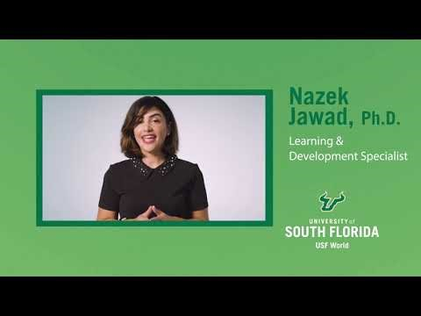
Video

Slide 9

VGE Training
Register for on-line asynchronous workshop
USF Faculty: https://www.usf.edu/world/for-faculty/virtual-exchange/index.aspx
2. Need additional guidance - contact our VGE team
This Photo by Unknown Author is licensed under CC BY-SA-NC

Slide 10
Questions?
Contacts
Wendy Baker: wbaker@usf.edu
Rene Sanchez: rene@usf.edu
KC Kirchner: kkirchner@usf.edu

