Slide 1
JUNE 2021
GLOBAL COLLEGE
REPRESENTATIVES MEETING
USF WORLD USF ADMISSIONS USF HEALTH

Slide 2
GUIDANCE FOR INTERNATIONAL TRAVEL
University-sponsored international travel continues to be prohibited.
For an international travel exception for the purpose of critical grant-funded research, training, or programs, submit an exception request to the USF Covie-19 Task Force via the veoci system: https://www.usf.edu/coronavirus/returning-to-campus/travel.aspx
Any personal travel remains strongly discouraged per CDC and FDOH guidance.
Vaccination is strongly encouraged.
USF WORLD USF ADMISSIONS USF HEALTH GLOBAL ENGAGEMENT UPDATE

Slide 3
GUIDELINES FOR INTERNATIONAL TRAVEL
Submit requests for international travel for approval by the COVID-19 Task Force.
USF WORLD USF ADMISSIONS USF HEALTH GLOBAL ENGAGEMENT UPDATE

Slide 4
INBOUND INTERNATIONAL TRAVEL
Restrictions in place for people or foreign nationals arriving from:
Brazil, China, Iran, the European Union, United Kingdom, the Republic of Ireland, South Africa & India
Exemptions for student travelers
Full vaccination: Two weeks after second dose in a 2-dose series of an FDA authorized OR WHO authorized vaccines:
Pfizer BioNtech – FDA & WHO
Moderna – FDA
EU nodes Astra Zeneca manufactured in the EU – WHO
SK Bio Astra Zeneca manufactured in South Korea – WHO
Serum institute of India COVISHIELD (same as the above two AZ vaccines) –
Sinopharm and Sinovac – WHO
2 weeks after a single-dose vaccine, such as the FDA and WHO authorized Johnson & Johnson’s Janssen vaccine
Proof of negative test before entry into the U.S.
USF WORLD USF ADMISSIONS USF HEALTH GLOBAL ENGAGEMENT UPDATE

Slide 5
On Campus Testing
All international students must test for COVID-19 after arrival irrespective of vaccination status.
Call SHS at 813-445-4976 or 813-974-2331 in advance to schedule test for Day 6
You can also schedule an appointment online by clicking here
If test is negative, student can end quarantine after Day 7
Test on Day 6 after arrival
USF WORLD USF ADMISSIONS USF HEALTH GLOBAL ENGAGEMENT UPDATE

Slide 6
COVID-19 Vaccine (recommended/optional)
International students interested in receiving the Pfizer vaccine (2 doses) or Janssen vaccine (1 dose) can contact Student Health Services after July 1:
Call SHS at 813-445-4976 or 813-974-2331 in advance to schedule the vaccine after completion of quarantine requirements
You can also schedule an appointment online by clicking here
Vaccination will be available at the Argos Study Lounge & on the second floor of the RAR building
USF WORLD USF ADMISSIONS USF HEALTH GLOBAL ENGAGEMENT UPDATE

Slide 7
Announcing a
New Globally Focused Student Center:
Opening Fall 2021
A One-Stop Shop
on the USF Tampa campus:
FAO GROUND FLOOR
International Student Programming
Education Abroad Programming/Advising
Peace Corps Recruiter
Peace Corps Prep
Alumni Outreach
USF WORLD USF ADMISSIONS USF HEALTH GLOBAL ENGAGEMENT UPDATE

Slide 8
INTERNATIONAL TRAVEL
RISK MANAGEMENT
USF WORLD USF ADMISSIONS USF HEALTH

Slide 9
Updates from CDC on COVID-19 Travel Health Notices and Institutes of Higher Education (IHE)
CDC uses Travel Health Notices (THNs) to alert travelers and other audiences to health threats around the world and advise on how to protect themselves.
As of June 7th, 2021, the CDC updated the primary and secondary criteria used to determine Travel Health Notice (THN) levels were updated to better differentiate countries with severe outbreak situations from countries with sustained, but controlled, COVID-19 spread.
This update gives specific travel advice for vaccinated and unvaccinated people according to the THN level, ensuring THN levels reflect the current global situation and are aligned with guidance for international travel: https://www.cdc.gov/coronavirus/2019-ncov/travelers/how-level-is-determined.html
On June 4th, the CDC removed the following language from the latest update of the CDC Guidance for Institutions of Higher Education (IHEs):
"The CDC recommends institutes of higher education (IHE) consider postponing or canceling upcoming student foreign exchange programs. In addition, CDC recommends IHE consider asking current program participants to return to their home country"
USF WORLD USF ADMISSIONS USF HEALTH GLOBAL ENGAGEMENT UPDATE

Slide 10
OFFICE OF
INTERNATIONAL SERVICES
USF WORLD USF ADMISSIONS USF HEALTH

Slide 11
OIS
UPDATE
F-1Student Travel to USF for Fall 2021
Currently F-1 students with valid visas from all countries are allowed to enter the US.
Travel Ban for Brazil, China, India, Iran, South Africa, UK, Ireland, & Schengen area include AUTOMATIC exception if student has or is approved a visa .
Students from the Schengen area, UK, and Ireland can enter the US 30 days prior to the start of their academic program.
Students from Brazil, China, India, Iran, or South Africa can enter 30 days after August 1, 2021 for Fall programs.
https://travel.state.gov/content/travel/en/News/visas-news/national-interest-exceptions-for-certain-travelers-from-china-Iran-india-brazil-south-africa-schengen-area-united-kingdom-and-ireland.html
USF WORLD USF ADMISSIONS USF HEALTH GLOBAL ENGAGEMENT UPDATE

Slide 12
Visa Denials or Administrative Processing
If students contact a faculty or staff member about a visa denial or administrative processing, please refer to OIS. Send any emails or documents to taylorm@usf.edu
It is best that our office handle the communication.
Administrative Processing takes 6 weeks in most instances. This cannot be changed. Students from Iran can take longer. If the process lasts past 6 weeks, OIS can intervene and communicate with the US Embassy.
USF WORLD USF ADMISSIONS USF HEALTH GLOBAL ENGAGEMENT UPDATE

Slide 13
Quarantine Requirement
International Students arriving for the Fall semester from a country outside of the U.S. and who are unvaccinated will be required to quarantine for 7 days and test for COVID-19 on day 6 after arrival. Test scheduled with SHS. Students call or schedule using online tool.
If a student does not get tested, they will need to isolate for a full 10 days.
If a student is fully vaccinated they do not have to quarantine but they will need to get tested on day 6 after arrival.
You are considered fully vaccinated:
2 weeks after the second dose in a 2-dose series, such as the FDA authorized Pfizer BioNtech and Moderna COVID-19 vaccines; or the WHO authorized EU sites - Astra Zeneca (AZD1222), SK Bio - Astra Zeneca (AZD1222), Serum Institute India - COVISHIELD, BIBP - Sinopharm, and Sinovac - CoronaVac vaccines.
2 weeks after a single-dose vaccine, such as the FDA and WHO authorized Johnson & Johnson’s Janssen vaccine
If a student arrives in the US and is having symptoms of COVID-19 they should continue quarantining and contact Student Health Services for a telehealth appointment to be evaluated.
https://www.usf.edu/world/international-services/about-us/faq.aspx
USF WORLD USF ADMISSIONS USF HEALTH GLOBAL ENGAGEMENT UPDATE

Slide 14
COVID 19 Vaccine
International Students who would like to receive the COVID 19 vaccine (Pfizer vaccine (2 doses) or Janssen vaccine (1 dose) can contact Student Health Services after July 1, 2021 to schedule an appointment for a date after the student’s quarantine period has been completed.
Vaccinations will be available on campus at the Argos Study Lounge on the second floor of the RAR building.
Students call or use online scheduling tool.
https://www.usf.edu/world/international-services/about-us/faq.aspx
USF WORLD USF ADMISSIONS USF HEALTH GLOBAL ENGAGEMENT UPDATE

Slide 15
Fall 2021
SEVP Guidance
SAME AS LAST YEAR!
OIS
UPDATE
F-1 Students Continuing Their Studies at USF
Must register full-time. Graduate students = 9 hours or Undergraduate students = 12 hours
May select ANY combination of course delivery modes for Fall 2021 schedule.
Continuing F-1 students include students changing levels ex. Pathway to Degree, Bachelor to Master, or Master to PhD.
Students who cannot travel back to the US, can maintain F-1 status while studying outside the US.
Students cannot remain employed if you are in ANY on-campus position including GA/TA/RA’s.
New F-1 Students Beginning Their Studies or New Program at USF
Must arrive no later than the first week of the semester to your their program at USF.You must register full-time.
Must register full-time. Graduate students = 9 hours or Undergraduate students = 12 hours
Must select at least ONE in-person courses categorized as classroom (CL) or hybrid (HB) delivery.
Students who cannot travel to the US can begin online if classes available.
https://www.usf.edu/world/international-services/immigration/enrollmentguidance.aspx
USF WORLD USF ADMISSIONS USF HEALTH GLOBAL ENGAGEMENT UPDATE

Slide 16
OFFICE OF ADMISSIONS
USF WORLD USF ADMISSIONS USF HEALTH

Slide 20
EDUCATION
ABROAD
USF WORLD USF ADMISSIONS USF HEALTH

Slide 21
EDUCATION ABROAD OFFICE UPDATES
Approximately 145 students are traveling abroad summer 2021.
Advisory Council's next meeting will be in September.
Small subgroup of the Council are working on a new proposal for faculty-led programs for 22/23.
Total number of Faculty-led Programs being developed is 45-48 (list added to chat).
USF WORLD USF ADMISSIONS USF HEALTH GLOBAL ENGAGEMENT UPDATE

Slide 22
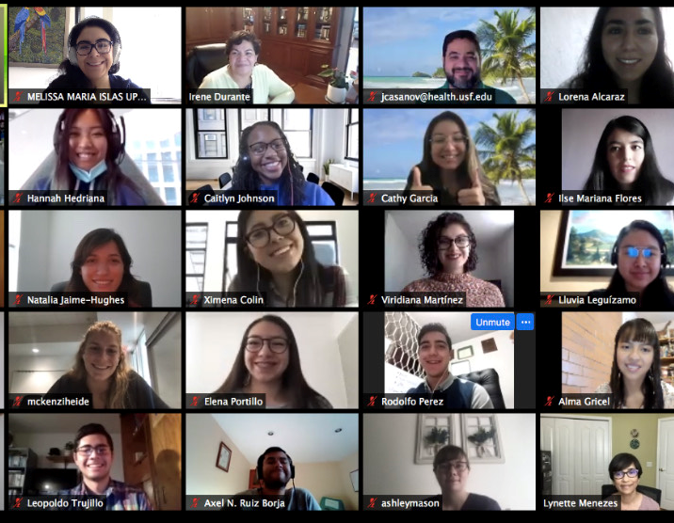
GLOBAL CLASSROOM INITIATIVE UPDATES
USF's Virtual Global Exchange (VGE) faculty training modules
Under development this summer
Fall launch
Estimated Global Classroom Participation 20/21* | Student Count
Global Tech Program | 418
Virtual Global Exchange | 148
International Virtual Internships | 30
Virtual Study Abroad | 30
Integrated Virtual Activity | 12
Grand Total | 638*
*Does not include ACE (262 expected) and Operation Global Action (210).
USF WORLD USF ADMISSIONS USF HEALTH GLOBAL ENGAGEMENT UPDATE

Slide 23
GCR TEAMS
UPDATE
USF WORLD USF ADMISSIONS USF HEALTH

Slide 24
THANK YOU
The Power Point Presentation and a recording of today’s Global College Representatives will be posted in our TEAMS Group for reviewing at a later date.
Thank you for being an active part of the USF Global Community
USF WORLD USF ADMISSIONS USF HEALTH GLOBAL ENGAGEMENT UPDATE
GLOBAL ENGAGEMENT UPDATE

