Slide 1
USF WORLD
Guidance for complying with the State of Florida Immunization Requirements

Slide 2
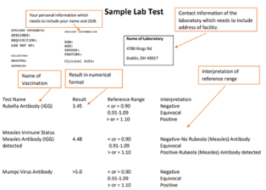
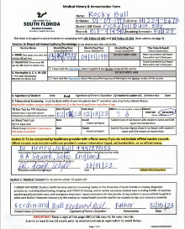
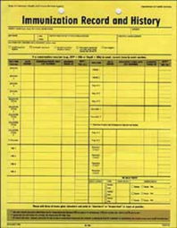
How Students may Show Proof of Immunizations and Medical Screenings
3. Laboratory Reports: Must be fully typed or stamped and include complete contact information for the healthcare provider (no handwritten information will be accepted)
1. Childhood Vaccine Records: Must include student’s full legal name, date of birth and health care provider’s contact information. The document must also be in English
2. USF Medical History Form (MHF): Flexible document that allows medical providers to either type, stamp or handwrite information on the form.
MHF Link: https://www.usf.edu/student-affairs/student-health-services/documents/current-usf-medical-history-form.pdf

Slide 3
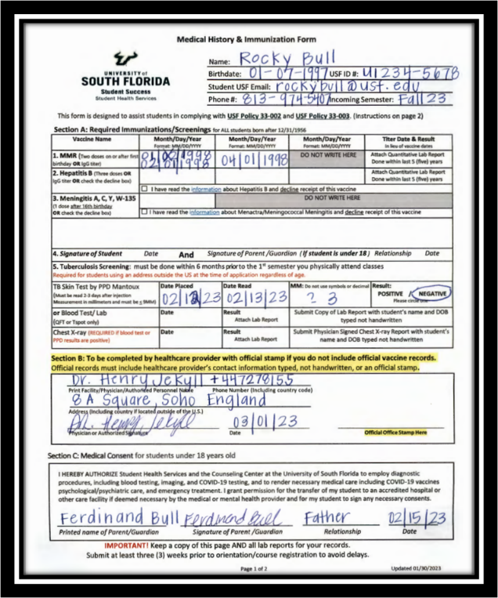
No Crossed-Out and Corrected Information Accepted
USF Student Health Services will not accept/review documents altered/corrected in any way, including using correction fluid.
Tip: bring multiple blank copies to your medical provider in case the person completing the document makes a mistake.

Slide 4
TOP PORTION OF FORM: Student May Complete

Slide 5
Item #1: MMR Vaccination (Measles, Mumps, Rubella)

Slide 6
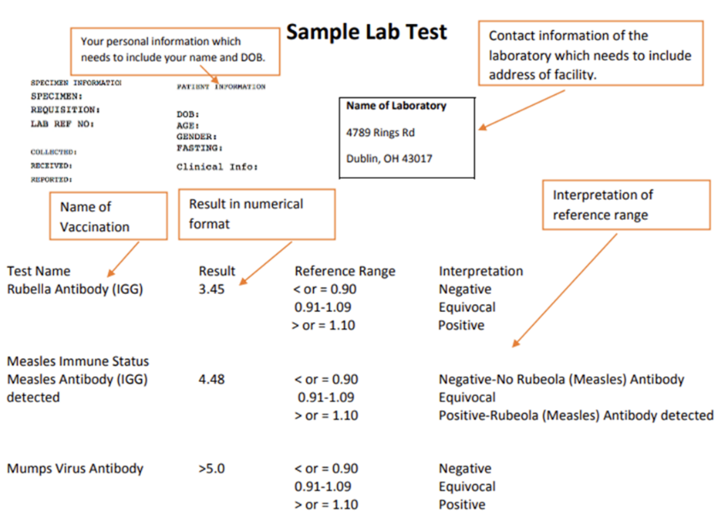
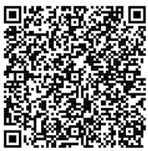
Formatting Requirements for Lab Reports (MMR)
Blood Titer Tests must be within the last five years of a student’s program start date
Information on the Lab Report must include the student’s full name and date of birth as well as complete contact information for the laboratory
Information may not be written onto this document. It must either be typed or stamped
MMR Lab Report Link: https://www.usf.edu/student-affairs/student-health-services/immunizations/sample-lab-test-nov2019.pdf

Slide 7
Items #2 & 3 Optional Vaccines
The State of Florida strongly recommends the Hepatitis B and Meningitis vaccinations
Meningitis vaccine valid if received after your 16TH birthday
You may decline/opt out of either vaccine on the form or electronically via Student Self-Service (formerly ‘Oasis’) or MyBullsPath
Students will receive a hold on their USF accounts if they do not decline or show proof of these immunizations

Slide 8
How to Decline Optional Vaccines Electronically
1. Go to www.usf.edu and Log in to your MyUSF account
2. Log in to your Student Self-Services (formerly ‘Oasis’) account
3. Go to View Immunization Record
4. For Hepatitis B and/or Meningitis, click on the hyperlink, HERE, and decline the vaccine(s)

Slide 9
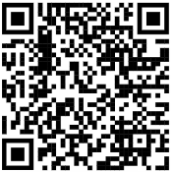
Item #5 Tuberculosis screening
Must be completed within 6 months prior to 1st semester you physically attend USF
USF Calendar: https://www.usf.edu/registrar/calendars/

Slide 10
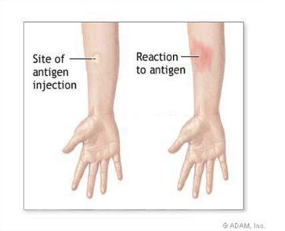
#5 Tuberculosis screening by Skin Test or Blood Test
TB Skin Test by PPD Mantoux must be read 48-72 hours after it is placed
Your medical provider must complete all sections fully or attach an official lab report with your full legal name and date of birth (month/day/year)
Age is not a substitute for date of birth
USF will NOT accept the following in the ‘MM’ results box:
Symbols such as “x,” (7 mm x 9 mm) or “<,” or “>” (>2mm or <2mm) will NOT be accepted
Decimals such as 2.5 and .4 will NOT be accepted

Slide 11
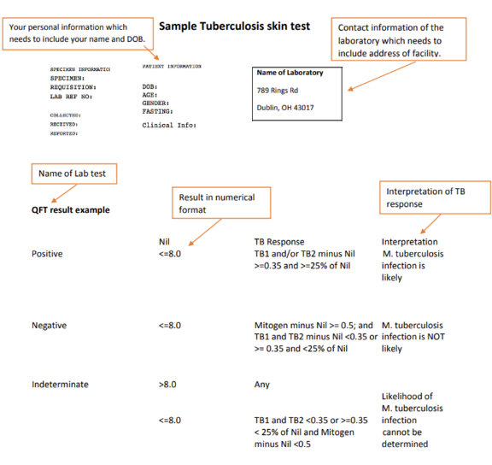
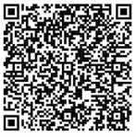
Formatting Requirements for QuantiFERON (QFT) or T-Spot Blood Tests
Information on the Lab Report must include the student’s full name and date of birth as well as complete contact information for the laboratory
TB lab reports must include the name of the lab test, a numeric result as well as an interpretation of the TB response
Information may not be written onto this document. It must either be typed or stamped
TB Lab Report Link: https://www.usf.edu/student-affairs/student-health-services/immunizations/sample-tuberculosis-skin-test-nov2019.pdf

Slide 12
#5 (continued) Tuberculosis screening by Radiology Report
USF Health Services will only accept the radiology report from a chest X-Ray after a student sends proof of a positive TB skin or blood test.
Radiology Reports will only be reviewed if accompanied with proof of a positive blood test.
1. Official radiology report must include a physician's signature and stamp
2. Contact information: Street address, city, country, telephone number + country
3. Students’ full name and date of birth
4. A narrative report including detailed summary of findings (please don't send chest x-ray images).
Students should not send the chest x-ray image/photograph – just the Radiology Report

Slide 13
Section B: Medical Provider Verification
Make sure that your Medical Provider has fully completed the section:
Name of doctor’s office, hospital or medical provider
Phone number, including the country code
Street address, including the city and country
Signature from physician or authorized personnel
Date (Month, Day, Year)
Office Stamp (must be readable)

Slide 14
Important for Parents of Students Below the Age of 18 (Complete Section C of the Medical History Form)

Slide 15
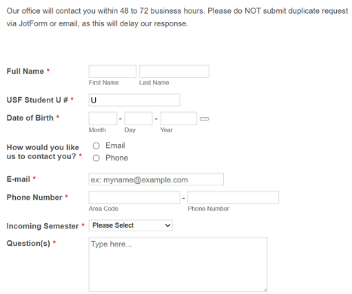
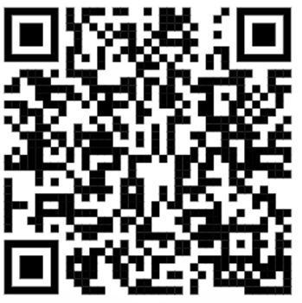
Additional Support for Students: USF Health and Wellness Center
Student Health Services Immunization Compliance Website: https://www.usf.edu/student-affairs/student-health-services/immunizations/
Immunization Questions/Concerns Link: https://form.jotform.com/212995896332167

Slide 16
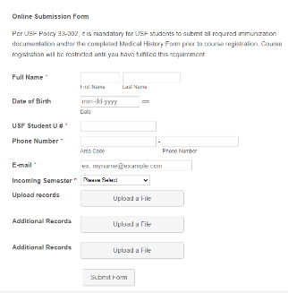
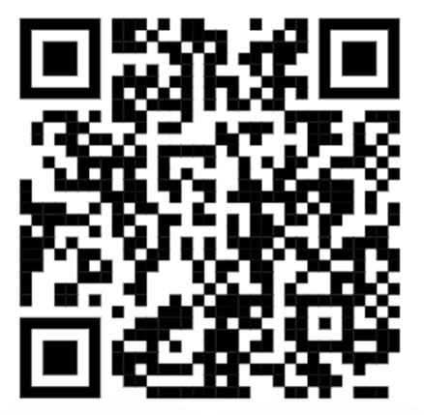
Ready to Submit Your Documents?
To submit vaccination documents please upload via this link https://form.jotform.com/211335806421144

Slide 17
Translation Requirements
Stamp of translator
Signature of translator
Contact details of translator (street address, city, country, phone number + country code)
*Students must send the original and translated documents together to the USF Health and Wellness Center for approval

Slide 18
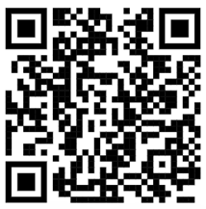
If Students Cannot Complete Immunization Requirements in their Home Countries…
3-5 days after scheduling appointment, students will be provided a temporary override, allowing them to register/pre-register for classes.
This override will expire the day after students’ appointment.
Students will be cancelled from classes and charged a $30 ‘No Show’ Fee if they do not show up on time for their appointments
USF Clinic Appointments Link: https://form.jotform.com/211114735926150

Slide 19
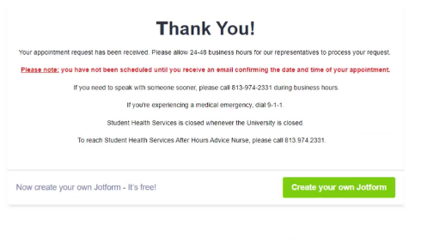
You will receive confirmation after you successfully schedule your appointment

Slide 20
Thank you for Joining Us Today!
We hope you enjoyed our video.

