Slide 1
CMS Workshops: Props vs. Index
UPDATING YOUR HOMEPAGE

Slide 2
Properties File (_props.pcf)
Basic information of a homepage
Updating the top and bottom of a homepage (header and footer)
Simple content updates
Includes:
Title and Metadata (Tags)
Section and Banner (Sub)Titles
Donate Link
Main Navigation
Footer
Social Media (if website was created after August 15, 2016)

Slide 3
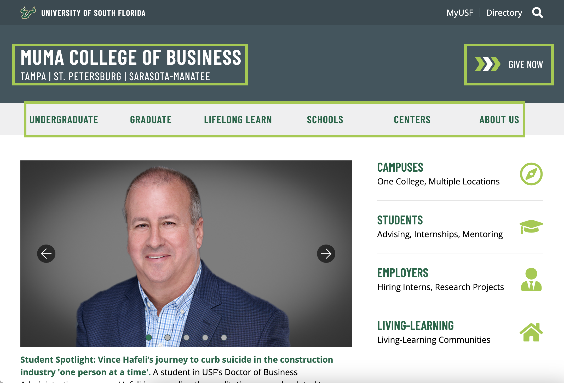
Properties File (_props.pcf)

Slide 4
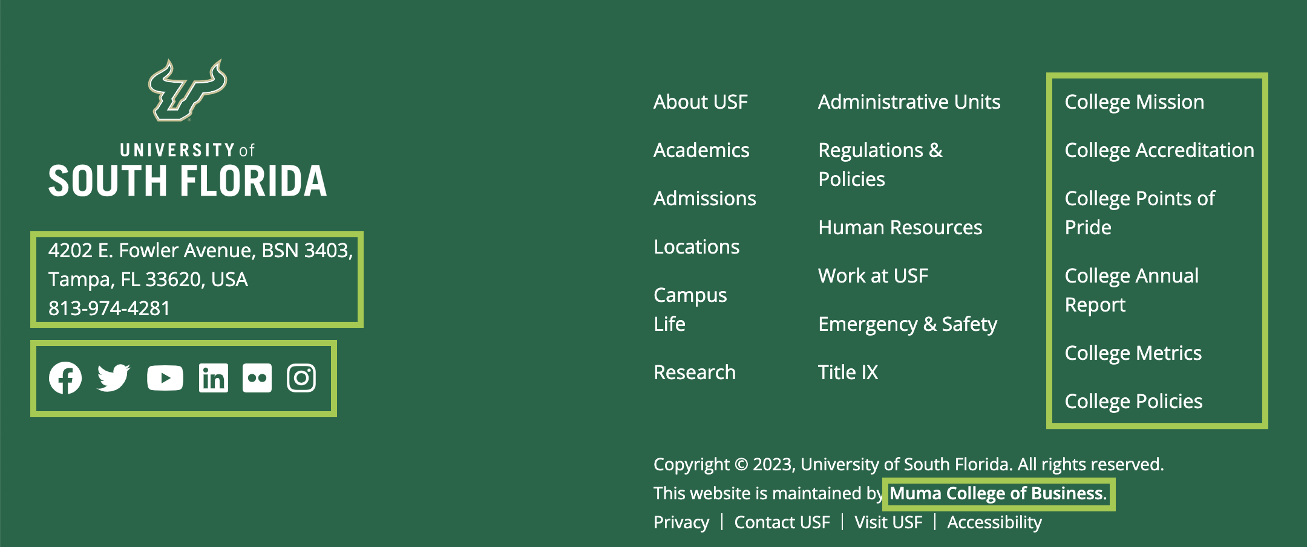
Properties File (_props.pcf)

Slide 5
Index - Parameters
Sets up look and feel of the homepage
Outlining how the middle (“meat”) of a homepage will be arranged
Somewhat involved content updates
Includes:
Title and Metadata
Custom Settings
Feature Area
Horizontal Call to Action
Highlighted Content Section
Widgets
Social Media (if website was created before August 15, 2016)

Slide 6
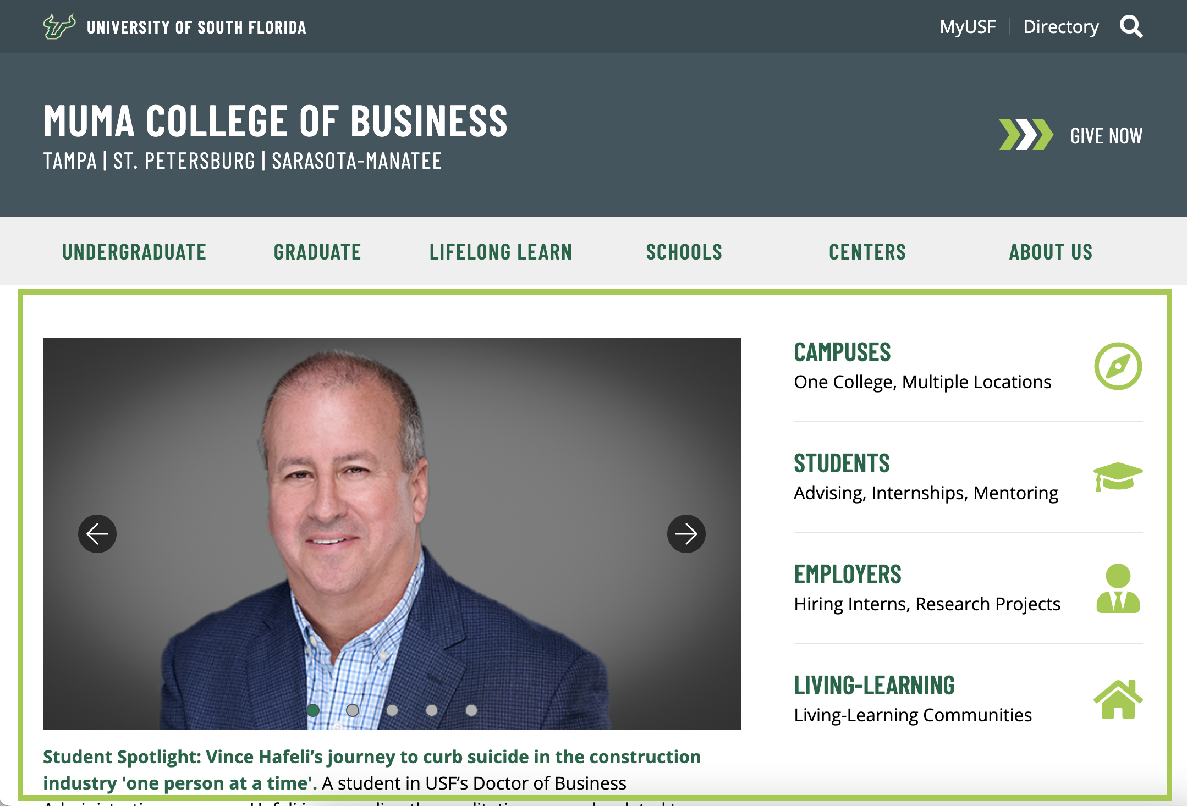
Index - Parameters

Slide 7
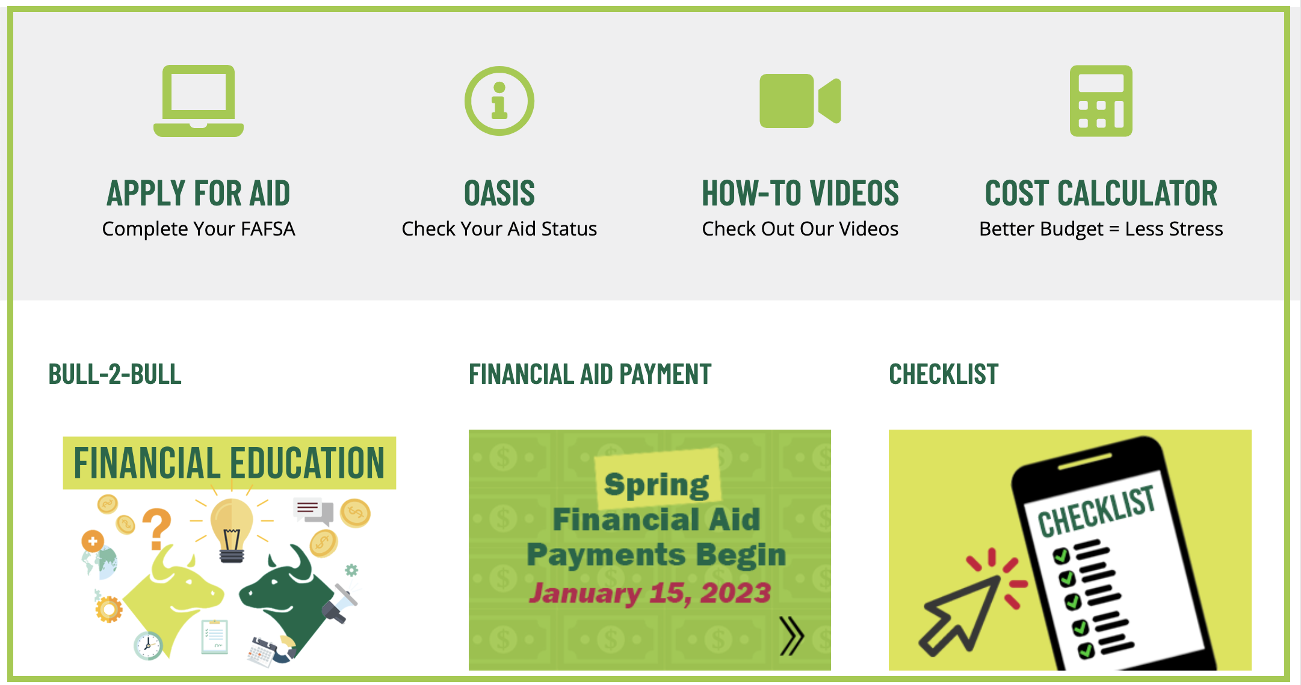
Index - Parameters

Slide 8
Index - Parameters

Slide 9
Index – MultiEdit
Majority of content edits happen in the MultiEdit
Updating the middle (“meat”) of a homepage
Most involved content updates
Includes:
Feature Image/Video
Feature Rotator Settings
Highlighted Content Section

