Slide 1
News Site Training

Slide 2
MultiEdit > Parameters

Slide 3
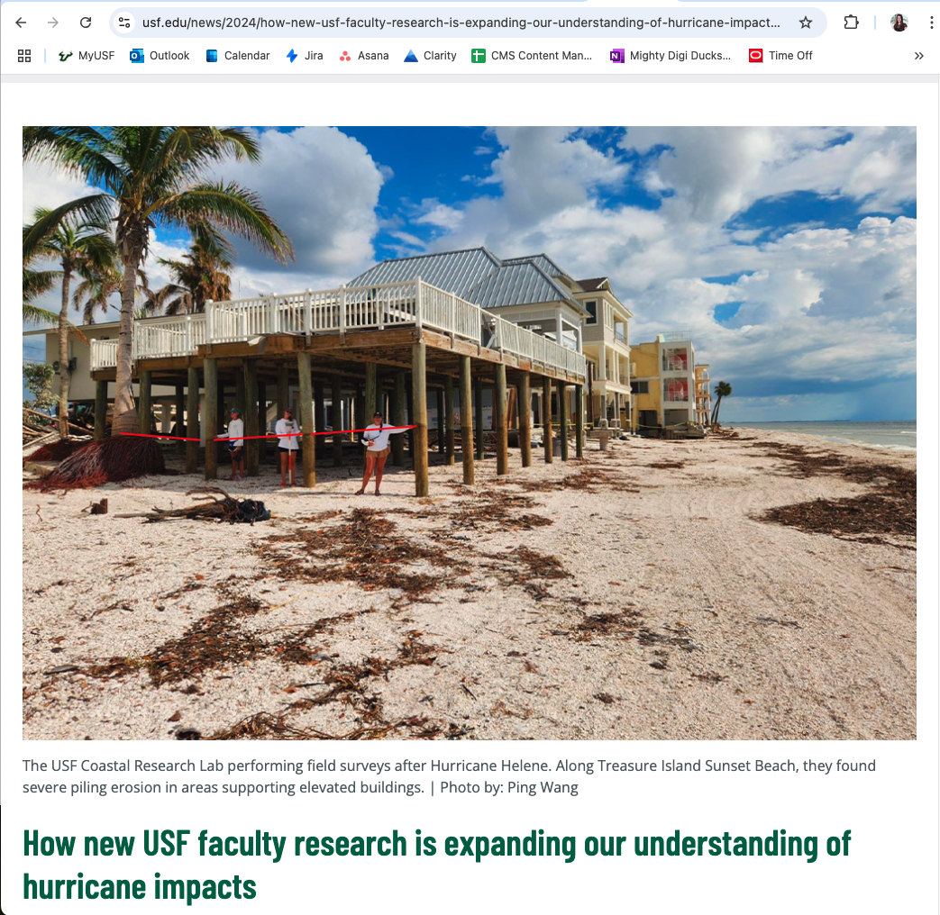
Title & Filename
Filename
Article Title

Slide 4
Title & Filename (continued)
Search engines crawl Titles and Filenames (URLs)
Filename’s character limit is 120 (not including “.pcf”)
  The shorter the better
  Ideal range is 50-60 characters = ~10 words
“.pcf” must be included in the filename
Match the Filename to the Title
  Title = How new USF faculty research is expanding our understanding of hurricane impacts
  Filename = how-new-usf-faculty-research-is-expanding-our-understanding-of-hurricane-impacts

Slide 5
Description
Descriptions tell searchers what they will find when they click on your article
Can get truncated in search results if it’s too long
  No more than 155-160 characters (including spaces) to ensure it doesn't get cut off mid-sentence
Include a Call to Action
  Provide a strong CTA and a description that tells them about the content in your article (this helps with Click Through Rates (CTRs)!)

Slide 6
Description (continued)
Keywords
  Using keyword(s) in your descriptions allows search engines to understand the intent of your article and promote more clicks
Include University of South Florida
  Not just “USF”
Can use Description as the Listing Summary

Slide 7
Description Example
Original: USF researchers are stepping up, launching critical initiatives to strengthen hurricane preparedness and insights following historical Milton and Helene.
Updated: Discover how University of South Florida researchers are launching initiatives to strengthen hurricane preparedness following historical Milton and Helene.

Slide 8
Keywords
Include in Description and article content, but not in “Keywords” field.

Slide 9

Tags = Categories and Tags
Categories = Pre-created and pre-populated
  Naming convention: News Category: Category Name
Current list of Categories:
  Campus Life
  Community Partnerships
  Cyber/AI
  Honors and Awards
  Research and Innovation
  Student Success
  USF Athletics
  USF Foundation
  USF Health
  University News
(and Categories)

Slide 10
Tags = Categories and Tags (continued)
Tags = Pre-populated (if used before) or created in real-time
  Naming convention: News Tag: Tag Name
  News Tag: Cassidy Delamarter
(and Categories)

Slide 11
MultiEdit > MultiEdit Content

Slide 12
Alt Text
Descriptive text that conveys the most basic and important information
Ensures screen reader users can access the image information
  If an image fails to load on a page (this text will appear in its place)
Search engines also use alt text when ranking web pages on their search results page

Slide 13
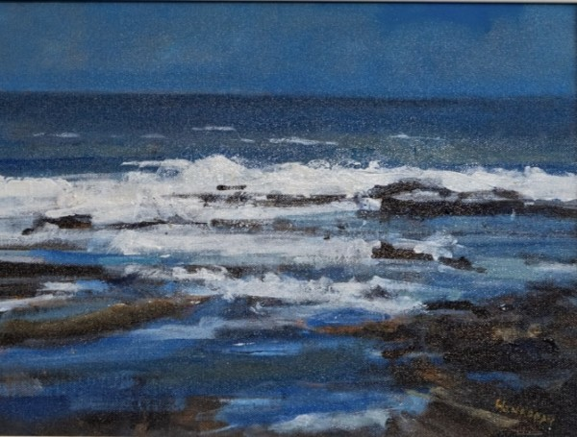
Alt Text (continued)
Do not use "Image of”/“Picture of” unless it adds context
  Ex: Watercolor painting of crashing waves in the Atlantic Ocean

Slide 14
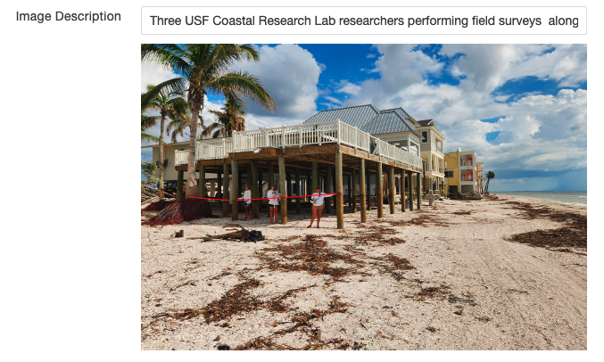
Alt Text - MultiEdit
In MultiEdit, alt text =
Image Description

Slide 15
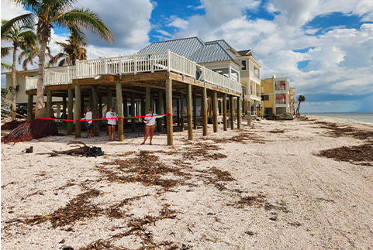
Alt Text
Example
Option 1: A group of people on a beach
Option 2: Three USF Coastal Research Lab researchers performing field surveys along Treasure Island Sunset Beach

Slide 16
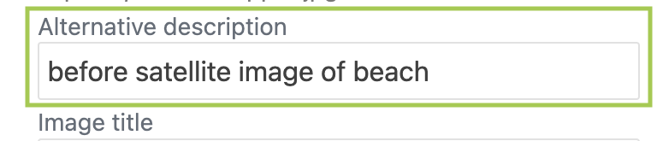
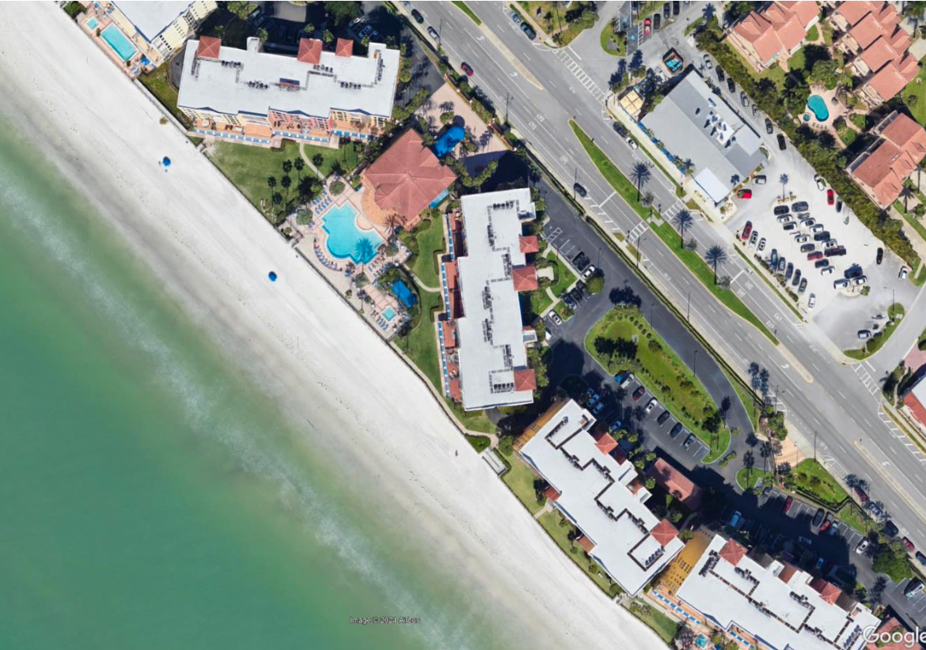
Alt Text – WYSIWYG Editor
In WYSIWYG Editor (article’s content), alt text = Alternative description
More descriptive example: Aerial satellite image of Treasure Island Sunset Beach before coastal erosion caused by hurricanes Helene and Milton

Slide 17
Edit > WYSIWYG Editor

Slide 18
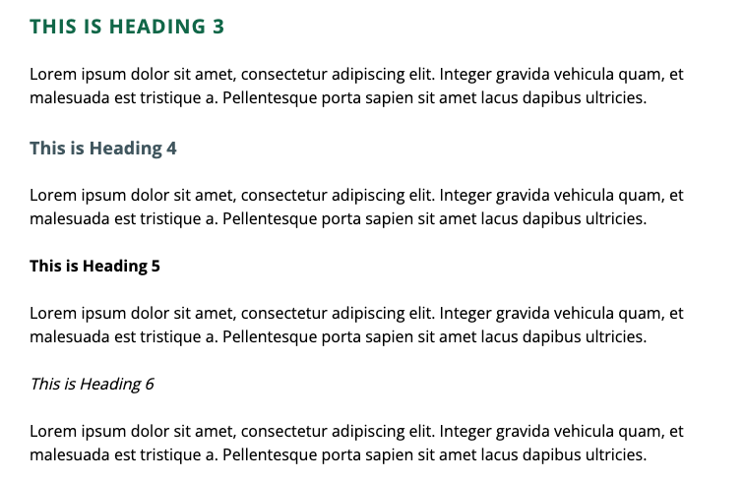
Headings
Used for structure and to indicate topics on a page
  Do not use for styling purposes
Always start with Heading 2 and work your way down based on nested topics
  Heading 3, 4, 5, then Paragraph
Organized subsections of content play an important role in accessibility

Slide 19
Headings (continued)
Use normal case
  Type "Heading" instead of "HEADING"
Do not bold or italicize
  Ex: Use "Heading" instead of "Heading" or "Heading"
  Unless a style guide indicates to italicize (i.e. book names)
Do not add colons to the end of the Heading
  Ex: Use "Heading" instead of "Heading:"

Slide 20
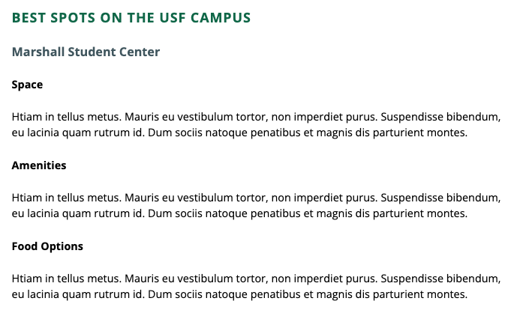
Headings Example
Heading 2 (Main Topic)
Heading 3 (Sub-Topic)
Heading 4 (Nested Sub-Topic)
Heading 4 (Nested Sub-Topic)
Heading 4 (Nested Sub-Topic)

Slide 21
Links
Always use the Insert/Edit Link tool in the WYSIWYG Editor when inserting links
  Always hyperlink, do not use URL strings
  This will automatically turn the linked text green and underline it when hovered over by a mouse or focused by keyboard
Do not underline text that is not a link - if you need to emphasize text, use bold or italic

Slide 22
Links (continued)
A link should be distinguishable from its surrounding text
Do not use "click here" when inserting links
Links should:
  Have a Call to Action
  Be SEO-friendly
  Be modern, or accessible for people using screen readers
A good exercise to test link copy is to examine the linked text without content: does it make sense?

Slide 23
Links Example
Incorrect Usage: "We can't wait to connect! Click here to register for a campus tour today.”
Correct Usage "We can't wait to connect! Register for a campus tour today."

Slide 24
Available News Snippets
Images (14 options)
Pullquote
Rotator
Text and Image
Video Embed

