Slide 1
CMS Workshops: Servers (and Much More)
Sept. 19, 2024

Slide 2
STAGING = CREATING

Slide 3
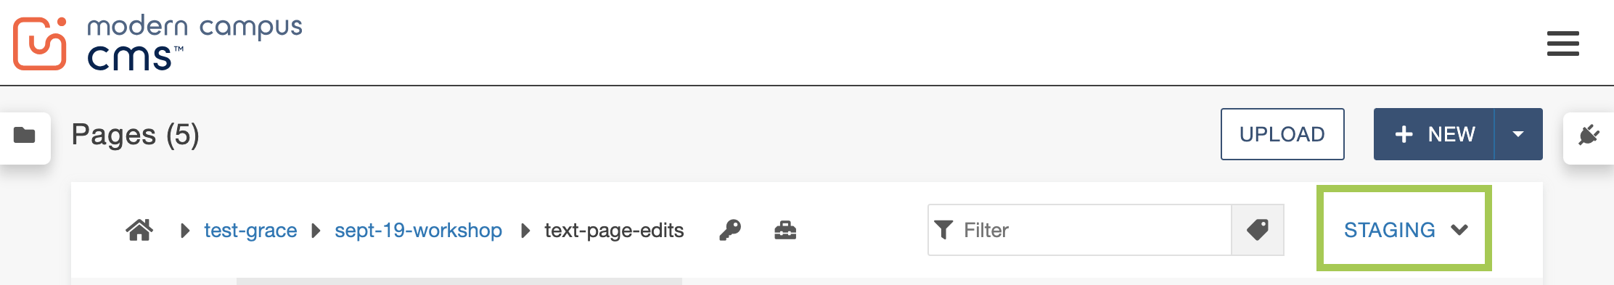
STAGING SERVER
All files (pages, website sections, folders, images, documents, widgets) should be created in the Staging server.
The Staging server screen is set by default.
  When in doubt, don’t change anything.
What does “created” mean in this context?

Slide 4
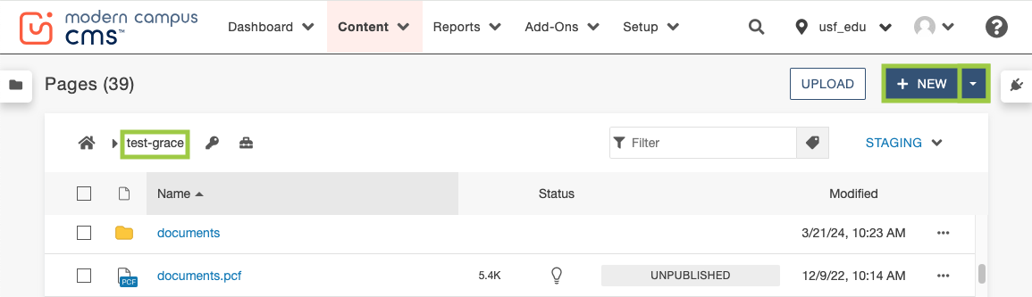
STAGING > NEW
NEW = Page, Folder, Website Section, Widget
  Check breadcrumbs to make sure you are in the correct CMS location.

Slide 5
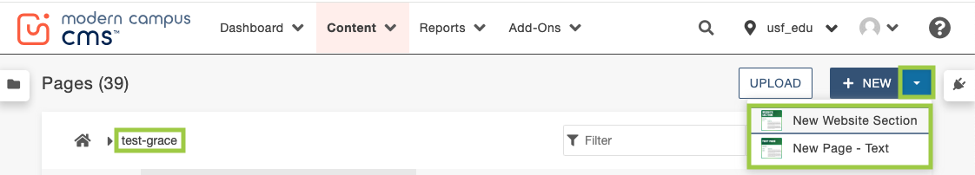
STAGING > NEW (cont.)
The dropdown will display the items you can create new (based on your CMS location).

Slide 6
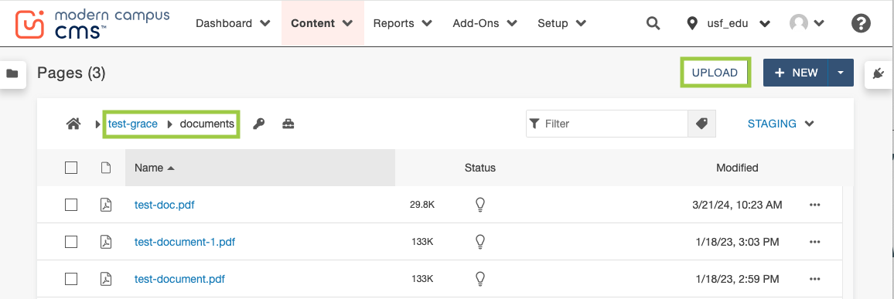
STAGING > UPLOAD
UPLOAD = Image, Document
  Check breadcrumbs to make sure you are in the correct CMS location.
  NEW = Folder only

Slide 7
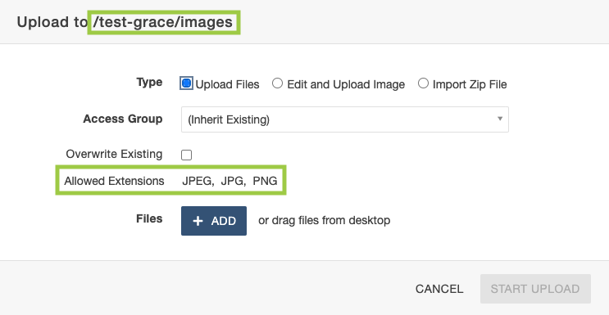
STAGING > UPLOAD (cont.)
The modal window will outline the allowed extensions (based on your CMS location).

Slide 8
TEST = REVIEW

Slide 9
TEST SERVER
Files (typically pages) that need approval by colleagues/stakeholders before going live can be published to the Test server for review.
Content Managers can also publish to the Test server to see a “live” preview of their pages before they are online for all to see/search for.
What does “published” mean in this context?

Slide 10
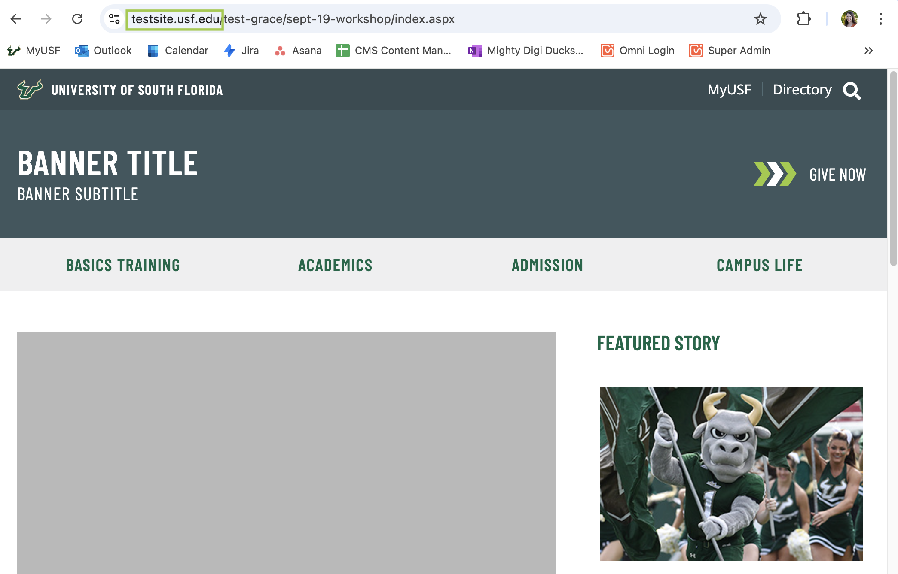
TEST > PUBLISHING PAGES
Publishing a page to the Test server generates a shareable test site link.
  Test site links display the content exactly as it would appear published live.

Slide 11
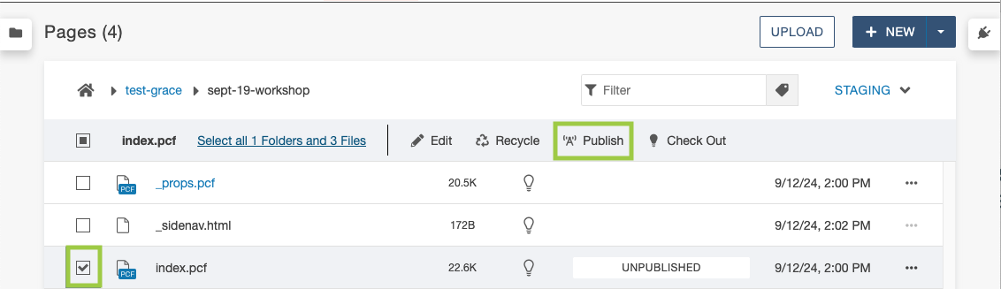
TEST > HOW TO PUBLISH PAGES
1. Click the box(es) next to the page(s) you want to publish to Test.
2. Click Publish.

Slide 12
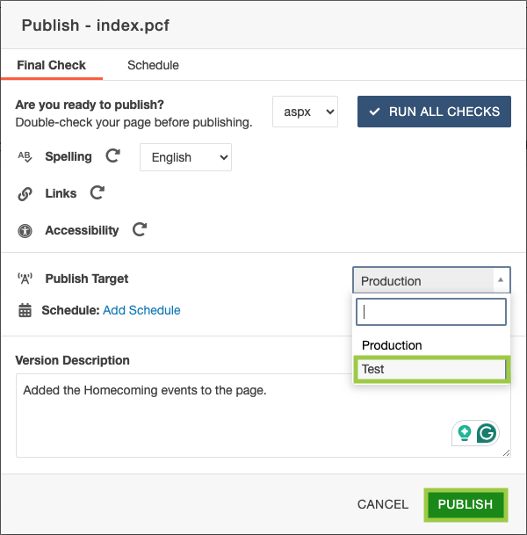
TEST > HOW TO PUBLISH PAGES (cont.)
3. Change the Publish Target to Test using the dropdown.
4. Add a Version Description for context.
5. Click Publish.

Slide 13

TEST > HOW TO PUBLISH PAGES (final steps)
6. Check the bottom lefthand corner for the modal window indicating the page has been published to Test.
7. Click the hyperlink “View in new window”.
The URL will start with “testsite”.
  Highlight and copy the URL to share the test page(s).

Slide 14
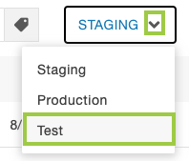
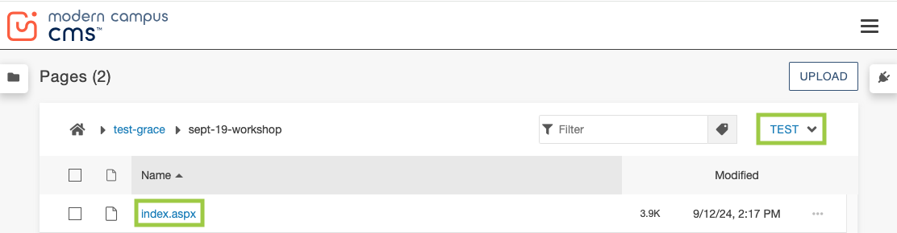
TEST > VIEW PUBLISHED PAGES
You can check to see if your files have been published to Test by changing the Server dropdown to “Test”.

Slide 15
TEST > WHEN AND WHAT
When/what files should be published to the Test server?
Pages = All content has been completed and needs approval, or to see a “live” preview.
Documents, Images, Widgets = Immediately after creation or upload.
Folders, Website Sections = N/A (files within are published)

Slide 16
PRODUCTION = LIVE

Slide 17
PRODUCTION SERVER
Publishing a file to the Production server means it is live online for all to see/search for.

Slide 18
PRODUCTION > HOW TO PUBLISH PAGES
1. Click the box(es) next to the page(s) you want to publish to Production.
2. Click Publish.

Slide 19
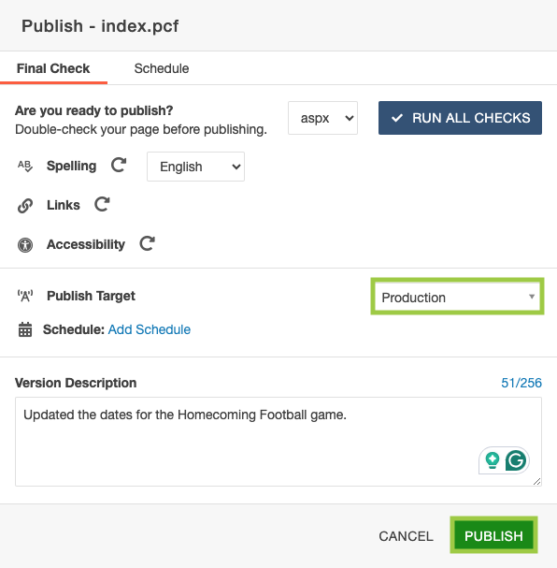
PRODUCTION > HOW TO PUBLISH PAGES (cont.)
3. Keep the default Publish Target set to Production.
4. Add a Version Description for context.
5. Click Publish.

Slide 20
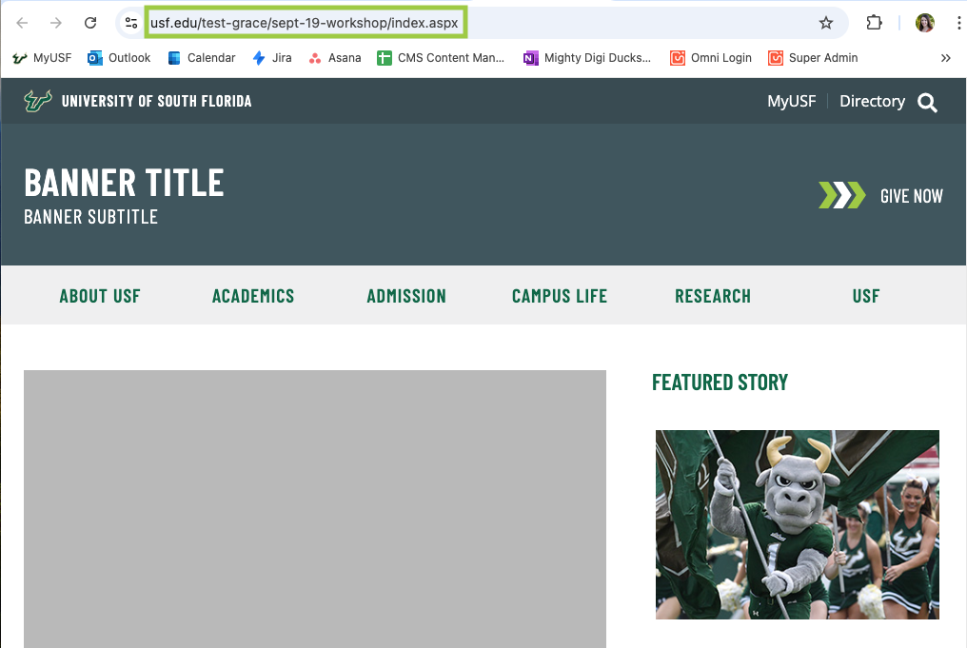
PRODUCTION > HOW TO PUBLISH PAGES (final steps)
6. Check the bottom lefthand corner for the modal window indicating the page has been published to Production.
7. Click the hyperlink “View in new window”.

Slide 21
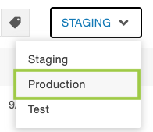
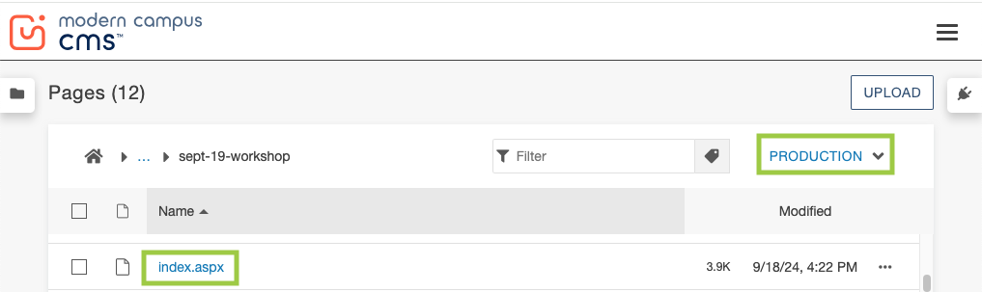
PRODUCTION > VIEW PUBLISHED PAGES
You can check to see if your files have been published to Production by changing the Server dropdown to “Production”.

Slide 22
PRODUCTION > WHEN AND WHAT
When/what files should be published to the Production server?
Pages = All content has been completed and/or approved.
Documents, Images, Widgets = Immediately after creation or upload.
Folders, Website Sections = N/A (files within are published)

Slide 23

THANK !

