Slide 1
USF Seed Library
"If you have a garden and a library, you have everything you need..."
Marcus Tullius Cicero, 46 BCE
By: The Agrarian Club, UN Millennium Fellowship team, and Food Sovereignty Initiative

Slide 2
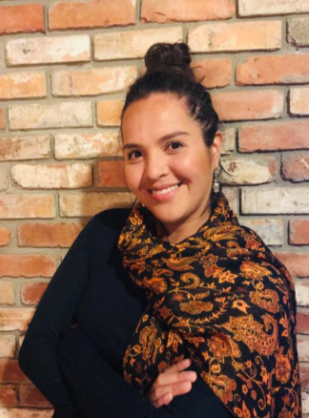
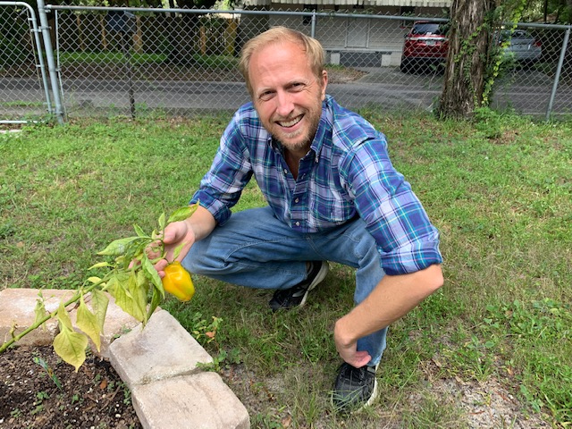
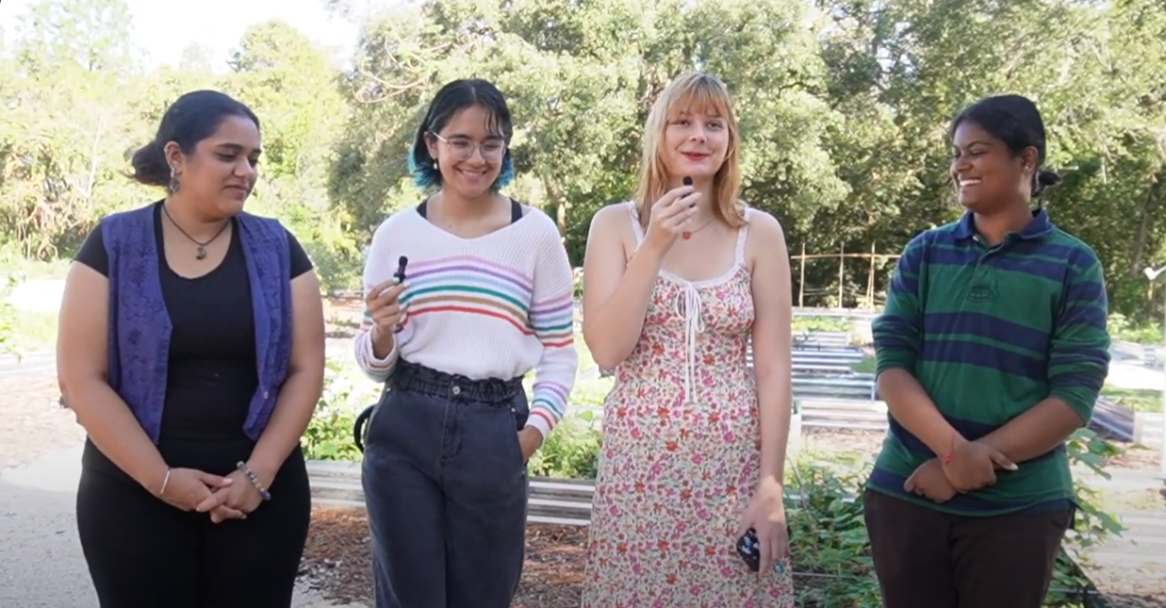
Team
5
6
Dharsh Saravana (1)
Amelie McLeod (2)
Leila Sujanani (3)
Ameya Singh (4)
Dr. William Schanbacher (5)
Dr. Esteli Jimminez-Soto (6)
Prof. Don Saunders
4
3
2
1

Slide 3
Objectives
Establish a seed library on the USF Tampa Campus Library for learning and research and secure funding for project longevity
Increase access to food/ agriculture for food insecure students and expand Feed-A-Bull pantry to include produce
Reduce and sequester carbon emissions through regenerative agricultural methods
Support plethora of future agricultural initiatives discussed at USF's Future of Food Think Tank
Empower/Inspire students to pursue sustainable food production on/off campus, healthful eating, and encourage low-carbon consumer behaviors

Slide 4
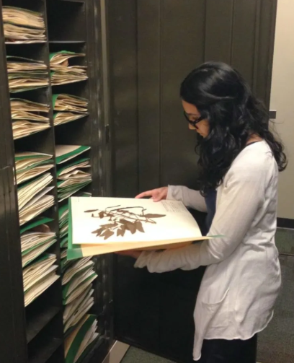
Project Overview
Location: USF Herbarium in Tampa Library's basement
Serve as a free public resource to empower students to grow their own food
Become a centralized hub of exchanging seeds, local knowledge, and cross-cultural understanding and strengthen community partnerships
Provide non-GMO, open pollinated seeds adapted to Tampa's climate and increase access to food/ agriculture as residents of a food desert
Give a platform for agricultural heritages of minority/ cultural groups & appreciate food as a gift of life

Slide 5
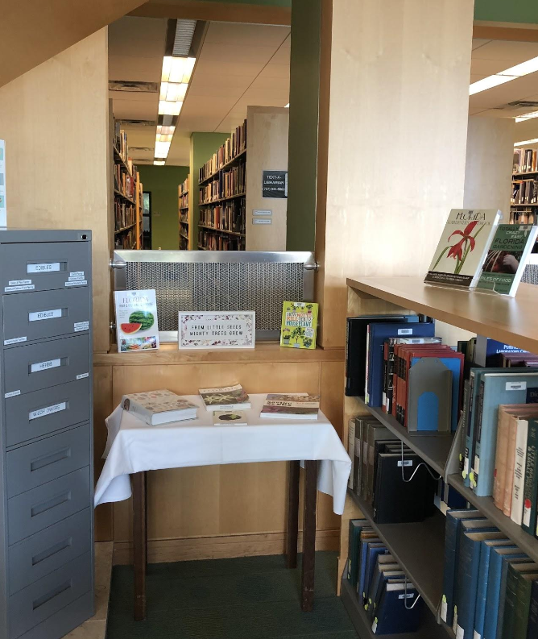
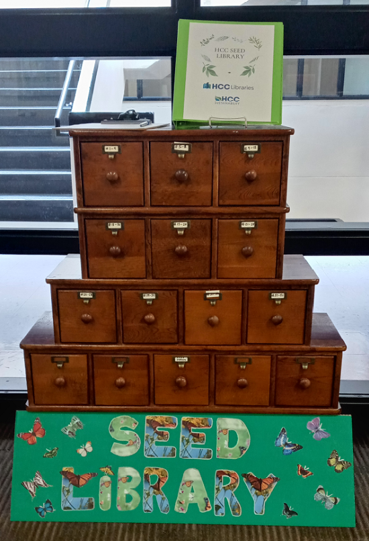
Model seed libraries:
Eckerd seed library
Ybor HCC seed library
"seed libraries are a low cost high impact initiative" - HCC seed library

Slide 6
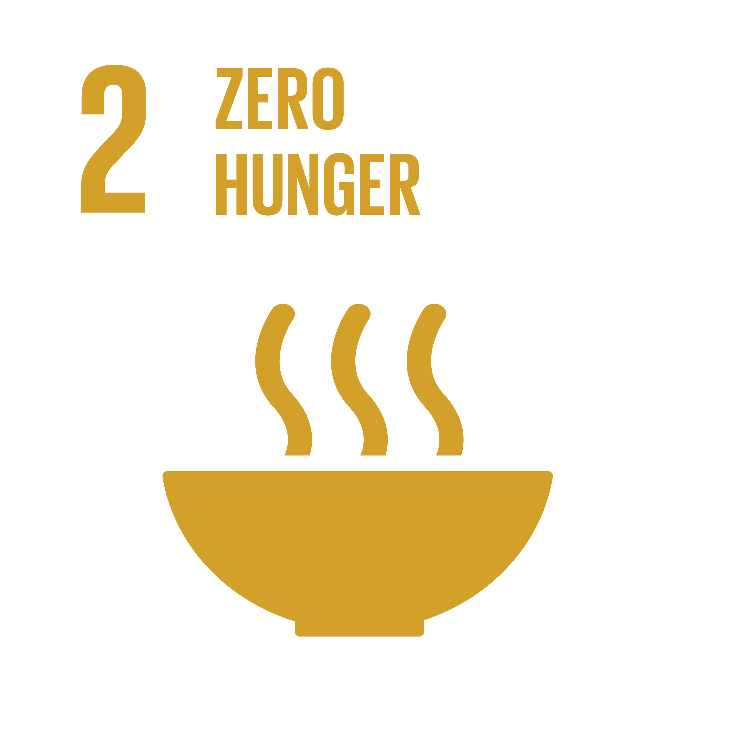
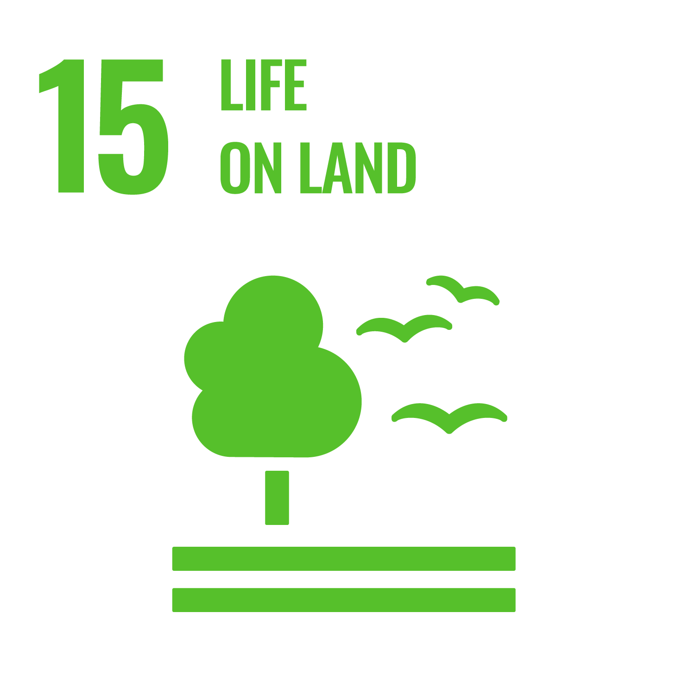
Sustainable Development Goals
SDG 2: Zero Hunger
SDG 3: Good Heatlh and wellbeing
SDG 15: Life on land
SDG 16: Peace, Justice, and Strong Institutions

Slide 7
STARS(2022 usf report)
The Sustainability Tracking, Assessment, and Rating System that different universities use to track their sustainability measurements using different dimensions.
The score of Greenhouse Gas Emissions is currently a 2.03/8.00 (OP-2). The criteria includes GHG emissions per person and per gross area.
The score of Sustainable Dining is a 0.98/2.00 (OP-8). The criteria includes support from the institution for a farmers market, community supported agriculture (CSA), or urban agriculture program (example: The Agrarian Club supported by us) which the University does not currently do.
We also help fulfill the Community Garden criteria (IN-7). By having a connection to our supported garden space, we gain 0.5 bonus points under the STARS rating.

Slide 8
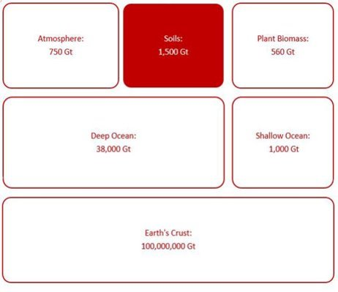
Industrial agriculture & seed consolidation
Seeds are patented and consolidated by the "Big 4" biochemical corporations and are GMO (cannot save seeds). Threatens local community's access to agriculture and food security
In the past 80 years, we've lost 93% of our seed varieties with 60% of seeds owned by the big 4.
Seeds provides 15-20% yields every time they are planted, a one-time investment in a seed library exponentially increases yields.
A single non-GMO tomato seed produces 300 seeds.
Soils and plant biomass are carbon sinks. Intensively managed soils loses its sequestration ability by 50-70%. Cover cropping, intercropping, and biological pest control practices we use combat this.

Slide 9
Carbon reductions through regenerative agriculture
We have impacted almost 250 people and have distributed approximately 2500 seeds (482 seed packets).
The garden beds we control are 608 sq ft. By avoiding transportation emissions of seeds and produce, using regenerative methods, and soil sequestration- we are averting approximately 350 lbs. of CO2 per year, compared to an industrial system.
Growing in season and local produce eliminates all transport emissions.
Promoting a plant forward diet could avert up to 100lb of CO2 per lb and encourages individuals to support local food (lowers energy consumption through consumer behavior)
Student consumer behaviors paired with the 20+ supporting food sovereignty courses developed under the NEH grant by the Food Sovereignty Initiative
Notes:
Cover Crops and Carbon Sequestration: Benefits to the Producer and the Planet | CropWatch | Nebraska
Not only does capturing carbon through soils helps co2 emissions to drop, but also enriches the plants that are grown themselves

Slide 10
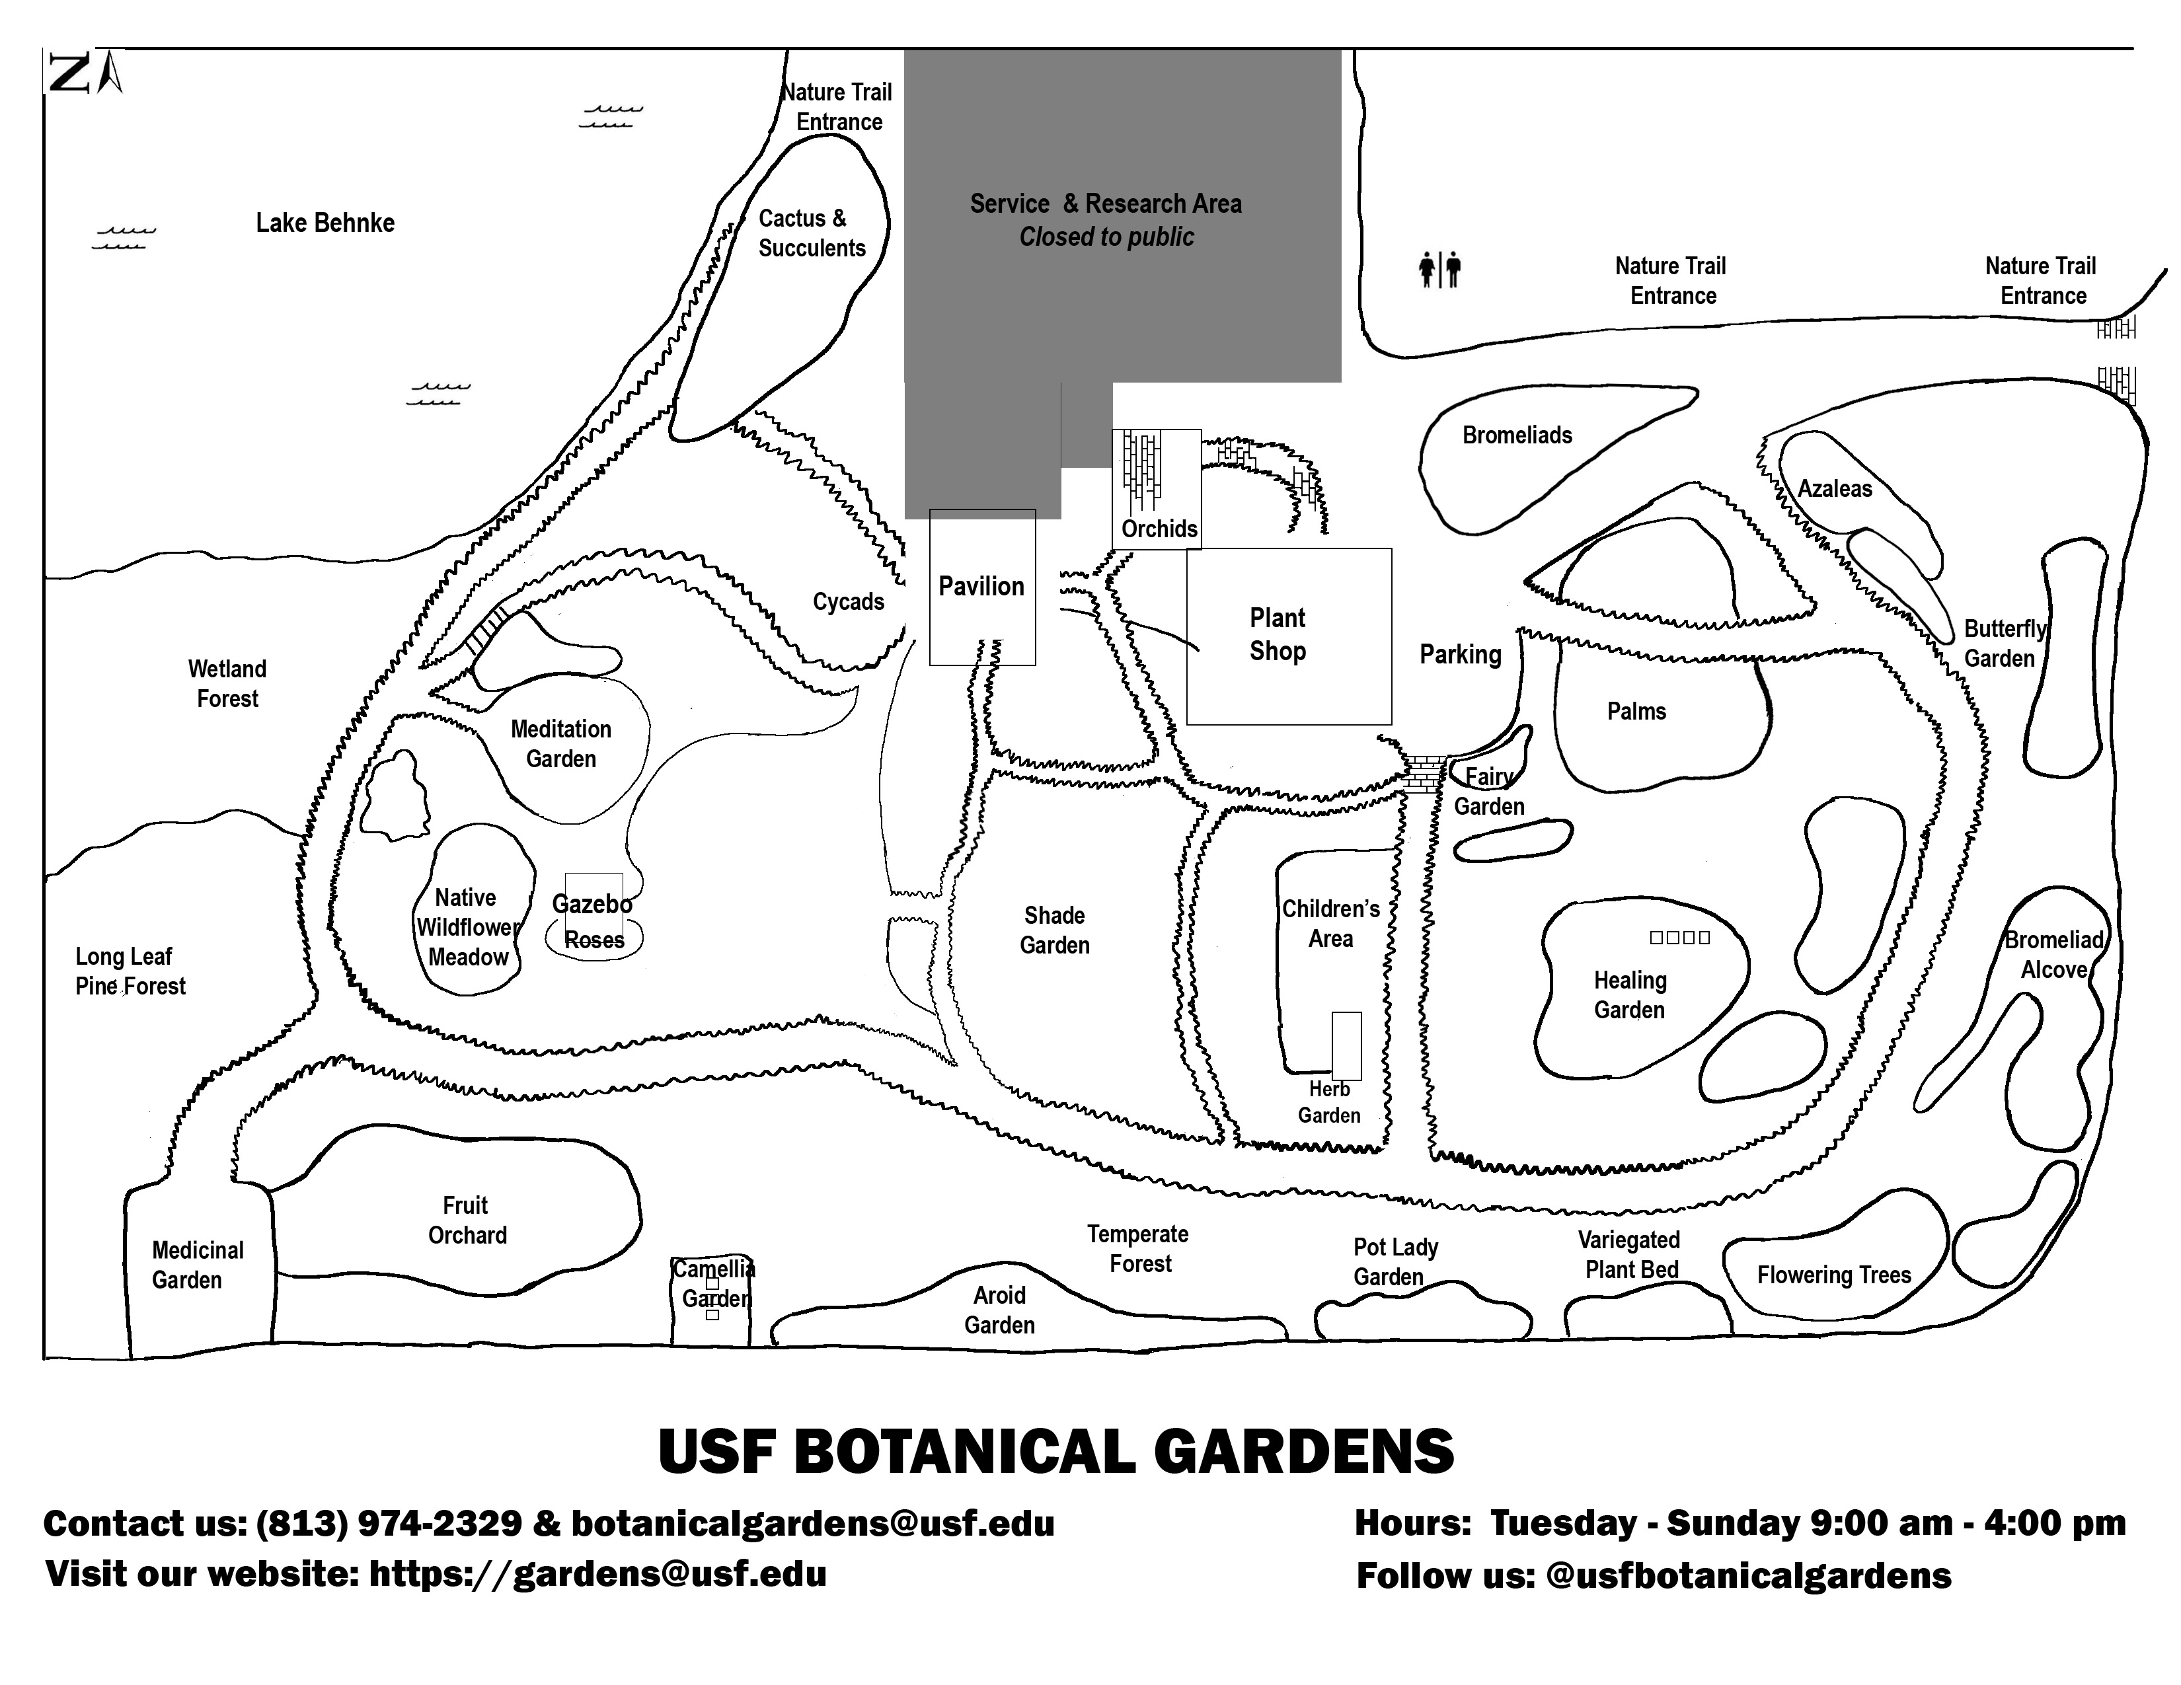
Our growing locations

Slide 11
Green Energy Impacts of a Seed Library
Relying on local food reduces dependence on distant farmers and shortens the journey food takes to reach our plates.
Local seeds and indigenous methods take less resources to plant and are less damaging to agroecosystems.
Revitalizes urban spaces, dorms, and apartments, enhancing access to fresh produce & greener living. Revitalizes
Increases awareness of local ecologies, current food systems issues, and alternate sources to food – Farmers Markets, CSA's
Environmental education offers an effective approach to improving the environmental knowledge, attitudes, intentions, and behavior of young people (our current focus )

Slide 12
Methods
MoU with Library's Special Collections Dept
Integrating seed saving & volunteering in service learning food systems courses
Developing a seed library committee under the Agrarian Club
Workshops with minority/ cultural groups on campus: Institute of Black Life, International Student Success (IBL)
Establishing seed drop off locations around campus to increase visibility
Seed saving campaigns via social media
Document project progress updates on Food Sovereignty Initiative's university website
Notes:
MoU with

Slide 13
Partnerships
USF Botanical Gardens & ECORE system -- 35,000 visitors annually
Agrarian Club – 300 members
Food Sovereignty Courses – Regenerative Agriculture, Food Justice, Agroecology & Sustainable Food Systems, etc. -- 100 students directly at the gardens
USF Food Sovereignty Initiative – Faculty members across CAS, MUMA, Health, etc
Institute on Black Life, International Student Success
Homegrown Hillsborough (county-backed food systems network)
Coalition of Community Gardens – 30+ community gardens in the area

Slide 14
Budget
Seeking $5,000 from SGEF to cover startup costs from overall budget
Materials | Cost
Workshops and Education | $2,000
Seeds and Seedlings | $1,400
Label Machine and Thermal Sheets | $120
Deep Freezer | $200
Seed Packets | $100
Books | $150
1 Paid Intern | $2,400 for one semester
3 Weather Temperate Boxes | $750
Marketing Materials | $1,000
Other | $750

Slide 15
Timeline
Develop materials, host workshops, raise funds, save seeds
Launch and set-up the physical space
Use seed library committee (volunteers, students from food systems courses, and interns) to run the seed library and ensure longevity of project

Slide 16
References
“Cover Crops and Carbon Sequestration - SARE.” SARE, 8 Feb. 2023, www.sare.org/publications/cover-crops-ecosystem-services/cover-crops-and-carbon-sequestration/.
‌Weber, Christopher L., and H. Scott Matthews. “Food-Miles and the Relative Climate Impacts of Food Choices in the United States.” Environmental Science & Technology, vol. 42, no. 10, May 2008, pp. 3508–3513, pubs.acs.org/doi/10.1021/es702969f, https://doi.org/10.1021/es702969f.
‌“What’s the Environmental Impact of Growing Your Own Food?” The Eco Guide, 18 Sept. 2016, theecoguide.org/whats-environmental-impact-growing-your-own-food.
‌https://reports.aashe.org/institutions/university-of-south-florida-fl/report/2022-03-04/OP/air-climate/OP-2/
Bryce, Emma, and Emma Bryce. “We’re Over-Freezing Our Food. Turning up the Temperature Slightly Could Avoid 17 Mt of CO2.” Anthropocene, 12 Jan. 2024, www.anthropocenemagazine.org/2024/01/were-over-freezing-our-food-turning-up-the-temperature-slightly-could-avoid-17-mt-of-co2/ Accessed 21 Feb. 2025.
‌“Fifth of Global Food-Related Emissions due to Transport.” The University of Sydney, 2025, www.sydney.edu.au/news-opinion/news/2022/06/21/fifth-of-global-food-related-emissions-due-to-transport.html? Accessed 21 Feb. 2025.
‌

Slide 17
Thank You!

