Slide 1
My Green Lab Certification for USF College of Arts and Sciences Teaching Labs

Slide 2
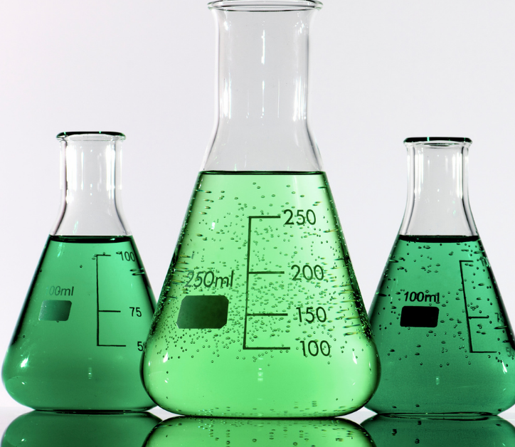
Project Scope
Certify 9 labs to the globally recognized standard for laboratory sustainability: My Green Lab Certification
Make recommendations for ways the labs can make reductions across energy, water, and waste
Provide a detailed report with the labs’ responses and recommendations for improvement. The report comes with a summarized PowerPoint presentation that can be used for communicating results to the lab members. Presenting the recommendations to the lab and following through on the actions will be the responsibility of University of South Florida
Provide support to the University of South Florida green labs team including access to resources such as communication templates for leadership, stakeholders, and assessment takers
Tools to support green lab activities (worksheets, presentations, poster templates, work plans, etc.)
General program management and technical support
Notes:
This project would certify the Chemistry and biology teaching labs to the globally recognized standard for laboratory sustainability: My Green Lab Certification. They will also make recommendations for ways the labs can make reductions across energy, water, and waste. Provide support to the teaching labs by offering access to resources and tools to increase sustainability.

Slide 3
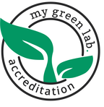
What is My Green Lab Certification?
The program provides scientists and the teams that support laboratories with actionable ways to make meaningful change.
They evaluate laboratory sustainability practices, identify targets to improve, and measure the success of green lab initiatives
The program is recognized by the United Nations Race to Zero campaign as a key measure of progress towards a zero-carbon future.
They cover 14 topics including energy, water, waste, chemistry/materials, and engagement.
Notes:
My Green Lab, a 501c3 non-profit, is the globally recognized leader in the Green Lab movement. My Green Lab has developed sustainability standards for laboratories that have been adopted by thousands of labs and hundreds of institutions around the world. These standards seek to reduce the environmental impact of laboratories in four key areas: energy, water, waste, and chemical use, through a combination of organizational initiatives and behavior change programs.
My Green Lab, provides independent third-party verification for My Green Lab Certification. Additionally, it offers technical expertise, resources, and software tools to operationalize the certification at a global scale. Third-party verification aligns with international best practices
My Green Lab Certification is used to evaluate laboratory sustainability practices, identify targets to improve, and measure the success of green lab initiatives

Slide 4
Why certify labs?
Lab sustainability can support several of the UN Sustainable Development Goals (SDGs), including SDG 7 (Affordable and Clean Energy), SDG 12 (Responsible Consumption and Production), and SDG 13 (Climate Action).
The typical laboratory uses 6 to 10 times more energy per unit surface area than the typical office building.
They use 4 times more water than office spaces
They generate 5.4 billion kg of plastic waste each year.
Notes:
Despite occupying far less area than offices and classrooms, research laboratories have been consistently ranked as the single largest contributor to carbon emissions in academic institutions.
The My Green Lab certification encourages labs to reduce waste, recycle more effectively, and adopt sustainable waste management strategies thereby reducing the laboratory’s carbon footprint. By adopting energy-efficient systems and reducing waste, certified labs often lower their utility costs and overall operational expenses.
By targeting teaching labs the Teaching Assistants and students can take the information that they receive through this program and apply it to their own research labs.

Slide 5
Project Timeline
Phase | Time | Action
Getting Started | 2 months | generating interest in sustainability and support for pursuing My Green Lab Certification – building the team & setting the goals
Initial Assessment | 1 month | engaging lab staff in completing the initial assessment and in starting to think about lab sustainability
Improvement Phase | 6-8 months | communicating the results to the assessment takers, engaging them in choosing recommended actions to take, and taking those actions
Certification Assessment | 1 month | engaging people in re-taking the assessment to measure the impact of the improvements, earn the certification, and plan for continuous improvement in sustainable lab culture
Notes:
Assess Baseline: Survey lab members to understand current practices,
3 weeks
• 50% participation
• Make recommendations for improvement
Implement Changes
• Labs discuss solutions and implement behavior change practices
• 6 – 8 months on average
Get Certification
• Re-assess lab practices
• 3 weeks
• 50% participation
• Certification level given
• Make recommendations
for further
Improvements
Make More Changes
• Labs adopt additional
policies and best
Practices
Do Re-Certification
• After 2 years, re-assess
lab practices and
provide new certification
level
• Further
recommendations made

Slide 6
Positive Impacts
Case Studies
University of Alabama Birmingham implemented a campus with My Green Lab program and found that each participating lab saves over 35,000 kWh annually*, leading to an estimated $4,382** annual energy savings per campus lab. They have also reduced waste by 75,000 lbs since 2017.
Technical University Berlin became My Green Lab certified and have an energy savings of 26,000 kWh/year, over 35% of the lab’s original energy usage.
Notes:
Becoming a Certified My Green Lab will provide laboratories with the tools to improve sustainability, reduce environmental impact, lower costs, enhance their reputation. Many employees that work in the teaching labs also work in research labs across campus. Labs that become certified can lead by example, inspiring others in the scientific community to adopt sustainable practices. They can take the information that they receive through this program and apply it to their own research labs.

Slide 7
Project Cost
9 My Green Lab Certifications (at $450/lab) $4,050

