Slide 1
Sustainability: Four Global Roots, One Future Outlook Martin Schönfeld Department of Philosophy University of South Florida Tampa, Florida, USA mschonfe@usf.edu Patel College of Global Sustainability Sustainability Speaker Series Fall 2018

Slide 2
contents
Brundtland definition: a principle of justice
The economic root: Carlowitz
The geopolitical root: Mencius
The adaptive root: Laozi
The evolutionary root: Kant
One future outlook: key features of integrative sustainable policies

Slide 3
The Brundtland Definition
Gro Harlem Brundtland (* 1939)
Minister for Environmental Affairs of Norway 1974-1979
Prime Minister of Norway (1981, 1986-89, 1990-1996)
Director-General of World Health Organization 1998-2003
Chair of World Commission on Environment and Development (WCED) 1983
= Brundtland Commission
WCED publishes Our Common Future (Brundtland Report) 1987
→ inspired organization of 1992 UNCED (Earth Summit, Rio)
→ led groundwork for UNCED Report Agenda 21 1992

Slide 4
The Brundtland Definition
Report of the World Commission on Environment and Development Our Common Future
1. The Global Challenge: 1.3. Sustainable Development: #27
“Humanity has the ability to make development sustainable to ensure that it meets the needs of the present without compromising the ability of future generations to meet their own needs. The concept of sustainable development does imply limits - not absolute limits but limitations imposed by the present state of technology and social organization on environmental resources and by the ability of the biosphere to absorb the effects of human activities. But technology and social organization can be both managed and improved to make way for a new era of economic growth. The Commission believes that widespread poverty is no longer inevitable. Poverty is not only an evil in itself, but sustainable development requires meeting the basic needs of all and extending to all the opportunity to fulfil their aspirations for a better life. A world in which poverty is endemic will always be prone to ecological and other catastrophes.”

Slide 5
The Brundtland Definition
Report of the World Commission on Environment and Development Our Common Future
“Humanity has the ability to make development sustainable to ensure that it meets the needs of the present without compromising the ability of future generations to meet their own needs. … Poverty is not only an evil in itself, but sustainable development requires meeting the basic needs of all and extending to all the opportunity to fulfil their aspirations for a better life.”
⬥ meeting our own needs / benefiting ourselves without harming others
⬥ concerns human interests / is anthropocentric; suggests obligations to posterity
⬥ concerns nonhuman interest only indirectly; no nonhuman rights implied
⬥ language: “evil,” “better,” “needs,” “opportunity,” etc.
⬥ defines sustainable development as an ethical concept – it’s a matter of fairness.  

Slide 6
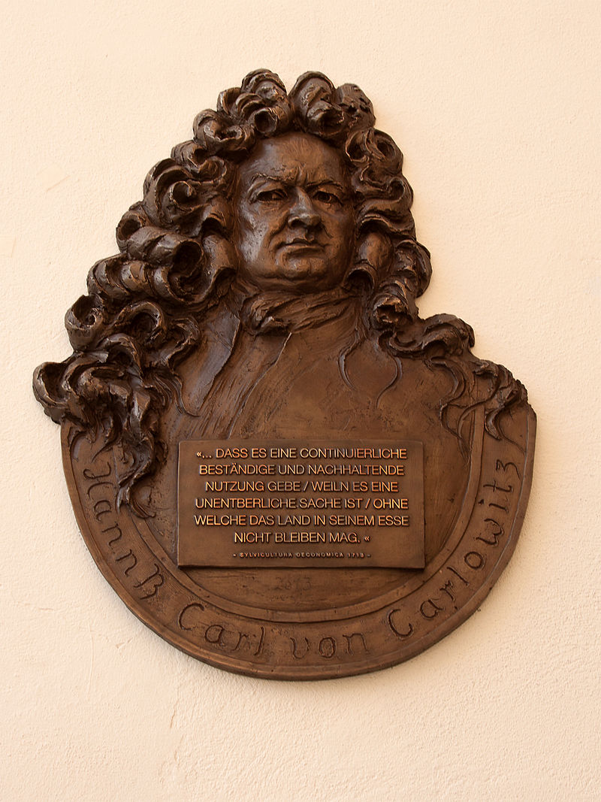
The first global root: Saxon, early modernity, economics
Hannß Carl von Carlowitz (1645-1714)
“Dass es eine continuierliche, beständige und
nachhaltige Nutzung gebe / weil es eine
unentbehrliche Sache ist / ohne welche das
Land in seinem esse nicht bleiben mag.”
“So that there shall be a continuous, steady, and
sustainable development / because it is an
indispensable affair / without which the
land may not remain in its being.”

Slide 7
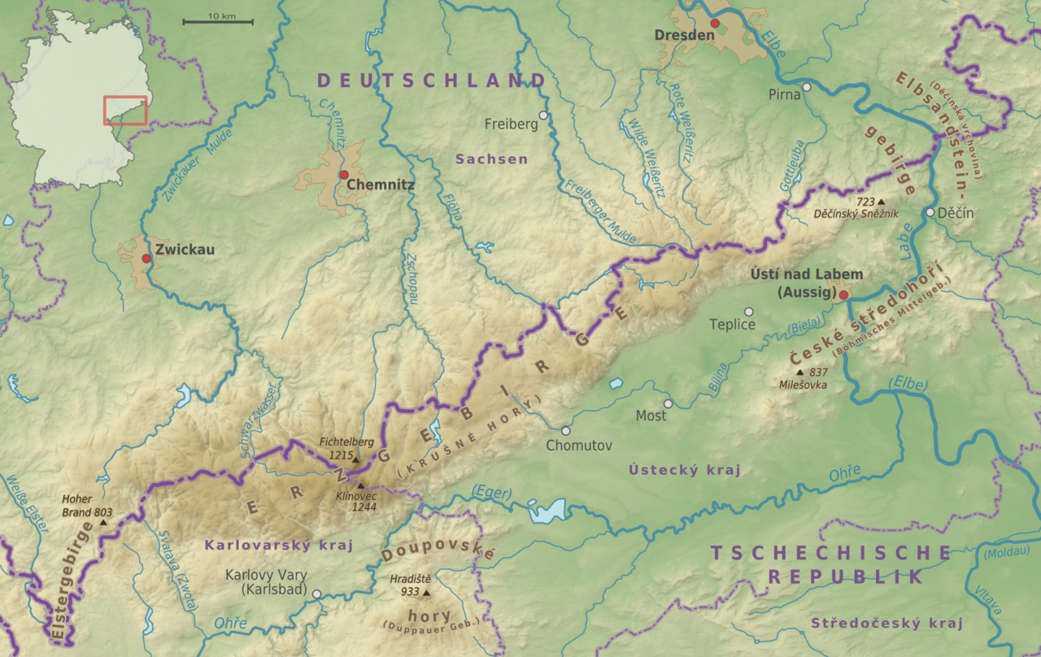
The first global root: Saxon, early modernity, economics
the Ore Mountains:
straddling the SW border
of Saxony, Germany, and
the NE border of
Bohemia, Czech Republic.

Slide 8
The first global root: Saxon, early modernity, economics
Hans Carl von Carlowitz (1645-1714)
… comes from officer’s family, born shortly before end of Thirty Years War. After Westphalian Peace, economic recovery begins in Saxony in the Ore Mountains (Erzgebirge) with silver mining.
… silver mining requires lots of timber, for securing the adits (shafts driven into the mountains) and for supplying the furnaces for smelting the metal from the ore.
… HCC’s dad worked as forest supervisor upon decommission and saw how the timber demand for silver mining blighted the Ore Mountain forests with clear-cutting.
… HCC studies in Halle and Jena, embarks on a 5-year Kavaliersreise (gentleman’s tour), and sees that wood is a scarce resource in Western Europe. Louis XIV’s 1669 forest law.
… returns home to Saxony and starts working as mining inspector in 1677. Supervising the management of steady wood supply for the silver mines is part of his responsibility.

Slide 9
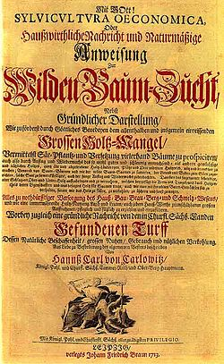
The first global root: Saxon, early modernity, economics
Hans Carl von Carlowitz (1645-1714)
Sylvicultura Oeconomica.
Hauswirtliche Nachricht und
naturmäßige Anweisung
zur wilden Baumzucht (1713)
= Forest Culture Economics:
economic manual and instruction,
in conformity with nature,
on how to grow wild trees.

Slide 10
The first global root: Saxon, early modernity, economics
Hans Carl von Carlowitz (1645-1714)
… writes Sylvicultura Oeconomica. Hauswirtliche Nachricht und naturmäßige Anweisung zur wilden Baumzucht (1713) = Forest Culture Economics: economic manual and instruction in conformity with nature, on how to grow wild trees
⬥ coins the term nachhaltig = “sustainable” in Sylvicultura Oeconomica
⬥ defines SD in ecological-economic terms: renewable resource management
⬥ principle: don’t cut more wood in a forest than the forest naturally regrows!
⬥ manage the renewable resource such that the industrial rate of extraction conforms to the biotic rate of renewal while allowing for a safety margin.
⬥ Cf. Callicott 2010: “Sustainability is a property of an activity or complex system of activities capable of going on and on indefinitely, if not forever.”

Slide 11
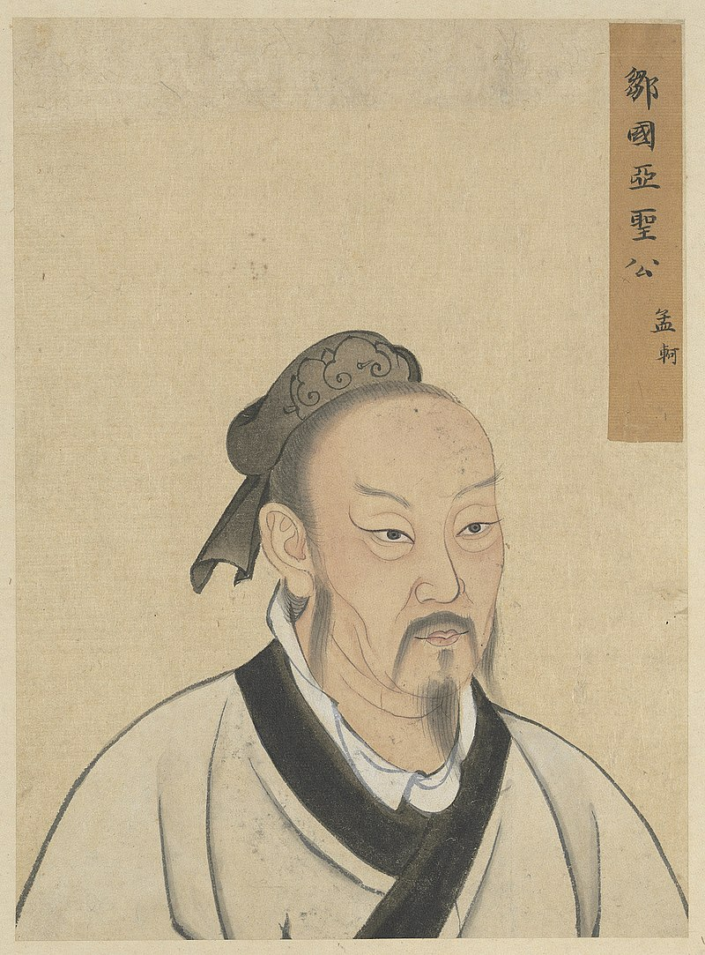
The second global root: North China, high antiquity, geopolitics
Mencius/Mengzi 孟子 (370-290 BCE)
“If you do not interfere with the busy seasons
in the fields, then there will be more grain than
the people can eat; if you do not allow nets with
too fine a mesh to be used in large ponds,
then there will be more fish and turtles than
they can eat; if hatches and axes are permitted
in the forests on the hills only in the proper
seasons, then there will be more timber than
they can use.”

Slide 12
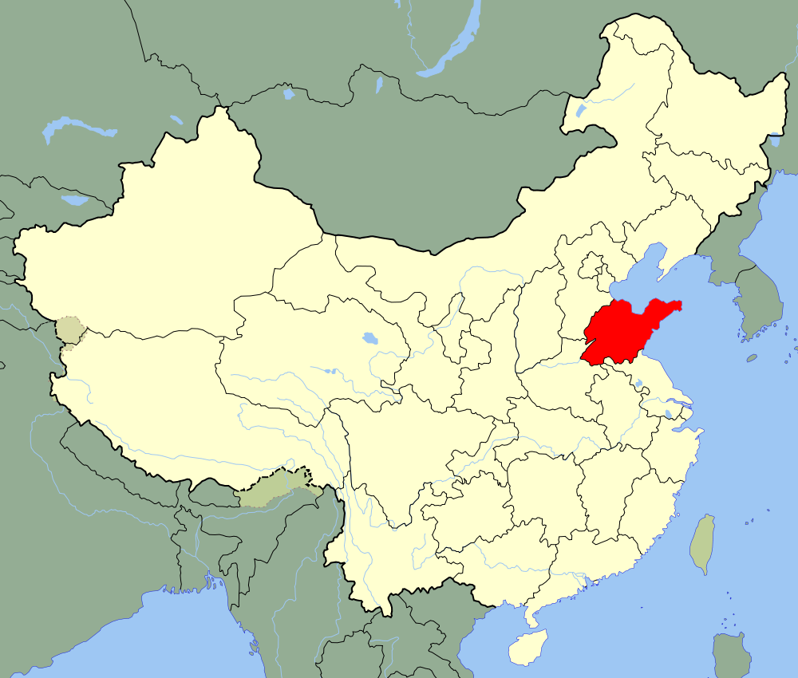
The second global root: Northeast China, high antiquity, geopolitics
Mencius/Mengzi 孟子 (370-290 BCE)
… from Shandong 山东 province
… during late Zhou 周 dynasty
Warring States period 戰國時代
… time of Alexander the Great
… greatest disciple of Confucius
… expanded Confucian ethics into a
political philosophy, adopted as
state doctrine in Han 漢/汉 dynasty

Slide 13
The second global root: Northeast China, high antiquity, geopolitics
“If you do not interfere with the busy seasons in the fields, then there will be more grain than the people can eat; 不違農時，穀不可勝食也；
if you do not allow nets with too fine a mesh to be used in large ponds, then there will be more fish and turtles than they can eat; 數罟不入洿池，魚鼈不可勝食也；
if hatches and axes are permitted in the forests on the hills only in the proper seasons, then there will be more timber than they can use.斧斤以時入山林，材木不可勝用也。
When the people have more grain, more fish and turtles than they can eat, and more timber than they can use, 穀與魚鼈不可勝食，材木不可勝用，
then in the support of their parents when alive and in the mourning of them when dead, they will be able to have no regrets over anything left undone. 是使民養生喪死無憾也。
For people not to have any regrets over anything left undone … is the first step along the Kingly way.” 養生喪死無憾，王道之始也。
Book of Mencius I.A.3 (Lau trans.)

Slide 14
The second global root: Northeast China, high antiquity, geopolitics
“... when those who are seventy wear silk and eat meat 七十者衣帛食肉，
and the masses are neither cold nor hungry, 黎民不飢不寒，
it is impossible for their prince not to be a true King.” 然而不王者，未之有也。
Book of Mencius I.A.3 repeated at I.A.7 (Lau trans.)
maintaining political power requires taking care of the needs of the people
taking care of the needs of the people requires sustainable resource management
⬥ → maintaining political power requires sustainable resource management.

Slide 15
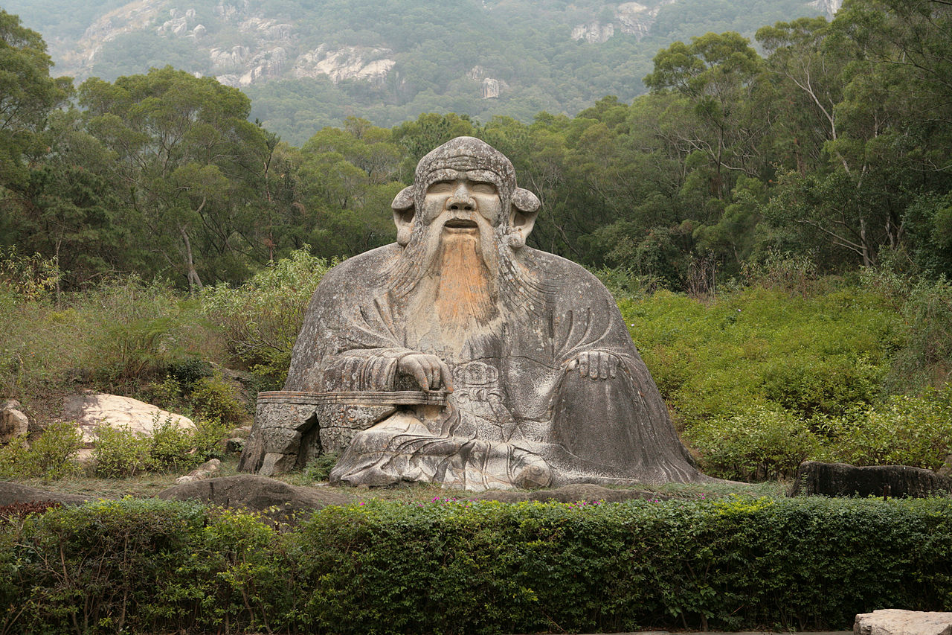
The third global root: Central China, early antiquity, adaptation
Lao Tzu/Laozi 老子 (6th C BCE)
“That which goes against the Tao
comes to an early end.”

Slide 16
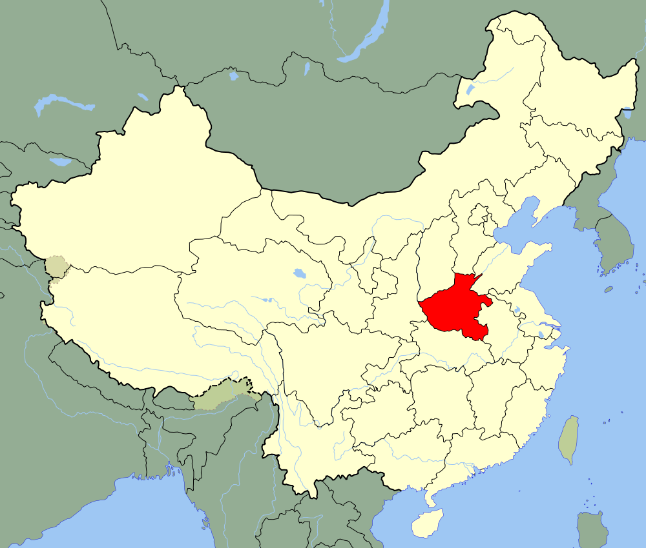
The third global root: Central China, early antiquity, adaptation
Lao Tzu/Laozi 老子 (6th C BCE)
… from Henan 河南 province
… during early Zhou 周 dynasty
Spring & Autumn period 春秋時代
… time of European Bronze Age
… semi-mythical figure
… revered as Daoist god 太上道君,
one of the Three Pure Ones 三清
… enshrined by the CTA in 2007 as
God of Ecology 生态保护神

Slide 17
The third global root: Central China, early antiquity, adaptation
Lao Tzu/Laozi 老子 Daodejing 道德經 verse 30 stanza 1
Whenever you advise rulers in the way of Tao 以道佐人主
counsel them not to use force to conquer the universe 者，不以兵
for this would only cause resistance. 強天下。
Thorn bushes spring up wherever the army has passed. 師之所處，荊棘生焉。
Lean years follow in the wake of a great war. 大軍之後，必有凶年。
Just do what needs to be done. 善有果而已，
Never take advantage of power. 不敢以取強。

Slide 18
The third global root: Central China, early antiquity, adaptation
Lao Tzu/Laozi 老子 Daodejing 道德經 verse 30 stanza 2
Achieve results, 果
but never glory in them. 而勿矜，
Achieve results, 果
but never boast. 而勿伐，
Achieve results, (果
but never be proud. 而勿伐，)
Achieve results, 果
because this is the natural way. 而勿驕。
Achieve results, 果
but not through violence. 而不得已，

Slide 19
The third global root: Central China, early antiquity, adaptation
Lao Tzu/Laozi 老子 Daodejing 道德經 verse 30 stanza 3
Force is followed by loss of strength. 果而勿強物壯則老，
This is not the way of the Dao. 是謂不道，
That which goes against the Tao 不道
comes to an early end. 早已。

Slide 20
The third global root: Central China, early antiquity, adaptation
Lao Tzu/Laozi 老子 (6th C BCE) Daodejing道德經
The concept of nature in Daoism anticipates the Standard Model: nature is a network; it is dynamic; it is self-organizing from energetic flow to spacetime and complexity; matter spawns life spawns consciousness spawns reason.
The human role in nature is to adapt to the natural flow and take care of life
The wise mirrors the way of nature (dao 道) in their outlook and conduct (de 德)

Slide 21
The third global root: Central China, early antiquity, adaptation
Lao Tzu/Laozi 老子 (6th C BCE) Daodejing道德經
The concept of nature in Daoism anticipates the Standard Model: nature is a network; it is dynamic; it is self-organizing from energetic flow to spacetime and complexity; matter spawns life spawns consciousness spawns reason.
The human role in nature is to adapt to the natural flow and take care of life
The wise mirrors the way of nature (dao 道) in their outlook and conduct (de 德)
The basic form of this reflection or ‘mirroring’ is harmony or attunement.
Good governance is attuned to natural dynamics and ecological conditions
Daoist policies are anticapitalist, non-violent, life-oriented, feminist, and green
The Daoist schema of sustainability = activity attuned to environmental dynamics
The Daoist schema of sustainable development = civilizational re-adaptation
s

Slide 22
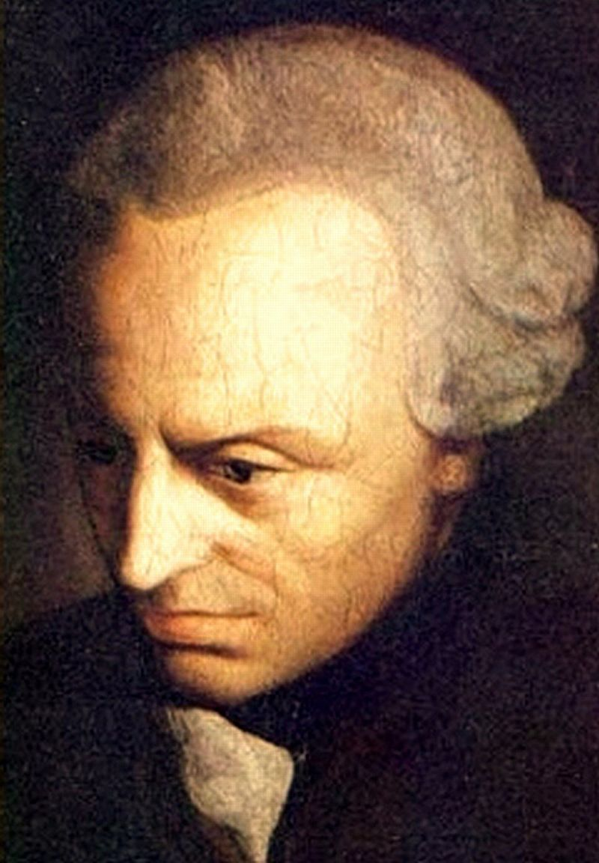
The fourth global root: Baltic, Enlightenment, evolution
Immanuel Kant (1724-1804)
“Act only in accordance with those policies
that can be universalized;
that is, which can be adopted by
anyone and everyone indefinitely.”
„Handle nur nach derjenigen Maxime,
durch die du zugleich wollen kannst,
dass sie ein allgemeines Gesetz werde.“

Slide 23
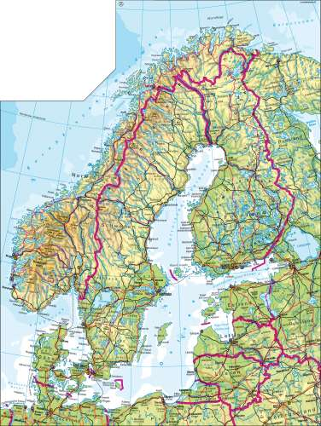
The fourth global root: Baltic, Enlightenment, evolution
Immanuel Kant (1724-1804)
… lived at the Baltic coast in the German town
Königsberg, now Kaliningrad, Russia
… family were humble artisans (harness-makers)
… was a pantheist free-thinker who wrote on
natural self-organization and human progress
… leading thinker of the German Enlightenment
… constructed a structural-dynamic foundation
of ethical theory, the Categorical Imperative

Slide 24
The fourth global root: Baltic, Enlightenment, evolution
Categorical Imperative (3 formulations)
I. Act only in accordance with those policies that can be universalized; that is, which can be adopted by anyone and everyone indefinitely.
Handle nur nach derjenigen Maxime, durch die du zugleich wollen kannst, dass sie ein allgemeines Gesetz werde = Universalisierungs- bzw. Naturgesetzformel, 4:421
II. Act so that you treat humanity, whether in your person or in that of another, always as an end and never as a means only.
Handle so, dass du die Menschheit sowohl in deiner Person, als in der Person eines jeden anderen jederzeit zugleich als Zweck, niemals bloß als Mittel brauchst. = Selbstzweckformel 4:429
III. Act as if your policies of action could always serve as law-making links in a web of autonomy.
Demnach muß ein jedes vernünftige Wesen so handeln, als ob es durch seine Maximen jederzeit ein gesetzgebendes Glied im allgemeinen Reiche der Zwecke wäre. = Reich-der-Zwecke Formel 4:438

Slide 25
The fourth global root: Baltic, Enlightenment, evolution
Categorical Imperative (3 formulations)
I. Act only in ways that can be adopted by anyone indefinitely.
II. Treat humankind as the end of your action, period.
III. Generate greater autonomy, more complexity, more diversity.

Slide 26
The fourth global root: Baltic, Enlightenment, evolution
Categorical Imperative (3 formulations)
I. Act only in ways that can be adopted by anyone indefinitely. → structure of sustainability
II. Treat humankind as the end of your action, period. → substance of sustainability
III. Generate greater autonomy, more complexity, more diversity. → dynamics of sustainability

Slide 27
One future outlook: economics-geopolitics-adaptation-evolution
pre-2000 principle of sustainability → post-2020 outlook for sustainability
Brundtland
one-dimensional
ethical (a matter of fairness)
liberal
market-based
politically neutral
human-based

Slide 28
One future outlook: economics-geopolitics-adaptation-evolution
pre-2000 principle of sustainability → post-2020 outlook for sustainability
Brundtland → integration of Brundtland + the four roots
one-dimensional → multi-dimensional
ethical (a matter of fairness) → evolutionary (a matter of readaptation)
liberal → existential
market-based → science-based
politically neutral → politically progressive
human-based → stewardship-based

Slide 29
One future outlook: economics-geopolitics-adaptation-evolution
Brundtland + four roots
multi-dimensional
evolutionary
existential sustainability
science-based
politically progressive
stewardship-based

Slide 30
One future outlook: economics-geopolitics-adaptation-evolution
Key features of integrative sustainable policies
social justice, equity
ecological economics
strategic geopolitics
sustainability earth system readaptation
intergenerational honor
cultural evolution

Slide 31
One future outlook: economics-geopolitics-adaptation-evolution
Key features of integrative sustainable policies
social justice, equity e.g. social democracy, socialism (NORDIC, EU, TW, CHINA)
ecological economics e.g. Sino-Leninist planned-market mix (CHINA)
strategic geopolitics e.g. belt-and-road initiative (OCEANIA, EURASIA, AFRICA)
earth system readaptation e.g. closed-loop, post-carbon, degrowth (NORWAY, CHINA)
intergenerational honor e.g. science-based policies (UN, EU, NORDIC, CHINA)
cultural evolution e.g. from individualism to relationalism (ROME, MECCA, BEIJING)

Slide 32
Sustainability: Four Global Roots, One Future Outlook
Thank you!

