Slide 1

Sustainable Investing
Presented by:
T.J. King, CFP
November 2019

Slide 2
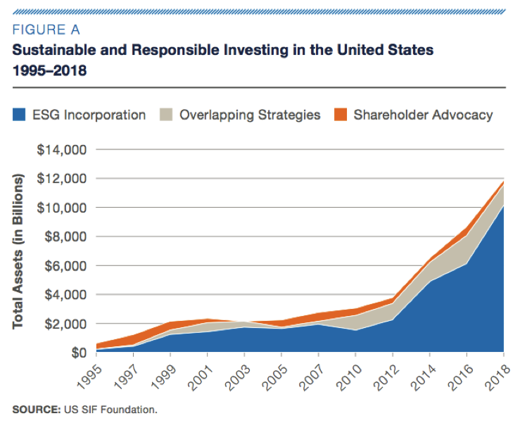
Growth of sustainable Investing

Slide 3
Sustainable investing
Socially Responsible Investing (SRI)
Values Investing
Impact Investing
Mission-aligned Investing
ESG

Slide 4

What is ESG?
Environmental
Social
Governance
Framework
Definable
Measurable

Slide 6



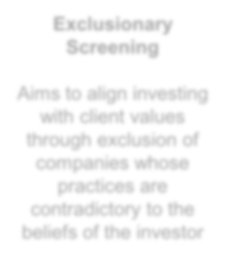


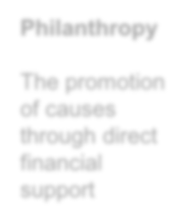
EVOLUTION OF SUSTAINABLE INVESTING
Exclusionary Screening
Aims to align investing with client values through exclusion of companies whose practices are contradictory to the beliefs of the investor
Integration
A strategy that considers ESG criteria as part of its analysis and portfolio construction to mitigate risks or invest in quality companies
Impact Investing
An intentional and measurable social or environmental impact through investing
Conventional
Investing
Philanthropy
Seeks an acceptable risk/return profile with no
investing limitations beyond suitability
The promotion of causes through direct financial support
This investment strategy may result in investment returns that may be lower or higher than if decisions were based solely on investment considerations and could result in either underperformance or outperformance of the market as a whole.
All investments are subject to risk and you may incur a profit or a loss. There is no assurance that any investment strategy will be successful. Asset allocation and diversification does not ensure a profit or protect against a loss. Past performance does not guarantee future results.

Slide 7

ESG - exclusionary
Examples:
Excludes companies involved in adult entertainment, alcohol and tobacco, weapons, fossil fuels, gambling, and nuclear power stocks.
Excludes stocks of companies that do not meet the labor, human rights, environmental, and anti-corruption standards as defined by the U.N. global compact principles as well as companies that do not meet appropriate diversity criteria.

Slide 8
ESG – integration / engagement
ESG analysis is implemented during investment selection
    Portfolio managers select individual holdings
    Each investment manager employs a unique strategy
Integration
  Core research – quantitative and qualitative analysis
  Materiality – do ESG factors represent specific risks or opportunities?
  “Best in class” investment selection
Engagement
  Proxy voting
  Dialogue with company management
  Market initiatives – working with peers to improve industry standards
  Target initiatives – focusing on desired outcomes
  Policy influence

Slide 9

ESG – THEMATIC

Slide 10
ESG – thematic
Examples:
“Seeks to track the investment results of an index composed of positive impact companies that derive a majority of their revenue from products and services that address at least one of the world's major social and environmental challenges as identified by the United Nations Sustainable Development Goals.”
“Every portfolio company is selected for their ability to deliver innovative solutions that simultaneously address our biggest systemic risks – climate change, resource scarcity and widening inequality – and improves economic productivity. We intentionally select each stock as a solution to a given risk, or interconnected set of risks, based on the products/services from which they earn revenue.”
“Research indicates that companies with more women in leadership have higher returns on capital, greater innovation, increased productivity and higher employee retention and satisfaction.”

Slide 11
Impact investing
Dual objective:
  Social and/or environmental outcome
  Financial return
Extremely broad range of investment vehicles and targeted solutions.
Many solutions exclusively available for accredited investors (i.e. – pension funds, foundations and high net worth individuals).
Some “grass roots” solutions available to smaller investors.
Examples:
  Community investment notes
  Regenerative agriculture
  Sustainable forestry
  Clean water
  Venture capital – renewable energy

Slide 12
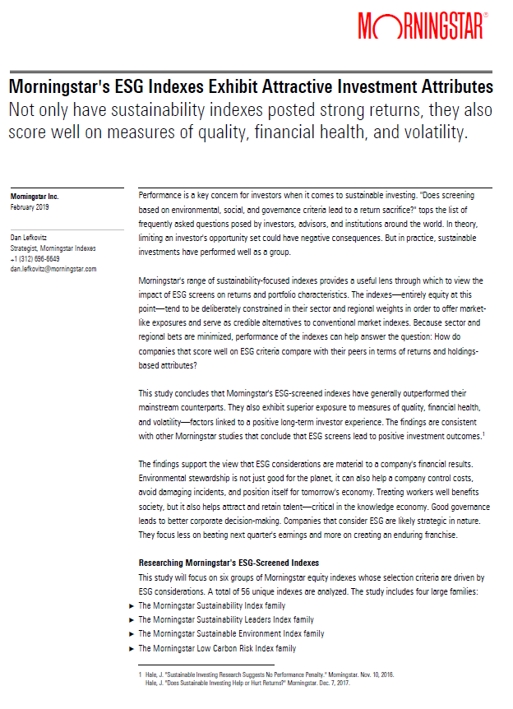
What about performance?

Slide 13
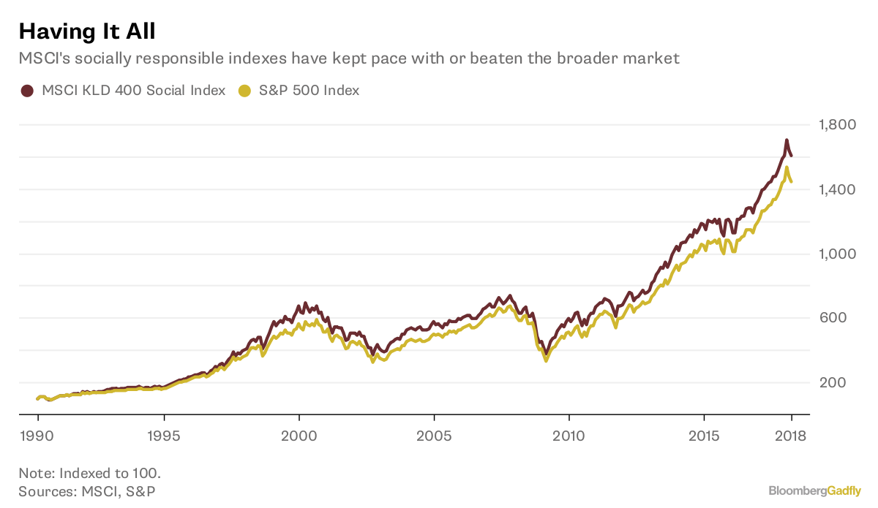
What about performance?

Slide 14
Is corporate responsibility good for business?
Fortune 100 best companies to work for: Cumulative total returns, 1998-2016
713%
229%
vs.
Publicly traded companies on the 100 Best Companies List
S&P 500
Sources: Fortune, “How Buying Stock in the 'Best Companies to Work For' Helped This Investor Crush the Market”, Jen Wieczner, March 9, 2017; FTSE Russell, Russell Investments. From http://fortune.com/2017/03/09/best-companies-to-work-for-stocks-invest-esg-parnassus/

Slide 15




Large ESG data providers

Slide 16







Sustainable investing resources

Slide 17
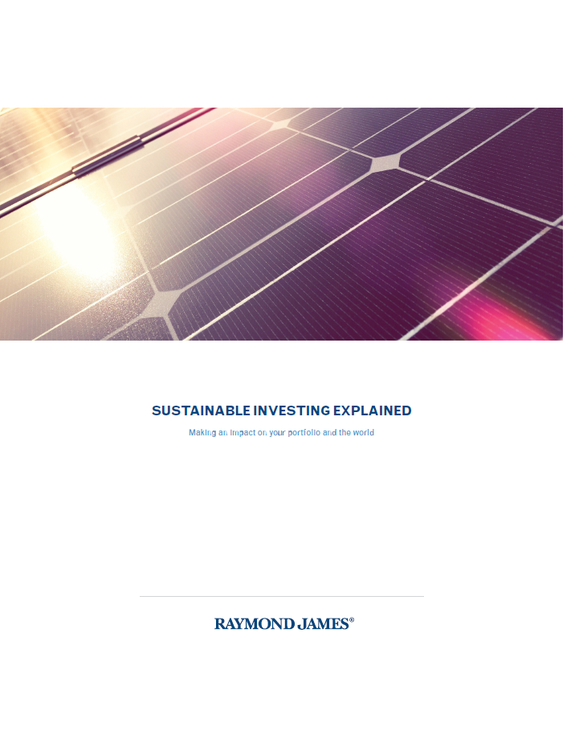

Sustainable investing AT Raymond James

Slide 18

RJ Sustainable Investment advisory council
The council was formed to promote two primary shared objectives between RJ’s advisors and home office:
Advocate for and promote ESG investing throughout the firm.
Develop innovative approaches and products to better serve advisors and their clients interested in using ESG factors to evaluate investment opportunities.
Through advisors and home office sharing their efforts on a single council, each group’s individual aims can also be achieved:
Home office representatives desire to understand the myriad of ways advisors are finding success using an ESG lens in their businesses, and how best to support advisors in their endeavors.
Advisors desire a safe space to share best practices and hurdles, learning from one another and engaging home office representatives in an effort to find solutions to current challenges.

Slide 19
sustainable investing career areas
Analysis – specific to sustainability issues
Advocacy – shareholder engagement, proxy voting
Consulting
Corporate sustainability / social responsibility
Impact Investment Officer – pension funds, foundations, family offices, etc.
Sales and marketing – “telling the story”
Technology – data integration and interpretation
Financial advisor – working directly with investors

Slide 20
Views expressed are not necessarily those of Raymond James & Associates and are subject to change without notice. Information provided is general in nature, and is not a complete statement of all information necessary for making an investment decision, and is not a recommendation or a solicitation to buy or sell any security. Past performance is not indicative of future results. There is no assurance these trends will continue or that forecasts mentioned will occur. Investing always involves risk and you may incur a profit or loss. No investment strategy can guarantee success. Raymond James & Associates, Inc., Member New York Stock Exchange/SIPC
This information is not intended as a solicitation or an offer to buy or sell any security referred to herein.
Charts are provided for illustrative purposes only. Past performance may not be indicative of future results.
Graphs included are for illustrative purposes only and are not intended to reflect the actual performance of any security. Investments involve risk and you may incur a profit or a loss.

Slide 21
T.J. King, CFP
First Vice President – Investments
880 Carillon Parkway – 32E
St. Petersburg, FL 33716
727-567-7664
tj.king@raymondjames.com
INTERNATIONAL HEADQUARTERS: THE RAYMOND JAMES FINANCIAL CENTER
880 CARILLON PARKWAY // ST. PETERSBURG, FL 33716 // 800.248.8863
RAYMONDJAMES.COM
© 2019 Raymond James & Associates, Inc., member New York Stock Exchange/SIPC.
Raymond James® is a registered trademark of Raymond James Financial, Inc.

