Slide 1
University of South Florida

Slide 2
Green Building Workshop
C. J. Davila
Executive Director
Florida Green Building Coalition
Notes:
First, What WE do.
Then, what YOU can do.

Slide 3
What is Green Building?
Green building (also known as green construction or sustainable building) refers to both a structure and the application of processes that are environmentally responsible and resource-efficient
Throughout a building's life-cycle: from planning to design, construction, operation, maintenance, renovation, and demolition.
Requires close cooperation of the contractor, the architects, the engineers, and the client at all project stages.
Notes:
First, What WE do.
Then, what YOU can do.

Slide 4
What is Green Building?
A ‘green’ building is a building that, in its design, construction or operation, reduces or eliminates negative impacts, and can create positive impacts, on our climate and natural environment. Green buildings preserve precious natural resources and improve our quality of life.
There are a number of features which can make a building ‘green’. These include:
Efficient use of energy, water and other resources
Use of renewable energy, such as solar energy
Notes:
First, What WE do.
Then, what YOU can do.

Slide 5
What is Green Building?
Pollution and waste reduction measures, and the enabling of re-use and recycling
Good indoor environmental air quality
Use of materials that are non-toxic, ethical and sustainable
Consideration of the environment in design, construction and operation
Consideration of the quality of life of occupants in design, construction and operation
A design that enables adaptation to a changing environment
Notes:
First, What WE do.
Then, what YOU can do.

Slide 6
Why is Green Building Important?
Globally, buildings are responsible for a huge share of energy, electricity, water and materials consumption.
Buildings account for 18% of global emissions today, or the equivalent of 9 billion tons of CO2 annually.
If new technologies in construction are not adopted during this time of rapid growth, emissions could double by 2050.
Green building practices aim to reduce the environmental impact of building.
Not building at all is preferable to green building, in terms of reducing environmental impact. The second rule is that every building should be as small as possible. The third rule is not to contribute to sprawl
Notes:
First, What WE do.
Then, what YOU can do.

Slide 7
Why Certify Florida Green?
We use independent third-party experts to review a home’s construction so that its owners can be assured their home will perform as expected in several critical areas such as:
Energy Performance – Exceeding code requirements and reducing energy costs
Water Conservation – Reducing water usage both inside and outside the home
Site Conditions – Minimal site disturbance and utilization of native plants
Healthier Home – Use of products and materials to create a healthier interior environment
Materials – Use of locally produced, resource-efficient materials and recycled content
Disaster Mitigation – The ability to withstand natural disaster and pests such as termites
Notes:
First, What WE do.
Then, what YOU can do.

Slide 8
Benefits of Certifying
Florida Green
Homebuyer | Builder | Community
Enhances indoor air quality | Gain valuable promotion and advertising | Conservation of water resources
More energy & water efficient | Differentiates your home from the competition | Improved stormwater and waste management
Safer and healthier to live in - more durable | Green homes are viewed as better quality | Provides affordable housing
Less expensive to operate & maintain | Increase customer referrals | Reduced capital outlay for energy & water
Increases mortgage money | Enhances market value | Measurable CO2 Reduction
Notes:
Green certified projects reduce operating costs for the building owners.
For a local government, this means reduced taxpayer burden since the local government has reduced operating costs.

Slide 9
Going Green? In Florida You Have a Choice
FGBC provides municipalities, builders, developers and commercial contractors a clear and straightforward pathway to third-party “Florida Green” certification with well-defined, Florida-specific criteria.
Why FGBC?
We are Florida. National programs also move projects towards environmentally-friendly building. But Florida Green are the only standards developed with climate-specific benchmarks. They address the state’s hot-humid environment, unique geology, topography and natural disasters.
We are a resource. FGBC’s certification process, including lower fees, is often more affordable than other certifications. The free market aspect keeps costs low but streamlines the process of Going Green. The five green certifications are powerful because they complement one another and provide guidance and a valuable resource throughout the process.

Slide 10
Going Green? In Florida You Have a Choice
Organization Year Founded Web Site | Geographical Criteria | Types | Total Florida Certified Projects (as of) | HQ | Endorsements
Florida Green Building Coalition (2000) www.floridagreenbuilding.org | Florida | Single-Family Homes Local Governments Multifamily Land Developments Hi-Rises Commercial | 18,700 (2019) | Orlando | Florida Legislature Florida League of Cities Florida League of Mayors. Florida Association of Counties (Pending)
Other Certifications
Green Globe (2004) www.greenglobe.com | International | New Construction Existing Buildings Interiors | 124 (2018) | Los Angeles | Department of Defense (DoD)
National Green Building Standard™ (NGBS) (2008) www.ngbs.com | National | Single-Family Homes Multifamily Buildings Land Developments | 1,058 (2018) | Upper Marlboro, Md. | American National Standards Institute (ANSI).
U.S. Green Building Council (USGBC) (1993) www.new.usgbc.org | International | Homes Multifamily Commercial Cities/Communities | 1,422 (2017) | Washington, D.C. | U.S. Conference of Mayors

Slide 11
About Florida Green
With over 20,000 certifications and registrations to date, FGBC is by far the state’s largest certifier of green residential and commercial construction, communities and local governments.
Florida Green are the only standards developed with Florida-specific criteria.
They address Florida’s hot-humid climate, environment, unique topography, geology and natural disasters.
Notes:
First, What WE do.
Then, what YOU can do.

Slide 12
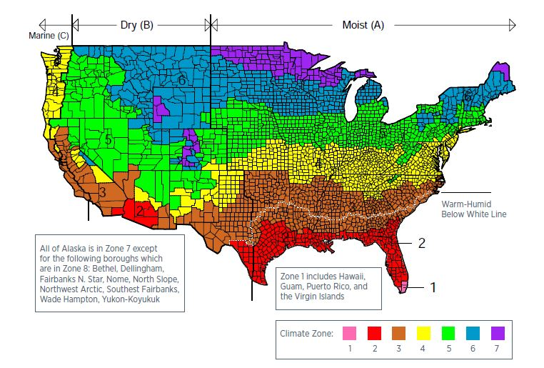
Climate Specific Requirements
Notes:
One of the most important aspects of any green building certification program is to achieve maximum building performance. Criteria must address climate-specific issues, such as humidity and natural disasters (hurricanes, wild fires, termites, etc.)
This map shows 7 climate zones. The far south tip of Florida and the Keys are in a climate zone shared by Hawaii, Guam, Puerto Rico and the Virgin Islands.
Climate zones are based on the 2009 International Energy conservation code (IECC).
Zones based on the Heating Degree Days (HDD) and Cooling Degree Days (CDD).
For example, Climate Zone 1 (South Florida) has CDD > 9000 and building space conditioning is dominated entirely by cooling.
Moisture and humidity are also considerations in determining climate zones.
Map from IECC 2009 Building Codes

Slide 13
FGBC’s Florida Green Certification
FGBC Has Developed 5 Standards
Homes
Developments
Local
Government
Cities/Counties
Commercial
High Rise
Residential

Slide 14
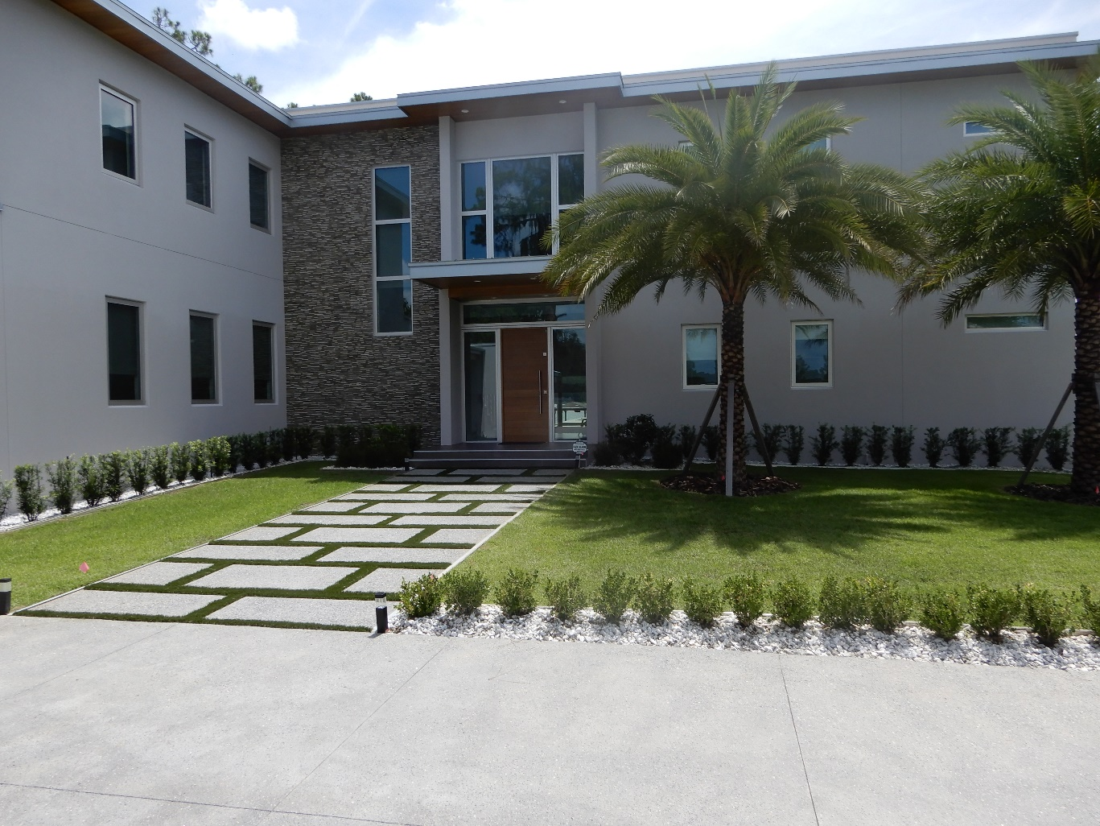
Single-Family Homes
Citrus – 2
Hernando – 44
Hillsborough – 1,054
Manatee – 5,175
Pasco – 552
Pinellas – 141
Sarasota – 1,786
8,754 Homes Certified Tampa Bay Regional Area

Slide 15
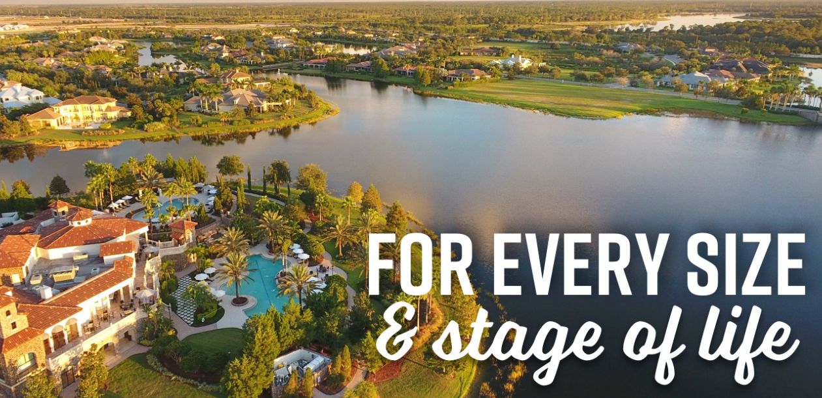
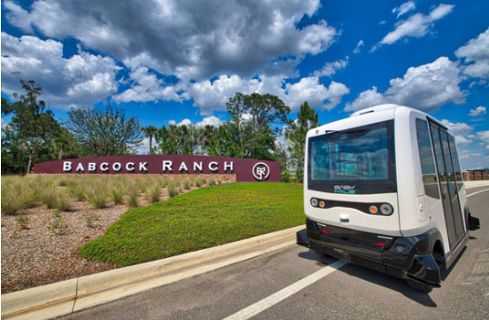
Land Developments
Lakewood Ranch – Sarasota/Manatee County, Florida
Babcock Ranch – Charlotte/Lee County, Florida
First FGBC Certified Platinum Level Land Development

Slide 16
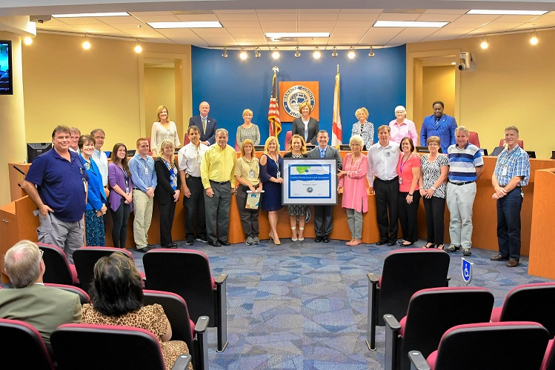




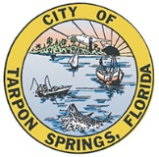



Local Government
Manatee County First FGBC Platinum Certified County.
Dunedin First FGBC Platinum Certified City.

Slide 17
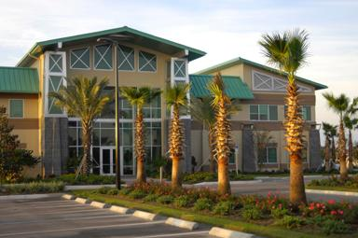
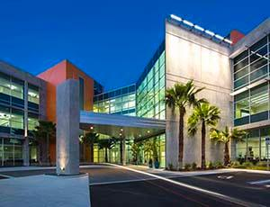
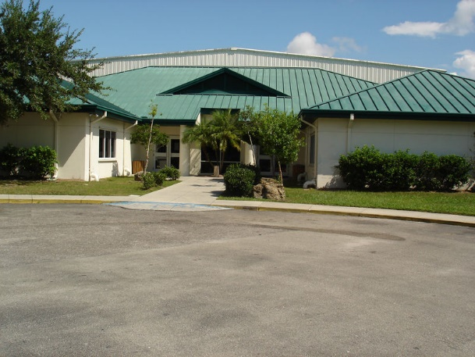
Commercial Buildings
SMR (Schroeder Manatee Ranch) Office Building, Bradenton, Florida
Harold Avenue Park Softball Field Concession Stand, Port Charlotte, Florida
Chico’s NSSC (National Store Support Center) Fort Myers, Florida

Slide 18
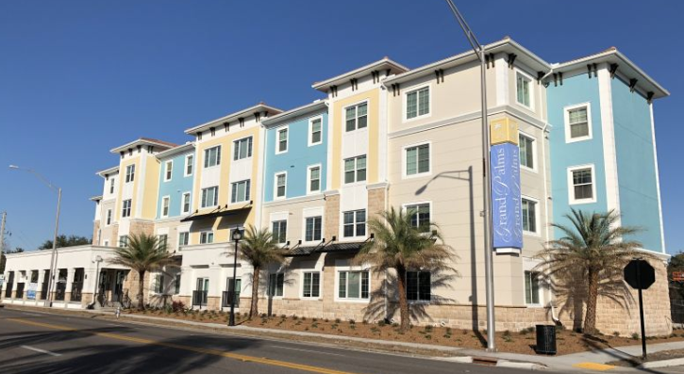
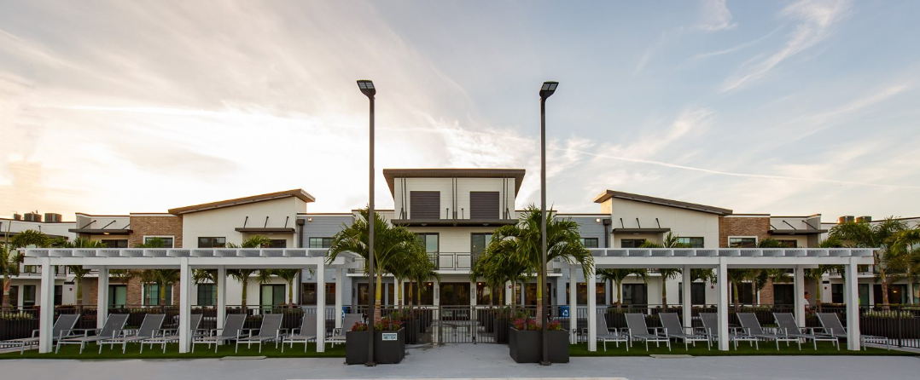
High-Rise Residential
Grand Palms Senior Apartments, Bradenton, Florida.
Artisan Apartment Homes, Dunedin, Florida
FGBC First Platinum certified High-Rise Residential project.
Highest scoring FGBC High-Rise Residential project.

Slide 19
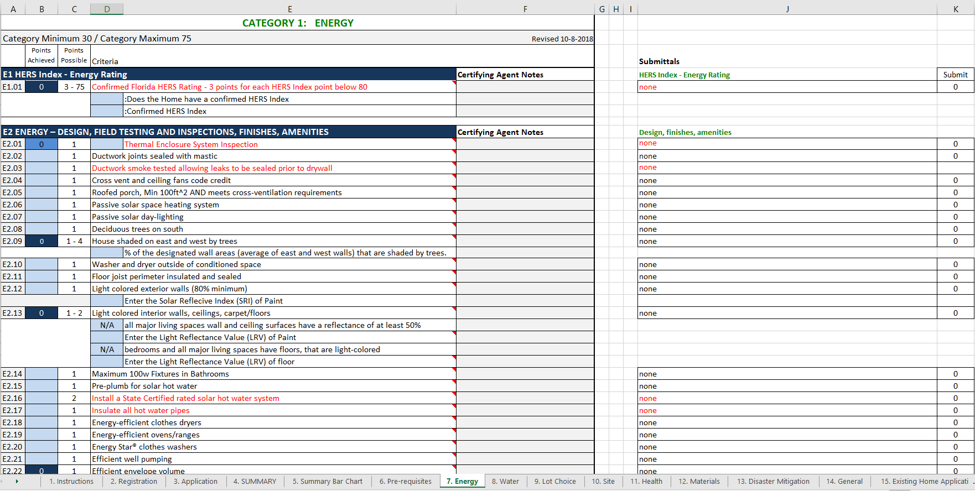
How it works?
Notes:
First, What WE do.
Then, what YOU can do.

Slide 20
What are the costs?
Homes - $75-125 for certification
High-Rise - $5,000 for certification
Commercial - $2,000 - $6, 000 depending on building square footage
Local Government - $3,000 - $6,000 depending on population
Additional certification costs for certifying agents, designated professionals, and membership requirements.
Visit www.floridagreenbuilding.org for a list of all fees and additional information.
Notes:
First, What WE do.
Then, what YOU can do.

Slide 21
‘Florida Green’ by the Numbers
20,701 Projects Certified
20,550 ‘Florida Green’ Homes
22 Commercial Buildings
14 Land Development Projects
78 Local Governments
37 Hi-Rise Residential Buildings

Slide 22
For More Information
Call: (407) 777-4919
Email: info@floridagreenbuilding.org
Visit: www.FloridaGreenBuilding.org
Notes:
Please check out our web site for more information and for an application to join the Coalition.

