Slide 1

Satisficing Death: Aging and End-of-Life Preparation among Transgender Older Americans
Nik M. Lampe, Ph.D.
Assistant Professor
Department of Mental Health Law & Policy

Slide 2
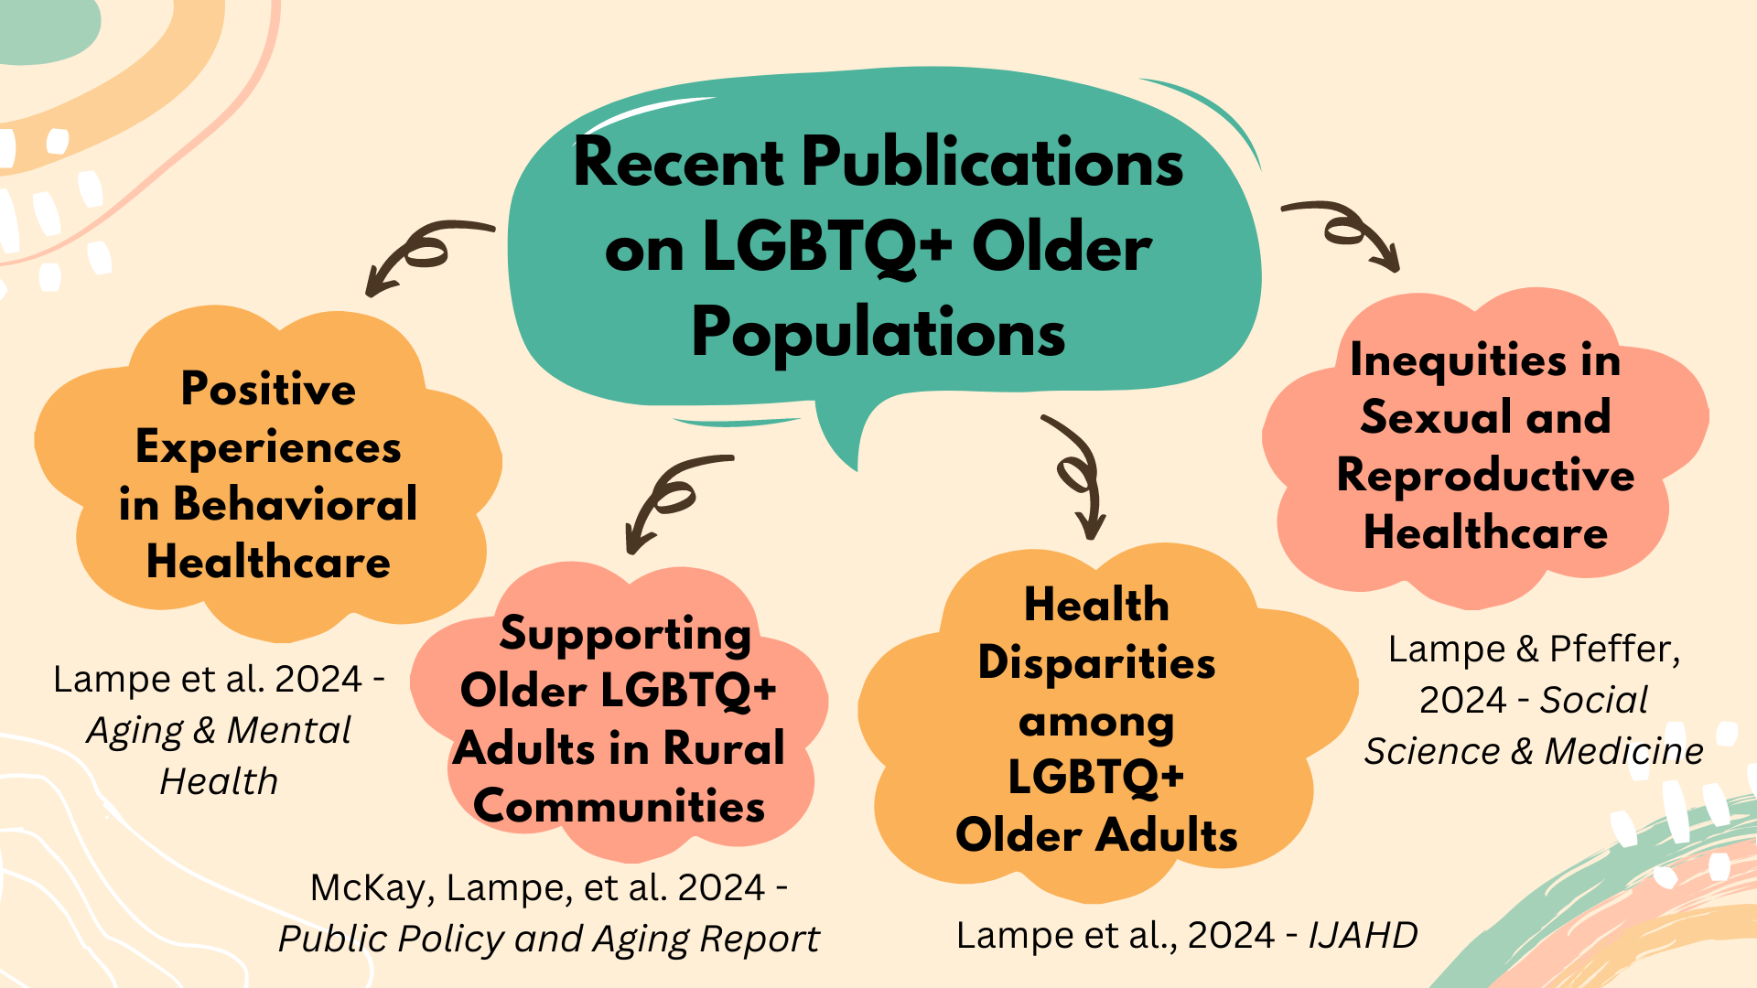

Slide 3
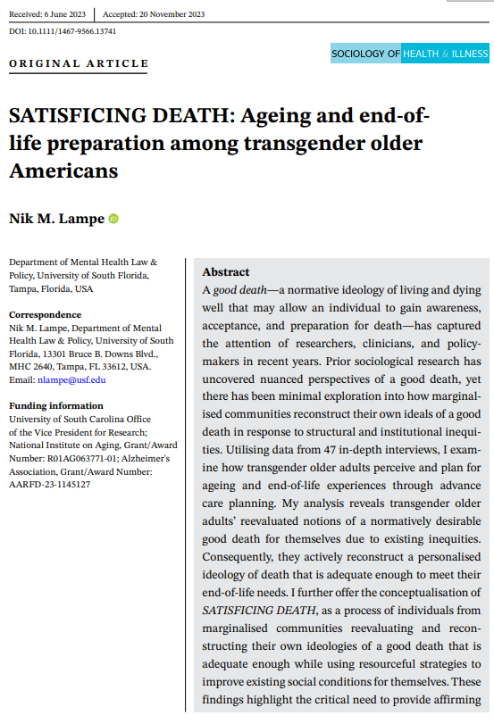

Slide 4
Funding & COI Disclosure
Funding was provided by:
  National Institute on Aging (R01AG063771-01; PI McKay)
  Alzheimer’s Association (AARFD-23-1145127; PI Lampe)
  University of South Carolina Office of the Vice President for Research (PI Lampe).
No conflicts of interest to disclose
Notes:
Funding was provided by the National Institute on Aging, the Alzheimer’s Association, and the University of South Carolina.
I have no conflicts of interest to disclose.

Slide 5

Research Question
How do transgender older Americans perceive and plan for end-of-life experiences in the context of advance care planning?

Slide 6
“A Good Death”
Definition: Living and dying in a way that is peaceful, dignified, and aligned with end-of-life goals, values, and preferences (Timmermans, 2005)
Examples in a U.S. context: Dying at home; comfort and familiarity; effective pain management; relief from suffering; dying surrounded by loved ones; Quality and available social support
Goal: To enhance awareness, acceptance, and preparation for death (McNamara et al., 1995).

Slide 7
Background
Death and dying are biosocial processes shaped by social institutions (Becker, 1997; Broom, 2016).
  Medicalization of death: Dying is increasingly viewed as a medical challenge, with medical authorities establishing control over the process (Becker, 1997).
Sociocultural factors and structural inequities affect access to a good death (Cain & McCleskey, 2019; Thomeer et al., 2017).
LGBTQIA+ older adults face disparities in ageing and end-of-life care, with limited access to culturally responsive health and peer support services (Lampe et al., 2024).
  With unique challenges among transgender older populations

Slide 8
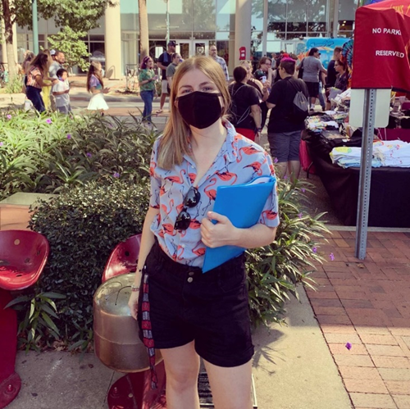
Data & Method
47 in-depth interviews conducted
Qualitative data collection
  Recruitment
  Interviewing
  Writing research memos
  Interview transcription
  Fidelity checking interview transcripts
Qualitative data analysis
  NVivo (Release 1.6) software
  Thematic analysis approach (Charmaz, 2014)
    Initial coding, focused coding, and axial coding
Participant recruitment at 2021 SC Pride Festival

Slide 9
Sample (N=47)
Age: 65 to 81 years (average age: 69 years)
Race/Ethnicity: white (73%); Black (13%); Hispanic/Latino (6%); Multiracial, non-Hispanic/Latino (4%); Multiracial, Hispanic/Latino (2%); Multiracial, non-Latin, and Indigenous (2%)
Social Class: Low income (17%); Working class (15%); Middle class (62%); Upper class (2%); Opted not to answer (4%)
Sexuality: Lesbian (34%); Bisexual (21%); Heterosexual (13%); Asexual (9%);Gay (9%); Pansexual (6%); Queer (6%); Flux (2%)
Gender Identity: Trans woman (59%); Trans man (22%);Trans (2%); Non-Binary (6%); Two-Spirit (4%); Blended-Gender (2%); Pangenderfluid (2%); Questioning (2%);

Slide 10
Research Question
How do transgender older Americans perceive and plan for end-of-life experiences in the context of advance care planning?

Slide 11
Satisficing Death: A Framework
Social conditions endured by LGBTQIA+ communities (e.g., anti-LGBTQIA+ politics) reassess normative ideologies of a good death among trans older adults.
Respondents reevaluate their notions of a normatively desirable good death experience by evaluating end-of-life care, support, and resources to transgender communities for themselves.
Consequently, respondents reconstruct an ideology of death that is adequate enough to meet their specific needs while addressing systemic challenges.
Satisficing Death – A process of marginalized communities reevaluating and reconstructing their ideologies of a good death that is adequate enough while using resourceful strategies to improve existing social conditions for themselves.

Slide 12
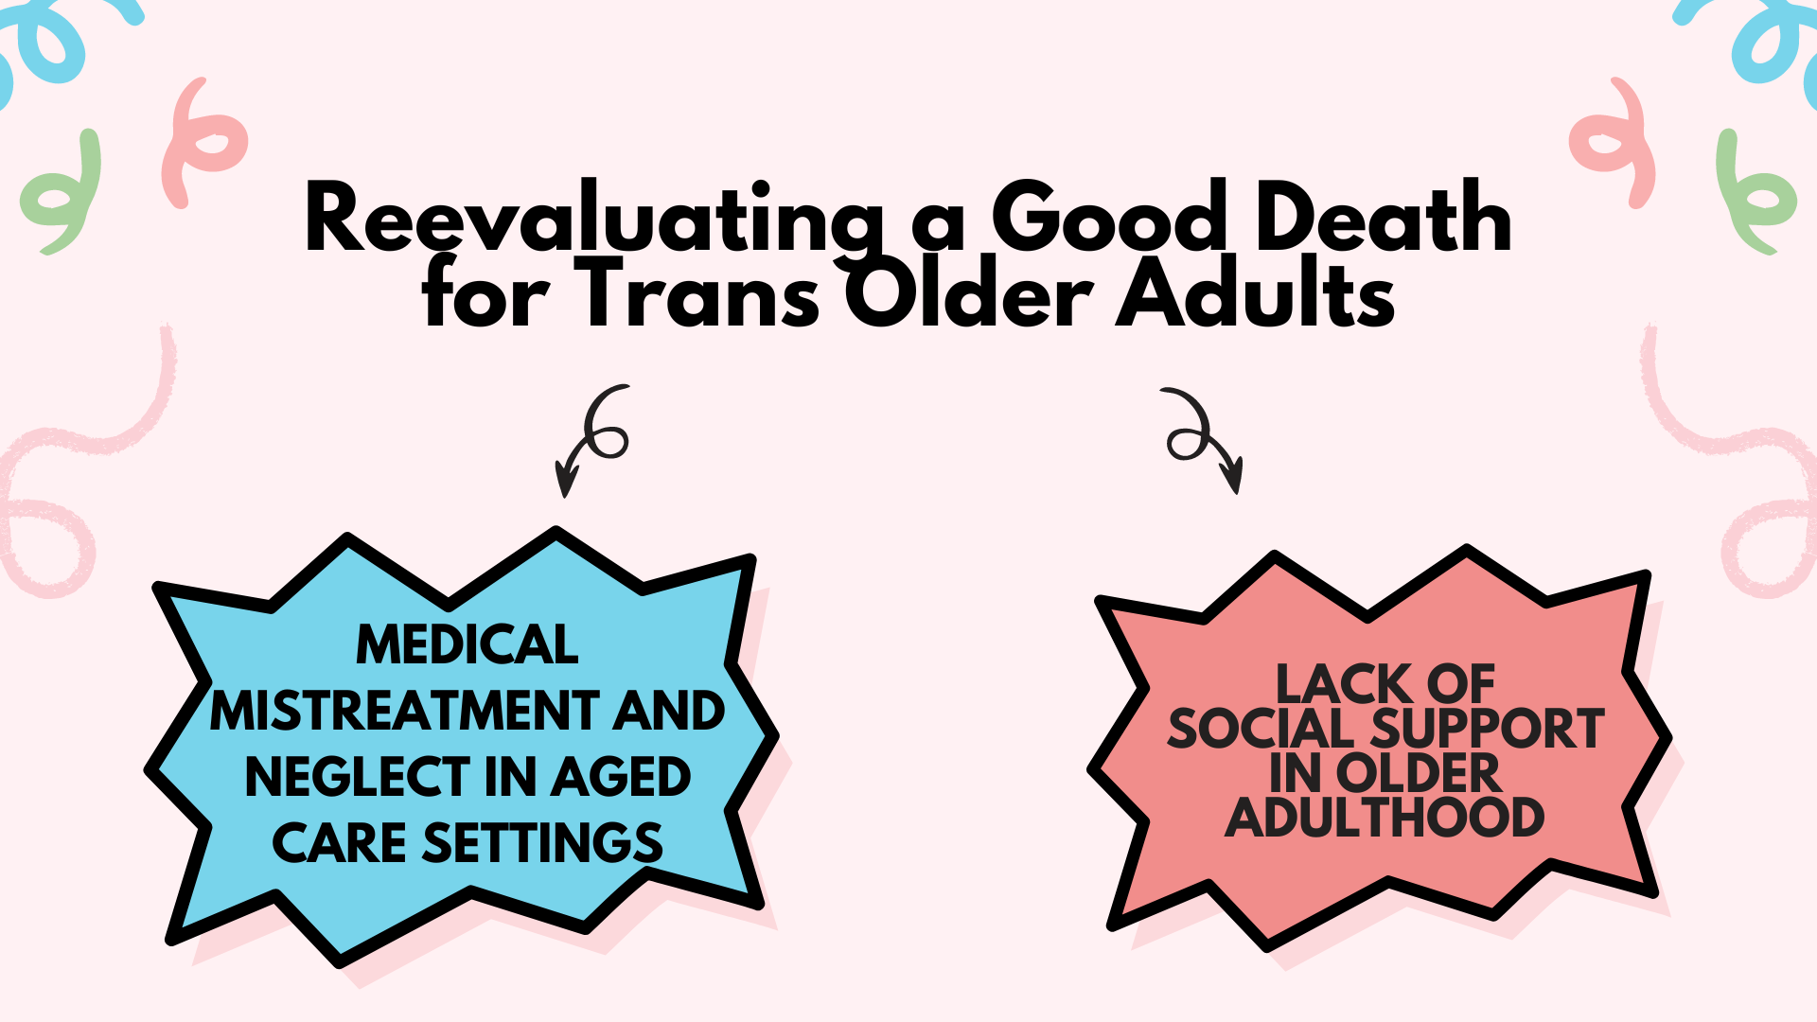

Slide 13
Medical Mistreatment and Neglect in Older Adult Care Settings
This experience with my brother dying has made it very, very important to me to get it [ACP] taken care of. I do not have anything prearranged… I’m concerned. Should my health require me to be in any kind of long-term care facility?… Will doctors treat me well as a trans female?… I don’t know. The fact that I have fully medically transitioned I think would probably make that experience not as clunky as someone who chose to not fully medically transition.
- Jane

Slide 14
Lack of Social Support
“I don't have a current advance directive… I had my daughter [as a healthcare agent], but two years ago she became a born-again Christian and now hates I’m non-binary and intersex. I'm gonna have to go back to square one. [long pause] It makes me uncertain about everything. [voice elevates] It makes me scared to have no one in my life who could take care of me during my final days.”
- Andie

Slide 15
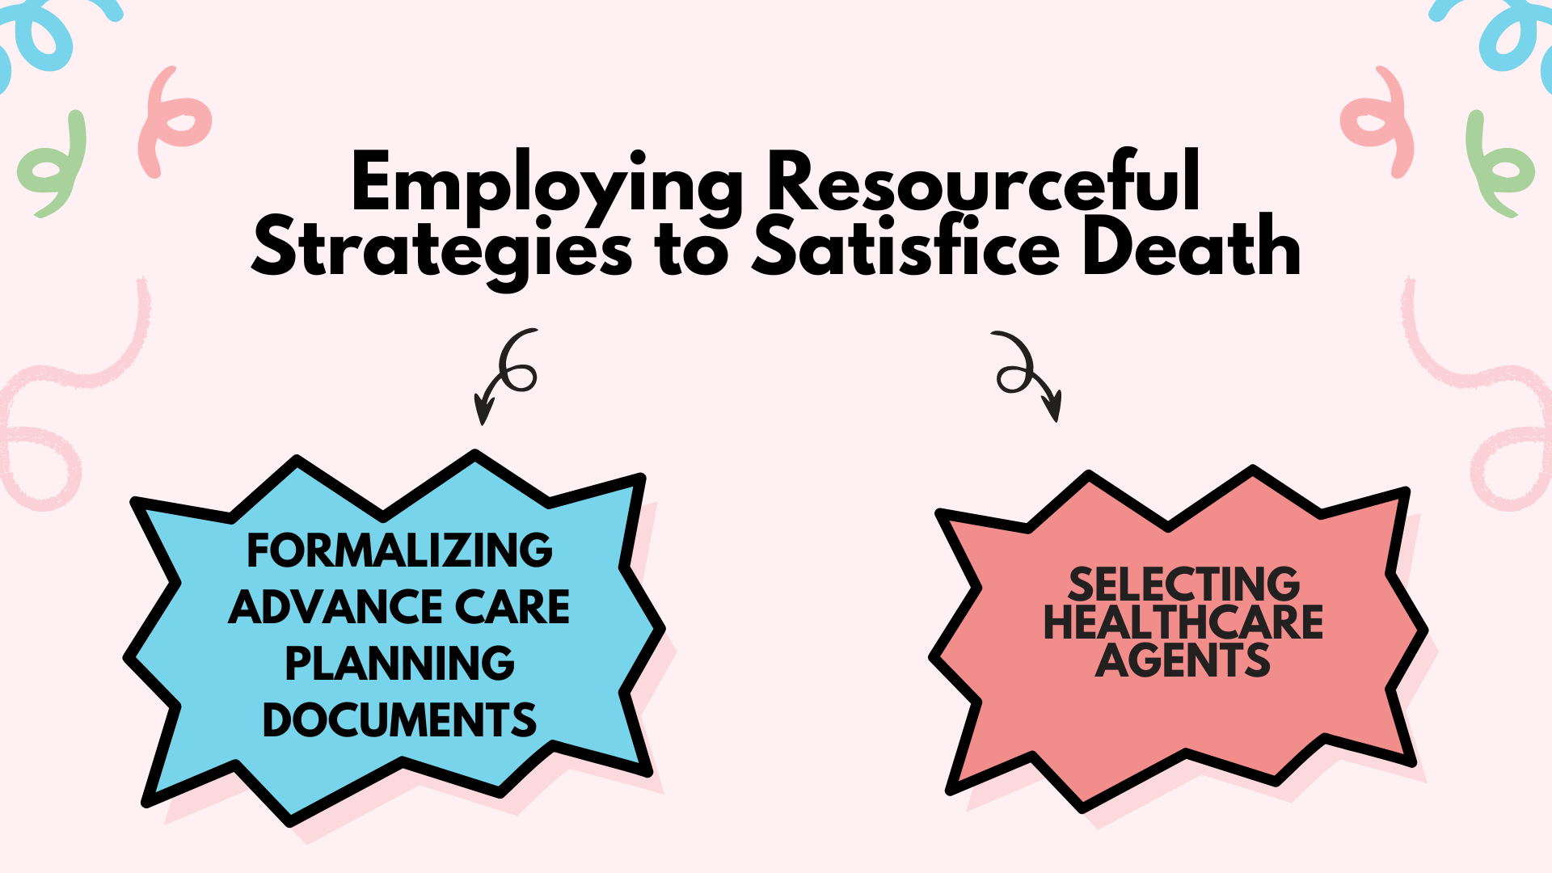

Slide 16
Formalizing Advance Care Planning Documents
“[W]e're very tuned into advance care planning as a same-gender couple together for 30 years. Before there was marriage equality, we wanted to ensure that our wishes were carried out. You know, you heard all the horror stories about same-gender spouses not being allowed visitation rights…”
- Linda
“Well, to be honest, I don’t [long pause]… I don’t even know where to get something done up like that. I don’t know if that’s something you get up at the doctor’s office or at the hospital or if you go downtown... You don’t see much information on things of that nature.”
- Summer

Slide 17
Selecting Healthcare Agents
“She [Diana] knows very well my wishes… [T]he most important thing is that we’ve had discussions about this and we’re very clear as to about what we want done, what we don’t want done. So, we see eye to eye about that. She would still be my healthcare surrogate if we didn’t see eye to eye, as long as she respected my wishes.…”
- Linda
“Well, I don't have anything down on paper. But… [m]y friends and family also know that if I'm in the kind of condition, you know where I got to be on life support and there's no chance of me coming back, and if I'm just going to be a vegetable [in a persistent vegetative state], just to let me go… I [am] so independent, I just can't see myself like that.”
- Summer

Slide 18
Summary
Satisficing death explains how marginalized communities redefine their ideologies of a "good enough" death using resourceful strategies.
Trans older adults reassess their concept of a good death and employ strategies to satisfice death, though conditions are not ideal.
Structural and institutional barriers—such as medical mistreatment and lack of social support—limit access to a good death, even with proactive advance care planning in place.

Slide 19
Implications
The findings emphasize the need for gender-affirming direct care programs and resources to support older trans adults in addressing barriers in advance care planning.
Ongoing sociopolitical conditions, including recent anti-trans legislation, impact trans older adults' preparation for death, calling for further efforts to address these effects.
Trans older adults use adaptive strategies to safeguard their end-of-life wishes, highlighting areas for future clinical interventions in family caregiver support and advance care planning.

Slide 20
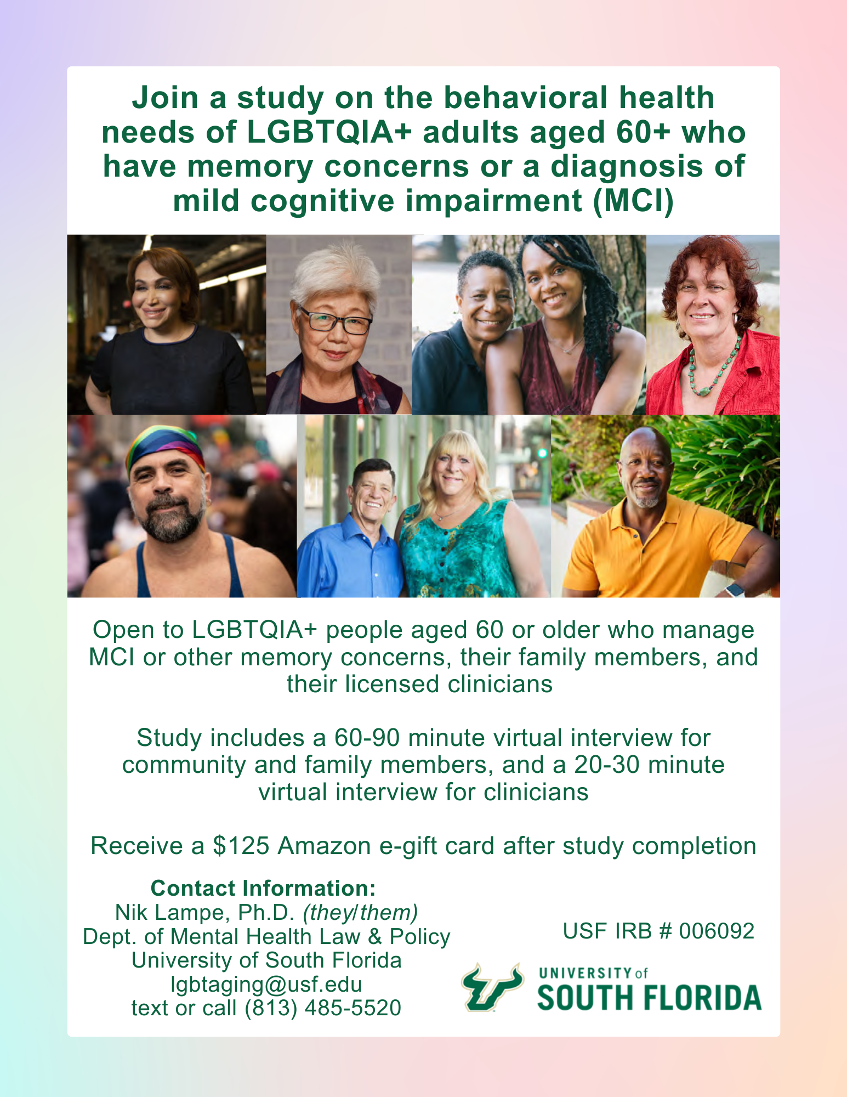

Slide 21
Thank you for your engagement!
Nik M. Lampe, Ph.D. (they/them)
Department of Mental Health Law & Policy
College of Behavioral and Community Sciences
University of South Florida
nlampe@usf.edu

