Slide 1
End of life psychedelic care
Christine Caldwell
February 14, 2024

Slide 2
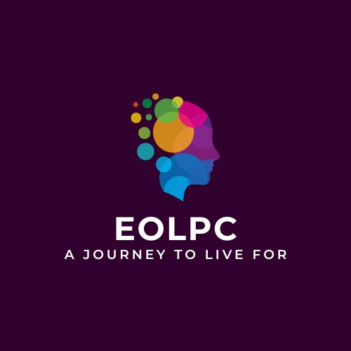
Christine Caldwell
Founder/Executive Director, End of Life Psychedelic Care
Graduate, 12-month Psychedelics Today Vital Therapies and Integration Program
Owner, 250-client home health care agency in Sarasota and sold it to Empath/Tidewell

Slide 3
agenda
The Psychedelics
The Research
Health considerations
Stories

Slide 4

The psychedelics
Psilocybin
MDMA
Ketamine

Slide 5
Psychedelics: A Novel Treatment Model
  Active Coping vs Passive Coping
  Transdiagnostic mechanism of action treatment approach
  Neuroplasticity: enhanced learning and opening of critical periods
  Mystical Experiences
  Social and Nature Connectedness
  Benefit dependent on mindset and the “setting”
  Integration is a key part of the therapeutic benefit
Notes:
Passive Coping/Psychic Rigidity: Decreased Limbic Responsivity, Emotional Blunting, Resilience, Patience, and Tolerance of Stress Increased
Active Coping/Psychic Flexibility: Cortical Entropy, Adaptability and Change, Environmental Sensitivity, Plasticity, Learning and Unlearning
Transdiagnostic: You don’t prescribe psychotropics to treat a DSM-V diagnosis
Critical Period: Research has shown psychedelics to open up the social reward critical period. Duration of reopening proportional to the acute subjective effects of the psychedelic
Gita Vaid, MD, and Barry Walker, MEd. https://12140291745743494666.googlegroups.com/attach/50964fb84aa4b/Vaid%20-%20Psychedelics%20-%20Connection.pdf?part=0.1&view=1&vt=ANaJVrGYZWfQflVEf30Ar8qsse0Lo9Yu3luu12cqI22WjomBV35U3AtIpgKoB1VBmjenaVtdC3cMZFMyT9bUOnBJJYY_naw0ih69l2JtCXLcyt0-m2AAdXY

Slide 6
Potential Benefits
  Ease anxiety and depression
  Reduce chronic pain
  Reduce fear of dying
  Learn to live in the present moment
  Bring purpose and meaning to life
  Experience a oneness with the universe and humanity
  Bring a sense of awe and wonder to “the next place”
Notes:
Almost like a “Maslow's Hierarchy”, although not linear, patients’s intention can be anywhere on the list.

Slide 7
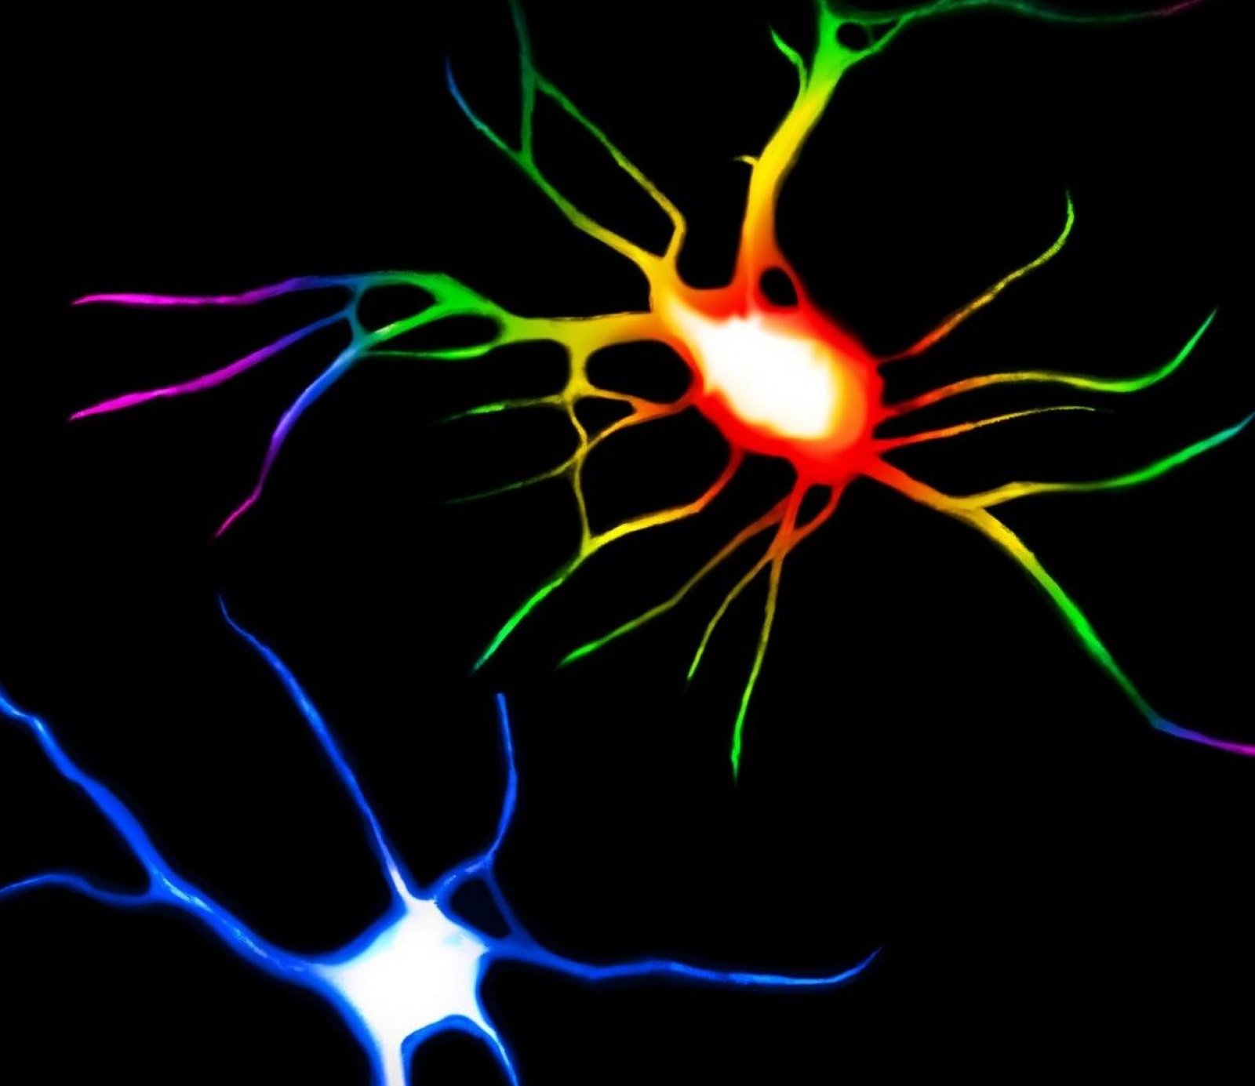
Key Similarities
Creates altered states of consciousness
Reduces anxiety, depression, PTSD, and more
Involves memory/learning regions of the brain
Increases neuroplasticity
Opens Critical Social Reward Period

Slide 8
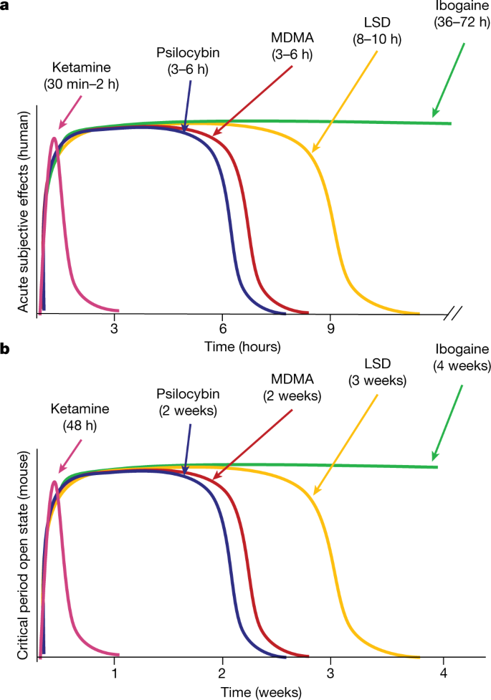
Acute Subjective Effects & Open Critical Period
    Ketamine: SE=30min-2hrs /CPO=48 hrs
    Psilocybin and MDMA: SE=3-6hours/ CPO=2 weeks
    LSD: SE=8-10hrs/CPO=3wks
    Ibogaine: SE=36-72hrs /CPO=4 weeks
https://www.nature.com/articles/s41586-023-06204-3
Notes:
June 14, 2023. https://www.nature.com/articles/s41586-023-06204-3

Slide 9
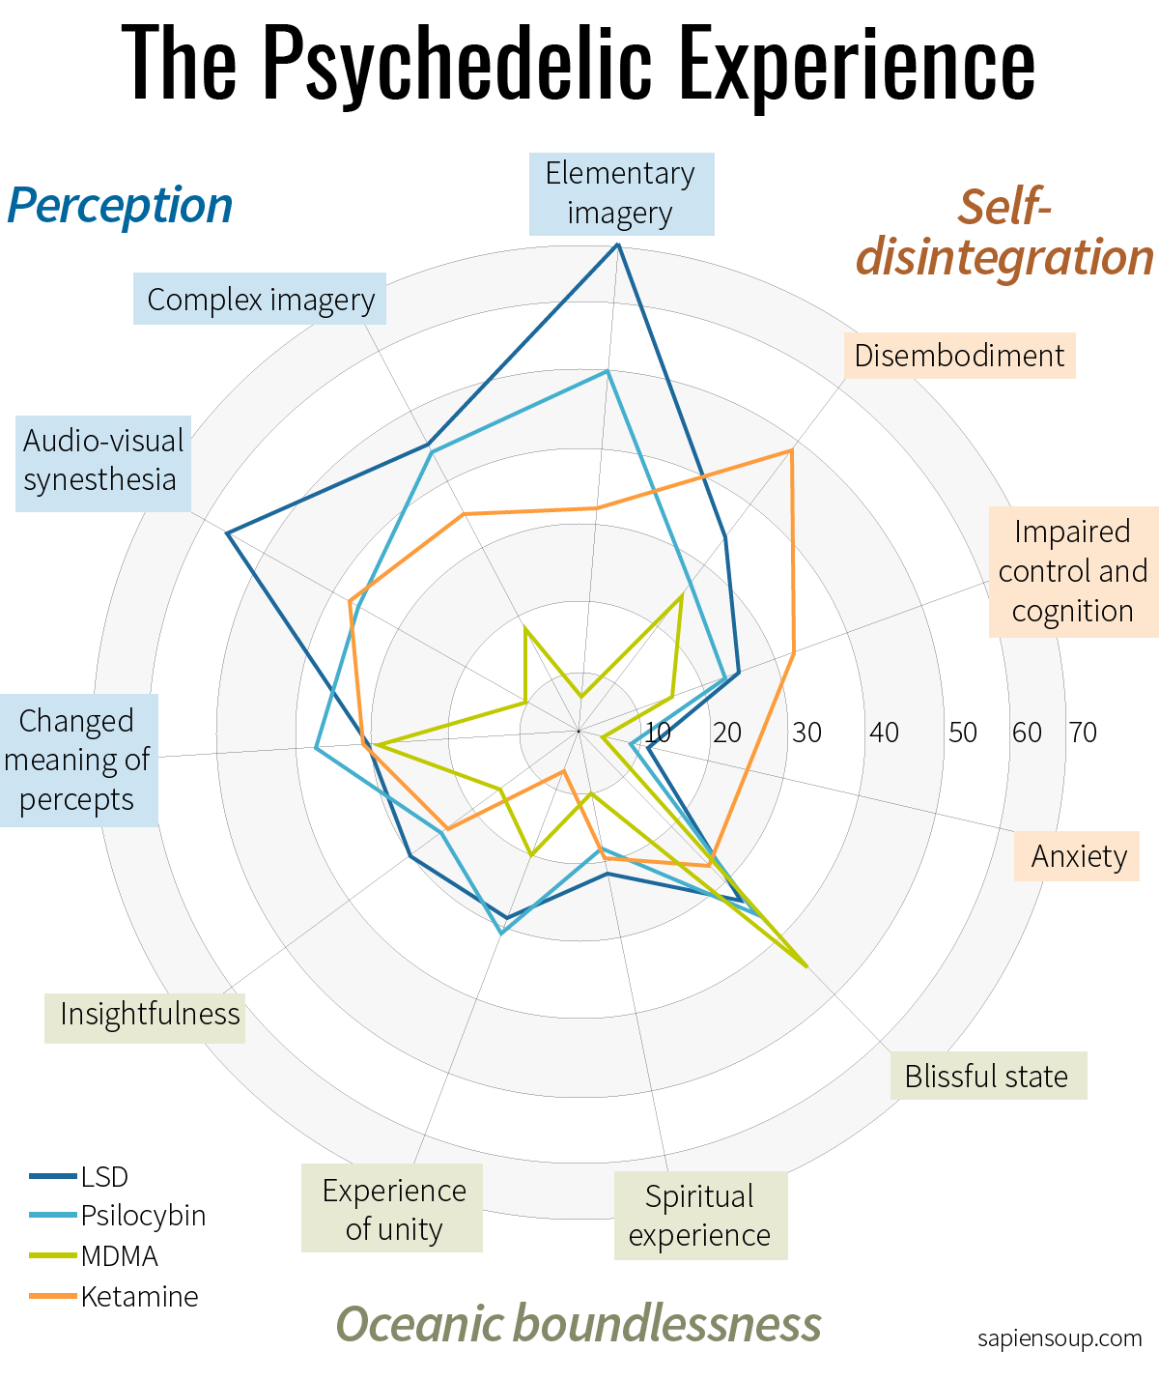
Differences: Altered States of Consciousness

Slide 10


psilocybin

Slide 11
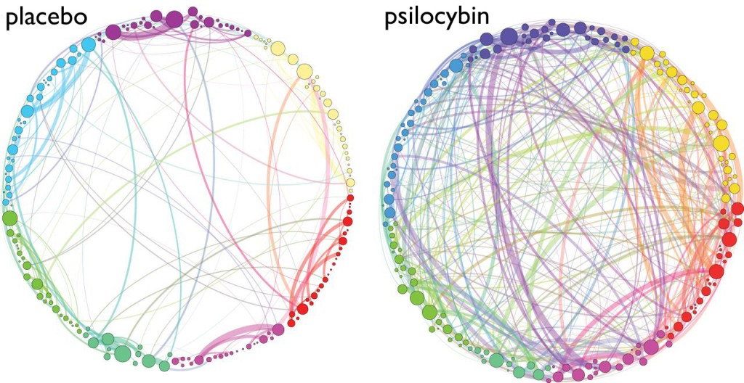
Global connectivity
https://royalsocietypublishing.org/doi/full/10.1098/rsif.2014.0873

Slide 12
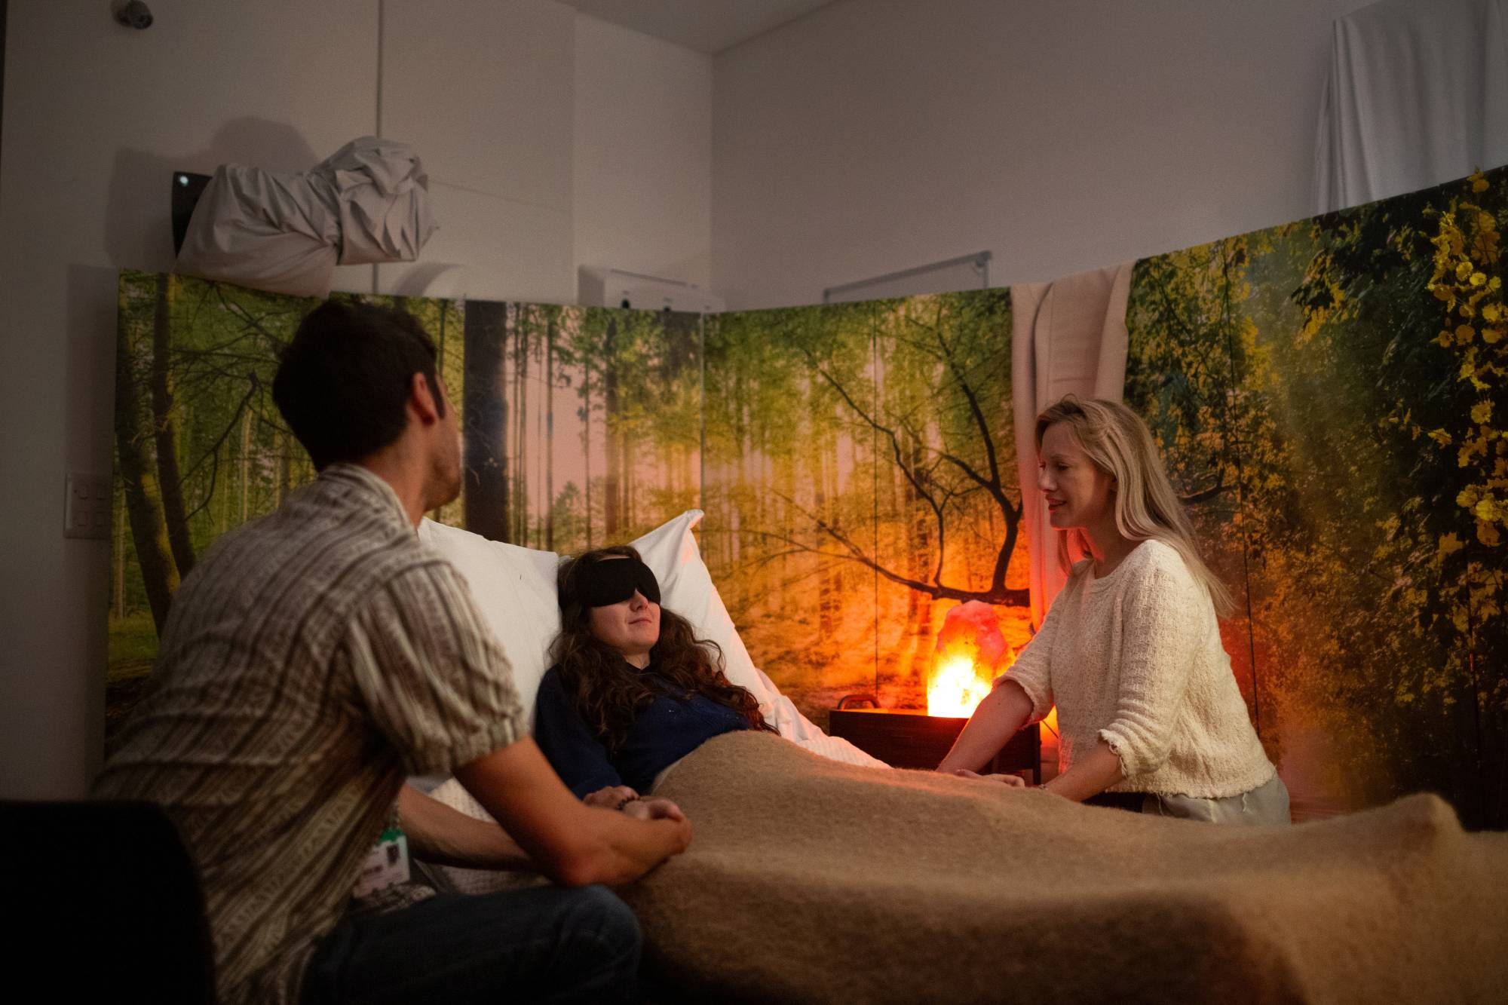
Some Key Differences: Psilocybin
  Classic Psychedelic, Serotonergic System
  Quiets the Default Mode Network
  Considered one of the gentlest on the body
  Higher potential for Mystical Experience
  Can bring issues “front and center”
  4-6 hours Journey Duration
  No known lethal dose, non-addictive
Imperial College of London/Reuters
Notes:
THE DMN: ACTIVE WHEN THINKING ABOUT SELF, WORRYING ABOUT THE PAST OR FUTURE, EXPERIENCING LOOPING THOUGHTS, OVERACTIVE IN PEOPLE WITH DEPRESSION, ANXIETY, OCD
NOT ONLY DO PSYCHEDELICS QUIET THE DMN AND THE NEGATIVE, LOOPING THOUGHTS, BUT IT ALSO HELPS TO RESET IT TO A MORE HEALTHYY CONFIGURATION.
TrkB, the receptor for BDNF, Brain Derived Neurotropic Factor, is primarily responsible for neuroplasticity. Psilocybin has a 1,000 fold increase in affinities on TrkB (tyrosine protein kinase gene)
THE DMN INCLUDES THE PREFRONTAL CORTEX, WHOSE ROLE IS IN ATTENTION, INHIBITORY CONTROL, HABIT FORMATION AND WORKING, SPATIAL OR LONG-TERM MEMORY. DMN ALSO INCLUDES THE POSTERIOR CINGULATE CORTEX, A MAJOR CONNECTOR WITHIN THE BRAIN AND THE ANGULAR GYRUS IS A HUB OF SEVERAL NETWORKS THAT ARE INVOLVED IN VARIOUS FUNCTIONS, INCLUDING ATTENTION, SELF-PROCESSING, SEMANTIC INFORMATION PROCESSING, EMOTION REGULATION, AND UNDERSTANDING/INTERPRETING ONE’S BEHAVIOR AND THAT OF OTHERS.

Slide 13
Psilocybin
https://old-prod.asco.org/sites/new-www.asco.org/files/content-files/Sunstone_Therapies_virtual_press.pdf
https://www.ncbi.nlm.nih.gov/pmc/articles/PMC5367557/.
https://journals.sagepub.com/doi/10.1177/0269881116675512
Notes:
Reporting sig reduction, Anx 83%, Dep 78% JHU Study: https://www.ncbi.nlm.nih.gov/pmc/articles/PMC5367557/..
Reporting sig reduction, Anx 58%, Dep 83% NYU Study: https://journals.sagepub.com/doi/10.1177/0269881116675512
Reporting sig reduction, Dep only: 80% and primary endpoint and 67% at 18 mos, plus 57% reporting remission after 18 mos. Sunstone Therapies study: https://www.globenewswire.com/news-release/2023/04/13/2646467/0/en/Sunstone-Therapies-Announces-Publication-of-Positive-Data-on-Use-of-Psilocybin-Therapy-for-Patients-with-Cancer-and-Major-Depression-Disorder-in-JAMA-Oncology.html
Huntsman study, n=12, 50% in remission, 11/12 clinically substantial reduction in depression (HAM-17) at 2 week timepoint and clinically substantial reduction at 26 weeks, HAM-17 mean scoreshttps://old-prod.asco.org/sites/new-www.asco.org/files/content-files/Sunstone_Therapies_virtual_press.pdf

Slide 14
Psilocybin Studies*
  MDAnderson: Depression in Gynecological Cancer Patients
  Sunstone Therapies: Major Depression
  Dana-Farber/CareDimensions Hospice: Demoralization
  UCLA and UCSF: Demoralization with Ketamine as Active Control
  Johns Hopkins: Depression in MCI/Early Alzheimer’s Patients
  University of Colorado/NYU: Existential Distress
  University of Washington: Anxiety
  Emory University: Demoralization and Chronic Pain
  Diamond Therapeutics/University of Alabama: Microdosing
*clinicaltrials.gov
Notes:
Emory University, demoralization and chronic pain in cancer patients and Diamond Therapeutics/Univ Alabama-Birmingham microdosing
Go to clinicaltrials.gov
MDAnderson, Dr. Moran Amit and Dr. Lorenzo Cohen, Palliative care dept, Dir Integrative Care Medicine.
Funding: MDAnderson and Gateway for Cancer Research
https://www.healio.com/news/hematology-oncology/20230817/experts-urge-study-of-psilocybin-other-psychedelics-for-cancerrelated-distress?utm_medium=email&_hsmi=75353733&_hsenc=p2ANqtz-96RuIATOlOrA8ZEKDYqBPnP26N1-rGOHKwnN7sOQRI6bB77pN8qQxBOkQoJn8CCsrbTkR8qHAly3Zqs03Eu3E--7CGi3evNaO7pjKyJ4a1-g868oI&utm_content=75353733&utm_source=hs_email

Slide 15
MDMA

Slide 16
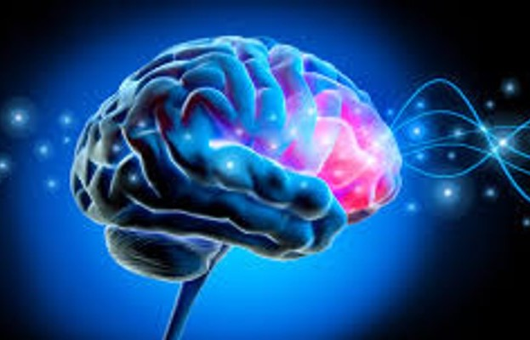
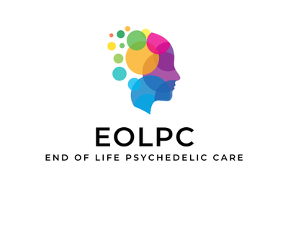
Some Key Differences: MDMA
  Empathogenic, works on Serotonergic, Dopaminergic, Norepinephrinergic
  Increases activity in Prefrontal Cortex, decreases activity in Amygdala
  Mystical Experiences are rare
  6-8 hours Journey Duration
  Risk of Serotonin Toxicity at very high doses
Notes:
MA = Methamphetamine
INCREASES LEVELS OF OXYTOCIN: HEART OPENER, BONDING, INCREASES COMMUNICATION
REVERSES TRANSPORTER IN PRE-SYNAPTIC NEURON, FLOODING SYNAPSE WITH THE MONOAMINES
Methyl​ene dioxy​ methamphetamine
BEN MALCOLM RESEARCH: https://www.ncbi.nlm.nih.gov/pmc/articles/PMC9177763/

Slide 17
MDMA Dyad Study: Sunstone Therapies
“I realize MDMA has just allowed me to rewrite the script of a major traumatic life experience. Death suddenly loses its sting.”
“Keeping depression at bay and having a loving relationship will still require attention, but after MDMA, it no longer seems like work.” Kurt Nemes
clinicaltrials.gov
Notes:
One earlier study at UCSF, n=19, measured anxiety but did not see a significant reduction in anxiety.
https://www.huffpost.com/entry/mdma-therapy-treatment-marriage-cancer_n_6423337be4b049e21e2eafb9

Slide 18
ketamine

Slide 19

Some Key Differences: Ketamine
  Dissociative Anesthetic, Glutamatergic System
  NMDA Antagonist creating surge of Glutamate
  Binds to the TrkB receptor and can mimic BDNF
  Binds to the Mu Opioid Receptor
  Shown to effectively treat chronic pain
  Fast acting but short lasting
  Puts you into “Observer Mode”
  45-75 minutes Journey Duration
  Lethal in very high doses and potentially addictive
Notes:
Dissociation: Reduces Alpha (alert and calming) brain waves and increases Theta Waves (dream-like state)
Study using Naltrexone to block Mu Opioid Receptor, there were no antidepressant effects
DICK SCWARTZ: IFS – KETAMINE ALLOWS FOR THE SOFTENING OF THE PROTECTOR PARTS
NMDA N-methyl-D-aspartate
BINDS TO INHIBITORY NEURONS ON THE NMDA RECEPTOR WHICH IS WHY IT RELEASES A SURGE OF GLUTAMATE
FAST ACTING: ADDS VOLUME TO EXISTING DENDRITIC SPINES, WELL-SUITED TO REDUCING SUICIDAL IDEATION WITHIN 24,STUDY SHOWED SIG REDUCTIONS IN ANXIETY <12, THEN AT 24 AND AT 1-2 WEEKS.
SHORT LASTING: KNOWN THAT CASCADING PATHWAY TO INCREASING BDNF IS DIFFERENT IN KETAMINE THAN PSILOCYBIN.
KETAMINE BINDS TO THE TrkB RECEPTOR AND CAN MIMIC BDNF
CAN RETURN PATIENTS TO BASELINE WITHIN ONE WEEK, SOMETIMES TWO. STANDARD PROTOCOL IS TO ADMINISTER 6 LOADING DOSES, TITRATING DOSE TO FIND PATIENT’S THERAPEUTIC EFFICACY.

Slide 20

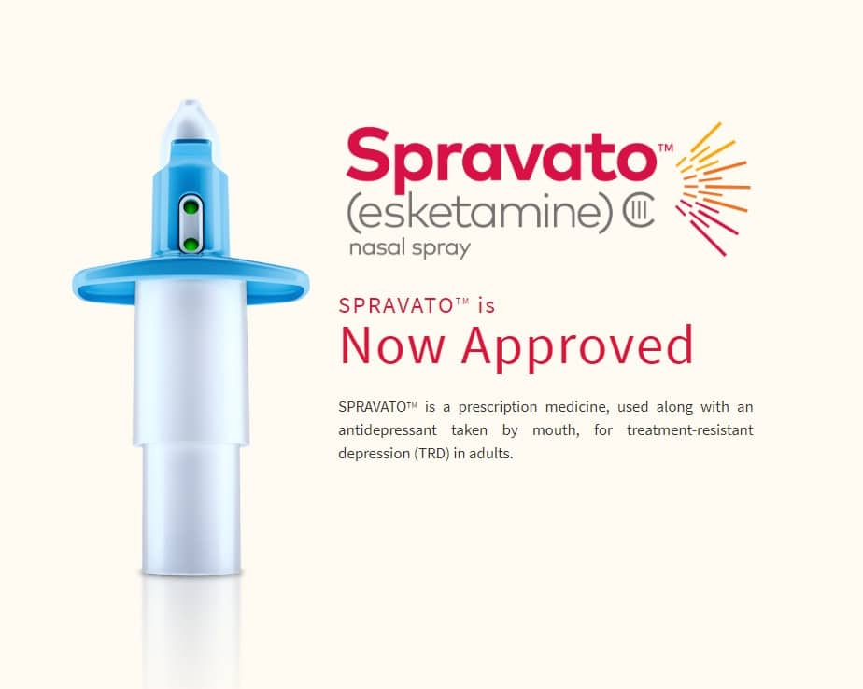
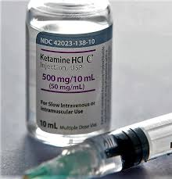
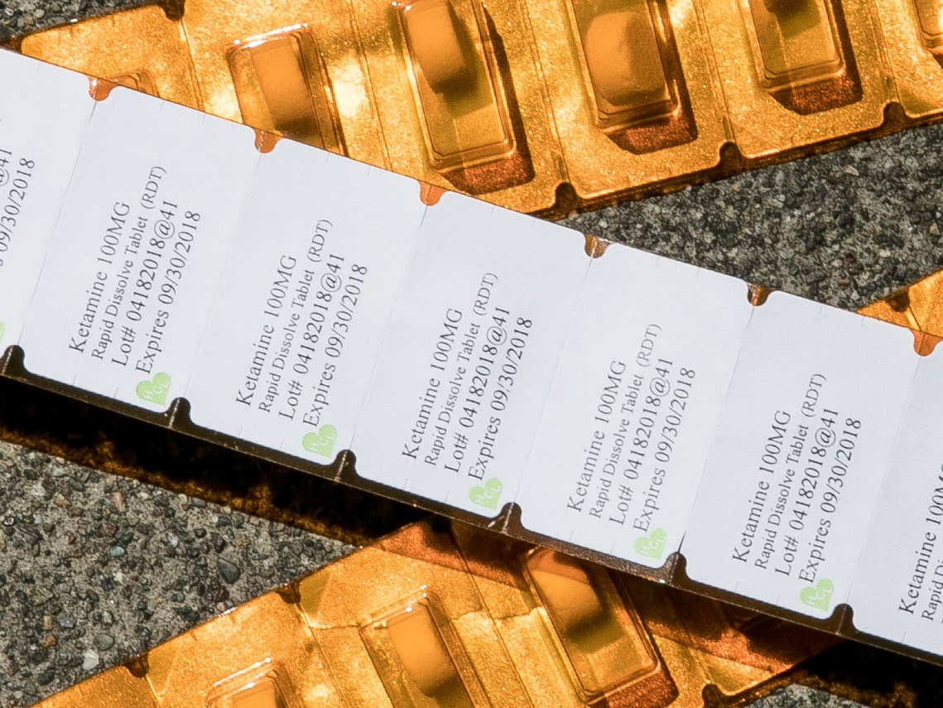
Major Routes of Administration
IV (100%): In-clinic
  Typically start at .5mg/kg and titrate
Injection (93%): In-clinic/At-home
  Typically delivered in two doses
Nasal Spray (<50%): In-clinic/At-home
  Spravato: FDA approved - can be reimbursed
  Compounded Nasal Spray for at-home use
Lozenge/Troche (<30%): At-home
  Can be used rectally, bypasses liver
  At-home to extend duration of pain and mental health relief
Notes:
NEED FOR LOADING DOSES.
FOR DEMENTIA PATIENTS, DR. WEINER PRESCRIBES A LOW DOSE, 55-70MG LOZENGE EVERY THIRD DAY AND FOR CANCER PATIENTS, 200MG EVERY DAY.
CHRONIC PAIN: COMPLEX REGIONAL PAIN SYNDROME, FIBROMYALGIA, NEUROPATHY, TRIGEMINAL NEURALGIA, MIGRAINES
In complex regional pain syndrome and other chronic pain, central sensitization intensifies pain by increasing the number of NMDA receptors which amplifies pain. Ket blocks NMDA receptors of peripheral nerves and the pain transmission is intercepted before reaching the spinal cord and brain.

Slide 21
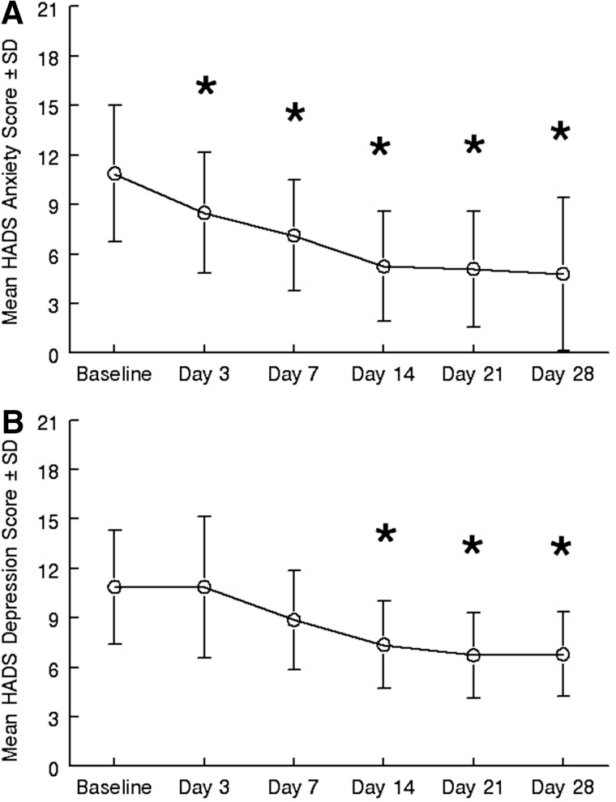
Ketamine Research in Hospice Patients
% Sig Reduction in Depression
% in Remission
75
50
25
0
University of Toronto
https://pubmed.ncbi.nlm.nih.gov/36672348/
https://pubmed.ncbi.nlm.nih.gov/23805864/
Notes:
ON THE LEFT: 70% REDUCTION IN ANXIETY AND 40% IN REMISSION, UNIVERSITY OF TORONTO STUDY
ON THE RIGHT: SIGNIFICANT REDUCTION IN ANXIETY AND DEPRESSION SCORES, INST FOR PALLIATIVE MEDICINE AT SAN DIEGO HOSPICE
University of Toronto Study: https://pubmed.ncbi.nlm.nih.gov/36672348/
https://pubmed.ncbi.nlm.nih.gov/23805864/

Slide 22
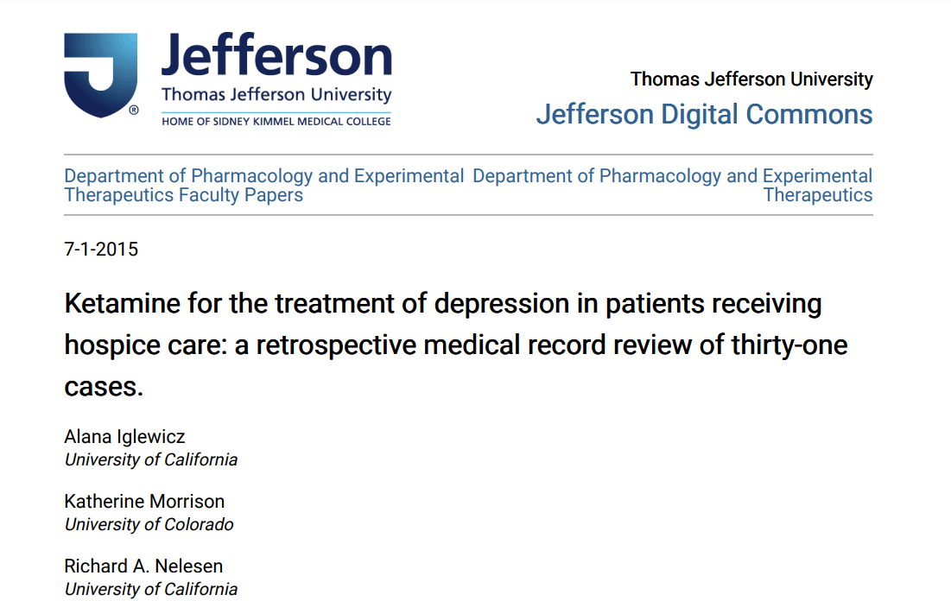
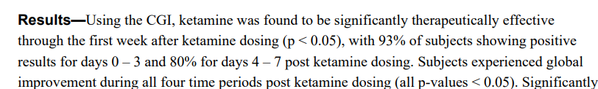
Ketamine Therapy in Hospice Patients
https://jdc.jefferson.edu/cgi/viewcontent.cgi?article=1069&context=petfp
Notes:
ON THE LEFT: 70% REDUCTION IN ANXIETY AND 40% IN REMISSION, UNIVERSITY OF TORONTO STUDY
ON THE RIGHT: SIGNIFICANT REDUCTION IN ANXIETY AND DEPRESSION SCORES, INST FOR PALLIATIVE MEDICINE AT SAN DIEGO HOSPICE
University of Toronto Study: https://pubmed.ncbi.nlm.nih.gov/36672348/
https://pubmed.ncbi.nlm.nih.gov/23805864/

Slide 23
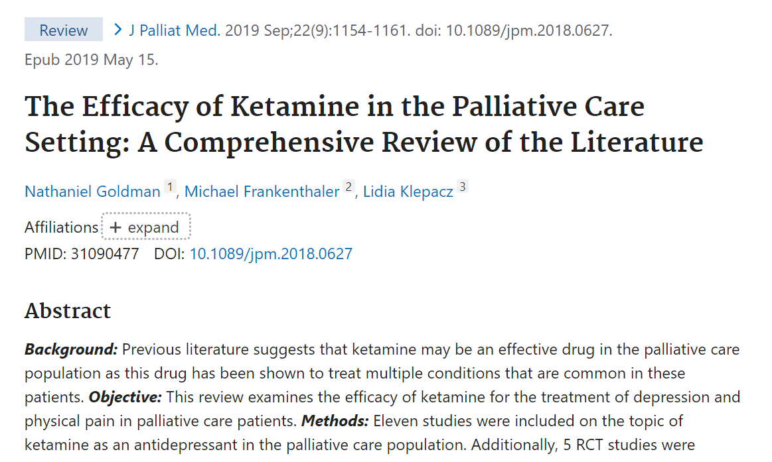
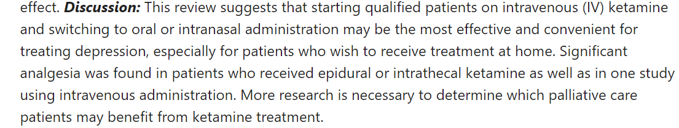
Ketamine Therapy in Palliative Care
https://pubmed.ncbi.nlm.nih.gov/31090477/
Notes:
ON THE LEFT: 70% REDUCTION IN ANXIETY AND 40% IN REMISSION, UNIVERSITY OF TORONTO STUDY
ON THE RIGHT: SIGNIFICANT REDUCTION IN ANXIETY AND DEPRESSION SCORES, INST FOR PALLIATIVE MEDICINE AT SAN DIEGO HOSPICE
University of Toronto Study: https://pubmed.ncbi.nlm.nih.gov/36672348/
https://pubmed.ncbi.nlm.nih.gov/23805864/

Slide 24
Ketamine Studies*
  PharmaTher: Reduce Dyskinesia in Parkinson’s patients
  Cedars Sinai LA: Reduce Anxiety in Pancreatic Cancer Patients
  Yale University/Michael J. Fox Foundation: Depression in Parkinson’s patients
  Vanderbilt Ingram Cancer Center: Reduce Acute/Chronic Pain in Patients w/Advanced Head & Neck Cancer
*clinicaltrials.gov

Slide 25
Proposed At-home ketamine pilot for palliative/hospice patients
5-6 patient pilot in California
Two palliative care physicians and one ketamine prescriber
End of Life Doula support
Up to 3 IM ketamine sessions with follow up integration
Report to be prepared and disseminated

Slide 26
Contraindications
Uncontrolled Hypertension, Severe Heart Disease, Severe Asthma
Patients undergoing chemotherapy: Psychedelic therapy reviewed on a case-by-case basis and may be scheduled around it
Schizophrenia, Bipolar Disorder, Borderline Personality Disorder*
Ketamine
  Severe liver and bladder disorders, intracranial pressure
  *Potential research in these topics

Slide 27
Drug Interactions
Psilocybin
  SSRI/SNRIs blunt subjective effects
  Lithium: Significantly higher risk for seizures
  Benzodiazepines can stop the “trip”
Ketamine
  Lithium and SSRIs can enhance effectiveness
  Lamotrigine and Benzos can reduce effectiveness
  St. Johns Wort can reduce effectiveness
MDMA
  SSRIs/SNRIS can greatly reduce effectiveness
  Wellbutrin can greatly increase effects
  MAOIs: Biggest risk for Serotonin Toxicity
Notes:
BENZOS: XANAX, KLONAPIN, ATIVAN, HALCION, VALIUM
SSRIs reduce subjective effects but not antidepressant effects
Imperial College of London Study https://journals.sagepub.com/doi/10.1177/02698811231224217?utm_source=newsletter&utm_medium=email&utm_campaign=psychedelics_and_antidepressants_interaction_lsds_impact_on_brain_entropy_psychedelics_insight_into_near_death_experiences_chacrunas_psychedelic_culture_conference_imperial_colleges_couples_psychedelics_study_eu_funds_psychedelic_research&utm_term=2024-02-10
WELLBUTRIN/BUPROPION and MDMA: DNRI INCREASED SUBJECTIVE EFFECTS AND HEIGHTENED MOOD EFFECTS. BUT, THE COMBO LED TO INCREASED RISK FOR SEIZURES EVEN DEATH IN COMBINED HIGH DOSES
AYAHUASCA CONTAINS DMT AND MAOI IN THE VINE
BEN MALCOLM, SPIRITPHARMACIST.COM, https://www.ncbi.nlm.nih.gov/pmc/articles/PMC9177763/

Slide 28
real life stories

Slide 29
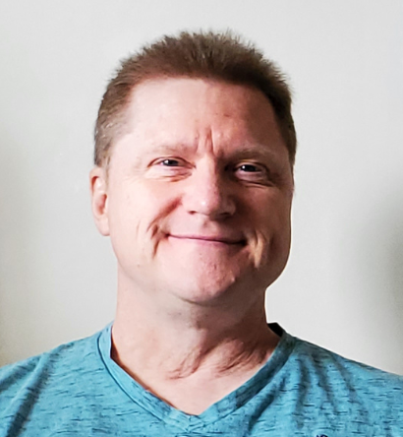
PSILOCYBIN: Thomas
  Diagnosed with Stage 4 Colon Cancer in 2016
  Prognosis: 18 months
  Approved for psilocybin therapy through Health Canada
  86 rounds of chemotherapy
  7 psilocybin journeys to-date

Slide 30

KETAMINE
  Patty
  VSED Patient
  New Zealand Patient
  ALS Patient

Slide 31
At-home ketamine case study: Als patient
53 year old ALS patient, non-ambulatory, max transfer assist
He and his son understood the risk of dying and both consented
First session: pretreated with Albuterol and Ondansetron
  Dosing: .7mg/kg and 10mg booster at 20 minutes
  Visualized himself running and playing with his children and was filled with contentment
Second session one week later
  Dosing: .8mg/kg and 15 mg booster at 15 minutes
  Stated “It’s like Soul Roulette”
  With great effort he brought his hands together in prayer posture in gratitude
The night before his third session, he passed peacefully in his sleep
Notes:
Earth Angel, Charles Gibbs

Slide 32
End of life psychedelic care
Education
  Free Webinars
  February 27: End of Life Doula Training
  March 11: Ketamine Therapy for End of Life Care
Resources
  Google Group, Palliative Care Psychedelic Therapy: https://groups.google.com/g/PalCarePsychedelicTherapy
eolpc.org
christine@eolpc.org

