Slide 1
Wound Care at End of Life
Dania Ballich
Hospice & Palliative Medicine
University of South Florida

Slide 2
Introduction
Wounds often develop during a severe or terminal illness, either as a direct result of the underlying disease or because the limitations of the disease make it hard to avoid sores and abrasions.
Unlike traditional wound care, the goals of palliative wound care are to prevent complications of the wound, such as infection, odor, additional breakdown of the skin, and to minimize the harmful effects of the wound on the patient’s overall condition
The first step in determining a successful wound plan of care involves establishing the patient’s prognosis, condition and potential for wound healing. A basic wound care plan will incorporate the elements below:
Cleansing debris from the wound
Possible debridement
Absorbing excess exudate
Promoting healing
Treating infection
Minimizing discomfort
Notes:
https://www.vitas.com/for-healthcare-professionals/making-the-rounds/2018/october/wound-care-in-hospice-settings

Slide 3
The Physiological Process of Wound Healing
Notes:
Hemastasis: When blood vessels get injured, it start to contract and forms a blood clot. Platelets which are the main contributors in this process, get activated and form platelet plug followed by fibrin matrix
Inflammation: initiated by injury-induced signals; damage-associated molecular patterns (DAMPs) released by necrotic cells and damaged tissue, and pathogen-associated molecular patterns (PAMPs) from bacterial components. Pro-inflammatory cytokines are released which attract neutrophils to the site, important to remove debris. Beside neutrophils, monocytes and macrophages also get signaled to the site to help remove necrotic tissues.
Proliferation: extensive activation of keratinocytes, fibroblasts, macrophages and endothelial cells to orchestrate wound closure, matrix deposition and angiogenesis. These fully reform the basement membrane and undergo terminal differentiation, to stratify and regenerate the epidermis
Remodeling: Major cell responsible for remodeling are fibroblasts which help with the formation of collagen
https://royalsocietypublishing.org/doi/10.1098/rsob.200223

Slide 5
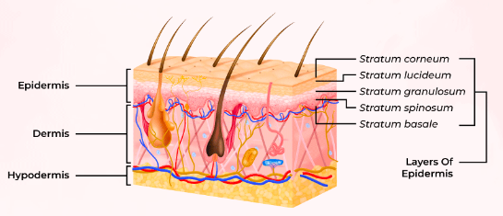
Types of Wound at End of Life
Pressure Injury/Pressure Ulcers
Diabetic Ulcers
Vascular Ulcers
Malignant Tumor Ulcers
Post Chemotherapy Ulcers
Notes:
https://www.threeoakshospice.com/blog/types-of-palliative-wound-care/

Slide 6
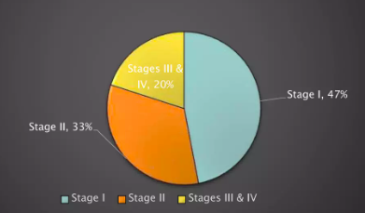
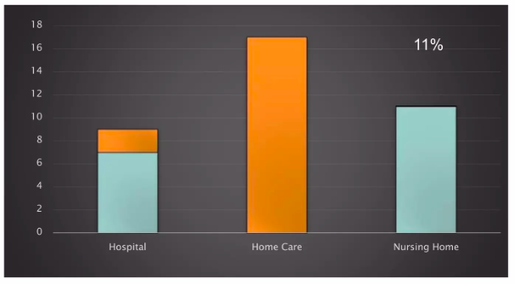
Incidence of Pressure Injury
Incidence varies by settings and stages
According to NPUAP (National Pressure Injury Advisory Panel) -->
Most common anatomical site are Sacrococcygeal Regien and Heels

Slide 7
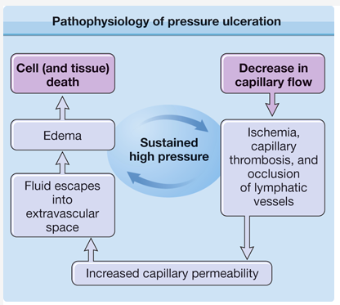
Mechanism of Development of Pressure Injury
Interface Pressure
Shear and Friction
Excessive Moisture
Notes:
Shear force when patient is sliding down the bed
Friction is when the patient dragged across a surface
https://plasticsurgerykey.com/decubitus-pressure-ulcers/

Slide 8
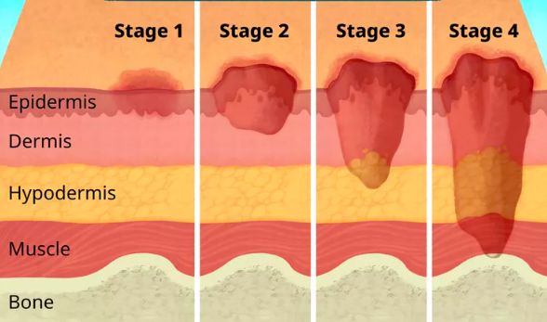
Pressure Injury Classification System
The most used option is US-NPUAP, which has 4 main grades
Stage I: Non Blanchable Erythema of Intact Skin
Stage II: Partial Thickness Skin Loss with Exposed Dermis
Stage III: Full Thickness Skin Loss
Stage IV: Full Thickness Skin and Tissue Loss
Unstageable
Notes:
https://www.vitas.com/for-healthcare-professionals/making-the-rounds/2018/october/wound-care-in-hospice-settings

Slide 9
Stage I
The skin is intact with non-blanchable redness of a localized area.
Darkly pigmented skin may not have visible blanching, but its color may differ from the surrounding area.
The area may be painful, firm, soft, warmer or cooler as compared to adjacent tissue

Slide 10
Stage II
Partial-thickness loss of dermis presenting as a shiny or dry shallow open ulcer with a pink wound bed, without slough or bruising.
It may also present as an intact or ruptured serum-filled blister.
Stage II does not describe skin tears, tape burns, perineal dermatitis, maceration or excoriation.

Slide 11
Stage III
Full-thickness tissue loss.
Subcutaneous fat may be visible, but bone, tendon or muscle is not exposed.
Slough may be present but does not obscure the depth of the tissue loss.
There may be undermining and tunneling. The depth of a stage-III pressure ulcer varies by anatomical location.

Slide 12
Stage IV
Full-thickness tissue loss with exposed bone, tendon or muscle.
Slough or eschar may be present on some parts of the wound bed.
This wound often includes undermining and tunneling.
The depth of a stage-IV pressure ulcer varies by location.
Stage-IV ulcers can extend into muscle and/or supporting structures, making osteomyelitis possible

Slide 13
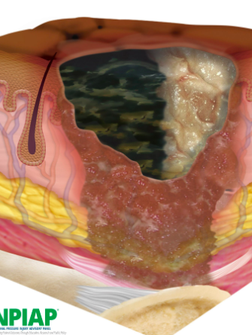
Unstageable
Full-thickness tissue loss in which the base of the ulcer is covered by slough (yellow, tan, gray, green or brown) and/or eschar (tan, brown or black) in the wound bed. Un
Till enough slough and/or eschar is removed to expose the base of the wound, the true depth, and therefore stage, cannot be determined.

Slide 14
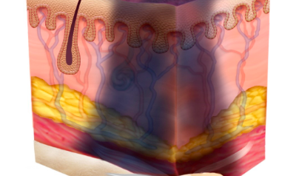
Deep Tissue Injury
A purple or maroon localized area of discolored intact skin, or a blood-filled blister due to damage of the underlying soft tissue from pressure and/or shear.
The area may be preceded by tissue that is painful, firm, mushy, boggy, warmer or cooler as compared to adjacent tissue.

Slide 15
Pressure Ulcer Assessment Scale

Slide 16
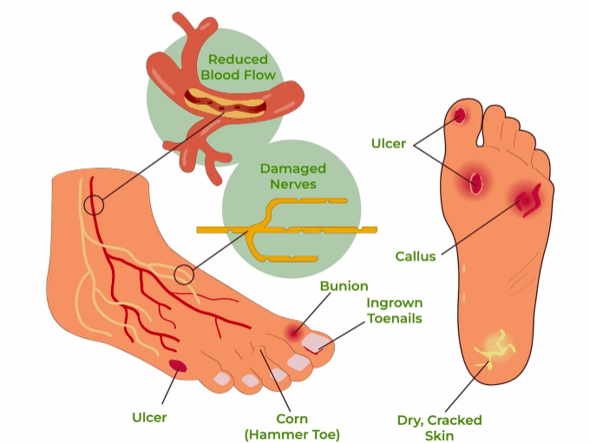
Diabetic Ulcers
Diabetic ulcerations occur due to:
mechanical changes in conformation of the bony architecture of the foot. Nonenzymatic glycosylation predisposes ligaments to stiffness.
Neuropathy causes loss of protective sensation and loss of coordination of muscle groups in the foot and leg, both of which increase mechanical stresses during ambulation.
Patients with diabetes mellitus also develop severe atherosclerosis of the small blood vessels in the legs and feet, leading to vascular compromise, which is another cause for diabetic foot infections. Because blood is not able to reach the wound, healing is delayed, eventually leading to necrosis and gangrene.
Notes:
https://viasox.com/blogs/viasox-blog/diabetic-foot-ulcers
https://www.ncbi.nlm.nih.gov/books/NBK537328/
The development of diabetic ulcer is multifactorial (The common underlying causes are poor glycemic control, calluses, foot deformities, improper foot care, ill-fitting footwear, underlying peripheral neuropathy and poor circulation, dry skin)
The development of a diabetic ulcer is usually in 3 stages. The initial stage is the development of a callus. The callus results from neuropathy. The motor neuropathy causes physical deformity of the foot, and sensory neuropathy causes sensory loss which leads to ongoing trauma. Drying of the skin because of autonomic neuropathy is also another contributing factor. Finally, frequent trauma of the callus results in subcutaneous hemorrhage and eventually, it erodes and becomes an ulcer.
Patients with diabetes mellitus also develop severe atherosclerosis of the small blood vessels in the legs and feet, leading to vascular compromise, which is another cause for diabetic foot infections. Because blood is not able to reach the wound, healing is delayed, eventually leading to necrosis and gangrene.

Slide 17
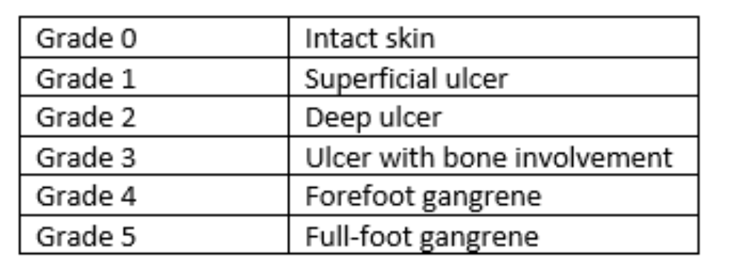
Wagner Classification System
Notes:
https://ecampusontario.pressbooks.pub/casestudieshealthsciences/chapter/jacks-health-diabetic-foot-ulcers/
https://www.woundsource.com/blog/understanding-diabetic-foot-ulcer-classification-systems

Slide 18
Vascular Ulcers
Arterial ulceration can be caused by either progressive atherosclerosis or arterial embolization. Both lead to ischemia of the skin and ulceration.
Venous ulceration is initiated by venous hypertension that develops because of inadequate calf muscle pump action and after the onset of either primary or secondary valvular incompetence.
Two hypotheses have been proposed to explain venous ulceration once venous hypertension develops.
Distention of the capillary beds occurs because of increased stasis. This leads to leakage of fibrinogen into the surrounding dermis. Over time, a fibrinous pericapillary cuff is formed, impeding the delivery of oxygen and other nutrients or growth factors to the affected tissue. The resulting hypoxic injury leads to fibrosis and then ulceration.
The endothelium is damaged by increased venous pressure and leukocyte activation. Proteolytic enzymes and free radicals are released, escape through the leaky vessel walls, and damage the surrounding tissue, leading to injury and ulceration.
The great majority of vascular ulcers are chronic or recurrent​
Notes:
Two hypothesis for the venous stasis = venous ulcers
https://emedicine.medscape.com/article/1298345-overview?form=fpf#a7
They cause a considerable amount of morbidity among patients with peripheral vascular disease including work incapacity. The care of chronic vascular ulcers pla

Slide 19
Arterial Ulcer
Arterial ulcers are often located distally and on the dorsum of the foot or toes.
Initially they have irregular edges, but they may progress to have a better-defined appearance.
The ulcer base contains grayish, unhealthy-appearing granulation tissue.
With manipulation, such as debriding, these ulcers bleed very little or not at all.
The patient may report characteristic pain, especially at night when supine, which is relieved by dependency of the extremity.
Upon examination, characteristic findings of chronic ischemia, such as hairlessness, pale skin, and absent pulses, are noted.

Slide 20
Venous Ulcer
Venous ulceration is located circumferentially around the lower leg from approximately mid-calf to just below the medial and lateral malleoli.
Larger but shallower than other ulcers, stasis ulcers have a moist granulating base and an irregular border.
This base oozes venous blood when manipulated.
The tissue surrounding these ulcers may exhibit signs of stasis dermatitis.
Patients often report mild pain that is relieved by elevation.

Slide 21
Malignant Tumor Ulcers
Can be Primary (Area where the cancer started) or Secondary (Area where the cancer spread to)
It's seen in Skin malignancy (Basal Cell Carcinoma, Squamous Cell Carcinoma, Melanoma), Breast Cancer, Head and Neck Cancer, and Angiosarcoma
5–14% of advanced cancer patients are affected by malignant fungating wounds
Mechanism of Action: as the cancer grows, it blocks and damages tiny blood vessels. This can reduce the supply of oxygen to the area which causes the skin and the tissue underneath to die, which lead to ulcers.
Presentation often occurs in the last 6 month of life and includes symptoms of pain, odor, excessive drainage, compromised body image, and limited mobility
The aim of therapy is to alleviate as many of these symptoms as possible because many of these tumors cannot be surgically removed. The management goal is to promote patient quality of life and independence; care is usually palliative and the fungating tumor is not expected to heal.
Treatment: Dressing change are selected to help manage exudate and bleeding, hemostatic powder is helpful to control bleeding, antibacterial solutions may be used as cleansing agents to gently debride necrotic tissue and to help kill micro-organisms in the wound, and wound drainage pouches are often beneficial when dressings must be changed frequently when the skin shows signs of damage.
Notes:
https://www.macmillan.org.uk/cancer-information-and-support/impacts-of-cancer/ulcerating-cancer-wounds
https://www.hmpgloballearningnetwork.com/site/wmp/content/palliative-care-patients-external-malignant-tumors
https://www.frontiersin.org/articles/10.3389/fcimb.2019.00373/full

Slide 22
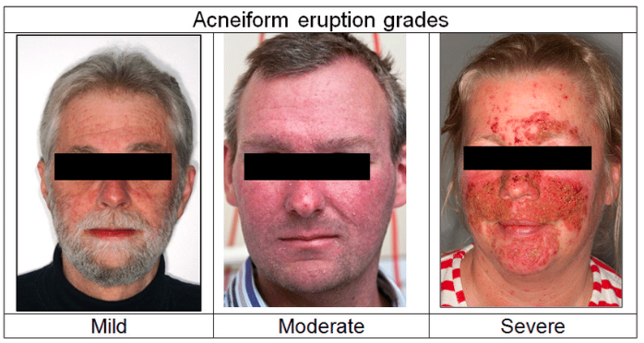
Post-Chemotherapy
Mucositis
Photosensitivity
Acneform Eruptions (Folliculitis)
Hyperpigmentation
Nail Changes
Alopecia
Vascular Injury
Most common chemotherapy drugs are :
Taxanes (Paclitaxel and Docetaxel)
Anthracyclines (Doxorubicin, Idarubicin, Epirubicin)
Notes:
https://dermnetnz.org/topics/skin-toxicity-of-chemotherapy-drugs
https://www.researchgate.net/figure/Grades-of-acneiform-eruption-according-to-CTCAE-30_fig1_313686470
Mucositis (inflammation of the mucosal lining in the mouth and GI) = prevent with daily oral care. Treat with topical agents like diphenydramine and oral antacids. In severe cases, PO or IV opioids might be needed
Photosensitivity = sunscreen and protective clothing
Acneform = begins with facial erythema followed by papules (small bumps) then pustules (pus) - just like true acne without bacteria = treat with oral tetracyclines like doxycycline + topical antibiotics due to their anti-inflammatory response and not anti-bacterial
Hyperpigmentation = in chemotherapy, most common drug Bleomycin, due to itching causing the drug to accumulate in a specific area = treat with anti-histamine
Nail changes improve after stopping agent. Can be painful and need pain killers
Vascular Injury = Vasculitis = STOP the agent and start Corticosteroids
Alopecia = no treatment found to be effective (headband to be worn during chemotherapy sessions to decrease amount of drugs reaching the site)
All improve with stopping the agent except vascular injury

Slide 23
Vascular toxic effects of cancer therapies include arterial and venous events and affect the systemic and pulmonary circulations.
Cancer therapy-related arterial toxicities can present as acute vasospasm, acute thrombosis and accelerated atherosclerosis.
Many clinical studies have implicated that several chemotherapies cause direct vascular injury, yet the mechanism and characteristics of this toxicity remains to be elucidated.
A journal was published in 2015 called "Chemotherapy-induced Vascular Toxicity - Real-time In vivo Imaging of Vessel Impairment". It looked at the effect of two chemotherapy agents (Doxorubicin and Paclitaxel) on blood vessels which represented a unique mechanism of vascular toxicity that may be the early event in end-organ injury.
Notes:
https://www.ncbi.nlm.nih.gov/pmc/articles/PMC4354501/#:~:text=Acute%20cardiovascular%20complications%20may%20occur,risk%20of%20late%20vascular%20morbidity.
A paper was published in 2015 – called Real-time In vivo Imaging of Vessel Impairment. The study looked at the affect of certain chemotherapy on blood vessels. Two chemotherapy agents were used (Doxorubicin and Paclitaxel on blood vessels in mices over a period of time). Agents were administrated in vivo
platform of in vivo, high-resolution molecular imaging in mice, suitable for visualizing vasculature within confined organs and reference blood vessels within the same individuals whereas each individual serve as its own control. Blood vessel walls were impaired after doxorubicin administration, representing a unique mechanism of vascular toxicity that may be the early event in end-organ injury

Slide 24
Management of Wounds at End of Life
Minimize trauma
1
Control odor
2
Manage excess exudates
3
Prevent deterioration and infection
4

Slide 25
Minimize Trauma
Granulation tissues are always friable and bleed easily
Reduced fibroblasts disrupt collagen matrix
Require peri-wound care with adhesive tape, skin barrier, spray, and gel

Slide 26
Control Odor
Occurs due to increase bacterial burden
Treatment consist of topical metronidazole, metronidazole soaks, and activated charcoal dressing

Slide 27
Exudates
Are the consequences of altered mesothelial and/or endothelial permeability results from a cytokine-mediated inflammatory response
Treatment with compression bandages, dressing, and surgery

