Slide 1
Suicide Risk and Management in Elderly: Considerations for Hospice/End of Life Settings
Stephanie Miller, Ph.D. – Tampa VA Suicide Prevention Lead
Maria Taylor, LCSW – Bay Pines VA Suicide Prevention Lead

Slide 2

Disclosures: None
Who am I?
~Stephanie Miller, Clinical Psychologist & Team Lead for the Tampa VA Suicide Prevention Program
~Not a SME for elderly/EOL, but have a lot of experience with working with older Veterans and am a SME in Suicide Risk Management & Prevention
Special Thanks (contributors):
Maria Taylor, LCSW
Lauren Weber, Ph.D.
MIRECC Suicide Risk Management Consultation Program

Slide 3
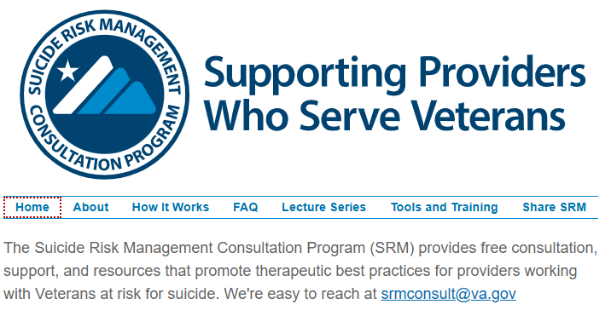

Slide 4

Overview
Introduction 5
Risk & Protective Factors in Elderly 6
Special Considerations for End of Life/Hospice Settings 10
Interventions 13
Contact Information 14

Slide 5
Introduction:
Elderly: defined as over 65
A growing population: Individuals > 65: 58 million in 2022; projected to be 82 million by 2050 (47% increase)
A more diverse population: Non-Hispanic Whites >65 will drop by 15% by 2050
Alzheimer’s rates are projected to double by 2050 to 13 million (vs. 7 million in 2024)

Slide 6
The Elderly and suicidality
Older adults have the highest rates of suicide of all age groups; older WM have 6x greater suicide rate (v. general population); suicide rates for those 80+ are high globally.
Among males* over 60:
  7-10% report recent (past 2 weeks) suicidal ideations
  Most older males* who report suicidal thinking aren’t involved in MH treatment, likely related to perceptions of stigma associated with receiving MH care and/or distrust of MH providers.
Suicidal Ideation rates increase in sub-groups of elderly: 12% of those receiving in home care; 31% of those in nursing homes
Desire to Hasten Death (DHD) vs. suicidality
  DHD seen as a WNL reaction to suffering, often without suicidal intent
  Spectrum?
Many older adults who think about suicide do not do so within the context of mental illness

Slide 7
Risk & Protective Factors in Older Adults & Adults at EOL

Slide 8
Risk Factors
Older Adults/EOL:
Suffering and Loss
Identity Changes, feelings of being a burden
Changes in relationships
Pain (acute or chronic) – physical/psychological; Sleep
Firearms: 83% of older Veteran suicide deaths; 71% of suicides among elderly are by firearm
→ firearms in home as an independent risk factor
Hopelessness
Medical/Physical issues – especially those leading to functional limitations
Delirium
  Social Isolation/Loneliness – linked to suicidal ideation, attempts, behavior and poor physical/mental health outcomes
  Loss of control, independence, dignity
  Psychosocial stressors: food/housing insecurity
  Transitions (ALF, nursing home, hospice)
  Discharge from Nursing Home can be a higher risk time; as can be the time right after diagnosis or change in prognosis
  Terminal diagnoses associated with 3x rate of suicidal ideation

Slide 9

Protective Factors
Advanced Care Planning
Goals of Care Conversations
Adequate Pain Control
Being able to talk about death/dying w/care providers and family
Addressing emotional, spiritual, existential needs
Connections
Palliative Care/Hospice
Meaning making/Leaving a Legacy

Slide 10
Special Considerations for EOL/Hospice Settings
Risk Assessment – how does it look different in EOL/elderly?
  Depression screenings and overlap with normative aging experiences
  Suicide screenings – perhaps going to sleep and not waking is a goal for those w/terminal illness
  Clarify: Suicidal thinking vs. DHD – traditional approaches vs. further discussion/dialogue
  What about Physician Aided dying/suicide inquiries?
Risk Management:
Discuss fears related to death
Minimizing pain/suffering
Planning for death (comfort care, hospice, advanced directives)
Safety Planning/Means reduction
Some Risk Mitigation and Safety Planning discussions may feel invalidating
Dignity Preservation
Relational work – unresolved interpersonal issues
Risk/Benefit analysis for treatment decisions

Slide 11
Barriers to Conversations around EOL
What makes these conversations difficult?
  Providers: language, training/background
  Patients/clients: inequitable access to healthcare, providers, negative experiences or beliefs about death/dying, misconceptions about palliative and hospice care, disagreements with loved ones
Addressing barriers:
  Providing space to talk/learn about palliative/hospice care; utilize chaplaincy, team meetings to identify barriers and impact of values/beliefs, facilitate meetings between patient/client and loved ones

Slide 12

Special Considerations for EOL/Hospice
Validating concerns about death/dying
Ways to start the critical conversations:
“What is most important to you as you approach the end of your life?”
“What concerns you the most when you think about death/dying?”
“Who are the most important people in your life? Should we include them in these conversations?

Slide 13

Interventions:
Ideally, treatments will enhance dignity and meaning, and EOL care planning can result in reduction of risk (e.g., reduced suicidal thinking/behavior)
Discussions about values and acceptance can help individuals connect with what is important to them and reduce suffering as they contemplate EOL.
Specifics:
Palliative/Hospice
Comfort/pain control
Dignity therapy, meaning centered psychotherapy, ACT
Unfinished business, final wishes
Spiritual Support
Safety Planning and Lethal Means Safety
Again, consider risk/benefit analysis of traditional options (involuntary hospitalization)

Slide 14
Recommended Training:
Suicide Prevention and End of Life - TRAIN Florida - an affiliate of the TRAIN Learning Network powered by the Public Health Foundation

Slide 15
thank you
Contact Info:
Stephanie Miller
Stephanie.miller1@va.gov
813-972-2000 x105283
References/slides available upon request
Maria Taylor:
Maria.Taylor2@va.gov
727-398-6661 x14226

