Slide 1
COVID-19: Latest Research and Available Data
End-of-Life Center: February 2021 Meeting
Dr. Debra Dobbs and Carlyn E. Vogel | February 10th, 2021

Slide 2
Known Cases in Long-term Care Kaiser Family Foundation Florida Department of Health

Slide 3
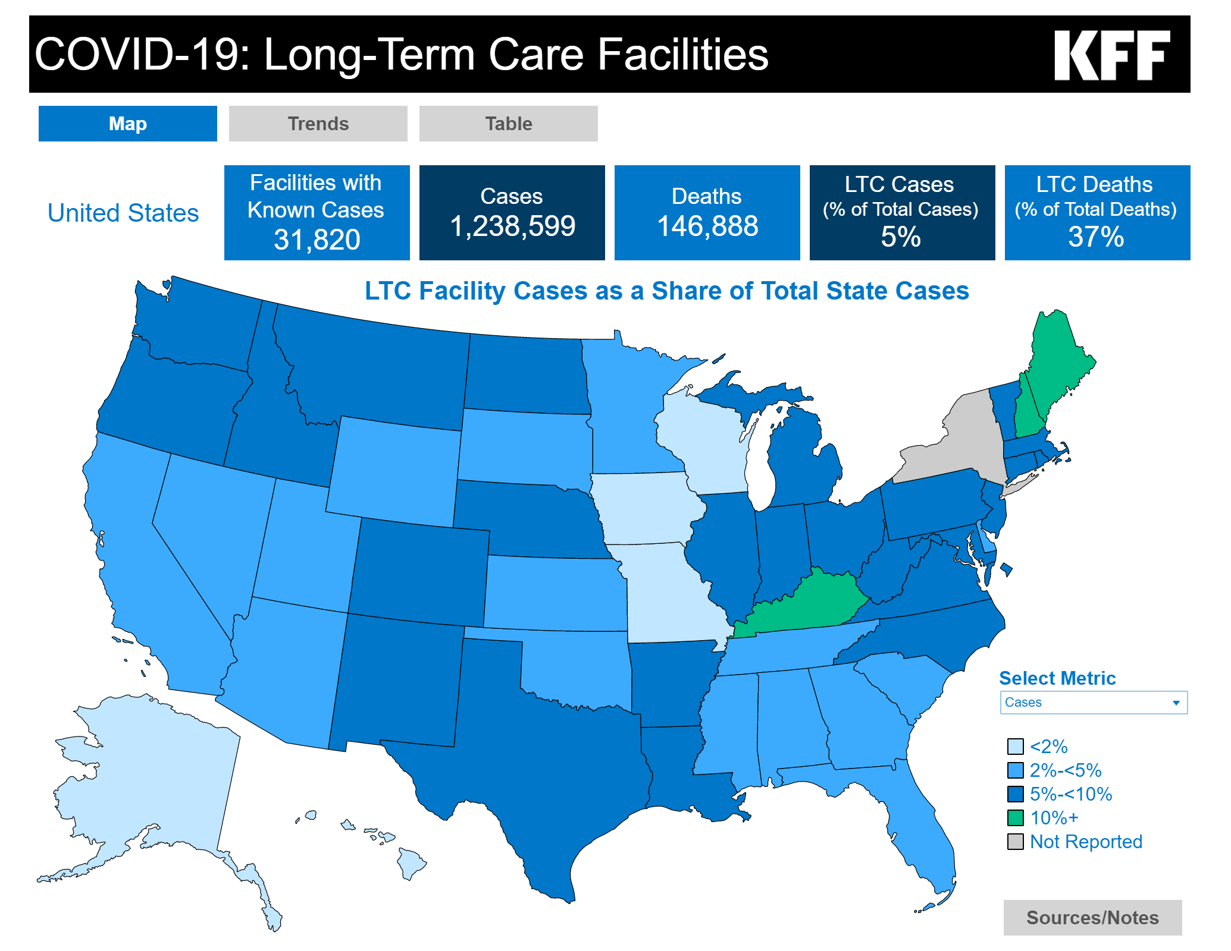

Slide 4
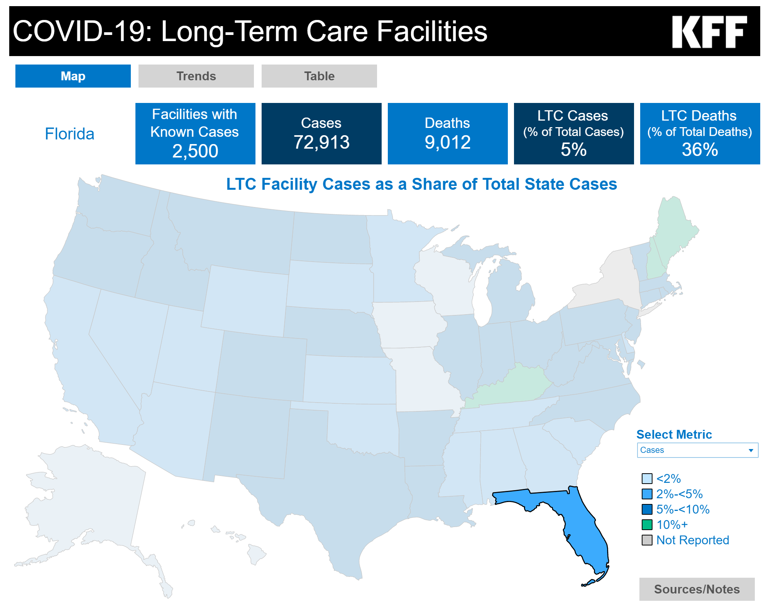

Slide 5
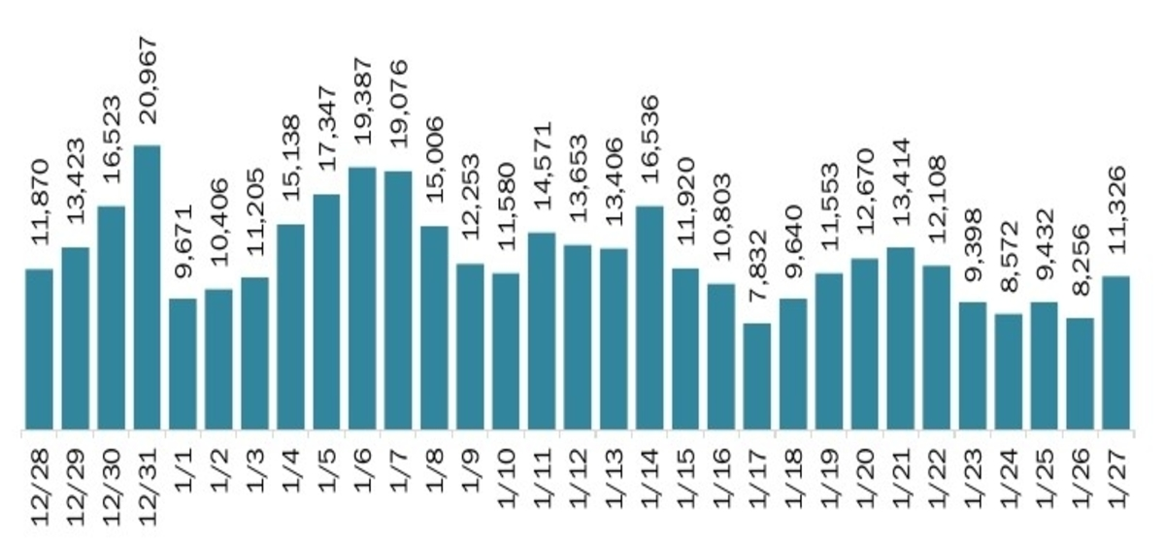
Notes:
From Florida Department of Health website: New Cases by Day

Slide 6
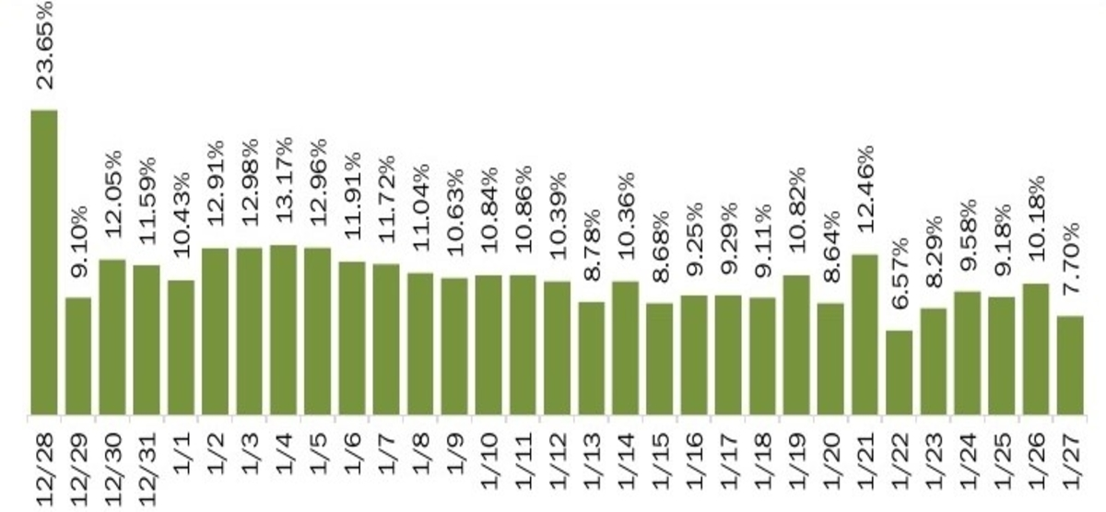
Notes:
From Florida Department of Health website: New Case Positivity Rate

Slide 7
Notes:
Florida Department of Health Reports: Long-term Care Facilities with positive COVID-19 cases

Slide 8
Known Deaths in Long-term Care Kaiser Family Foundation Florida Department of Health

Slide 9
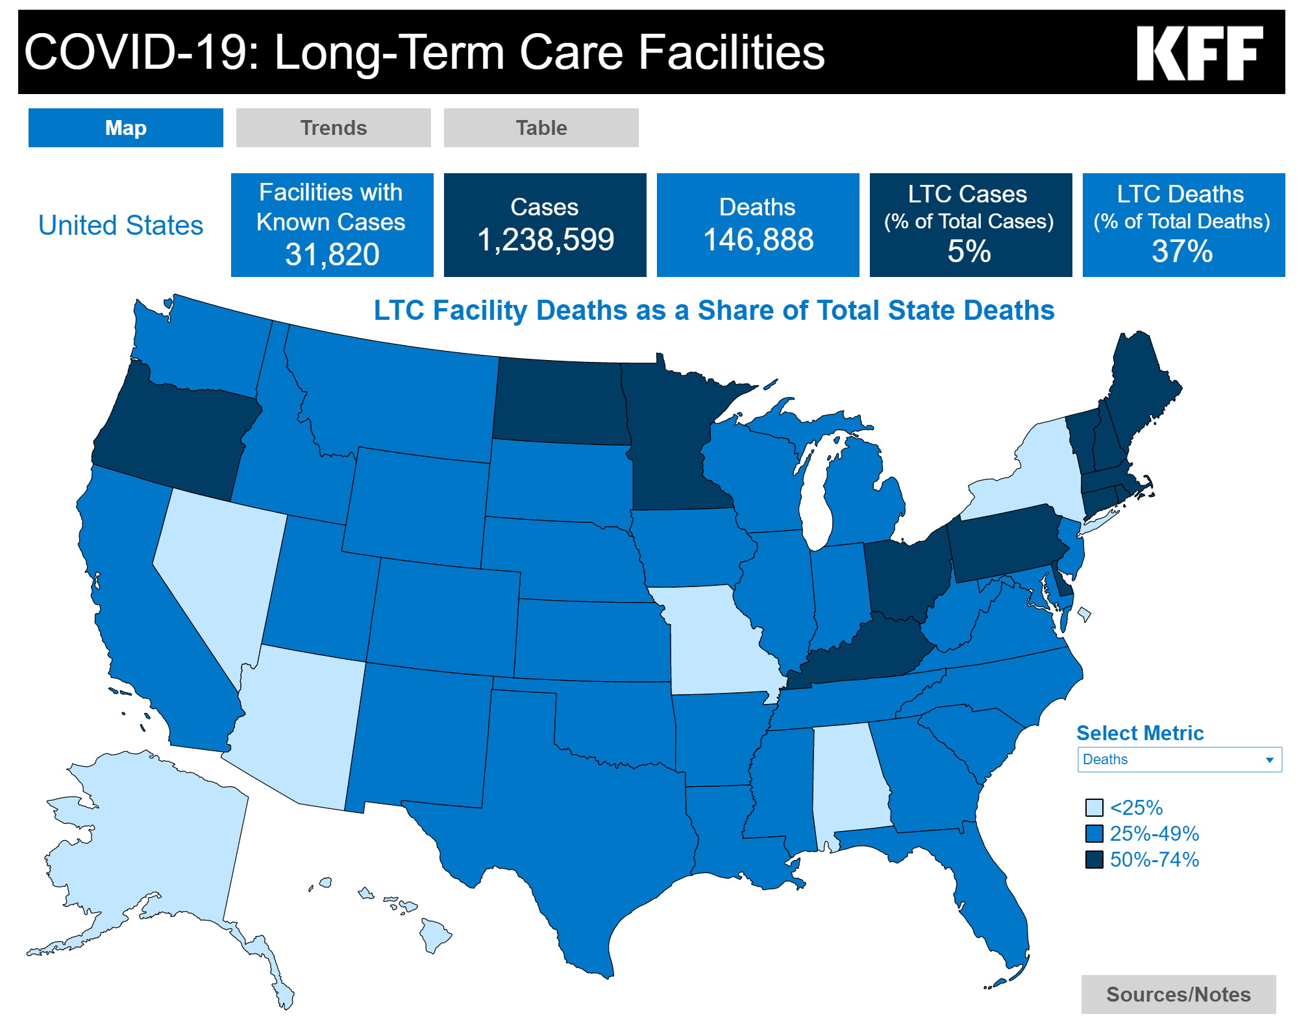

Slide 10
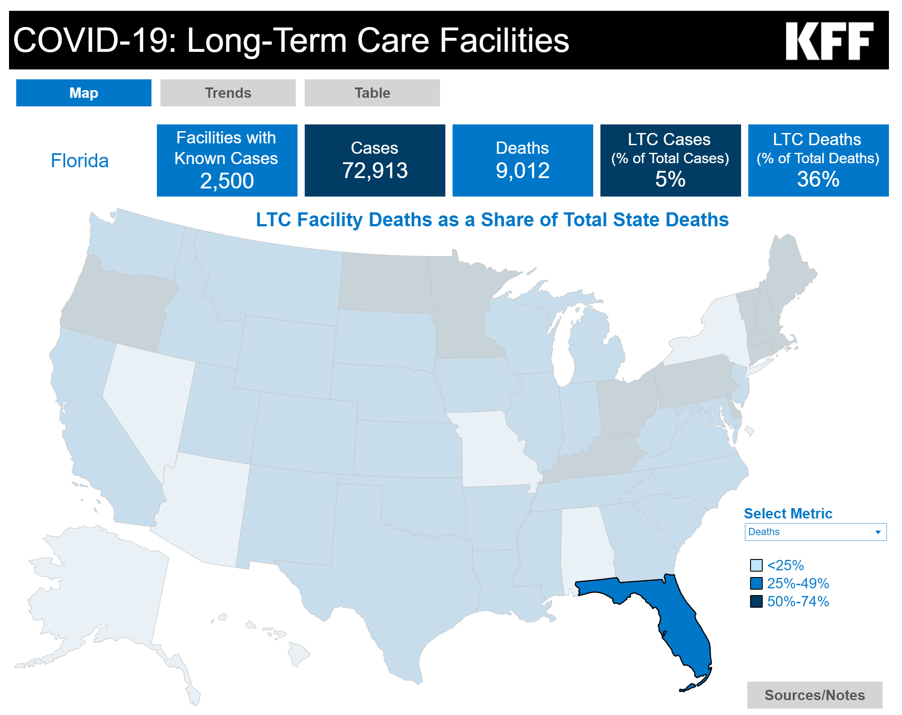

Slide 11
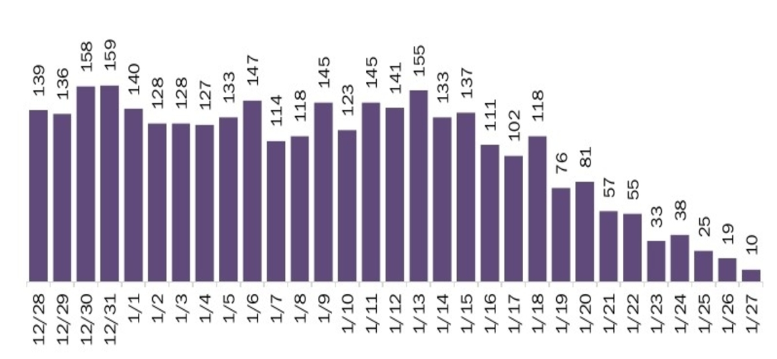
Notes:
From Florida Department of Health website: Death by Date of Death

Slide 12
Long-term Care Facility Deaths
Total Deaths | Number of Facilities | Percentage of Total Facilities
0 | 410 | 22%
1 | 359 | 20%
2 | 202 | 11%
3 | 124 | 7%
4 | 111 | 6%
5 | 70 | 4%
6 – 10 | 221 | 12%
11 – 20 | 251 | 14%
>20 | 77 | 4%
Total: | 1,825 | 100%
Outlier: Hialeah Nursing and Rehabilitation Center in Dade County: 74 total deaths – all residents
Notes:
Florida Department of Health Reports: Long-term Care Facility Deaths associated with COVID-19
Second highest number of deaths: 45 (all residents) for both Life Care Center of Altamonte Springs in Seminole County and Pahe Rehabilitation and Healthcare Center in Lee County.
Hialeah Nursing and Rehabilitation Center: As of June, 72 staff were positive, but they did not die. Of the 276 bed nursing home: 169 residents affected: 159 transferred out.
Mayor: created a task force with city leaders saying that it is our job to work with the state versus just saying it is a state problem – Hialeah county has the highest concentration of long-term care facilities in Florida.
-Agency for Healthcare Administration has been there 4 times between March and June and inspection records show no deficiencies.
Administrator of the facility, Emma Dial, said: “Hialeah Nursing & Rehabilitation Center remains committed to the care and safety of our residents and staff, and we continue taking critical steps to keep them protected, following all CDC guidelines and working with our state and local health officials and regulatory partners,”.
“Since tests became available, all residents and staff have been tested weekly. We are excited about the vaccines and hope to receive adequate supplies in either late December or early January to vaccinate all residents and staff,” she said.

Slide 13
COVID-19 Vaccine Florida Department of Health Tampa Bay Times The Wall Street Journal

Slide 14
COVID-19 Vaccine Summary
Notes:
Of the total number of people vaccinated, 247,330 have received both the first and second doses, leading to 1.8 million doses administered in total.

Slide 15
Demographic Summary

Slide 16
COVID-19 Vaccine News
Tampa Bay Times

Slide 17
COVID-19 Vaccine News
The Wall Street Journal

Slide 18
COVID-19 Recommendations for Research from The Gerontological Society of America COVID-19 Task Force Barbara Resnick, Sheryl Zimmerman, and The GSA COVID-19 Task Force
Notes:
The following research recommendations are from the article titled “COVID-19 Recommendations for Research from The Gerontological Society of America COVID-19 Task Force” and was also written by Barbara Resnick and Sheryl Zimmerman
The recommendations included in the following slides are only the ones related to end-of-life care.

Slide 19
1. Health care practices and decision-making, and related outcomes
Decision-making practices across different levels of care and oversight
Individual level (e.g., related to social distancing, advance care planning)
Societal/governmental, including ethical decision-making for different populations (e.g., allocation of scarce resources)
Amount and type of personal protective equipment (PPE) for staff and residents in long-term care settings
Isolation (including during hospitalization) and cohorting (in long-term care settings)
Telehealth, including teletherapy and teledentistry
Types, barriers and facilitators, outcomes (e.g., detection and management of clinical problems)
Stakeholder attitudes
Impact of COVID-19 on health care receipt in other areas and related outcomes (e.g., less preventive care, exacerbation of chronic conditions)
Preparedness for subsequent waves of COVID-19
Sustainability of new care practices

Slide 20
2. Effects of social distancing, and related risk and protective factors (e.g., resilience, spirituality)
Change in cognition and related behaviors
Mood, social engagement, mental health, and well-being (e.g. due to social isolation, less productivity)
Change in daily activities and physical function, and related outcomes (e.g., falls, infections)
Nutrition and nutritional status (e.g., weight loss, weight gain)
Change in sleep behaviors
Sensory change (e.g., vision/hearing)

Slide 21
3. Care for psychosocial well-being (including grief), and related challenges and outcomes (e.g. mood, quality of life)
Use of technology (e.g., types, barriers and facilitators, access)
In-person interactions
Special activities (e.g., events seen from windows)
Involvement of pets

Slide 22
4. Impact on families
Effects on family members (e.g., stress, guilt related to decision making and outcomes)
Changes in intergenerational and other relationships

Slide 23
5. Impact on professional and paraprofessional health care providers (e.g. nurses, nursing assistants)
Health care provider experiences and reactions
Health care provider outcomes (e.g., staff absenteeism, turnover)

Slide 24
6. Economic security and older workers
Consequences of job loss on health, well-being, and health coverage
Decision-making related to work and financial well-being
Notes:
Potentially related to the family of someone at the end of life.

Slide 25
7. Considerations for different populations (e.g. access, needs, economic impact, models of care
Setting based (e.g., long-term care, community organizations, prisons, persons living alone)
Persons with dementia
Veterans
Different races, ethnicities, socioeconomic backgrounds
HIV, immunocompromised
Disparities at the intersection of age, gender, and race

Slide 26
8. Care for COVID-19 positive older adults
Of hospitalized long-term care residents and others (description and survival rates)
Of non-hospitalized older adults (description and survival rates)
Of those with chronic and co-morbid conditions (e.g. dialysis, receiving chemotherapy)

Slide 27
9. Pharmacologic treatments (e.g., anti-virals, modulation of inflammatory response)
Vaccine development and effectiveness compared to younger adults
Interventions to rejuvenate immune function
Relationship of age to viral replication, response to infection
Improving vaccine responsiveness to novel antigens in older adults

Slide 28
10. Attitudes
Perceptions of older adults themselves, including source of influence (e.g., wearing a mask and media)
Societal ageism
Societal stigma (e.g., to Asians)

Slide 29
11. Policies related to COVID-19
Intersection of policies with age, health, SES, and race
Responsiveness by government
Preparedness for co-occurring disasters (e.g., hurricane)
International comparisons

Slide 30
12. Research methods
Innovative approaches to recruitment
Sustaining research in the post-COVID-19 era
Harmonizing existing data to facilitate larger scope analyses, including of risk factors and outcomes

Slide 31
References
Kaiser Family Foundation (2021, January 28). State COVID-19 Data and Policy Actions. https://www.kff.org/coronavirus-covid-19/issue-brief/state-covid-19-data-and-policy-actions/#longtermcare
Florida Department of Health (2021, January 28). Current Situation in Florida. https://floridahealthcovid19.gov/#latest-stats
Resnick, B., & Zimmerman, S. (2021). COVID-19 Recommendations for Research from The Gerontological Society of America COVID-19 Task Force. The Gerontologist.

Slide 32
Florida Department of Health 1. Florida Department of Health Website 2. Dashboard

