Slide 1
Hospice:
A Benefit in Transition
OR
Where It Began And Where It’s Going
Tara C Friedman, MD FAAAHPM
Enterprise Chief Medical Officer
Chapters Health System

Slide 2
Objectives
At the completion of this activity, the participant will:
Understand the history of the hospice benefit in the US
Identify trends in the delivery of hospice care
Recognize current and future challenges to hospice care delivery

Slide 3
The birth of hospice
Dame Cecily Saunders
Introduces specialty care for the dying; opens St Christopher’s Hospice in UK
Florence Wald
HCFA
Carve Out
26 demonstration programs in 16 states to define hospice and assess cost
Founds the Connecticut Hospice
Growth of MA
Establish Medicare Carve Out
1967
1972
1974
1978
1979
1982
1990
Elizabeth Kubler-Ross
NHO
MHB
Early hospice founders create NHO to promote hospice
Congress creates a provision to create the first MHB. 1983 regulations are published defining 4 LOC.
US Senate Special Committee on Aging holds national hearings on death with dignity
Notes:
1950s
With rapid medical advances, death shifted to hospitals where doctors saw it as a failure. Pain and suffering were rarely the target of treatment. 1960’s
Dame Cicely Saunders introduces the idea of specialized care for the dying to the United States in a lecture at Yale University.
Florence Wald, Dean of the Yale School of Nursing,
1967
Dame Cicely Saunders creates St. Christopher’s Hospice in the United Kingdom. People started to live through infections and heart attacks and ongoing care for people with chronic illness became a turning point in medicine.
1968
Florence Wald takes a sabbatical from Yale to work at St. Christopher’s Hospice.
1969
On Death and Dying, written by Dr. Elisabeth Kubler-Ross
1972
Elisabeth Kubler-Ross testifies at the first national hearings on the subject of death with dignity, conducted by the U.S. Senate Special Committee on Aging. Kubler-Ross said, “We live in a very peculiar, death-denying society. We isolate both the dying and the old, and it serves a purpose, I guess. They are reminders of our own mortality. We should not institutionalize people. We can give families more help with home care and visiting nurses, giving the patients and families the spiritual, emotional and financial help in order to facilitate the care at home.”
1974
Florence Wald, along with two pediatricians and a chaplain, founds Connecticut Hospice in Branford, Connecticut.
1978
The National Hospice Organization grew out of efforts by the founders of the earliest hospice programs in the United States to protect hospice care, advocate for hospice in Congress and other public policy forums, define standards, and provide education on running hospice programs for others who were interested in starting hospices.
1979
The Health Care Financing Administration (HCFA) initiates demonstration programs at 26 hospices in 16 states to assess the cost effectiveness of hospice care and to help determine what a hospice is and what it should provide.
1982
Congress includes a provision to create a Medicare hospice benefit.
Addition of hospice benefits in many third-party payer insurance plans. (1982 – 1985)
1983
Initial Medicare Hospice Regulations are published in the Federal Register. Regulations establish the four levels of care and outline The Joint Commission Hospice Accreditation Program is implemented.

Slide 4
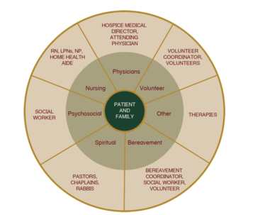
What is Hospice?
•
Interdisciplinary care aimed at enhancing the quality of life for patients who are terminally ill and their families
A bundled per-diem insurance benefit for those in the final stages of disease, with defined levels of care
•
Notes:
Hospice/Hospes – old french –borrowed from latin Hospitium
First notion of hospice began in the 11th century
Crusaders established places where people with incurable illnesses could go for treatment
This aligns with focus of hospice today caring for the whole person and their family/caregivers
Considers not only physical needs but the comprehensive needs including spiritual, social, psychological and emotional
Today refers to a concept of caring focused on comfort and quality of life for people with advanced illnesses

Slide 5
The Cure - Care Model
Disease Directed Care
MHB

Slide 6
Levels of Care
Routine Home Care
Respite
Interdisciplinary palliative care provided intermittently based on patient need, wherever patient calls home.
Short-term care provided outside of the home to enable the patient's caregiver to take some time off.
Continuous Care
General Inpatient
“Continuous” bedside nursing in the home setting, provided for short periods of time when symptoms require more intensive management.
Crisis-like level of care for short-term management of uncontrolled symptoms, provided in an inpatient setting
Notes:
National rates, subject to geographical modification are as follows Went to 2-tiered (+60 days) reimbursement in 2016) to encourage earlier referral but also discourage long length of stay patients.
Description Updated Rate Routine home care (days 1-60) $ 199.25/day Routine home care (days 61+) $ 157.49/day Continuous home care $ 59.68/hour Inpatient respite care $ 461.09/day General inpatient care $1,045.66/day

Slide 7
Eligibility Guidelines
Prognosis estimated at < 6 months IF the disease runs its expected course
Declining functional status
Altered nutritional status
Clinical decline
Patient elects a palliative plan of care
Notes:
For a patient to be eligible for hospice, consider the following guidelines PROFESSIONAL JUDGMENT
The illness is terminal (a prognosis of ≤ 6 months) and the patient and/or family has elected palliative care.
The patient has a declining functional status as determined by either:
Palliative Performance Scale (PPS) rating of ≤ 50%-60%
Dependence in 3 of 6 Activities of Daily Living (ADLs)
The patient has alteration in nutritional status, e.g., > 10% loss of body weight over last 4-6 months
The patient has an observable and documented deterioration in overall clinical condition in the past 4-6 months, as manifested by at least one of the following:
≥ 3 hospitalizations or ED visits
Decrease in tolerance to physical activity
Decrease in cognitive ability
Other comorbid conditions

Slide 8
Mr. D
72 yo man with advanced lung cancer. He has lost more than 40 pounds since diagnosis, 5 months ago. Nausea has improved since discontinuing chemotherapy. He tolerates moderate oral intake. He is independent with his ADLs but with increasing shortness of breath and requiring significant rest. He spends more than half the day in a chair or bed. but still enjoys visits with his grandchildren and watching baseball on tv.
Notes:
Exemplar patient

Slide 9
Hospice In It’s Youth
89% of hospice’s were not-for-profit
Hospice recipients:
MLOS was 39 days
79% had a cancer diagnosis
83% were non-Hispanic white
Notes:
89% of hospice agencies were NFP in 1992, 7% FP
79% of hospice patients had a cancer diagnosis
83% of recipients were non-Hispanic white
Average LOS was 39 days
Length of Hospice Care among U.S. Adults: 1992–2000
February 2007
Inquiry: a Journal of Medical Care Organization, Provision and Financing 44(1):104-13

Slide 10
From Childhood to Adolescence
2005 National Summary of Hospice Care Contact: nds@nhpco.org
Notes:
With the adoption of a formal payment mechanism, hospices began to pop up around the country.
In 90’s and early part of 2000s, still a bias against hospice, even among medical colleagues
By 2005:
about 1/3rd of all deaths were served by hospice.
Hospice was successful in helping people die at home, about 75% of hospice deaths occurred in the place the patient called home.

Slide 11
Hospice Care Today By the Numbers
About 1.6m Medicare beneficiaries being served
MLOS stuck <3w
1/2 of patients receive hospice for < 18 days
1/4 of hospice patients die within 5 days of enrollment
1/10 of hospice patients receive more than 266 days of care
NHPCO Facts & Figures, 2021.
Notes:
2005: ALOS 59, MLOS 26
2013: ALOS 70, MLOS 17.4
2019 ALOS 96, MLOS 18
Trends: MLS decreased as we continue to admit many short LOS patients. ALS is pulled up by a small percentage with very long LOS.
Hospice: Studies have shown that providing hospice care earlier in the course of advanced serious illness leads to better health outcomes, higher satisfaction and lower care costs. However, when patients and physicians are forced to make the choice between hospice and curative care, hospice enrollment is often delayed.
LOS is a double edged sword

Slide 12
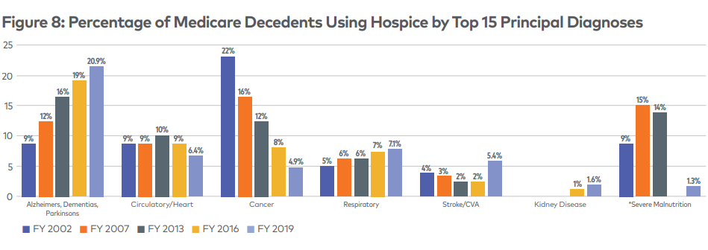
ABCs
NHPCO Facts & Figures, 2021.
Notes:
Changing Primary Diagnoses
Interesting trends- only cancer has gone down consistently. For several decades, hospices primarily served people with cancer diagnoses. As recently as 2007, cancer continued to be the leading principal diagnosis of those receiving care. However, that has shifted dramatically over the last decade.
In 2019 - continued growth in the number of Medicare hospice patients with non-cancer diagnoses, including a principal diagnosis of Alzheimer’s, dementia, or Parkinson’s, which represented more than four times the number of patients who had cancer.
27% of hospice patients have a cancer diagnosis

Slide 13
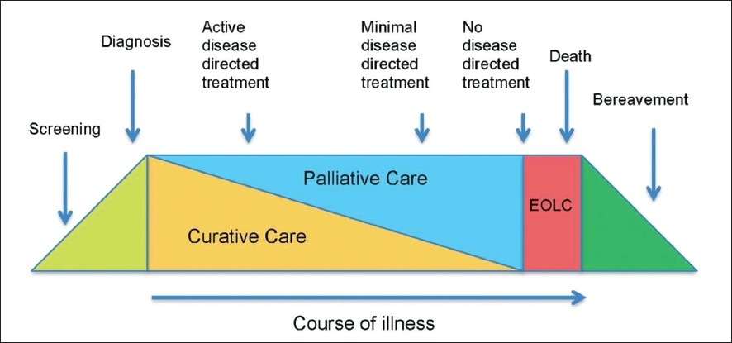
Integration of Palliative Care
Medicare Hospice Benefit
Notes:
Hospice’s don’t typically have contracts with managed care, so even if they could get paid, they have to invest resources to get Drs and NPs credentialed with health plans if they want to play in the non-hospice pal care world. Some hospices do begin to offer non-hospice palliative care, typically as “loss leaders” for their hospice programs, but, they are terribly challenged by the lack of reimbursement. Hospital-based pal care generates a revolving door of high-intensity very acute end-of-life patients and community-based programs struggle with productivity.

Slide 14
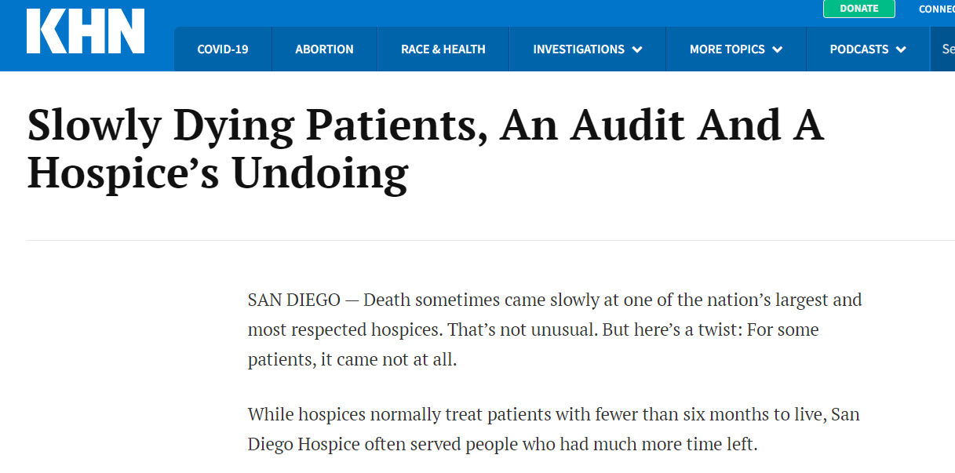
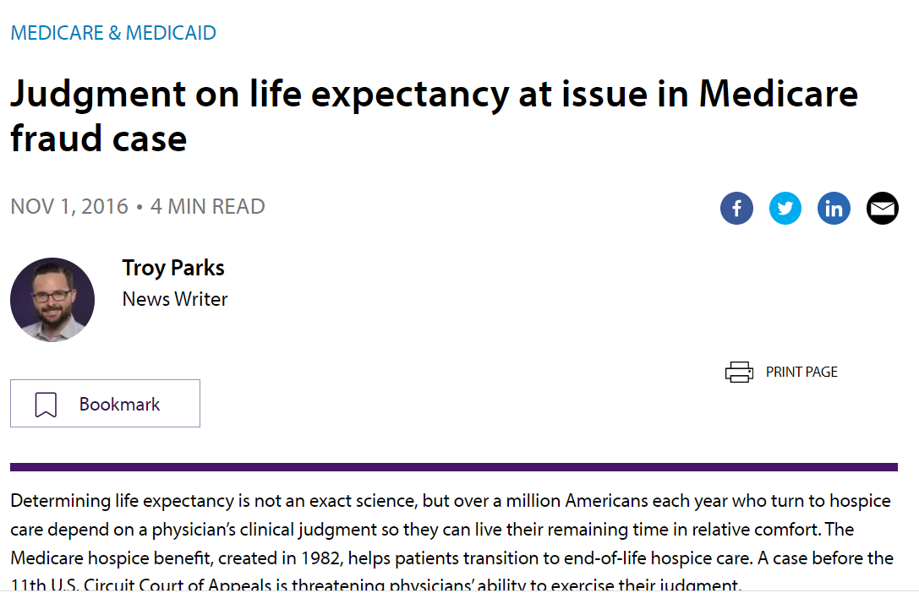
Hospice Length of Stay A Double-Edged Sword
Notes:
Late Hospice Access
Hospice professionals continue to be concerned about the number of people accessing hospice care late in the course of an illness. The NHPCO report indicates that 10 percent of Medicare decedents received hospice care for two days or less in 2019. Twenty-five percent of beneficiaries received care for five days or less, and 50 percent received care for 18 days or less. These very short stays in hospice are considered too short a period for patients to fully benefit from the unique person-centered, interdisciplinary care provided by hospice.
Live Discharges and Transfers
In 2019, out of all Medicare hospice discharges, 17.4 percent of all Medicare beneficiaries using hospice were discharged alive, with patient-initiated and hospice-initiated discharges being about equal.

Slide 15
Turning Up The Heat
Administrative Burden
Comorbid related services
Medication/therapeutics relatedness
Certification of Terminal Illness (CTI)
2011 – Face-to-Face (F2F)
Intense Audit Environment
Documentation
Medical Necessity (LOS)
Covered Services
Levels of Care
Physician Billing
Notes:
As a result of attempts to slow medicare spending, and now that hospice is on the radar screen as a major cost center…. Additional non-reimbursable administrative requirements are added and the audit environment becomes much more aggressive.
CTI – physician narrative at admission and recertification, often with F2F requirement
Based on recommendations from MedPac, Congress introduced additional administrative provisions for hospice. Beginning 2011 – every patient needs a f2f prior to the 180th day of service and each benefit period thereafter. It is not billable. It is just admin overhead and must be performed by an employed physician or NP. Also, if pt has been in hospice previously and readmits into the 3rd benefit period, they need an F2f before they can be readmitted.
Intense Audit Environment
With medicare spending on the rise, medicare begins to more aggressively scrutinize hospice claims. The audit environment has become onerous for many hospices, who are already strapped. It’s not uncommon for hospice’s to be sited not only for insufficient documentation of daily care practices but also for things specific to hospice. Bigger ticket items can lead to claw backs of $millions and are often reported as representing “fraud” or “fraudulent billing practices.
Medical necessity of services
Appropriate justification of the level of care provided
Physician billing

Slide 16
Joan
80 years old, COPD, was losing weight, memory impaired, no other caregiver in the house except family who lives 40 minutes away, had been diagnosed with a potential malignancy of thyroid cancer, and her physician recommended hospice and then when the hospice came out the nurse upon examining her thought she would clearly be eligible, but the nurse went to ask the medical Director of the hospice they said they weren’t eligible,
PROGNOSTIC DILEMMA

Slide 17
Open Access
Palliative Chemotherapy and Radiation
Blood transfusions
IV antibiotics
Parenteral nutrition
Hemodialysis/PD
Cardiac infusion therapy
Ventilator withdrawal
Notes:
Research has shown wide variation in the admission practices as well as the breadth of services for both types of hospice (nonprofit and for-profit). In a survey of 100 hospices in California, 63% reported that admission was denied on the basis of at least one of seven restrictions.²⁵ Among the restrictions were chemotherapy (48%), total parenteral nutrition (38%), radiation therapy (36%), and transfusions (25%).²⁵
KA Lorenz, SM Asch, KE Rosenfeld , etal: Hospice admission practices: Where does hospice fit in the continuum of care? J Am Geriatr Soc 52: 725– 730,2004
The hospices who have created open access programs often site longer length of stays but typically have guidance about how long some of these therapies can be continued or find that patients naturally abandon them after a period of time on hospice as they see diminishing returns.

Slide 18
Francis
72 y/o w/ met ovarian ca w/ peritoneal carcinomatosis and ascites on Weekly Taxol + Zirabev with Neupogen support. Last dose 8/23/23. Currently hospitalized with weakness, abdominal pain, diarrhea and is s/p therapeutic 4L paracentesis. The patient is not sure she is ready for hospice, but hospital case manager would like to know if she is eligible.
PALLIATIVE PLAN OF CARE? COST? APPROPRIATE MONITORING?
Notes:
Taxol + Avastin or Zirabev, with Neupogen and all labs, fluids, flushes, etc. associated with the infusions. This can easily be $10,000 or more every 3 weeks and typically include follow up scans. but then not covering the PET or MRI/follow up scans that are part of these regimens,

Slide 19
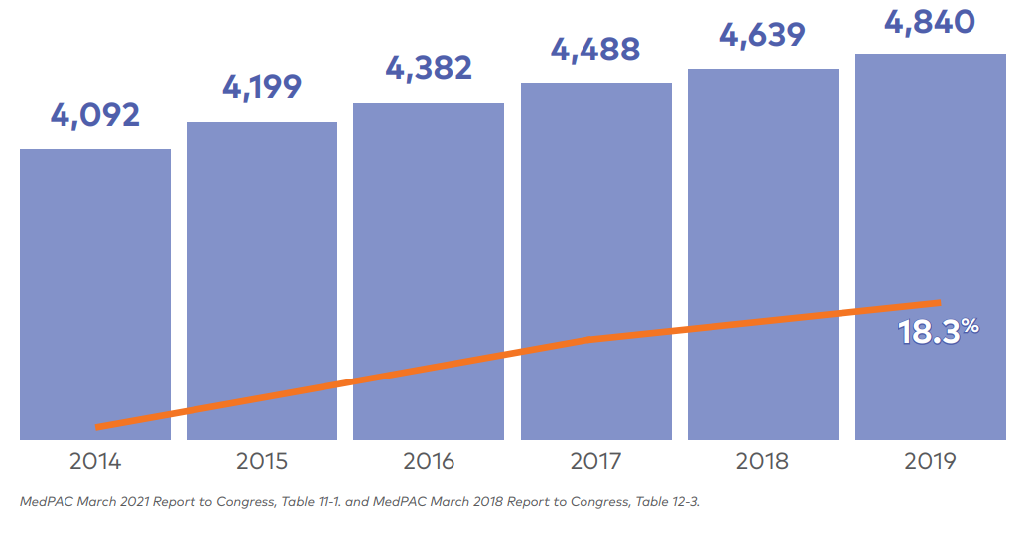
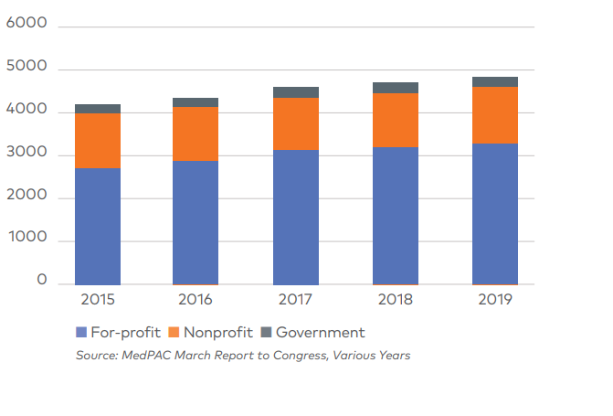
Provider Proliferation
NHPCO Facts & Figures, 2021.
Notes:
Over the course of 2019, there were 4,840 Medicare certified hospices in operation based on claims data. This represents an increase of 18.3 percent since 2014.
The proliferation of providers reflects the growth of for profit hospice providers. Between 2018 and 2019, the number of for-profit hospices increased by 6.3%, while the number of nonprofit hospices increased by 0.2%, and government owned hospices declined by 5.7%. As of 2019, about 71% of hospices were for profit, 26% were nonprofit, and 3% were government owned.

Slide 20
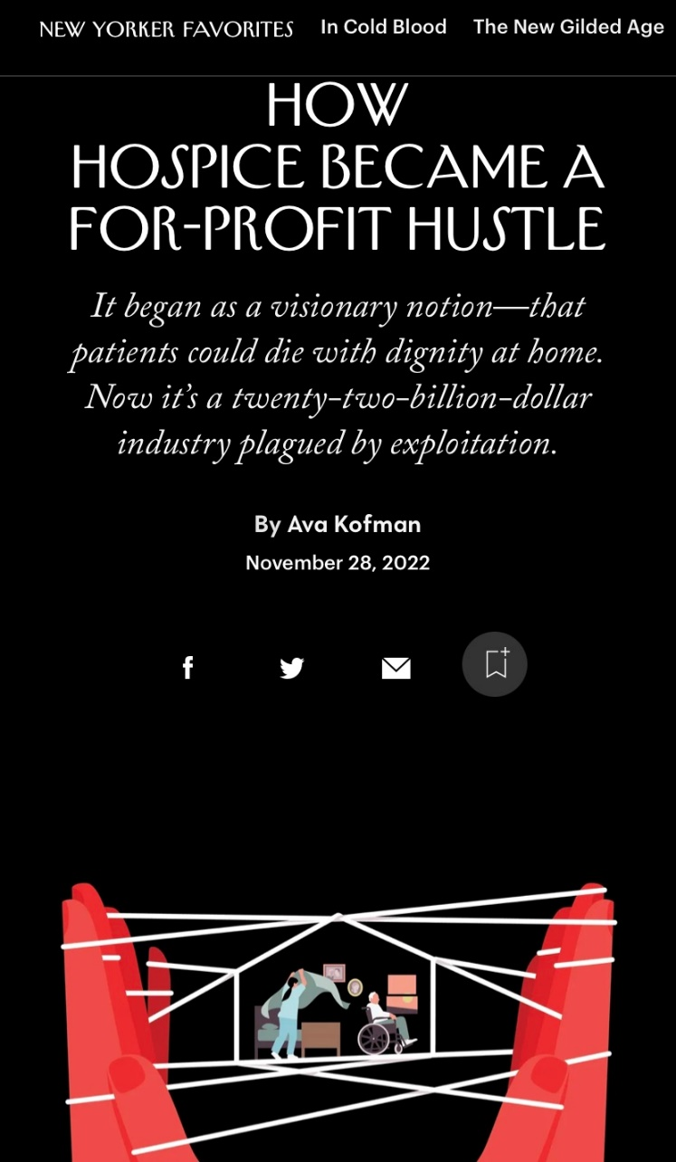
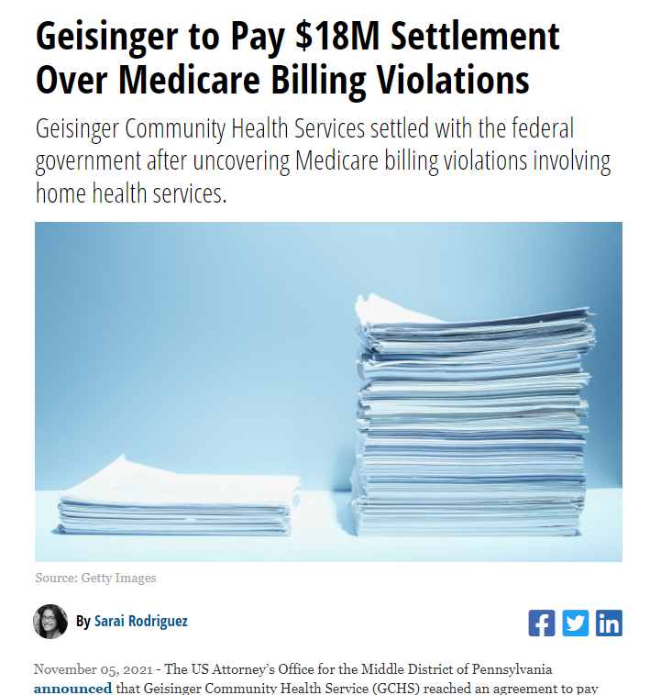
Notes:
While there are always bad actors, some of the publicity is the result of the aggressive survey environment – leading to major claw backs. But “FRAUD” has an intentional ring to it…. Which may not always be the case. Paints the whole industry in a terrible light and certainly exacerbates the barriers for those who could really benefit. Also, impact on audit environment.

Slide 21
What about VBID?
Reversal of the Medicare Hospice Carve Out
MA Plans will become the Payer
Implications
Network alignment
Contract negotiations
Variable SLAs
SO, WHAT IS THE PROBLEM?
Notes:
https://innovation.cms.gov/innovation-models/vbid-hospice-benefit-overview
Value Based Insurance Design
Currently, when an MA beneficiary elects hospice, Fee-for-Service (FFS) Medicare becomes financially responsible for most services, while the MA retains responsibility for certain services (e.g., supplemental benefits). Under the Hospice Benefit Component of the VBID Model, participating MAs retain responsibility for all Medicare services, including hospice care. The Hospice Benefit Component of the Model implements a set of changes recommended by the Medicare Payment Advisory Commission (MedPAC), the U.S.Department of Health and Human Services (HHS) Office of Inspector General (OIG), and other stakeholders.
Information for Hospice Providers
Beginning Jan 2023 – The government wants to get out of healthcare payer space. So, CMS will begin testing the inclusion of the Part A Hospice Benefit within the Medicare Advantage (MA) benefits through Value-Based Insurance Design (VBID) Model. This test allows CMS to assess the impact on care delivery and quality of hospice care when the MA plan is itself financially responsible for all Parts A and B benefits.
Need to negotiate with all the MA plans? Will they bother ….potential cuts in reimbursement, more administrative requirements
Can make up their own rules
Additional administrative burden

Slide 22
Florida Hospice CON
CON began in 1986 to ensure quality
One of 13 states and the District of Columbia
Highest hospice utilization rate in the country
2018, proponents of deregulation advocated for >1 hospice/county
CA, TX, AZ and NV
CMS scrutiny for fraud and abuse
Now restriction on new programs
AL is working to overturn their deregulation and there is suspicion that others may follow suit.
Florida continues to be heralded as a model for other states to aspire to and yet the CON is likely to be overturned in the next legislative session.
Notes:
CON program began in 1986 (only hospice, SNF, inpt care for developmental disabilities remain) as a way to ensure quality
Florida is one of 13 states + DC that has a hospice CON
Florida has the highest utilization rate in the country (about 150k patients/year)
In 2018, advocates of deregulation fought for all counties having more than 1 hospice, so now each county has at least 2 hospice providers
CON only approves new hospices if an area’s growth rate suggests there will be an unmet need – population based formula. - providers compete to launch new hospice programs. This guides manageable growth of providers, making it easier for Florida to monitor quality and ensure providers have sufficient number of patients to sustain business
Nationally, many states have repealed their hospice CON programs – Florida considered doing this in 2019. Consequences of such are exemplified by the challenges faced in California where 1000s of “providers” grew overnight and there is outright rampant fraud. Meanwhile, Florida has been lauded as an effective model.
Florida’s model has been studied many times over the years and always recommended to continue to ensure quality of hospice provision.

Slide 23
Q & A
Tara C. Friedman, MD FAAHPM friedmat@chaptershealth.org

