Slide 1




Shared decision-making in home-based palliative care
Sandra Jahr Svendsen

Slide 2


Slide 3
Introduction
Ability to be at home – an overarching goal (1)
Palliative care trajectories are complex (2)
Need for treatment clarifications (1)
Patients want to be involved (3, 4)
We know little about how they want to be involved (5)
Unclear and undefined roles among healtcare professionals in primary healthcare (6, 7)

Slide 4
Research Questions
Patients | - How do home-dwelling patients in palliative care understand the concept of treatment decision-making? - What experiences do patients have with involvement in decision-making? - How do they prefer to be involved in SDM?
Nurses in homecare services | - How do nurses in homecare services describe their role in SDM regarding treatment decision-making for patients in palliative care? - What experiences do nurses have with collaborating with GPs in these decision-making processes?
GPs and CCCs | - What considerations and experiences do GPs and CCCs have regarding SDM related to treatment and care for home-dwelling patients in the palliative phase receiving homecare services? - What roles do GPs and CCCs perceive themselves to have in these collaborative processes?

Slide 5
Objective
This project aims to gain insight into participants' experiences and perceptions regarding factors that facilitate, hinder, or potentially complicate SDM related to treatment and care for home-dwelling patients in palliative care.

Slide 6
User Involvement
Steering Group
  Comprising a researcher in the field, a representative from the Center for Development of Nursing Homes and Home Care Services (USHT), and a patient in palliative care (deceased).
Reference Group - Co-researchers
  Comprising a patient in palliative care, a general practitioner experienced in the field, a nurse with further education in palliative care and experience in the field, a cancer nurse from home care, and a cancer coordinator.
Based on “Framework for Patient and Informal Caregiver Participation in Research” (PAICPAIR) (8)

Slide 7
Methodology
Qualitative design
Interpretative paradigm
Gadamer’s philosophical hermeneutics
Preunderstanding

Slide 8
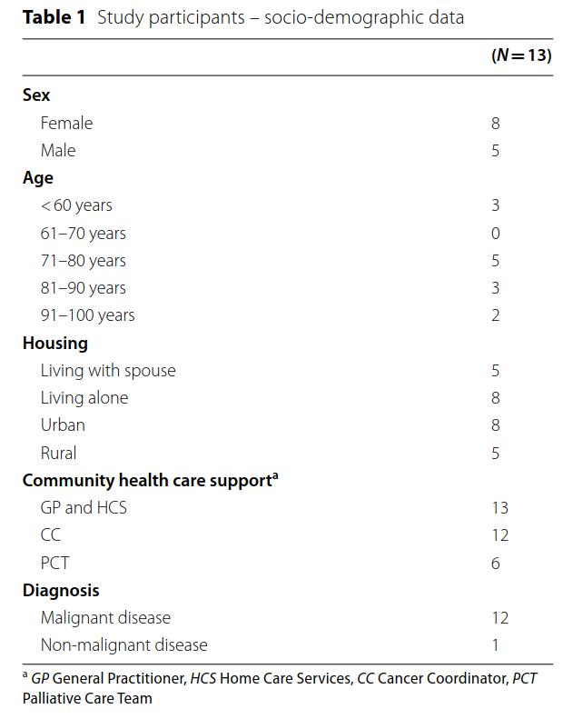
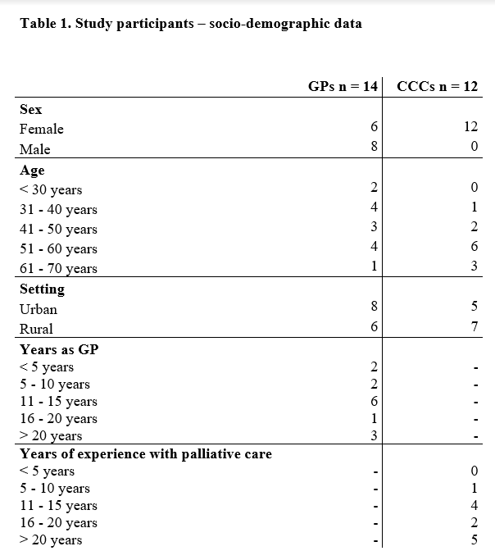
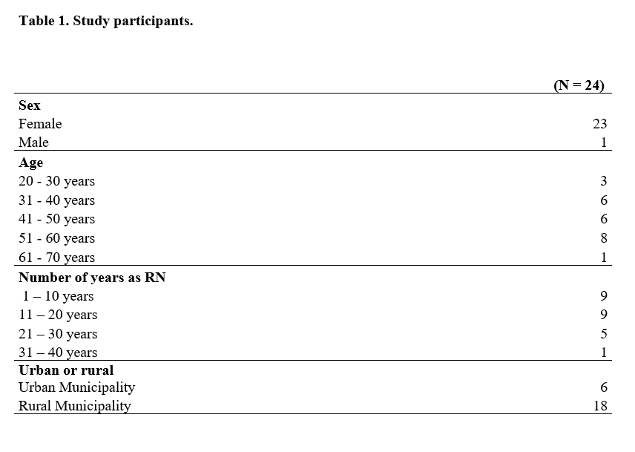
Sub-study 1 Patients
Sub-study 2 Homecare nurses
Sub-study 3 GPs and CCCs
Individual in-dept interviews
Focus group interviews
Focus group interviews

Slide 9
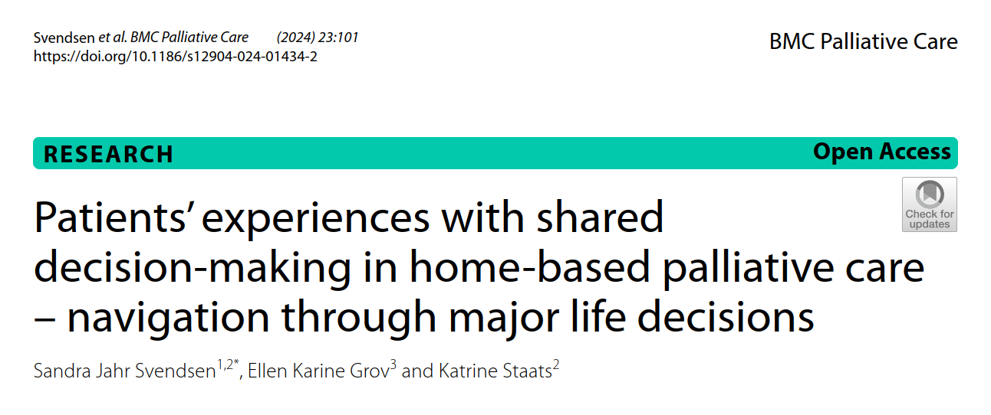

Slide 10
Main findings
Navigating to reach own decisions
To be trapped in life without decisions to act on
To surrender to others and let others deal with decisions
To continue to be oneself without focus on disease and decision-making

Slide 11
To be captured in life without decisions to act on
"Well, it's the uncertainty that's difficult. Not knowing what's ahead, you know. (...) I've stopped planning, and then someone says you could live for many years, but I don't know. (…) Just being here at the day center, it's a challenge because there are patients here who are worse off than me, and they're dying, you know, yes, and here I am, what am I doing here?" (Woman, 56)

Slide 12
To surrender to others and let others deal with decisions
"They thought I should try treatment first before I could say anything. Yes, that might be the case, but my standpoint is not to accept any treatment. They had problems understanding that. ‘It's important to try', the doctor said. He kept going on like that. Eventually, I said yes. (...) so I was there at the hospital alone, waiting for something to happen, but no, I was told that I was too sick to undergo those treatments." (Woman, 75)

Slide 13
To continue to be oneself without focus on disease and decision-making
"No one has asked, 'how are you doing?' But then again, I haven't pushed for it either. (…) I'm really happy when someone asks, then I can decide if we can talk some other time or if it's okay to talk now." (Man, 58)

Slide 14

Conclusions
Flexible, person-centered SDM – tailored to the fluctuating health literacy and changing preferences of patients in palliative care settings

Slide 15
Paper 2 and 3 – Not published (yet)
«Home care nurses’ ethical compass in palliative decision-making processes»
«Navigating together toward shared decision-making in home-based palliative care – perspectives from general practitioners and cancer care coordinators»

Slide 16
References
1. Norwegian Ministry of Health and Care Services. Report to the Storting (White Paper) 24 (2019–2020). In norwegian: Lindrende behandling og omsorg - Vi skal alle dø en dag. Men alle andre dager skal vi leve.: Oslo: Ministry of Health and Care Services.; 2020.
2. Ministry of Health and Care Services. NOU 2017:16 Life and death - Palliative care. Department: t. N. M. o. H. a. C. Services 2017 Oslo, Norway; 2017.
3. Sandsdalen T, Hov R, Høye S, Rystedt I, Wilde-Larsson B. Patients' preferences in palliative care: A systematic mixed studies review. Palliat Med. 2015;29(5):399-419.
4. Guldhav KV, Jepsen R, Ytrehus S, Grov EK. Access to information and counselling – older cancer patients’ self-report: a cross- sectional survey. BMC Nursing. 2017;16(1):18.
5. Kuosmanen L, Hupli M, Ahtiluoto S, Haavisto E. Patient participation in shared decision-making in palliative care – an integrative review. Journal of Clinical Nursing. 2021;30(23-24):3415-28.
6. Fasting A, Hetlevik I, Mjølstad BP. Palliative care in general practice; a questionnaire study on the GPs role and guideline implementation in Norway. BMC Family Practice. 2021;22(1):64.
7. Sercu M, Renterghem VV, Pype P, Aelbrecht K, Derese A, Deveugele M. "It is not the fading candle that one expects": general practitioners' perspectives on life-preserving versus "letting go" decision-making in end-of-life home care. Scand J Prim Health Care. 2015;33(4):233-42.
8. Staats K, Grov EK, Husebø B, Tranvåg O. Framework for Patient and Informal Caregiver Participation in Research (PAICPAIR): Part 1. ANS Adv Nurs Sci. 2020;43(2):E58-e70.
9. Svendsen SJ, Grov EK, Staats K. Patients' experiences with shared decision-making in home-based palliative care - navigation through major life decisions. BMC Palliat Care. 2024;23(1):101.

