Slide 1
Reconciliation of Financial Data

Slide 2
What does it mean to reconcile?
A reconciliation is simply a comparison of two sets of information as of the same point of time.
  Example:
    Identify the difference between what actually posted in the reporting system Finance Mart vs. what you actually posted in accounting systems like FAST or Bull Marketplace.
*Tip: A great source for reconciliation is Finance Mart, the official USF reporting system. Compare your departmental records to Finance Mart during your monthly reconciliation.*

Slide 3
Reconciliation
Why reconcile?
What should be reconciled?
If you don’t reconcile, what happens?

Slide 4
Why Reconcile?
Good internal controls and sound business practices necessitate the reconciliation of funds by business staff
USF needs assurance that all assets are safeguarded and used to the best benefit of the university

Slide 5
What should be reconciled?
Budget | Any type of funding
Cash | Auxiliaries / Sponsored Research
Expenditure | Any type of funding
Encumbrances (PO’s) | Any type of funding
Pre-Encumbrances | Any type of funding
Interdepartmental Billings | Any type of funding
Travel Authorizations | Any type of funding
Travel Expense Reports | Any type of funding
Expenditure Transfers | Any type of funding
Payroll Expense Transfers | Any type of funding
Customer Billings | Auxiliaries
Accounts Receivable | Auxiliaries
Inventory and Fixed Asset | Any type of funding

Slide 6
If reconciliation is not done, what happens?
Errors, missing funds, and theft
  If you don’t look at all, you will never know
  Errors are more difficult to correct as time passes
Poor Decisions
  If your books are inaccurate, you will make poor decisions and recommendations
This is costly
  It can cost your department money and/or budget
  It reflects poorly on your department
  It could reflect poorly on you

Slide 7
Separation of Duties
Separation of Duties Chart
What to do if you cannot separate duties
Who should not reconcile

Slide 8
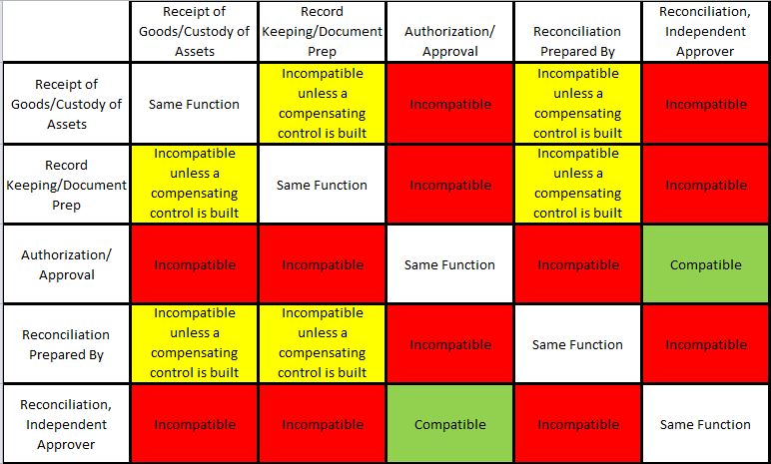
Separation of Duties Chart

Slide 9
What to do if duties cannot be separated
If you cannot clearly separate duties as prescribed by good business practices:
  Have another department in your college or unit provide a secondary level of review
  Departments can reciprocate by providing secondary review of each others reconciliations
  The PI is the accountable officer for projects
Who should not reconcile?
Ideally the reconciler should not be a person who has responsibility for:
  Creating a PO or buying with a PCard
  Approving purchases
  Recording the receipt of vendor items in FAST
  Approving payroll actions
  Handling cash

Slide 10
During Reconciliation
What to look for during reconciliation
Simple Steps
Systems and Resources

Slide 11
What to look for during reconciliation
Salary expense:
  Expense is charged to correct chart field strings
  Look for duplicate payments or unknown employee names
  The amount is correct
  The payroll distribution percentage is correct
  Individual staff may be paid from more than one funding source
For salary:
  Confirm that PETs (payroll expenditure transfers) have cleared and posted correctly
  Review leave payouts
  If you have a question about benefits charges, contact USF HR
  Watch out at the end of the fiscal year; the last payroll period of June may include one or more days that will be accrued to July (the next fiscal year); however this is not true for FY 2016

Slide 12
What to look for during reconciliation
Operating expense:
  Expense is charged to correct chart field strings
  Interdepartmental billings have been correctly recorded
  Travel expense reimbursements have been correctly recorded
  Non-payroll expenditure transfers have been posted correctly
PO’s and requisitions verify:
  All requisitions have processed; PO’s have been issued
  If partial payments have been made, the encumbrance balance is correct
  Encumbrance is recorded to the correct chart field string
  All change order requests have been posted
  PO’s for which final payment has been made have closed and have a zero balance

Slide 13
What to look for during reconciliation
Revenue verify:
  Outside sales/revenue has been recorded to correct chart fields
    The revenue on your department will appear with a 44xxx account code
  Interdepartmental billings have been recorded to correct chart fields
    The revenue on your department will appear with a 74xxx account code
  Revenue amounts are correct; matching departmental records
  All invoices in FAST Billing, whether paid or outstanding, reconcile to departmental point of sale records
  All revenue and/or AR adjustments have been correctly posted
  Revenue has been credited to both the AR module (subsidiary ledger) and the General Ledger
  Correcting entries from previous reconciliations have posted

Slide 14
What to look for during reconciliation
As payments are received and applied to AR verify:
  Payments are applied to correct customers and invoices
  Outstanding invoices are actually unpaid
    Was the payment applied in another way?
    Was the invoice created by error?
  Outstanding invoices are collectible
    Is the customer still in business?
Cash entries verify:
  All deposits sent to the Cashier have been posted
  Payments received directly by Cashier are posted to the correct customer
  Correcting entries from previous reconciliations have posted
  Cash transfers (general ledger accounts 10xxx)

Slide 15
Simple Steps
1 | Gather departmental source documents
2 | Run reports from Finance Mart (FM)
3 | Review outstanding items from prior month
4 | Compare source documents to FM reports
5 | Identify anything that did not clear
6 | Identify errors
7 | Balance
8 | Research outstanding items and errors
9 | Prepare documents to correct all errors
10 | Sign and date the reconciliation
11 | Have a supervisor sign and date reconciliation For grants the PI is the appropriate supervisor to approve the reconciliation

Slide 16
System and Resources
The primary USF sources
  Finance Mart reports (the official USF reports)
  GEMS (salary detail information)
  OASIS (for detail of student related transactions
  FAST modules (accounts payable, travel, purchasing)
Your departmental source documents
  Your (departmental) original source documents
  Manually kept subsidiary ledger

Slide 17
System and Resources
What about a format?
  You may use whatever format serves you best
  But be consistent and reconcile at least monthly
  We do offer options on the Controller’s Office web site
    A spreadsheet designed specifically for research grants
    A spreadsheet designed for paperless reconciliation

Slide 18
Finance Mart
Finance Mart Reports
Balancing

Slide 19
Finance Mart Reports
RSA Summary | Reconcile Budget – suitable for any funding source
Financial Report Summary | Reconcile Expenses and Revenue – suitable for auxiliaries and sponsored projects
Balance Sheet Summary | Reconcile Cash and Accounts Receivable – suitable for auxiliaries and sponsored projects
Encumbrance Summary | Reconcile PO’s and Requisitions – suitable for any funding source
Expense Detail | Reconcile Expenses and Revenue – suitable for auxiliaries and sponsored projects
Revenue Detail | Reconcile Expenses and Revenue – suitable for auxiliaries and sponsored projects
Budget Detail | Reconcile Budget – suitable for any funding source
Balance Sheet Detail | Reconcile Cash and Accounts Receivable – suitable for auxiliaries and sponsored projects
Encumbrance Detail | Reconcile PO’s and Requisitions – suitable for any funding source

Slide 20
Balancing
Ensure that you have found all reconciling items
  All outstanding items
  All errors
Total all of the reconciling items
Does the total equal the difference between your balance and the balance in Finance Mart?

Slide 21
Possible Accounting Issues
How to resolve accounting issues
Minimize surprises

Slide 22
How to resolve accounting issues
If there are a list of outstanding items and errors
  Plan how to track down the outstanding items
  Find out if more information is needed
  Maybe the document should be re-submitted
  Maybe support documentation is missing
Vendor claims they have not been paid
  Lookup vendor payment info in AP/Voucher
  Navigation in FAST: Accounts Payable/Review Accounts Payable Info/Vouchers/Voucher
  You will see:
    The check number
    The date the check was issued
    If the check has been cashed (Reconciled)
    The date check was reconciled

Slide 23
Possible Situations
Expense paid from wrong chart fields
  Correct with a non-payroll expenditure transfer
  Find the form on the General Accounting Forms page
Expense failed budget checking
  Allocate budget to the chart field string
  Change the chart field string
Residual balance on a PO
  Need to submit a change order to close PO
  Look on the Purchasing web site

Slide 24
Possible Situations
Look for partially matched Pos and receipts
  Close a partially received PO if:
    Nothing is owed to the vendor and nothing more is expected
  If the PO is described as “Received-to be matched”
    Send a close request or a change order to Purchasing
Travel expense has not appeared as paid
  Look at the travel expense report pending actions
  Navigation is:
    Employee Self Service
    Travel and Expense Center
    Expense Reports
    View

Slide 25
Possible Situations
Deposit issues – wrong chart field string
  If recorded to wrong chart field string, submit a cash correction on a journal entry form (Excel spreadsheet template)
  But be careful
    AR payments must be linked to an invoice number
    This must be done through the Cashier Office
    Sometimes payments are recorded with a chart field string but should be linked to an invoice – talk to the AR Office

Slide 26
Minimize Surprises
Remember
  Transactions will stall if there is insufficient budget
    True for both expense and revenue transactions
  Be careful how you search for data
    Search all operating units
  Grant transactions will stall
    If the grant project has closed
    If there is insufficient budget
    If there is no budget

Slide 27
Submitting your Reconciliation
Sign and date the reconciliation
Supervisor(s) review and sign

Slide 28
Sign and Date the Reconciliation
Gather all of your documentation
  The Finance Mart reports
  Your list of outstanding items
  Your list of errors
  Your plan to correct the errors
Sign the reconciliation form
Date the form
Bind all of these documents together

Slide 29
Supervisor(s) Review & Sign
Give the documentation package to your supervisor
They will review method and documentation
They will sign and date the reconciliation
File the documentation package in a safe place

Slide 30
The University Controller’s Office Resources
Contacts
Additional Information

Slide 31
Helpful Resources
Email | Department
aphelp@usf.edu | Accounts Payable Help
Asset-help@usf.edu | Asset Management Help
billingarhelp@usf.edu | Billing and AR Help
cashiers@usf.edu | Cashiers Office Help
Electronic-media-disposal@usf.edu | Electronic Media
financemart@usf.edu | Finance Mart Questions
payrollhelpdesk@usf.edu | Payroll Questions
pcard@usf.edu | PCARD Questions
travelhelp@usf.edu | Travel Questions
usfpurchasing@usf.edu | Purchasing Help

Slide 32
Look for the TRAIN
The Research Administration Improvement Network
www.research.usf.edu/train
The Goals
  Building the knowledge base of research administrators
  Enhancing professional competencies
  Improving business processes and reporting
    Online Business Processes
  The address is www.usf.edu/businessprocesses
  Allows for keyword search or category search
  You may pose questions
  Look for information on
    Accounting practices
    HR-payroll
    Purchasing
    Research
    The USF Foundation
    And many other subject areas

