Slide 1
Payment Card Industry (PCI) Compliance Certification
A course reviewing: the security standards, guidelines and procedures designed for employees accepting, processing and reconciling credit card payments at the University of South Florida.

Slide 2
Credit Card Reconciliation Process

Slide 3
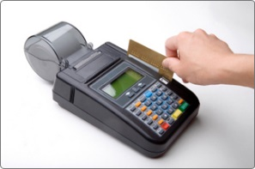
Banking, Cash Collections and Reconciliation Training
Today’s training has been design for all departments that accept credit cards and new staff that need to understand the process of reconciling credit cards.

Slide 4
University General Ledger Accounts
On this training we will talk about the credit card accounts.
There are two main credit card accounts:
  Regular Credit Card
  Student Tuition Account
In the general ledger they both have a different account number.
Account General Ledger account
Regular Credit Card 10061
Student Tuition Account 10071
We also have two different systems Banner (Oasis) used for all student transactions and People Soft (Fast) used for all other transactions.
If the deposit number or the paperwork submitted to the cashiers office is not properly identified, a deposit could be posted in the incorrect general ledger account.

Slide 5
Credit Card Accounts
Regular Credit Card Account:
Account used for all University departments and all three Campus:
Tampa,
St. Pete
Sarasota
Student Tuition Account:
Account used for all Student Tuition, Transcripts, Admissions and Housing.

Slide 6
To request new credit card merchant
Send an email requesting your new credit card merchant account to General Accounting. (nmerced@usf.edu)
A form will be sent to you to provide the merchant name, the contact person, phone number, fax number, email address and campus mail address.
We will also need a chart field to post the revenue and the merchant fees.
Also specify which credit card types would you like to accept: Visa, Master Card, Discover and American Express.

Slide 7
Changes in your Department
On a new Fiscal Year some departments close a fund or a project and open another.
If any change occurs on the revenue or merchant fees chart field, we encourage you to inform General Accounting to make the appropriate correction.
Also if an employee leaves the department please make sure you notify us so we can make sure we contact the new employee to have our credit card contact list updated. Also a change on name if you get married and your email changes please notify us to make the changes as well.

Slide 8
Types of transactions accepted
The University of South Florida has two different forms of accepting a credit card transaction.
Online payments or card not present transactions:
these are processed thru Touch net Payment Gateway. A website is setup for the department to receive the payments online for the products or services they want to provide.
Card Swipe or Card present transactions:
This is the typical transactions where the customer is present and swipes its card to pay for the transaction.

Slide 9
Wells Fargo Merchant Services:
On their website https://www.myclientline.net ,we can view all our credit card deposit activity, chargebacks, merchant fees at all times.
All departments have access to this website and they are responsible for reconciling on a monthly basis and save a copy for audit purposes
If you have not setup your account in client line please do so to view your merchant statements and reconcile.
You will need your merchant number, bank account number and tax id number.
If you do not have this information send me an email and I would gladly sent it to you.

Slide 10
Recording credit card deposits:
All credit cards being processed thru touch net are posted on a daily basis by the cashier’s office but the chargebacks need to be posted by the department.
All departments that send the credit card deposits to the cashier’s office to be posted should do them on a daily basis. Deposits are sent to cashiers in a Miscellaneous receipts Form. Please remember to write the correct chart field, the deposit number and the amount.
The deposit number for Visa, Mastercard, and Discover merchants is the last five numbers of the merchant number:
  USF Athletics – 482032953994 = 53994
For American Express merchants the deposit number is:
  376 + the last three numbers of your merchant number :
    USF Athletics – 4098139008 – 376008

Slide 11
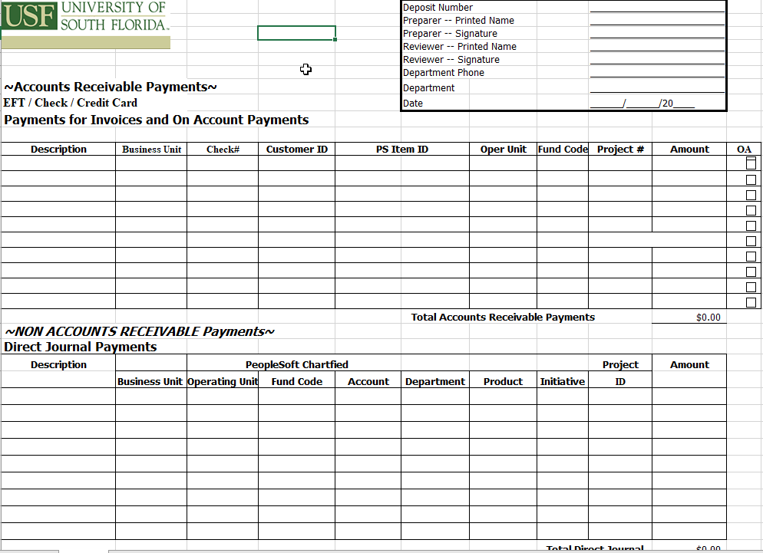

Slide 12
Deposits sent to the cashiers thru email
When sending the cashiers office deposits thru an email please remember to :
The cashier’s office email to send paperwork to be posted is uco-cashier@usf.edu
Attach paperwork with deposit number, amount, date and specify if it is a credit card or lockbox deposit since they belong to different general ledger accounts.
Make sure the email was received by the cashiers office and that you have a confirmation from them.
Also if it is a correction make sure to write a brief but clear note of what is being corrected. The date of the original transaction and the amount.

Slide 13
Backup paperwork needed?
All departments that originate their own Miscellaneous Receipts Form should include back up paperwork for example:
  copy of the invoice, check , credit card slip, etc.
All information pertaining the deposit should be included in order to have backup papers for future reference.
On the Miscellaneous Receipts Form do not change the order of the chart field. It is in order to assist the data entry process for the cashiers.

Slide 14
Deposits sent to cashier’s office:
The Cashier’s Office rules are:
Take all deposits to the office before 2:30 p.m. in order to be processed the same date.
If a deposit number is not on the paper submitted it will be returned to the department.
Identify clearly if it is an e check, check, lockbox, credit card and remember all American Express deposits should be posted separate from the Visa, Master Card and Discover Card.
If submitting a prior month correction please write a note stating the correction and the original transaction’s date and amount to facilitate the reconciliation process.

Slide 15
Departments reconciliation:
All departments are responsible of reconciling their credit card account on a monthly basis.
Find your Book side at FAST – DATA MART – FINANCE MART
The credit card account in the General Ledger is 10061.
Compare all deposits posted in your revenue account against your merchant statements information which is your Bank side.
It is your responsibility to follow up, dispute, and resolve all chargebacks done to your credit card account.
Send to cashiers office all refunds to be posted. Debits and negative amounts.
Save a copy of your reconciliation for audit purposes.

Slide 16
Department reconciliation:
Finance Mart
Go to MyUSF
Data mart
Finance Mart
On report type select
  Balance Sheet Summary
  Enter the department # and the fund
Select : check to enable period selection
View Report
  Select 10999 Total Cash
  Select account 10061 which is the credit cards GL account
Bank Merchant Statements
Go to www.myclientline.net
Go to merchant login and enter your user id and password.
Select from Statements
  Card Processing Statements
Print the Statement
Compare deposits from the Finance Mart Report with the Merchant statements report from Wells Fargo Merchant Services.

Slide 17
Chargeback recording:
The contact person for the department will receive a chargeback document that the bank sends General Accounting and they make a copy and send to the contact person via campus mail .
It is your responsibility to print your merchant statement and review if any chargeback has been charged to your account, follow up with the student or owner of the credit card. Dispute and send any information, the bank is requesting.
Send the appropriate Miscellaneous Receipts form with the posting of the chargeback to the cashier’s office. Also remember to write a note and include any backup paperwork.

Slide 18
All corrections and chargebacks posting should be on the same month:
All prior month corrections should be stated in a note in the Miscellaneous Receipts form sent to the cashiers.
  Include as much information to be able to tie the correction to the original transaction.
All chargebacks are always in the first page of your merchant statements.
All corrections and chargebacks should be posted or corrected in the same month .
Chargebacks are also known as debits in your merchant statements and they are negative amounts.

Slide 19
General accounting reconciliation process:
The accountant has 30 days to reconcile the accounts for all the credit card departments.
There is 30 days to make corrections for the current month.
After 60 days all corrections are going to be addressed by the Staff Accountant and the General Accounting Supervisor.
Prior to year end old outstanding items will be removed from the Credit Card account and placed in a suspense account. After a year they will be taken against merchant fees or revenue if the department doesn’t provide another chart field where they would like it to be posted.

Slide 20
Understanding your merchant statements

Slide 21
Visa, Master Card and Discover merchant statements:
Go to : https://www.myclientline.net
  Log in with your user Id and password
  Proceed to Statements on your right side
  Select Statement Type - Location
  Select the date year and month
  Open the statements
  Print statement

Slide 22
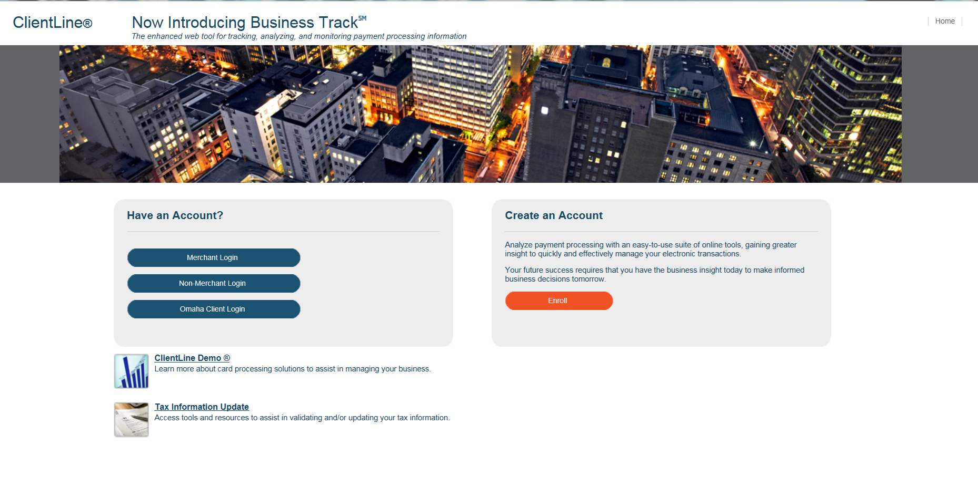

Slide 23
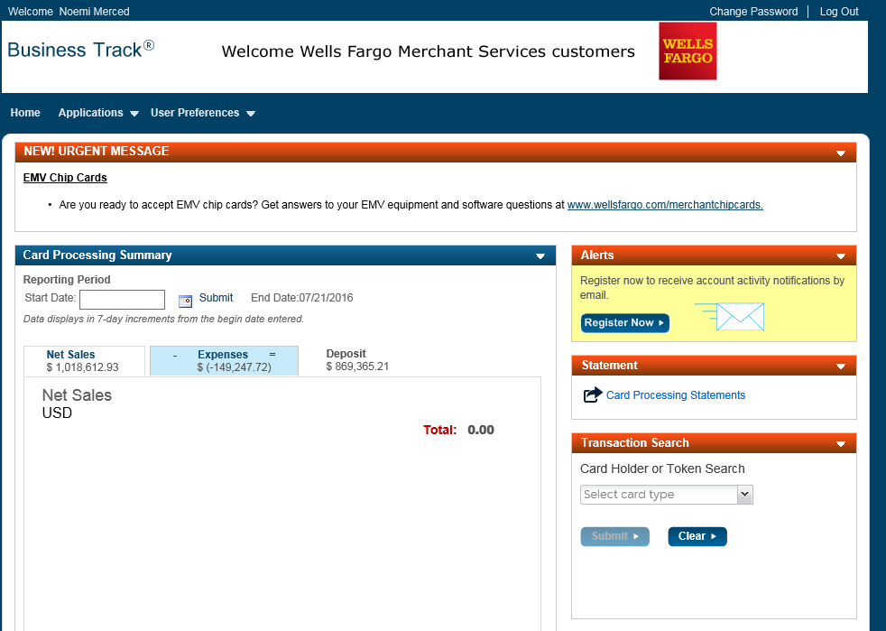

Slide 24
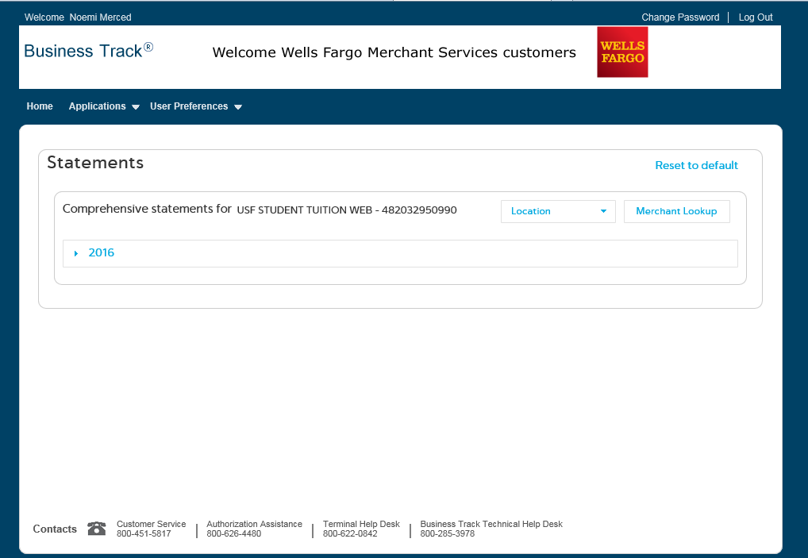

Slide 25
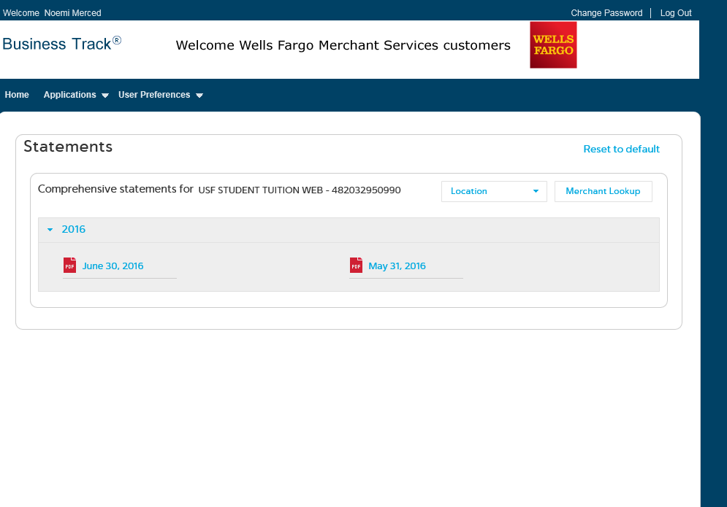

Slide 26
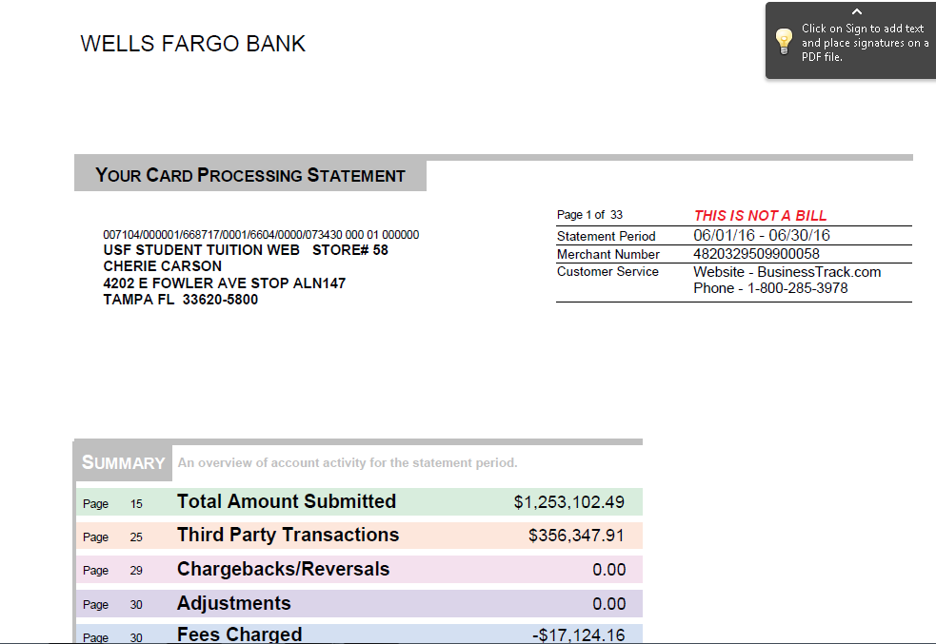

Slide 27
How to create a report:
Go to Applications on your top left hand side
Go to Reports / Create a Report
  Select : Sales/Funding, Transactions
  On Date Type: Select Funded Date to match the bank
  On Report Type: Select Detail
    Select the Date Range needed
Then Hit Next
Hit Run Now on your Right hand side
The report will be available and you can export it as a PDF file, Excel Spreadsheet, CSV or HTML.

Slide 29
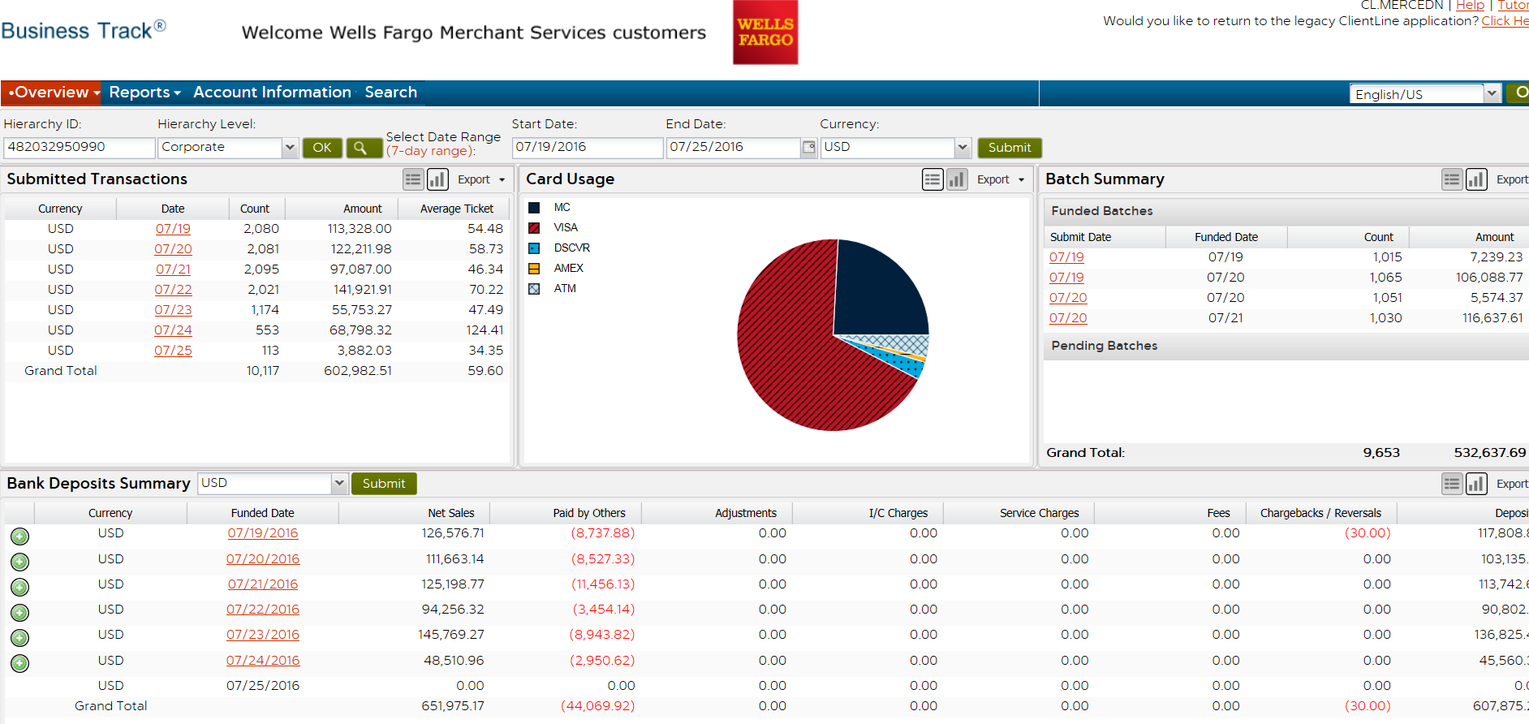

Slide 30
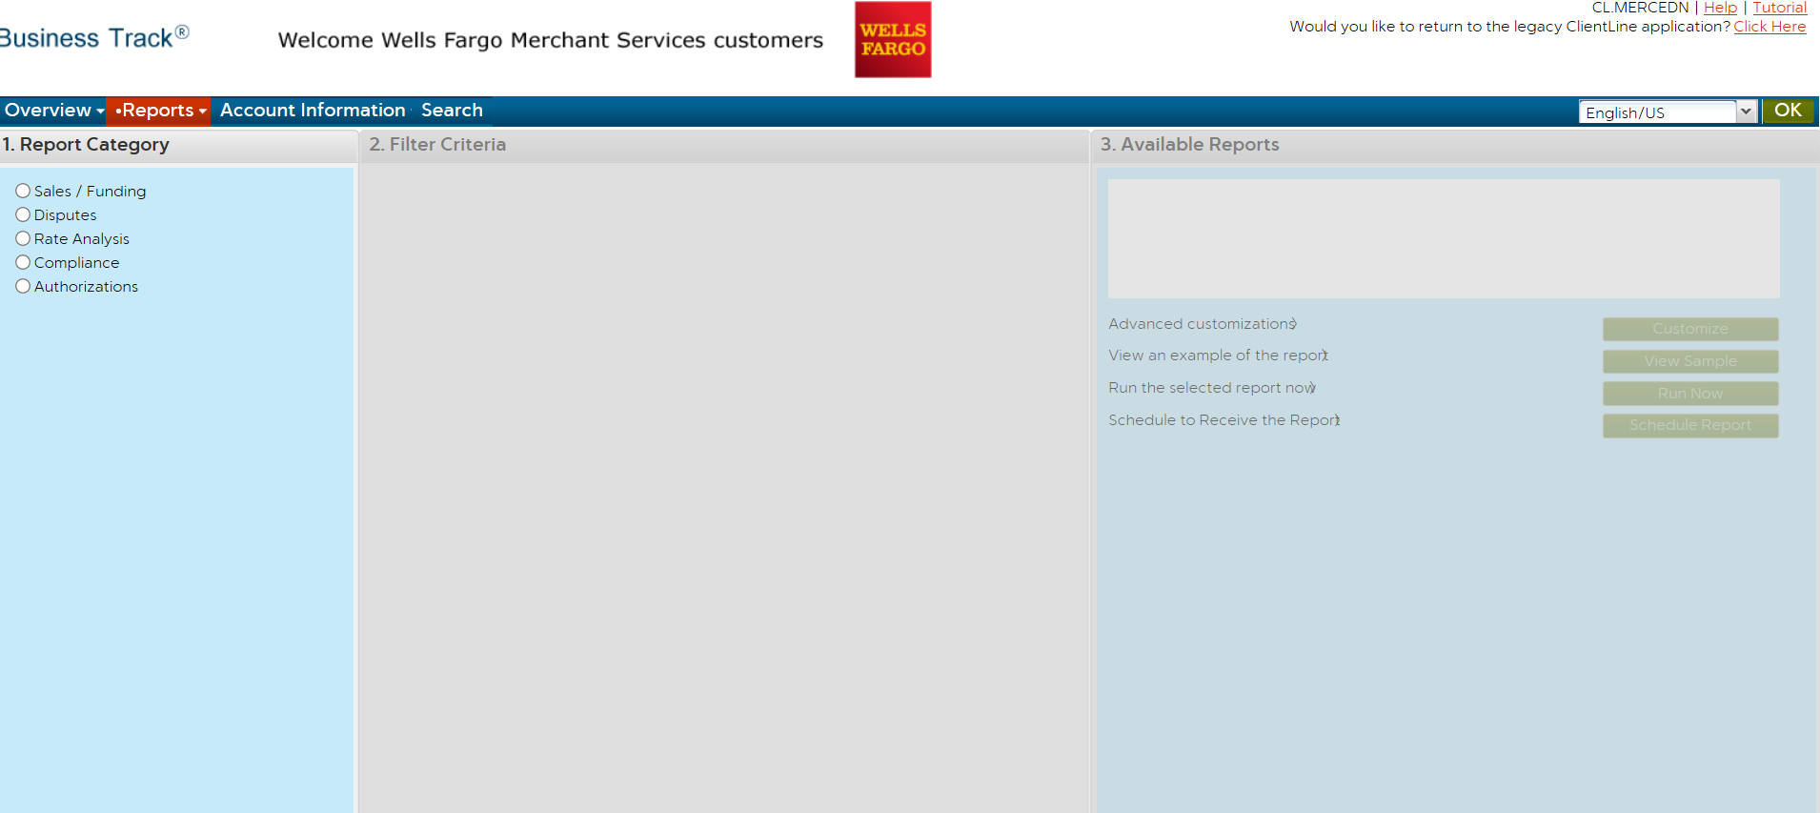

Slide 31
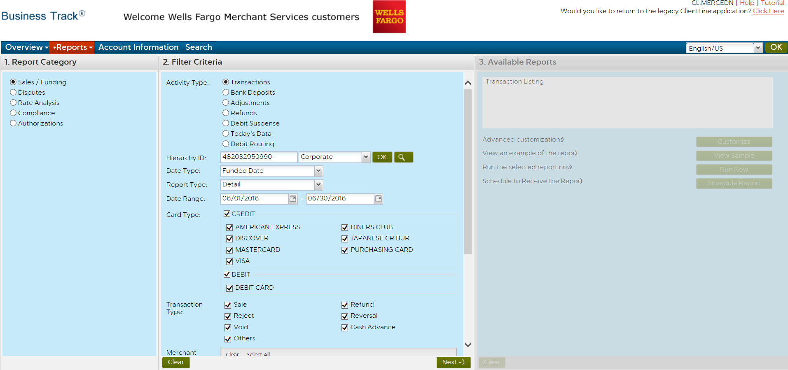

Slide 32
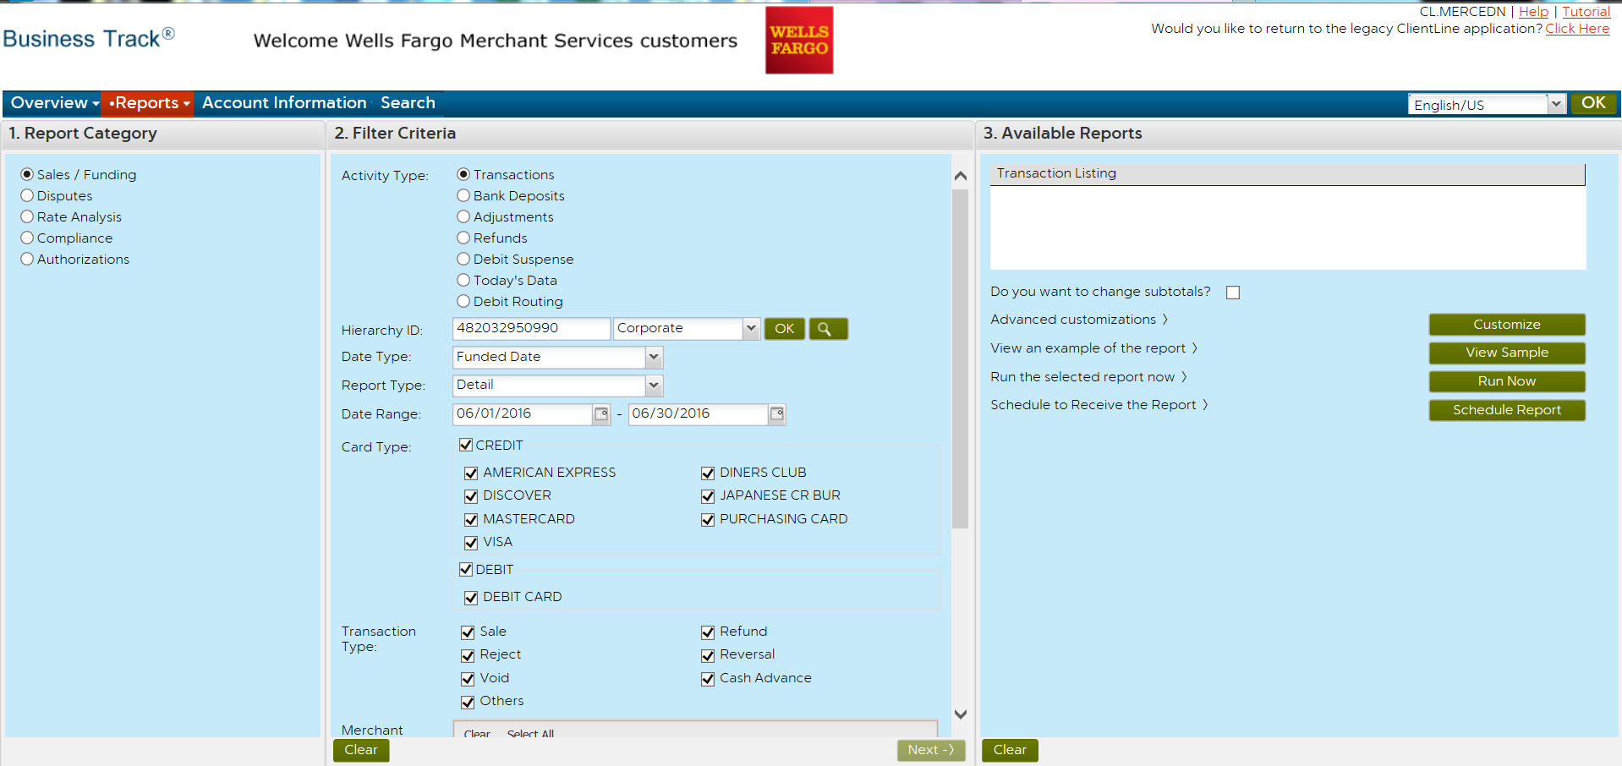

Slide 33
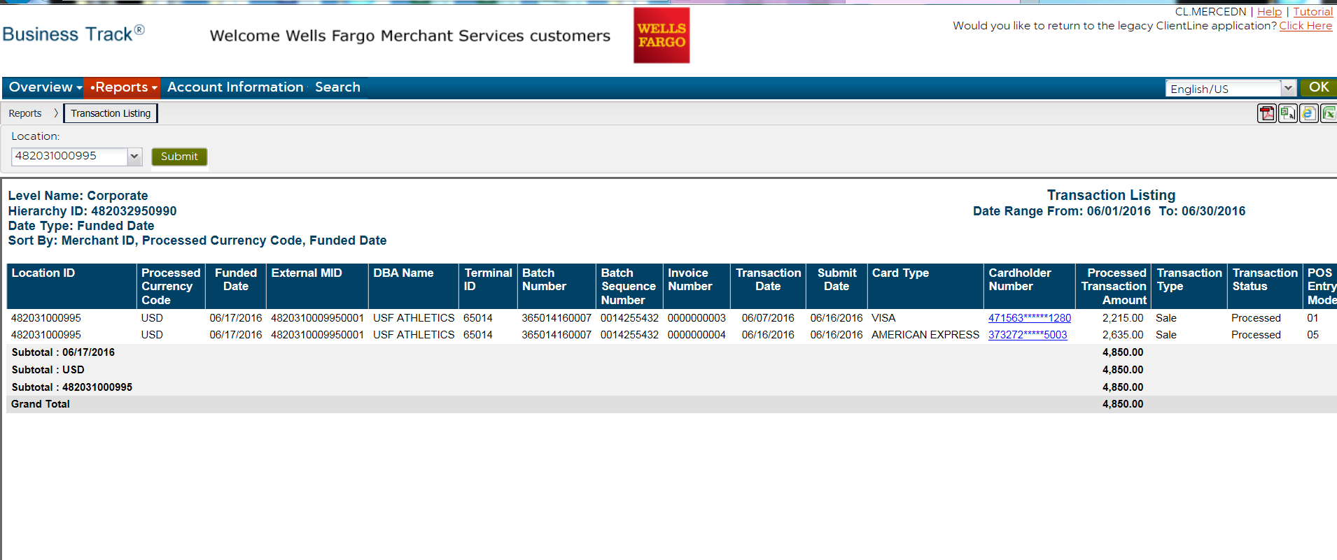

Slide 34
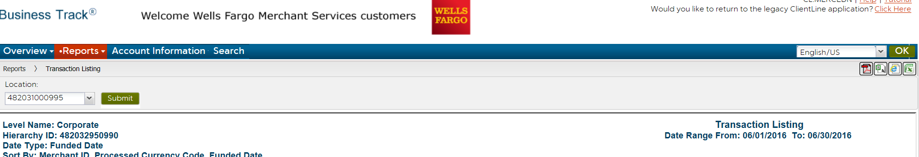

Slide 35
American Express merchant statements:
Go to https://sso.americanexpress.com
Log in with your user id and password
Select the month you need to view an hit view statement
If you need to view a prior month statement go to customize statement
Select the month and hit Go
Select view E statement
Select print
The merchant fees are called Discount Amount on the American Express statements.

Slide 36
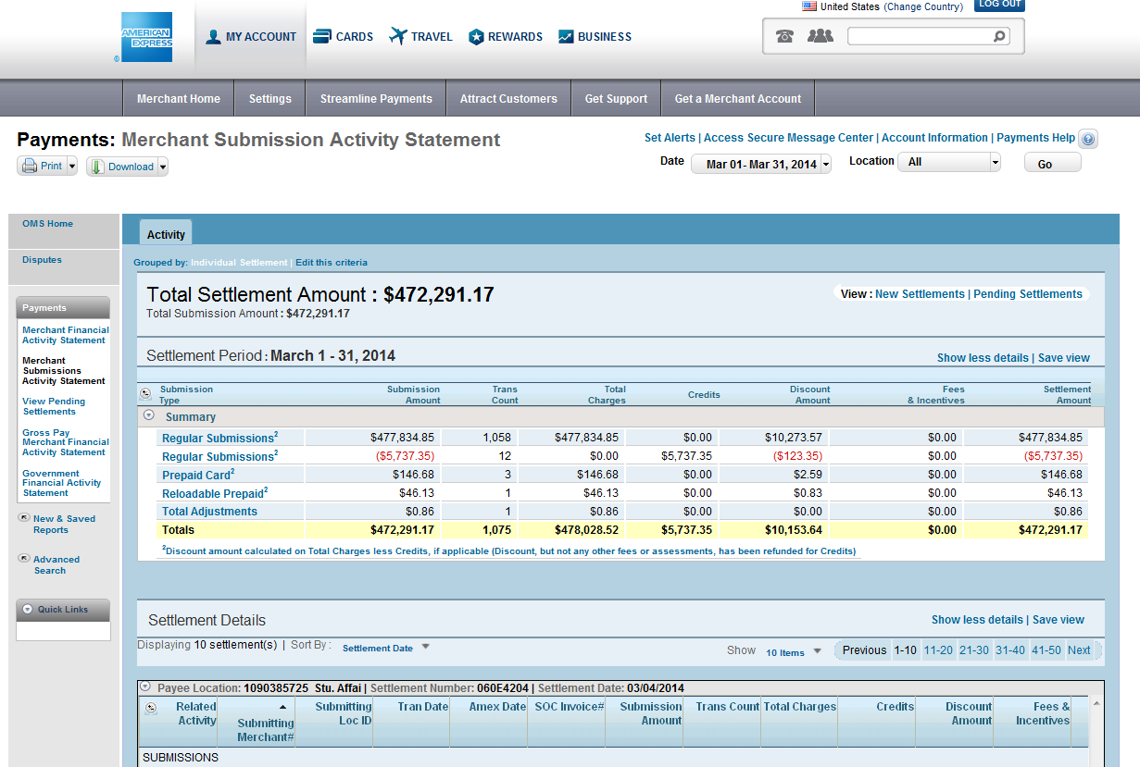

Slide 37
Credit card machine replacement:
Please contact Cherie Carson or Noemi Merced in General Accounting to find out if your credit card is still under warranty.
All replacements should be done thru us so we can get the best deal for your department according to our contract with Wells Fargo Merchant Services.

Slide 38
Payment Collection and Internal Controls

Slide 39
Agenda
Enhance USF Business Practices
Establish Internal Controls related to accepting payments at the University
How to apply appropriate segregation of duties
The roles, responsibilities, procedures and constraints associated with each step
Record Keeping
Custody
Reconciliation
Authorization
Four Functions of Segregation of Duties

Slide 40
Accountability & Internal Controls
Defining Accountability
Internal Controls
Examples

Slide 41
Defining Accountability
Delegation of authority to qualified persons to:
  Initiate, approve, process and review business transactions
Holding these persons responsible for:
  The validity, correctness and appropriateness of their actions

Slide 42
Accountability
Everyone is accountable for their actions
Of all the individuals involved in the receipt, recording and balancing of funds, the person of ultimate responsibility is the custodian
Payment processors are accountable for
  Recording payments accurately
  Observing all of the USF internal controls
  Protecting the cardholders information
Supervisors are accountable for
  Proper allocations of payments
  Assignment of duties that comply with separation of duties guidelines
Others are accountable for
  Proper transfer of custody of payments
Accountable officers are ultimately responsible for payment transactions.

Slide 43
Internal Controls
Protect
  USF
  USF staff
Are designed to provide reasonable assurance regarding:
  Effectiveness and efficiency of operations
  Reliability of reporting
  Compliance with applicable rules, laws, and regulations

Slide 44
Internal Controls as They Relate To Cash Management
Internal controls specifically ensure:
  The safety of all funds
  The timeliness of recording the receipt of all funds
  That assignment of duties complies with separation of duties guidelines
  That reconciliations are completed and reviewed on a monthly schedule
  A sound audit trail and adequate documentation are created
Find specifics on internal controls on:
  www.usf.edu/businessprocesses

Slide 45
Internal Controls - Examples
Generally, access to credit card terminals and POS systems must be limited to a primary and a secondary custodian
Physical safety of the information and equipment must be ensured at point of collection and then stored overnight
All adjustments must be documented and approved by a supervisor (authorizer)
The payments must balance to the system where the payments were recorded
Deposits must be reconciled to the general ledger

Slide 46
Segregation of Duties
Defining Segregation of Duties
The Four Functions of Segregation of Duties
  Record Keeping
  Authorization
  Custody
  Reconciliation
When Segregation is not possible
Examples

Slide 47
Separation of Duties
Separation of duties protects USF and the individual by ensuring that no one person has the ability to control all of the steps involved in handling and accounting for money received by USF.
Custody
Record Keeping
The ideal is that any one person performs only one function; four people are needed for the four functions
Authorization
Reconciliation

Slide 48
Four Functions of Segregation of Duties
The four functions are Record Keeping, Authorization, Custody and Reconciliation
The ideal is that any one person performs only one function; four people are needed for the four functions
If one person performs two functions
  Risk exists that presents the opportunity for something to go wrong
  A compensating control is needed to reduce the risk
  The compensating control might be an extra layer of review

Slide 49
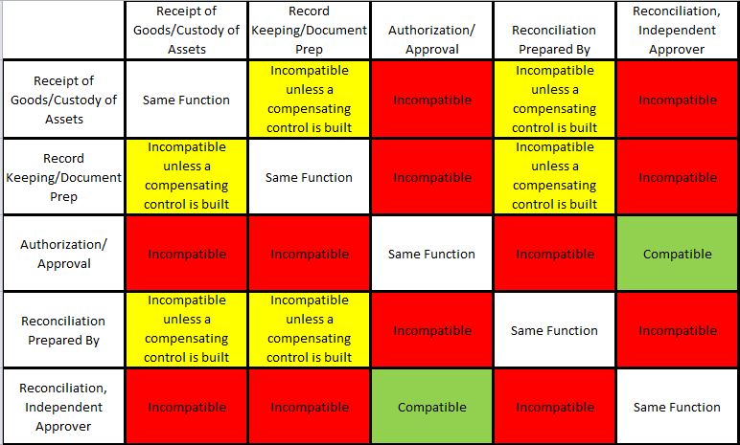
Segregation of Duties

Slide 50
When Segregation Is Not Possible
If one person performs two or more of the functions:
  Risk exists that presents the opportunity for something to go wrong
  A compensating control is needed to reduce the risk
  The compensating control might be an extra layer of review

Slide 51
Examples of Compensating Controls
A manager may perform a high level of review of detailed transaction reports
A manager may periodically sample transactions and request supporting documentation to ensure the transactions are complete, appropriate, and accurate.
Someone from an another area may perform an external review of a reconciliation. For instance two departments within a college may share responsibility to review each others reconciliations.
Some colleges and units have a centralized business services department

Slide 52
Record Keeping
Defining Record Keeping
Retention
Examples

Slide 53
Record Keeping
Record keeping is the process of creating and maintaining official records
Record keeping may occur manually or through an automated data system
Record Keeping Examples:
  Mail log – paper or electronic
  Customer receipts
    Official USF pre-numbered cash receipts
    System generated cash receipts
  Deposit slips
  Credit card receipts
  Cash register reports
  EFT (electronic funds) payment documents
  Balancing and reconciliation reports

Slide 54
Record Keeping - Retention
Observe record retention requirements
  Find information on Online Business Processes
  Also find information on the Purchasing web site
Records serve multiple needs
  Compliance with best business practices
  Helpful in researching a question

Slide 55
Authorization
Defining Authorization
Best Practices

Slide 56
Authorization
Authorization is the process of granting formal approval to perform a specific function
For example, someone must be authorized in order to perform one of the following functions:
  Verify cash collections
  Review daily balancing reports
  Approve discounts, voids, or refunds

Slide 57
Authorization
The person who originally created a transaction should not be:
  The one who makes a correction
  The one who creates a void
  The one who creates/approves a refund
The best practice is to have a supervisor take these actions

Slide 58
Custody
Defining Custody
System Passwords
Register Keys
Storage of Funds

Slide 59
Custody
Having access to or control over any physical asset
Custodians:
  Collect and handle payments
  Prepare deposits
  Have access to safes, lock boxes, & file cabinets where funds are kept
  Custodians of petty cash funds or change funds

Slide 60
Custody – System Passwords
All cash registers or Point of Sale (POS) systems should be password protected to assign accountability and fix responsibility
Every person must have their own password
Passwords must never be shared
Don’t write your passwords down
If you need to leave the work area, sign off your password; log back on when you return
Passwords should be changed periodically
Passwords should be inactivated whenever a custodian vacates the position

Slide 61
Custody – Register Keys
If your cash register or point-of-sale system uses key access:
  Only essential staff should possess the keys
  An inventory of the keys should be kept
  Keys should never be shared
  Keys must be collected whenever a custodian vacates the position
Custody – Storage of Funds
The safe or lock box combination should be changed:
  Any time an employee with knowledge of the combination or access to the key terminates or is reassigned
  Periodically
  Funds should never be stored in a desk, even if it is locked

Slide 62
Reconciliation
Defining Reconciliation
Why Reconcile?
Transaction Reconciliation
Non-Inventory Reconciliation
Credit Card Reconciliation
Reconciliation Guidelines

Slide 63

Reconciliation & Balancing
Cashier Balancing
Check Log Balance

Slide 64
Defining Reconciliation
A reconciliation is simply a comparison of two sets of information as of the same point in time
Identify the differences between what actually did post in Finance Mart vs. what you expected to post in Finance Mart
Why Reconcile?
Good internal controls and sound business practices necessitate the reconciliation of funds by business staff
USF needs assurance that all assets are safeguarded and used to the best benefit of the university

Slide 65
What Do We Reconcile?
Point of sale transactions ( POS )
Check logs
Bank card payments
E check payments
Transaction posting in FAST and FM
Credit Cards
Inventory

Slide 66
Point of Sale Transactions ( POS )
The POS system should
  Record sales and cash collections
  Produce a daily detailed sales report
  Produce a pre-numbered customer receipt
Reconciliations to perform
  Balance the cash drawer
  Balance the day’s sales to actual collections
  Reconcile daily balancing sheet to deposit

Slide 67
Transaction Reconciliation
Reconcile
  Deposits to accounts receivable postings
  Deposits to general ledger postings
  Inventory to sales
Finance Mart is the official reporting system
  Confirm that correct chart fields were used
  Submit corrections immediately
  Confirm that corrections posted correctly
  Find detail in FAST or OASIS

Slide 68
Non-Inventory Reconciliation
Some sales may not involve tangible inventory
To ensure that all billings have been completed, review
  Room usage logs
  Equipment or lab usage logs
  Participant lists or class rolls
  Order forms or contracts for services

Slide 69
Credit Card Reconciliation
When credit cards are used with a POS
  POS system should produce a report of credit card transactions
  Compare the POS report to the daily settlement report
  Supervisor reviews this

Slide 70
Reconciliation - Guidelines
Reconciliation must be performed by a person with no cash handling responsibilities
The reconciliation must be dated and signed or initialed
The reconciliation should be reviewed by an independent party
The prescribed procedure should be followed; find reconciliation resources on the UCO web site

Slide 71
Glossary
Account Number | The 16-digit account number that appears in print on the front of all valid credit cards. The number is one of the card security features that should be checked by merchants to ensure that a Card-Present transaction is valid.
Address Verification Service (AVS) | AVS allows USF Merchants that accept card-not-present transactions to compare the billing address (the address to which the card issuer sends its monthly statement for that account) given by a customer with the billing address on the card issuer’s master file before shipping an order. AVS helps merchants minimize the risk of accepting fraudulent transactions in a card-not-present environment by indicating the result of the address comparison.
Authorization | The process by which a card issuer approves or declines a credit card purchase. Authorization occurs automatically when you swipe the magnetic stripe of a payment card through a card reader. See also: Voice Authorization Center.
“Call” or “Call Center” response | A response to a merchant’s authorization request indicating that the card issuer needs more information about the card or cardholder before a transaction can be approved; also called a referral response.
Card Acceptance Procedures | The procedures USF Merchants and Employees must follow at the point of sale to ensure a card and cardholder are valid.
Card Expiration | See Good Thru date.
Cardholder | The person to whom a credit card is issued.
Card-Not-Present | A merchant, market, or sales environment in which transactions are completed without a valid credit card or cardholder being present. Card-not-present is used to refer to mail order, telephone order, and Internet merchants and sales environments.

Slide 72
Card-Present | A merchant, market or sales environment in which transactions can be completed only if both a valid credit card and cardholder are present. Card-Present transactions include traditional retail—department and grocery stores, electronics stores, boutiques, etc.—cash disbursements, and self-service situations, such as gas stations and grocery stores, where cardholders use unattended payment devices.
Card Security Features | The alphanumeric, pictorial, and other design elements that appear on the front and back of all valid credit card and debit cards. Card-Present merchants must check these features when processing a transaction at the point of sale to ensure that a card is valid.
Card Verification Value 2 (CVV2) | A fraud prevention system used in card-not-present transactions to ensure that the card is valid. The CVV2 is the three-digit value that is printed on the back of credit cards. Card-not-present merchants ask the customer for the CVV2 and submit it as part of their authorization request. For information security purposes, merchants are prohibited from storing CVV2 data.
Cardholder Information Security Program (CISP) | A program that establishes data security standards, procedures, and tools for all entities— merchants, service providers, issuers, and merchant banks—that store cardholder account information. CISP compliance is mandatory.
Chargeback | A transaction that is returned as a financial liability to a merchant bank by a card issuer, usually because of a disputed transaction. The merchant bank may then return or “charge back” the transaction to the merchant.
Code 10 Call | A call made to the merchant’s voice authorization center when the appearance of a card or the actions of a cardholder suggest the possibility of fraud. The term “Code 10” is used so calls can be made without arousing suspicion while the cardholder is present. Specially trained operators then provide assistance to point-of-sale staff on how to handle the transaction.
Copy Request | A request by a card issuer to a merchant bank for a copy or facsimile of a sales receipt for a disputed transaction. Depending on where sales receipts are stored, the merchant bank either fulfills the copy request itself or forwards it to the merchant for fulfillment. A copy request is also known as a retrieval request.

Slide 73
Credit Receipt | A receipt that documents a refund or price adjustment a merchant has made or is making to a cardholder’s account; also called credit voucher.
Disclosure | Merchants are required to inform cardholders about their policies for merchandise returns, service cancellations, and refunds. How this information is conveyed, or disclosed, varies for Card-Present and Card-Not-Present merchants, but in general, disclosure must occur before a cardholder signs a receipt to complete the transaction.
Firewall | A security tool that blocks access from the Internet to files on a merchant’s or third-party processor’s server and is used to ensure the safety of sensitive cardholder data stored on a server.
Good Thru Date | The date after which a bankcard is no longer valid, embossed on the front of all valid credit cards. The Good Thru date is one of the card security features that should be checked by merchants to ensure that a Card-Present transaction is valid. See also: Card expiration date.
High-Risk Merchant | A merchant that is at a high risk for chargebacks due to the nature of its business. High-risk merchants include direct marketers, travel services, outbound telemarketers, inbound teleservices, and betting establishments.
Internet Protocol Address | A unique number that is used to represent individual computers in a network. All computers on the Internet have a unique IP address that is used to route messages to the correct destination.
Key-Entered Transaction | A transaction that is manually keyed into a point-of-sale device.
Magnetic Stripe | The magnetic stripe on the back of all credit cards is encoded with account information as specified in the Payment Card Industry Operating Regulations. The stripe is “read” when a card is swiped through a Point of Sale (POS) terminal. On a valid card, the account number on the magnetic stripe matches the account number on the front of the card.
Magnetic Stripe Reader | The component of a point-of-sale device that electronically reads the information on a payment card’s magnetic stripe.
Mail Order / Telephone Order (MO / TO) | A merchant, market, or sales environment in which mail or telephone sales are the primary or a major source of income. Such transactions are frequently charged to customers’ bankcard accounts. See also: Card-not-present.

Slide 74
Merchant Agreement | The contract between a merchant and a merchant bank under which the merchant participates in a credit card company’s payment system, accepts credit cards for payment of goods and services, and agrees to abide by certain rules governing the acceptance and processing of credit card transactions. Merchant agreements may stipulate merchant liability with regard to chargebacks and may specify time frames within which merchants are to deposit transactions and respond to requests for information.
Merchant Bank | A financial institution that enters into agreements with merchants to accept credit cards as payment for goods and services; also called acquirers or acquiring banks.
Merchant Chargeback Monitoring Program (MCMP) | A program that alerts merchant banks when one of their merchants has a chargeback-to-transaction rate of over one percent. Merchants then work with the bank to reduce their chargeback rates to acceptable levels. Failure to reduce chargebacks can result in fines for a merchant.
Payment Gateway | A system that provides services to Internet merchants for the authorization and clearing of online credit card transactions.
Pick-Up Response | This response indicates that the card issuer would like the card to be confiscated from the customer. However, USF Employees should not attempt to pick up credit cards, even when the card issuer requests this action, as this could potentially cause confrontation and safety issues.
Point-of-sale Terminal (POS terminal) | The electronic device used for authorizing and processing bankcard transactions at the point of sale.
Printer Number | A four-digit number that is printed below the first four digits of the printed or embossed account number on valid credit cards. The four-digit printed number should be the same as the first four digits of the account number above it. The printed four-digit number is one of the card security features that merchants should check to ensure that a Card-Present transaction is valid.
Representment | A chargeback that is rejected and returned to a card issuer by a merchant bank on the merchant’s behalf. A chargeback may be represented, or redeposited, if the merchant or merchant bank can remedy the problem that led to the chargeback. To be valid, a representment must be in accordance with Payment Card Industry Operating Regulations.

Slide 75
Sales Receipt | The paper or electronic record of a bankcard transaction that a merchant submits to a merchant bank for processing and payment. In most cases, paper drafts are now generated by a merchant’s POS terminal. When a merchant fills out a draft manually, it must include an imprint of the front of the card.
Skimming | The replication of account information encoded on the magnetic stripe of a valid card and its subsequent use for fraudulent transactions in which a valid authorization occurs. The account information is captured from a valid card and then re-encoded on a counterfeit card. The term “skimming” is also used to refer to any situation in which electronically transmitted or stored account data is replicated and then re-encoded on counterfeit cards or used in some other way for fraudulent transactions.
Split Tender | The use of two forms of payment, or legal tender, for a single purchase. For example, when buying a big-ticket item, a cardholder might pay half by cash or check and then put the other half on his or her credit card. Individual merchants may set their own policies about whether or not to accept split-tender transactions.
Third-Party Processor | A non-member organization that performs transaction authorization and processing, account record keeping, and other day-to-day business and administrative functions for issuers and merchant banks.
Transaction | The act between a cardholder and merchant that results in the sale of goods or services.
Unsigned Card | A seemingly valid credit card that has not been duly signed by the legitimate cardholder. Merchants cannot accept an unsigned card until the cardholder has signed it, and the signature has been checked against a valid, government-issued Photo ID, such as a driver’s license or passport.
Voice Authorization | An authorization obtained by telephoning a voice authorization center.
Voice Authorization Center | An operator-staffed center that handles telephone authorization requests from merchants who do not have electronic POS terminals or whose electronic terminals are temporarily not working, or for transactions where special assistance is required. Voice authorization centers also handle manual authorization requests and Code 10 calls.

Slide 76
Resources
Office of University Audit & Compliance
Online Business Processes
Additional training resources are available on the University Controllers Office website
  UCO Website > About UCO > Training > Banking and Cash Management
    Credit Card Reconciliation Process
    Lock Boxes and ACH’s
    Internal Controls
    Separation of Duties

Slide 77


Are you ready for the Quiz?

