Slide 1
USF Financial Systems Introduction

Slide 2
Agenda
USF vs Private Business
Review the many DSO’s and Component Units and other funding sources within the USF Financial System
FAST and Workflow
Financial Data Systems
OASIS
GEMS (Fluid on 11/13/2019)
FAST

Slide 3
USF Overview
The University of South Florida is a large, public 4-year university offering undergraduate, graduate, specialist and doctoral level degrees. USF has an annual budget of over $1 billon.
The USF mission is to deliver competitive undergraduate, graduate, and professional programs, to generate knowledge, foster intellectual development, and ensure student success in a global environment.

Slide 4
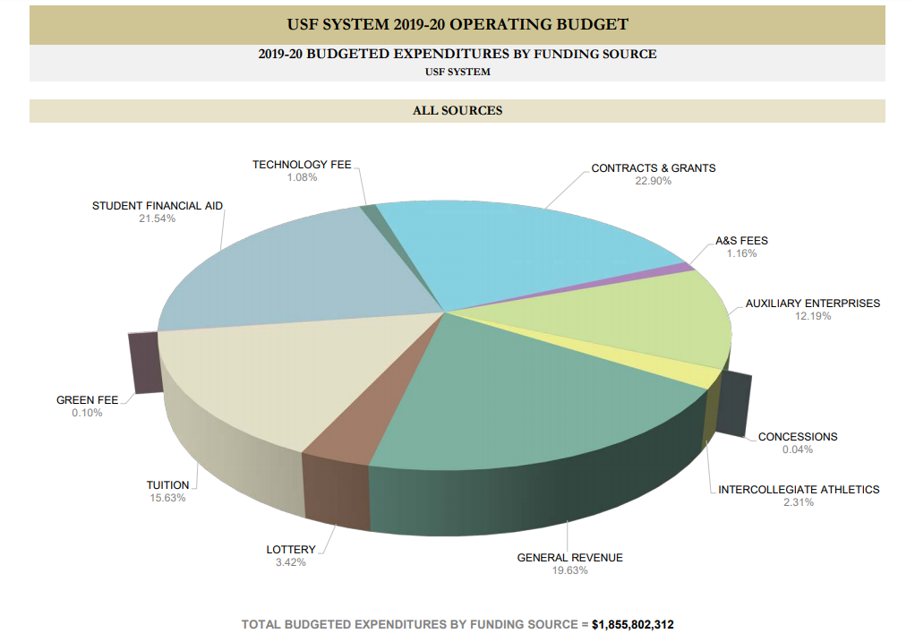

Slide 5
USF Governance
USF operates within the USF Board of Trustees governance structure
The USF BOT appoints the USF President, who in turn appoints the Regional Chancellors of the member institutions
USF has many governance organizations that advise the President on matters of interest including the Administrative Advisory Council, the Faculty Senate, and the Staff Senate

Slide 6
Code of Conduct for Financial Functions
Supporting the constitution and laws of the State of Florida there is a USF Code of Conduct for Financial Functions. Find the document on the UCO web site under About UCO/Training and Resources/Business Training and also on the USF Business Processes web site.
There is also a separate statement of Fund Accountability and Signature Authorization supported by a Code of Ethics for the USF Foundation.

Slide 7
How is USF Different from Private Business?
USF
Emphasis on accountability
USF relies on a variety of external funding sources
Responsible to multiple organizations
Board of Trustees
State of Florida
Research sponsors
DSO, component units, auxiliaries, sponsored research
Private Business
Emphasis on profit
Company relies on sales and investments
Responsible to shareholders
Company may have subsidiaries

Slide 8
How is USF Similar to the Private World?
Need to control expenditures
Need to be concerned about cash balances
Need to adhere to accounting principles
Are held accountable for our operations
Are audited

Slide 9
Direct Support Organizations (DSOs)
Component Units (CU)
Any organization for which the nature and significance of their relationship to USF is such that exclusion would cause the USF financial statement to be misleading or incomplete
Separate not-for-profit corporations
Provide supplemental resources from private gifts and bequests and valuable educational support services

Slide 10
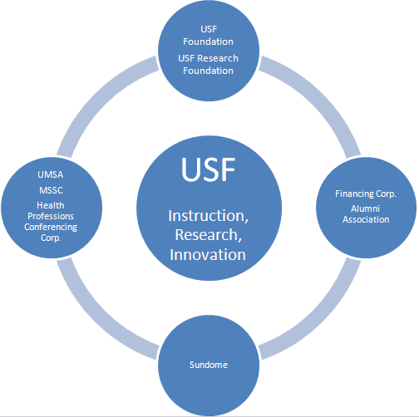

Slide 11
DSOs and Component Units
USF Foundation (DSO and CU)
The legal conduit for the raising, acceptance, investment, and distribution of all private gifts made to USF
USF Research Foundation (DSO and CU)
Supports technology research as a catalyst for economic development and advocates the development and construction of facilities for high technology companies and related support functions
Yuengling Center (formerly Sun Dome) (DSO and CU)
Organized to operate and administer certain facilities located on the campus

Slide 12
DSOs and Component Units
UMSA (DSO and CU)
University Medical Service Assn. operates exclusively for scientific and educational purposes
MSSC (DSO and CU)
Medical Services Support Corporation provides non-physician personnel and services in support of the operation of the facilities utilized by the University’s College of Medicine
HPCC (DSO and CU)
Committed to sponsoring quality activities/events to meet the needs of USF faculty

Slide 13
DSOs and Component Units
USF Financing Corporation (DSO and CU)
The University's financing arm is expected to provide attractive long-term financing for the University's major capital projects.
USF Property Corporation (CU only)
Organized to support the Finance Corporation by assisting in acquiring and constructing facilities
USF Alumni Association (DSO and CU)
Seeks to maintain and enhance a mutually beneficial, lifelong relationship between the University and alumni
Find more information about DSOs view the USF Treasurer’s web site

Slide 14
Public Purpose Funds
State funding (E&G aka General Revenue)
This is a budget allocation from the state of Florida
E&G funds are supported by taxes, fees, and other state revenue
It includes the “lottery” funds (Educational Enhancement Trust Fund)
Not cash but spending authority allocated for one fiscal year
May be carried over to a subsequent year (Carry-forward funds)
Auxiliary funds
Generated by sales from authorized business activities
Taxability concerns about relation to the USF mission
Actual cash balances that roll forward year to year
Requires EBA (Educational Business Activity) approval

Slide 15
Special Purpose Funds
Sponsored Research/Grant funding
Federal, state, or private sources
Allocated by a sponsoring agency to USF with a PI (project investigator) identified with a specific line item budget
RIA (Research Initiative funds)
Includes F&A recovery, new faculty start-up funds, USF internal research awards, and residual amounts of fixed-price contracts
Student Fee Trust Fund
Paid by students and used exclusively for student support
Local fees such as Tech fees and Green fees
Fees charged to students to fund these specific programs

Slide 16
Not USF Money
Student Financial Aid
May be received from federal, state, or private sources
May involve a transfer from the USF Foundation
Agency funds
For example sales tax collected from commercial sales of services to customers outside USF
Convenience funds
Reimbursement received from a DSO or other organization (such as Moffitt) in acknowledgement of effort expended by USF staff in support of the USF College of Medicine clinics

Slide 17
Other Funding Sources
Other funding sources
PECO
Public Education Capital Outlay
For building construction
Bonding of buildings
Our DSO, the Finance Corp.
Concession Funds
Revenue collected from vending machines and other coin operated campus services

Slide 18
Resource Management and Anaylsis
Resource Management and Analysis
University Budgets & Reporting releases, manages, and reports budget activity
RMA Web site
The web site provides guidance on:
The operating budget
The operating budget process
A funding commitment training guide
Budget transfer procedure
Budget account mapping (linkage between budget codes and general ledger account codes for both expense and revenue)

Slide 19
FAST – Budget Module
In FAST the Commitment Control module
Expenses are budgeted for all funding sources
Budget is reserved whenever a requisition or a purchase order is created
Budget is consumed whenever a vendor invoice is paid
Budget is consumed whenever a purchase is made with a USF P-card (procurement card)
Budget is released to individual chart field strings
Colleges and departments are accountable for their budgets

Slide 20
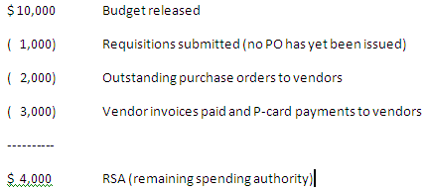
RSA – Remaining Spending Authority

Slide 21
Commitment Control & Revenue
The module is also used to track revenue
Auxiliaries have revenue targets for the fiscal year
“Revenue Budget” is released to individual revenue chart field strings
Periodically actual generated revenue is compared to the revenue budget
It will not limit revenue

Slide 22
Primary Data Systems
OASIS
All student activity; financial and academic (Banner software)
GEMS
All human resource activity; financial and employment related
PeopleSoft software
FAST
The actual financial accounting system for USF (PeopleSoft software)

Slide 23
Subsidiary Systems
Subsidiary systems
TAS (IT telecommunications application)
FACNET (Physical Plant management application)
Supporting and Reporting systems
TouchNet (web based bank card payment processing)
IFIS (space management application)
BDMS (document imaging application)
Data Warehouse (data collection from multiple applications)
Finance Mart (the official financial reporting application)

Slide 24
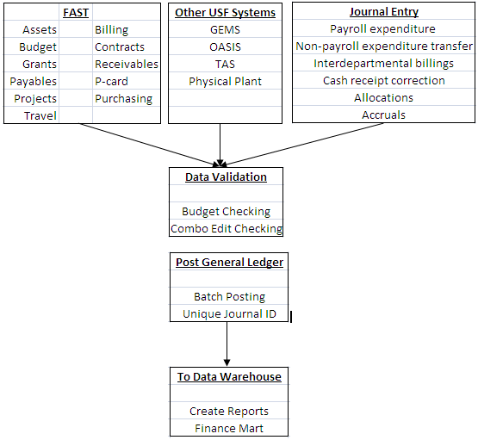
The Data Flow

Slide 25
FAST – Security Roles
For FAST complete the security access form
Find it on the UCO web site; www.usf.edu/business-finance/controller
Email to FAST Security (appears as BUSFIN FAST Security in Outlook) for review
Your job duties drive what access you are granted
We must avoid business conflicts; we must observe proper separation of duties
Access is granted by specific roles with levels of access
View only
Add
Update
The request must be signed by your Accountable Officer

Slide 26
FAST – Security Details & Tips
If you change jobs within USF
On your last day in a position, your FAST ID will be automatically locked preventing use of the system
Submit a FAST security update request to unlock your ID with new appropriate security roles
If you leave USF employment
On your last day, your FAST ID will be automatically locked
Access to Finance Mart is open to all USF employees (you must have a USF employee ID) use your NetID to log in

Slide 27
Workflow
Hierarchy of chart fields for workflow
Project ID
Initiative
Fund ID
Operating Unit/Department ID combination
Choose carefully
Don’t ask for assignments to general use chart fields
Like Fund 10000 or the initiative DEPTMENT
Notification system for two modules
Purchasing workflow
Travel workflow
Purchasing workflow assignments
Send the form by email (Excel spreadsheet format)
Controller’s office reviews and approves; IT updates workflow
Workflow is assigned based on chart fields

Slide 28
Purchasing Workflow
Choose the correct role for assignment
Accountable Officer
Accountable Officer Designee
Requisition Approver (needs USF_PO_REQAPPR security)
Requisition Manager (needs USF_PO_REQAPPR security)
How to submit the request
Email Excel spreadsheet to FAST Security (find in Outlook)

Slide 29
Travel Workflow
Anyone who participates in the travel process
Needs FAST access
Needs travel module workflow role assignment
How to submit the request
Travel workflow is requested on page 3 of the FAST Access form
Email the form to FAST Security (In Outlook)

Slide 30
Accountable Officers – Accountability?
Accountable officers are assigned to:
A specific project ID
A specific Initiative
A specific fund code (usually an auxiliary fund)
A specific combination of Operating Unit and Department
There can be only one accountable officer
For a specific project, initiative, fund code, or combination of operating unit/department
But every project, initiative, fund code, or operating unit/department must have an accountable officer

Slide 31
What does the AO do?
Ensure purchases are made from valid, authorized funds
Ensure that revenue is received and deposited timely
Ensure that staff have the appropriate training necessary to create transactions in FAST
Account for all USF equipment and assets
Identify any fraudulent activity; notify authorities
Review and approve system security requests and workflow requests

Slide 32
Online Business Processes
Our online guide to business process
The address is www.usf.edu/businessprocesses
Allows for keyword search or category search
You may pose questions
Look for information on
Accounting practices
HR-payroll
Purchasing
Research
The USF Foundation
And many other subject areas

Slide 33
University Controller’s Office (UCO)
http://www.usf.edu/business-finance/controller
UCO Administrative Services, Accounting & Reporting, Student Services, Travel & Accounts Payable, Payroll & Tax Services, and Procurement.
Important ListServ
Join the FAST ListServ
Visit http://listserv.usf.edu/scripts/wa.exe?A0=FAST-LIST to subscribe; click Get Password
Join the Travel ListServ
Travel home page to subscribe
Join the Payroll ListServ
Look on the Payroll Overview page to subscribe
Join the Purchasing ListServ

Slide 34
Helpful Resources
Email | Department
aphelp@usf.edu | Accounts Payable Help
Asset-help@usf.edu | Asset Management Help
billingarhelp@usf.edu | Billing and AR Help
cashiers@usf.edu | Cashiers Office Help
Electronic-media-disposal@usf.edu | Electronic Media
financemart@usf.edu | Finance Mart Questions
payrollhelpdesk@usf.edu | Payroll Questions
pcard@usf.edu | PCARD Questions
travelhelp@usf.edu | Travel Questions
usfpurchasing@usf.edu | Purchasing Help

