Slide 1
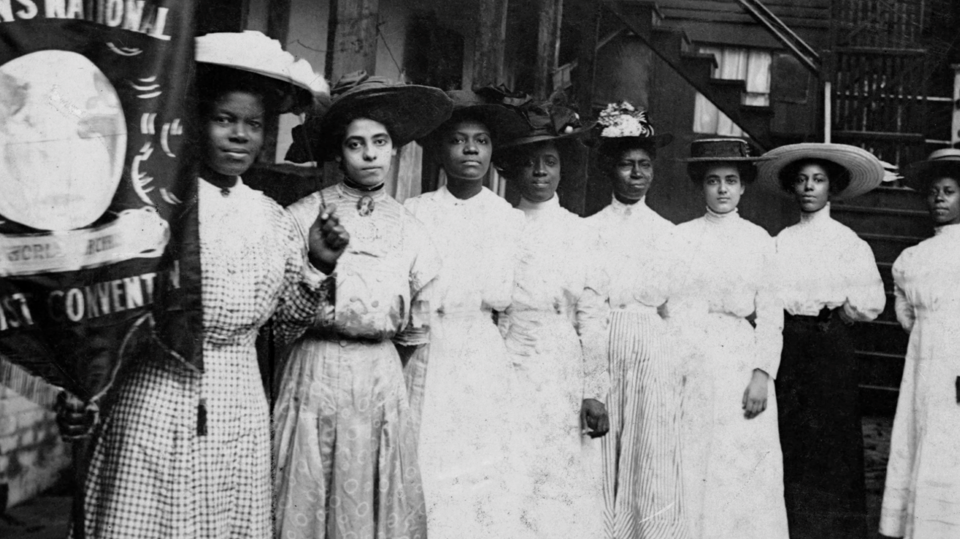
Votes & Victory
Women’s Participation in Government & World War I

Slide 2
Relevant Curricular Standards
SS.1.A.1.1: Develop an understanding of a primary source.
SS.1.A.2.1: Understand history tells the story of people and events of other times and places.
SS.912.A.1.4: Analyze how images, symbols, objects, cartoons, graphs, charts, maps, and artwork may be used to interpret the significance of time periods and events from the past.
SS.912.A.1.6: Use case studies to explore social, political, legal, and economic relationships in history.
SS.912.A.4: Demonstrate an understanding of the changing role of the United States in world affairs through the end of World War I
SS.912.AA.3: Identify significant events, figures, and contributions that shaped African American life from 1865 to 1954
SS.8.CG.2: Evaluate the roles, rights, and responsibilities of US citizens, and determine methods of active participation in society, government, and the political system

Slide 3
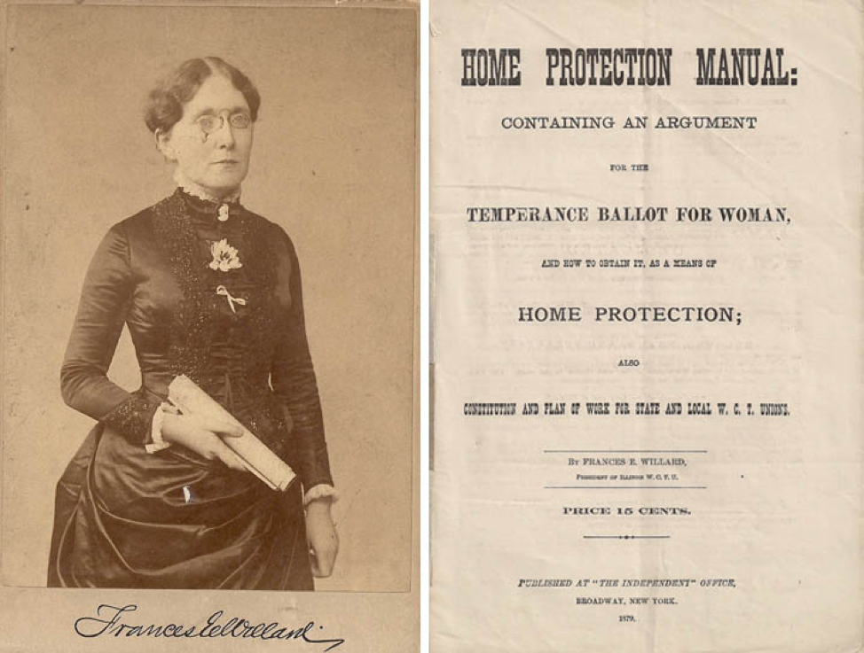
Home Protection Ballot
Women’s Christian Temperance Union (WCTU)
“The WCTU seeks the ballot for no selfish ends. Asking for it only in the interest of the home, which has been woman’s divinely appointed province, there is no clamor for ‘rights.’” –Frances Willard
General Federation of Women’s Clubs (GFWC)
Civic Motherhood
“Woman’s place is in the home, but Home is not contained within four walls. Home is the community. The city is the Family. The school is the Nursery. Badly do they need their mother.” –Rheta Child Dorr
(Primary Source)

Slide 4
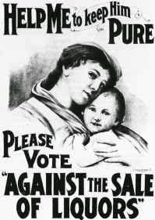
“We want the ballot because the liquor traffic is entrenched in law, and law grows out of the will of majorities, and majorities of women are against the liquor traffic.” –Frances Willard

Slide 5
Black Women’s Suffrage Movement
Anti-Lynching Laws
National Association of Colored Women’s Clubs
Ida B. Wells
Primary source: Nannie Burroughs, “Black Women and Reform” Crisis (1915)

Slide 6
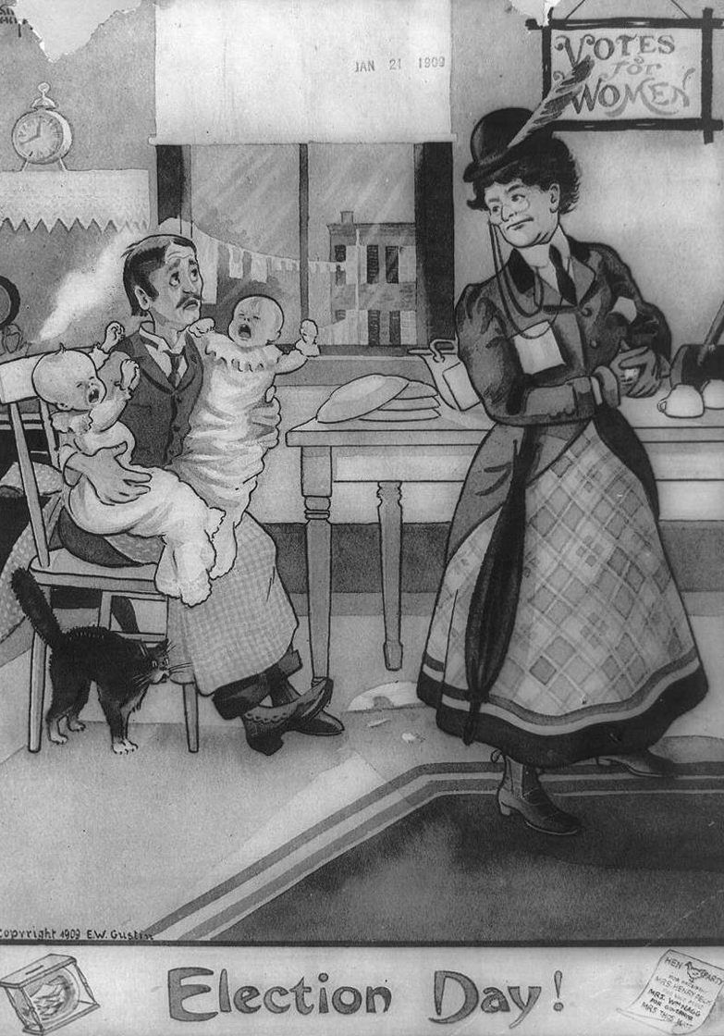
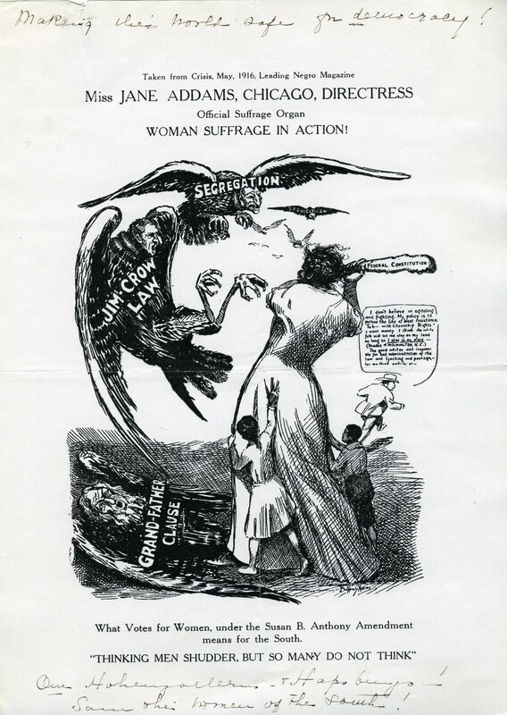
Opposition

Slide 7
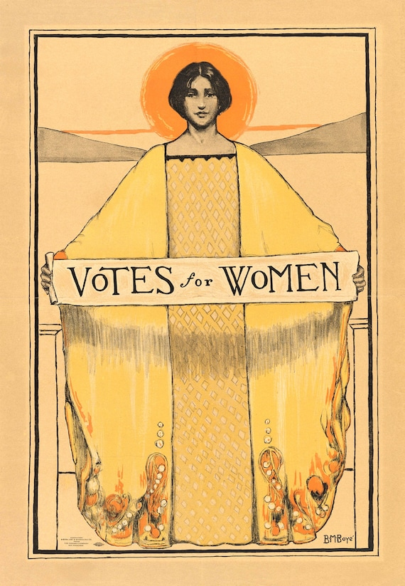
New Approaches
The Beautiful Campaign
Alice Paul
Suffrage Parade, March 3, 1913
Civil Disobedience
Primary Source, Inez Haynes Irwin, The Story of the Woman’s Party (New York, 1921)

Slide 8
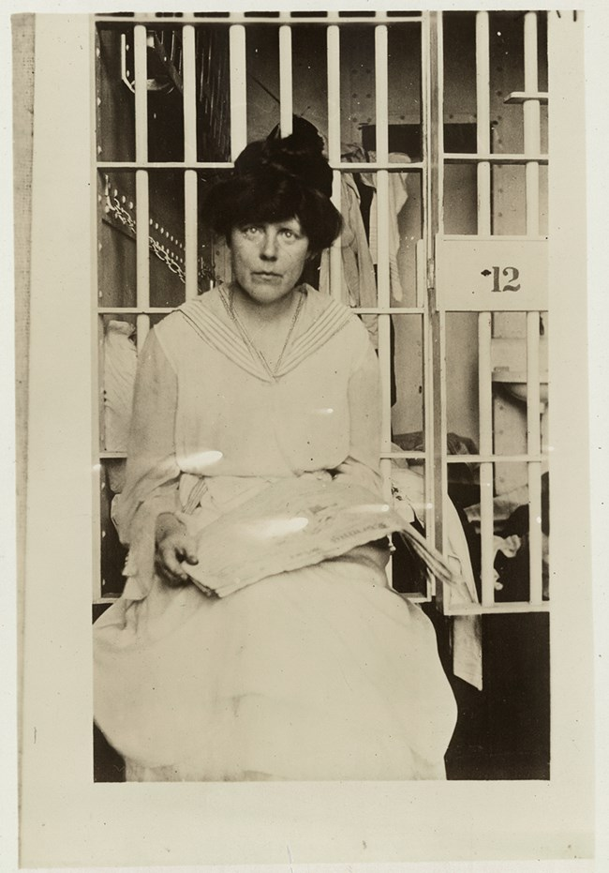
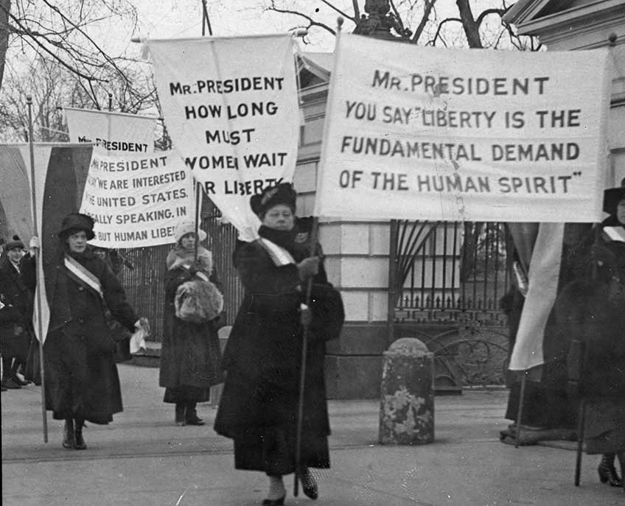

Slide 9
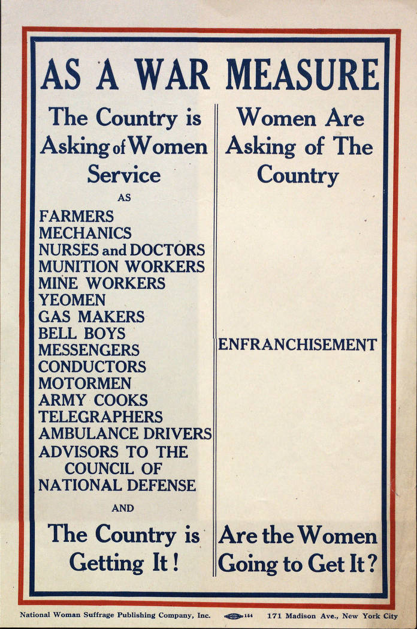
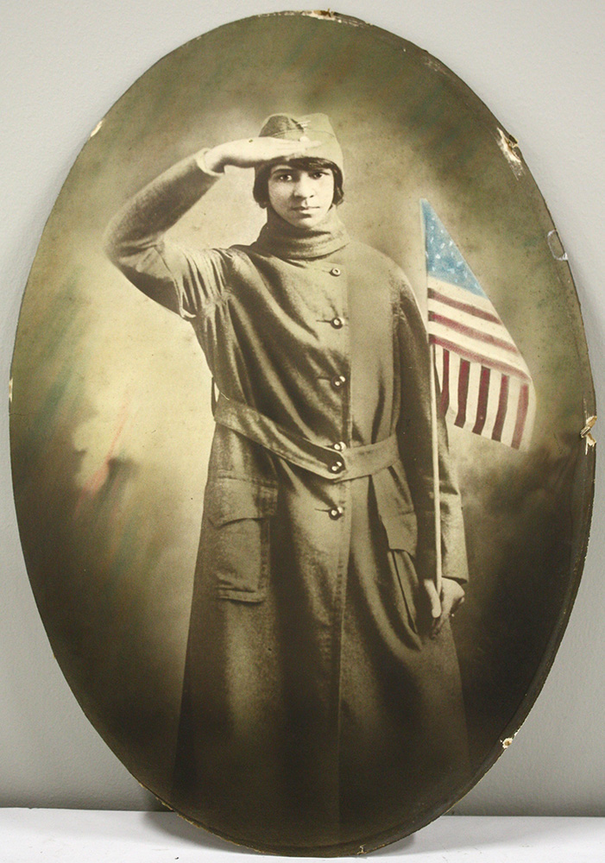
Preparedness & Patriotism
Women’s Committee of the Council for National Defense (WCND)
Primary Source, “Negro Women in War Work,” Alice Dunbar Nelson
Women in Industry (later the US Women’s Bureau)
Parades, Food Conservation, Nurses
Labor
“When men go awarring, women go to work. War compels them to work. That is one of its merits.” –Harritot Stanton Blatch

Slide 10
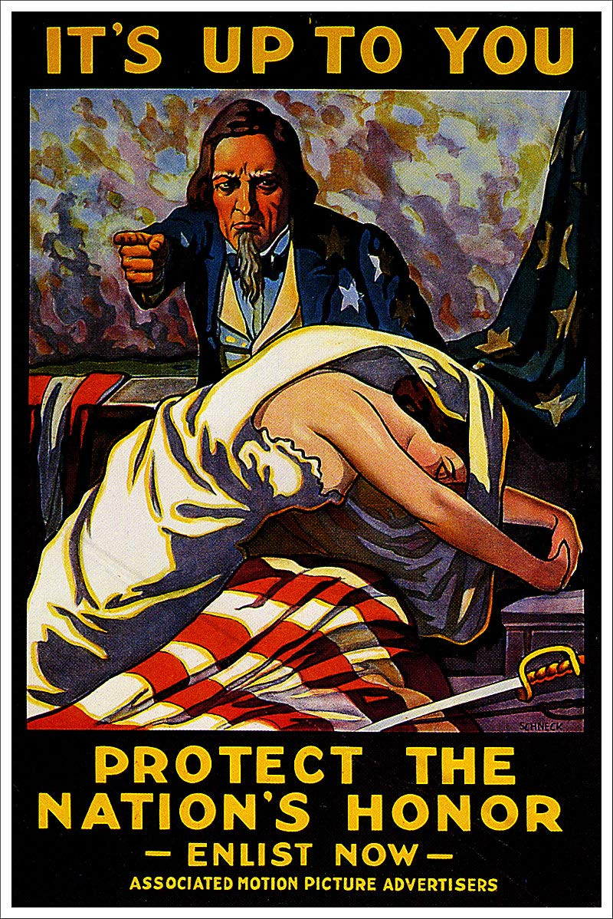
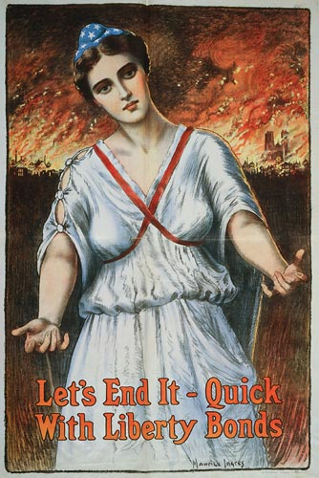

Slide 11
