Slide 1
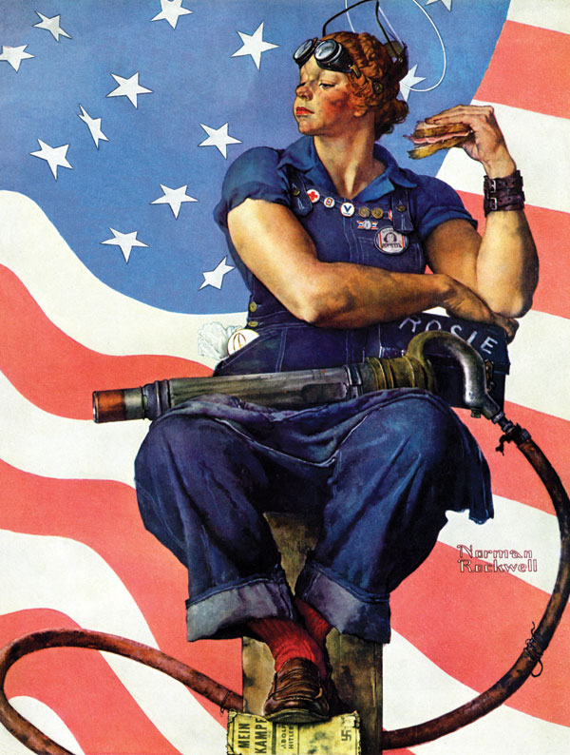
Beyond Rosie & Rosa
Women in World War II & the Civil Rights Movement
Cassie Yacovazzi (cyacovazzi@usf.edu)
Department of History, University of South Florida
Pedagogical Content Knowledge Workshop, April 11, 2024

Slide 2
Relevant Curricular Standards
SS.1.A.2.1: Understand history tells the story of people and events of other times and places.
SS.912.A.1.4: Analyze how images, symbols, objects, cartoons, graphs, charts, maps, and artwork may be used to interpret the significance of time periods and events from the past.
SS.912.A.1.6: Use case studies to explore social, political, legal, and economic relationships in history.
SS.8.CG.2: Evaluate the roles, rights, and responsibilities of US citizens, and determine methods of active participation in society, government, and the political system
SS.912.A.6: Understand the causes and course of WWII, the character of the war at home and abroad, and its reshaping of the US role in the post-war world
SS.912.AA.4: Analyze the economic, political, legal, and social advancements of African Americans and their contributions and sacrifices to American life from 1954 to the present, including factors that influenced them

Slide 3
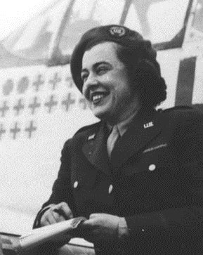
Virginia Irwin
“As I write, the Russian artillery is pounding the heart of the city with a barrage I have never heard equaled in an American battle. The earth shakes. The air stinks of cordite and the dead. All Berlin seems confusion. . . . Wild horses turned loose after pulling supply carts roam the streets. German dead lie everywhere. Here and there a horse, caught by some sniper’s bullet, lies sprawled amidst the wreckage of the buildings.” –Irwin, (Berlin, 1945)
(Primary source)

Slide 4
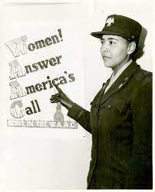
Uncle same wants you
Women’s Army Corps (WAC)
Clerks, telephone operators, dieticians, nurses
Charity Adams
“the most important post-war plans of the majority of women in the WAC include what all women want—their own homes and families.” –New York Times (1945)
Women Service Pilots (WASPs)

Slide 5
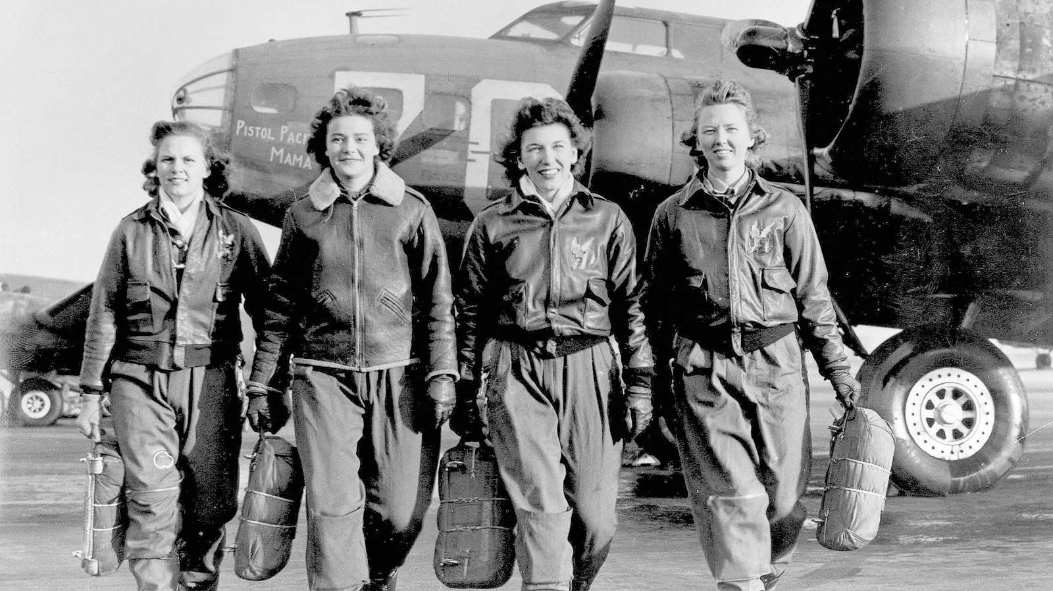

Slide 6
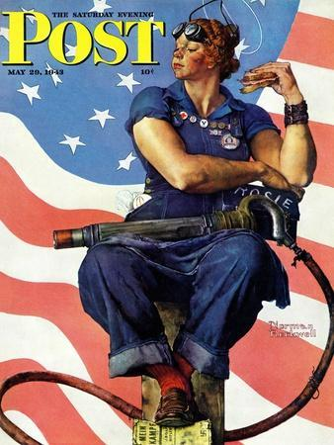
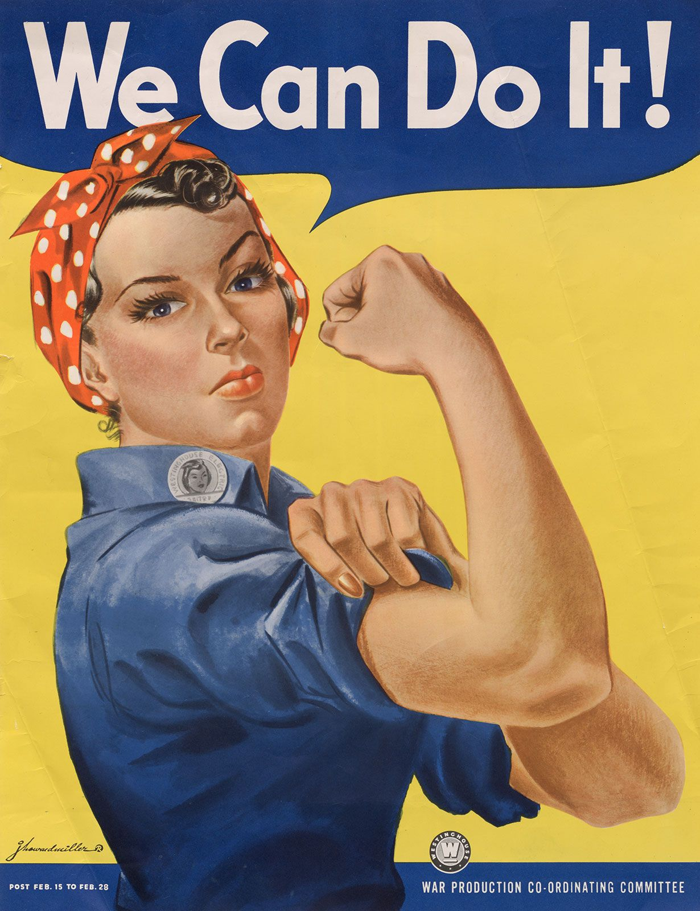
Rosies
Women in defense industry
Riveters, welders, & electricians
“The work is hard & sometimes dangerous, but victory in this war isn’t going to come the easy way. And we brown women of America need victory so much.” –Hortense Johnson, “What My Job Means to Me” (1943)
(primary source)
“I felt proud of myself and felt good being that I had never done anything like that. I felt good that I could do something…that I was doing my part.” –Beatrice Morales

Slide 7
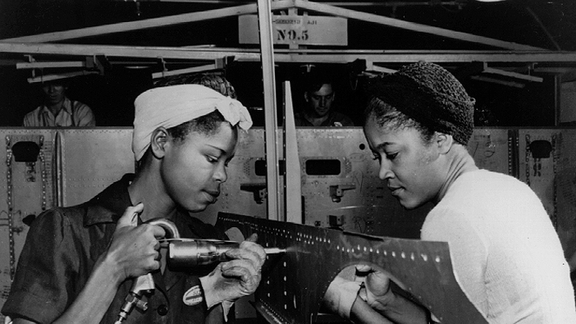

Slide 8
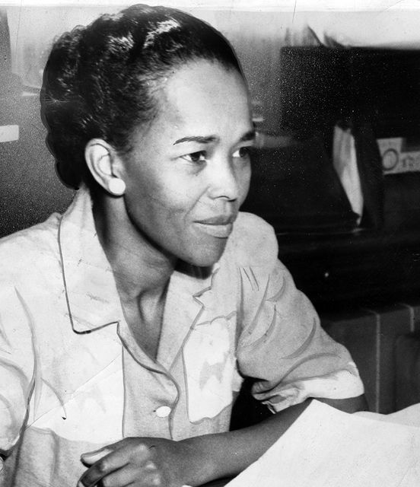
Rosas
Rosa Parks
Women’s Political Caucus (WPC) & Montgomery Improvement Association (MIA)
“Bridge Leaders”
Ella Baker
Community Leaders
Fanny Lou Hamer
“Position Paper: Nov. 1964” (Primary Source)

Slide 10
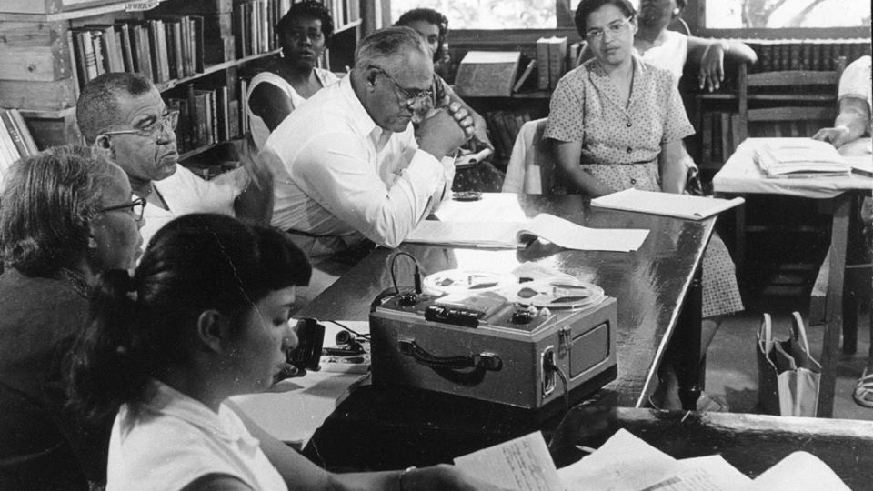

Slide 11
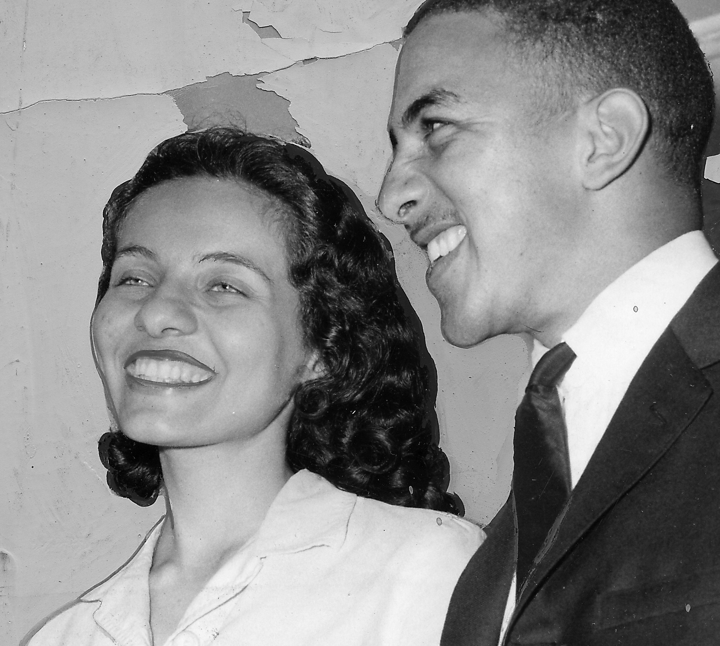
Diane Nash
“The first sit-in we had was really funny, because the waitress was nervous. She’d pick up dishes and she dropped one, and she’d pick up another one, and she’d drop it. We were sitting there trying not to laugh, because we thought laughing would be insulting. At the same time we were scared to death.”
“Before we did the things we did, we had no inkling that the movement would become as widespread as it did.”
“The movement had a way of reaching inside you and bringing out things that even you didn’t know were there. Such as courage.”
“I coordinated the training and recruitment of more people to take up the Freedom Ride.”
[Nash later became a rider herself and was jailed in Jackson, Mississippi in 1961.]

