Slide 1
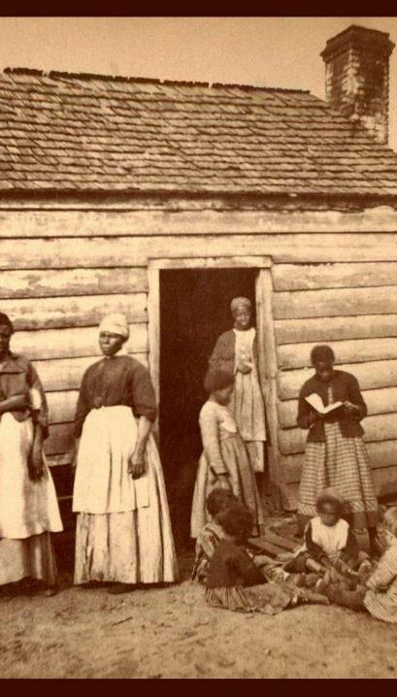
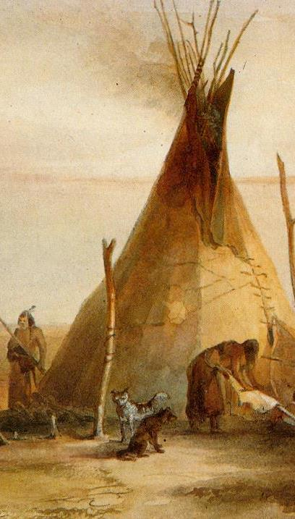
Reconstruction South and West Black and Indigenous Experiences after the Civil War Dr. Erin Mauldin John Hope Franklin Chair of Southern History emauldin@usf.edu
This Photo by Unknown Author is licensed under CC BY-SA-NC

Slide 2
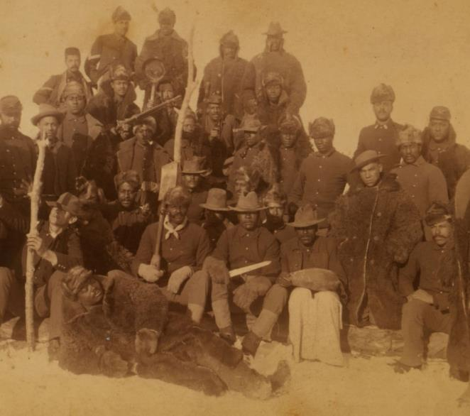
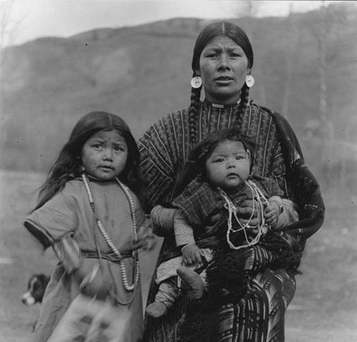

Slide 3
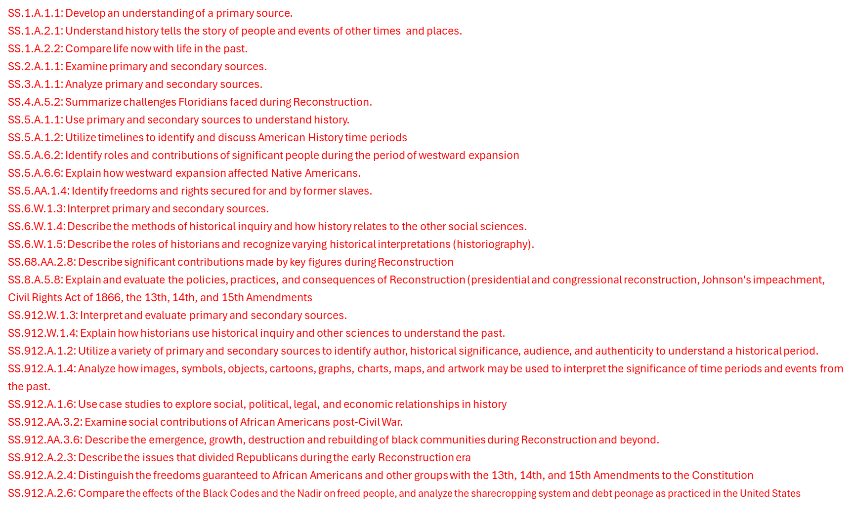

Slide 4
The Civil War as Indian War
Civil War, emancipation, and Indian wars all intertwined
Emerge from conflicts over US westward expansion
In the West, the Civil War a three-cornered conflict: US v. Confederacy v. Indigenous peoples

Slide 5
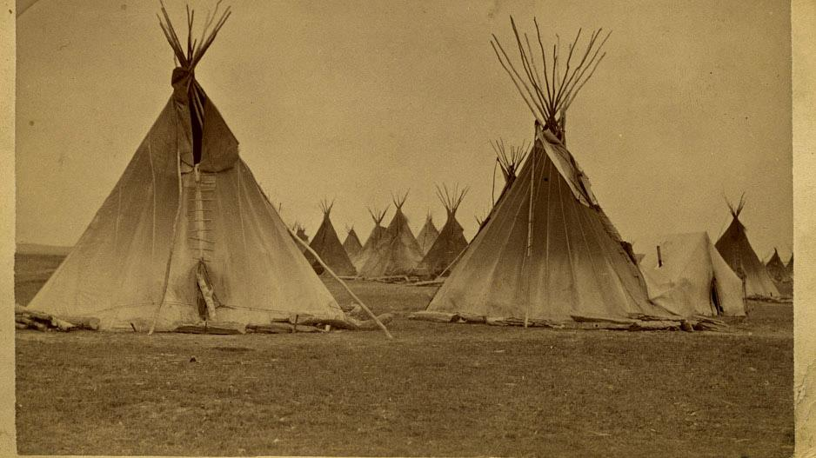

Slide 6
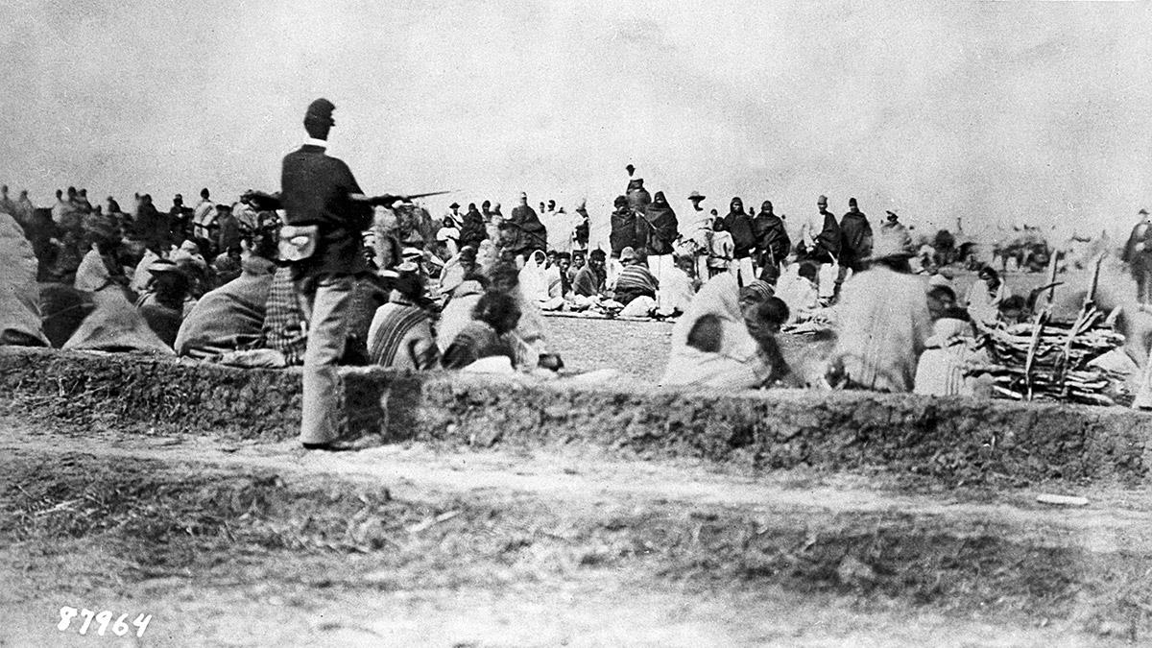

Slide 7
1862:
Civil War battles increase in size and intensity, such as Shiloh, the Peninsula Campaign, and the Seven Days’ Battles;
the Sioux Uprising begins in Minnesota;
the largest mass execution in U.S. history occurs (38 Sioux men hanged)
1863:
First African-American US regiments organized and used at battles like Fort Wagner;
Lincoln issues the Emancipation Proclamation;
U.S. Army commits the Bear River Massacre in Idaho which is then organized as a territory;
Battles of Gettysburg, Vicksburg, and more turn the tide against the C.S.A.;
Col. “Kit” Carson begins scorched earth fighting against the Navajo
1864:
Battle of Atlanta and Sherman’s March;
Grant’s Overland Campaign (Spotsylvania, the Wilderness, Petersburg);
the U.S. Army’s forced march of tens of thousands of Navajo prisoners (the Long Walk) begins as does their four-year imprisonment at Bosque Redondo;
the Sand Creek Massacre of Cheyenne by U.S. troops;
largest battle of the Plains Indian Wars at Adobe Wells (draw between Apache and U.S. Army)

Slide 8
A National Republican Vision
Republicans in Congress pass laws intended to remake the nation before the war is over
Many geared toward the West:
USDA
Transcontinental Railroad
Homestead Act
Morrill Act

Slide 9
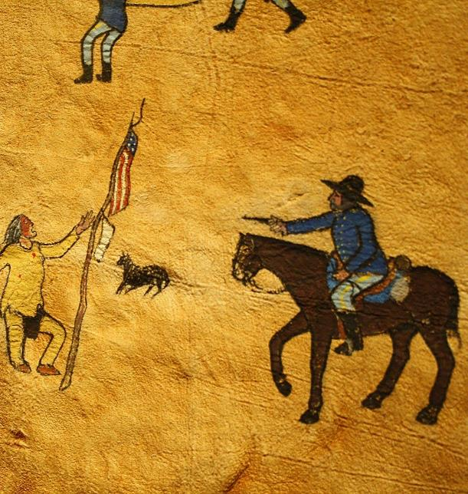
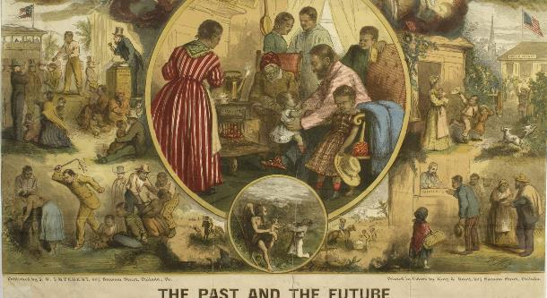
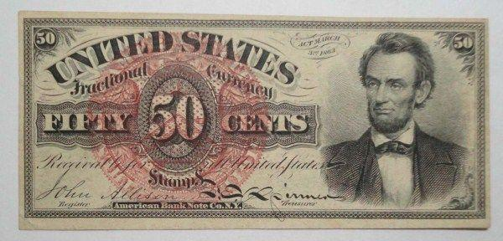

Slide 10
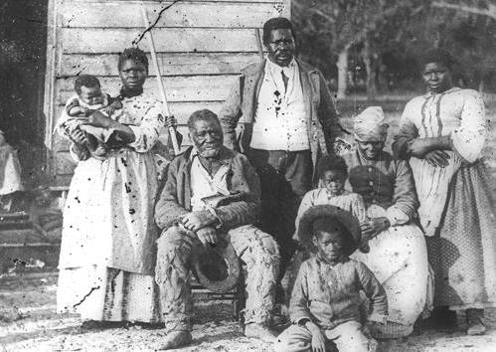
Questions of Reconstruction
In the South: How to protect ex-slaves’ freedom? Are they citizens? Should they be able to vote? How to reincorporate rebels? How to keep cash crop economy going?
In the West: How to protect US territory and settlements? Can Indigenous people be citizens? How to maintain peace? How to “civilize” those on reservations?

Slide 11
Defining the legal and political standing of Black and Indigenous Americans
Ensuring economic development in the South and West
Supporting “civilization” (or community formation) in Black and Indigenous populations

Slide 12
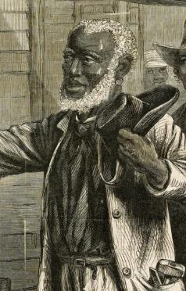
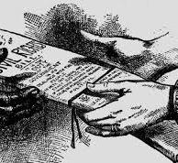
Legal and political standing of Black Americans
13th Amendment
Black Codes (packet)
Civil Rights Act 1866 (packet)
14th Amendment
Reconstruction Acts (packet)
15th Amendment

Slide 13
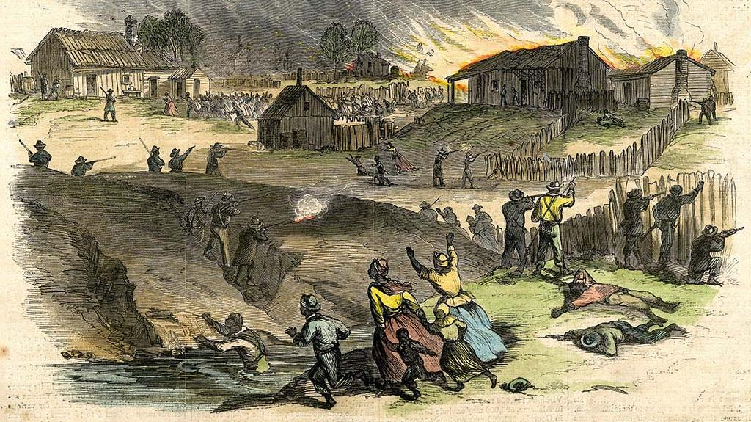

Slide 14
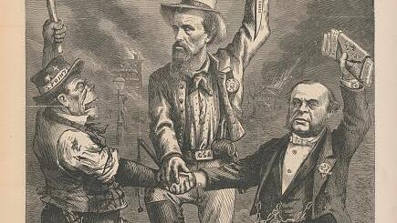

Slide 15
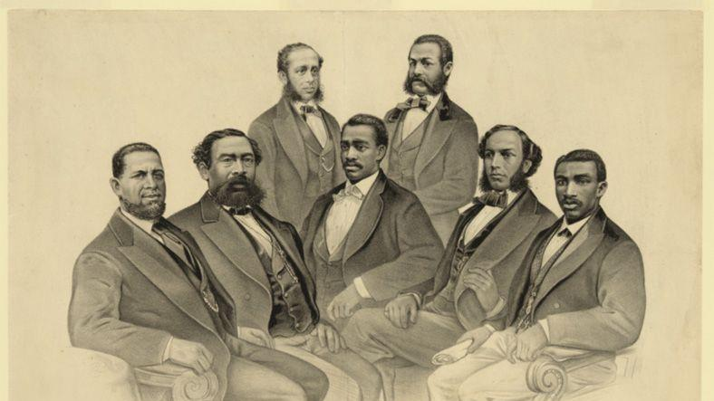

Slide 16
Legal and political standing of Indigenous Americans
Civil Rights Act and 14th Amendment
Department of the Missouri
Sherman and Sheridan treat and war with Native Americans (packet)
Doolittle Commission (packet)
Indian Peace Commission (packet)
Indian Appropriations Act of 1871
Indians “wards of the state”, US will not make treaties

Slide 17
Red Cloud’s War
Snake War
Cheyenne Expedition
Great Sioux War
1866 – 1868
1864 – 1868
1868-9
1876
Caused by Sand Creek Massacre and Powder River Expedition during Civil War
Lakota, Cheyenne, Arapaho, Crow
Able to protect Black Hills amid mining spree
Inter-alliance fighting
Guerrilla war between Paiute – Shoshone & WA, CA, OR, ID vols
Deadliest Indian war
Miners / wagon trains / squatters were cause
‘Snake Indians’ raided NW reservations too
Meant to quell “unrest”
US Army expedition against Cheyenne under Sheridan
Scorched earth campaign
Catalyst for changes to Indian Policy
Led by Sitting Bull in response to violation of Treaty of Ft Laramie
Last great gatherings of multiple nations on the Plains
Included Battle of Little Bighorn

Slide 18
Economic Development of the West
Transcontinental Railroad
Homestead Act (packet)
Organized buffalo hunting
Use of barbed wire
Military protection of mining trails and sites

Slide 19
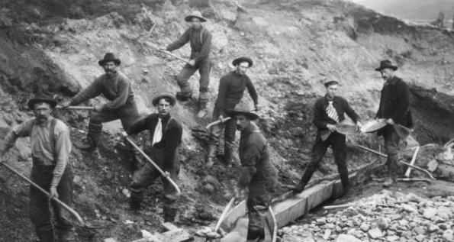
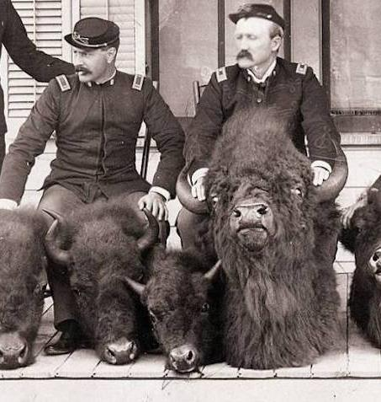
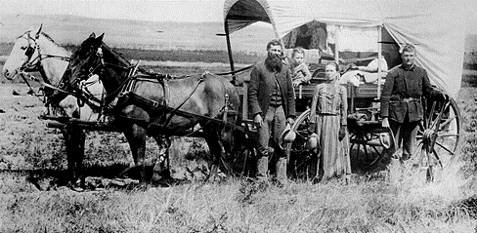

Slide 20
Economic Development of the South
Plantation Bureau (packet)
Field Order No. 15 (packet)
Sharecropping and tenant agreements (packet)
Bureau of Refugees, Freedmen, and Abandoned Lands
Southern Homestead Act 1866 (packet)

Slide 21
Community Formation
Republican policies promoted farming, male-led families, education, Christianity, ‘civilization’ in both West and South
Reaction very different according to region
Policy toward Indigenous was much more reliant on force

Slide 22
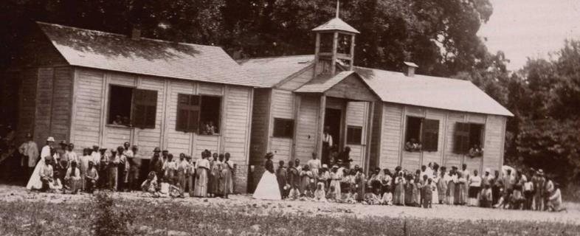
“Civilization” in the South
Black-led drive for community formation, establishment of religious and educational institutions, political apparatuses, and more
Black ministers become leaders of the community, both socially and politically
More than 3,000 schools in the South by 1869, many HBCUs like Fisk and Howard founded (packet)

Slide 23
“Civilization” in the West
General Allotment Act, 1887
Divides up reservation land into individual plots; anything leftover sold off
Attached citizenship to assimilation
Included use of funds for Indigenous boarding schools

Slide 24
