Slide 1
General Laboratory
Tools Techniques and Methods
Browse through these files to get familiar
with equipment, techniques and general approaches
to use in your laboratory work this semester.
This is your ‘toolbox’

Slide 2
‘Toolbox’ content
HOW TO:
Determine concentration of unknown in solution
Prepare solutions
Mixture separations
Identify molecular or ionic species
Identify ions in solution
How to measure heat exchange
Measure how fast a chemical reaction proceeds (rates of reactions)
Make buffers and how to use them
General techniques- equipment use
Glassware glossary
Volume measurement
Balances
Error analysis
Excel for lab work
Heating
Melting Point
pH meters
Waste disposal

Slide 3
General Techniques-Equipment
Use

Slide 4
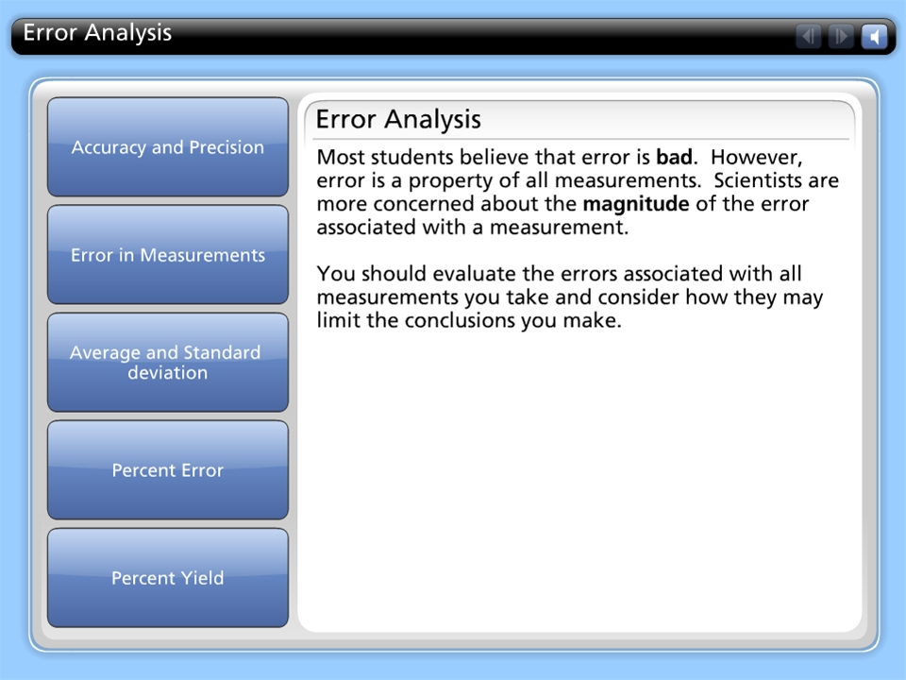



Error Analysis

Slide 5
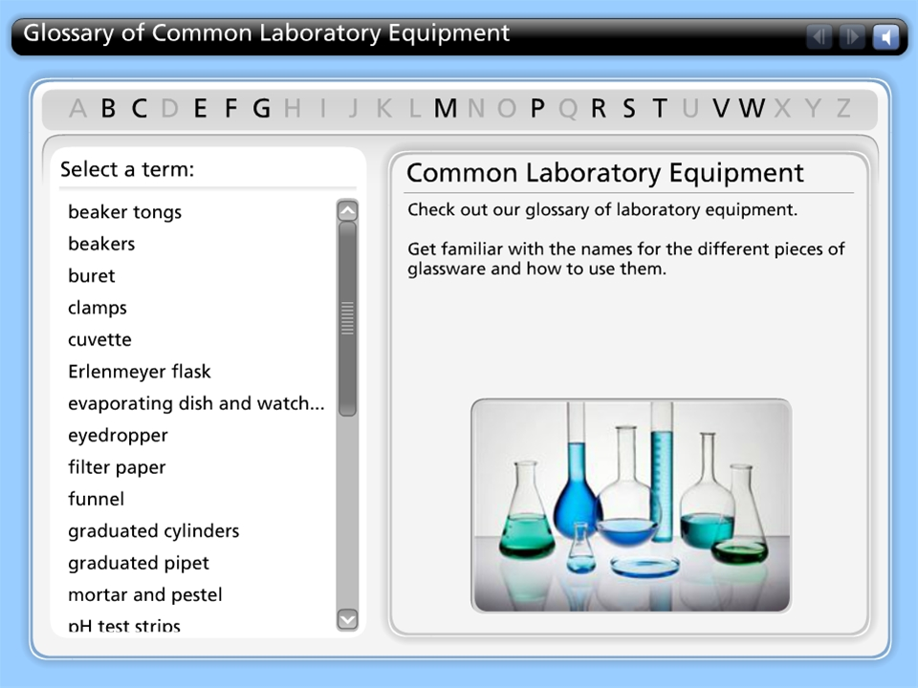
Glossary of Common Laboratory Equipment

Slide 6
Excel use for lab work

Slide 7
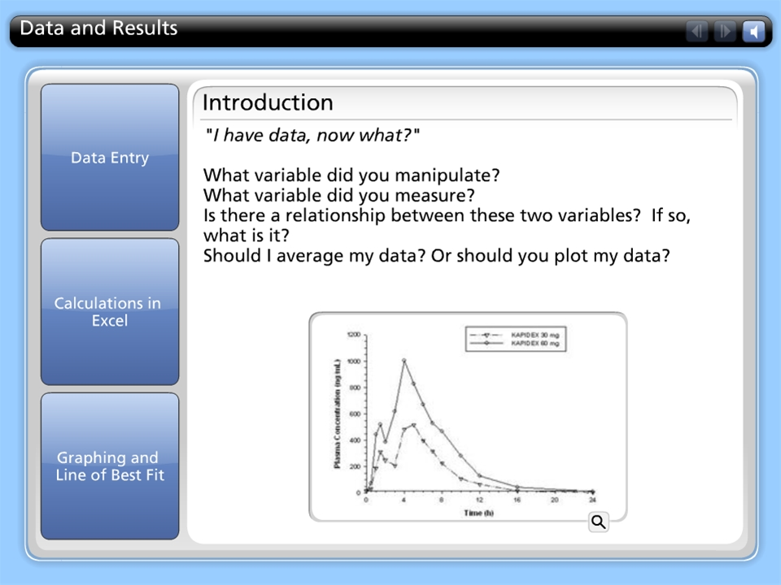
Data and Results

Slide 8
Heating Equipment

Slide 9
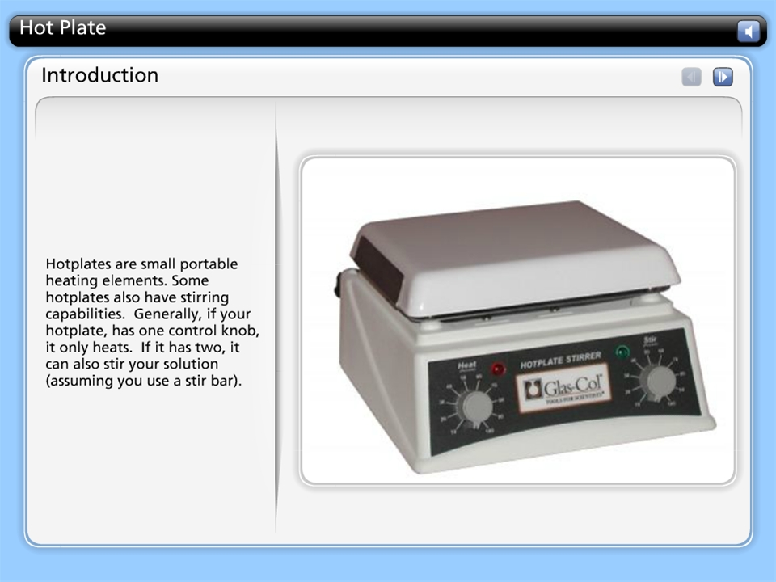
Hot Plate

Slide 10
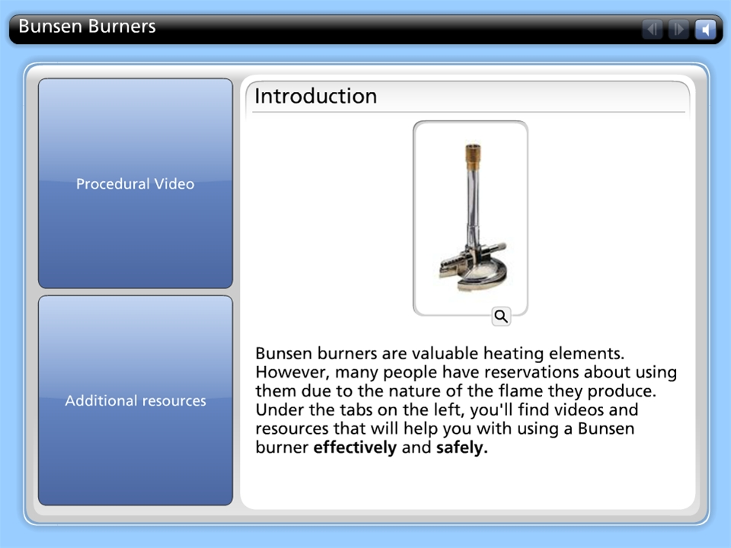
Bunsen Burners

Slide 11
pH meters

Slide 12
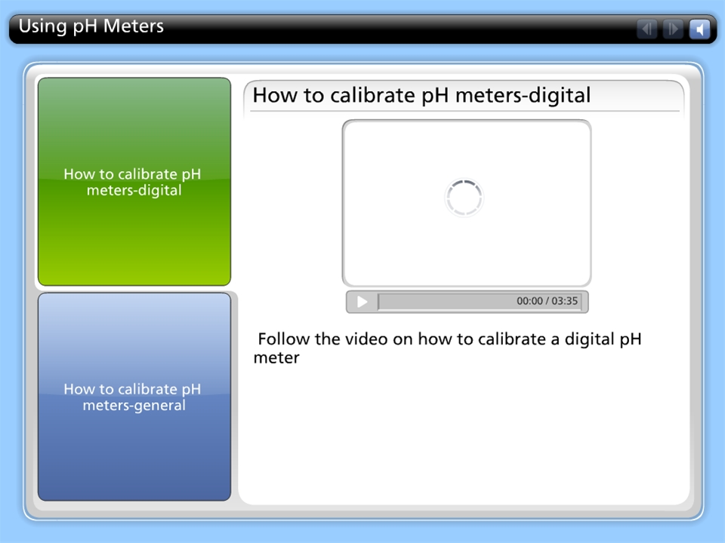
Using pH Meters

Slide 13
Volumetric glassware

Slide 14
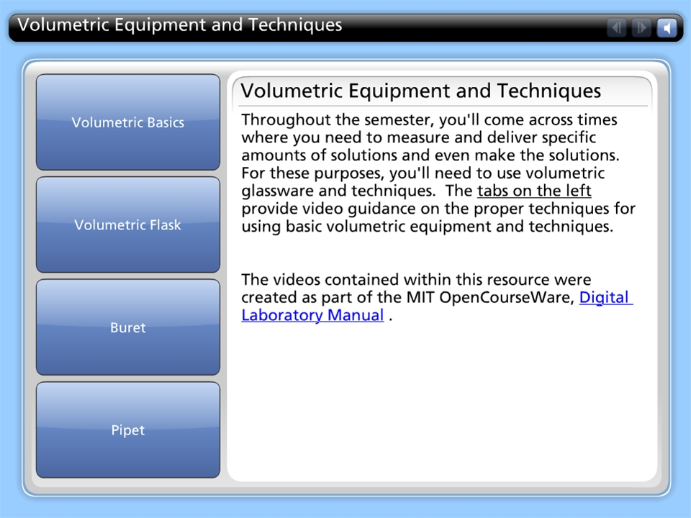
Volumetric Equipment and Techniques

Slide 15
HOW TO
Determine the concentration of unknown species in a solution?

Slide 16
A. Titration-based on aqueous reactions
Acid-base titrations
Complexometric titrations
  Back titration calculation

Slide 17
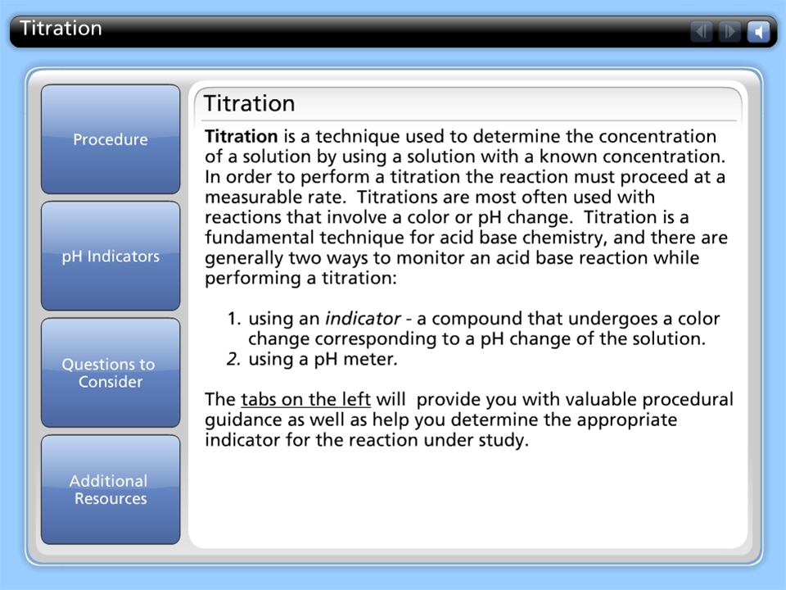
Titration

Slide 18
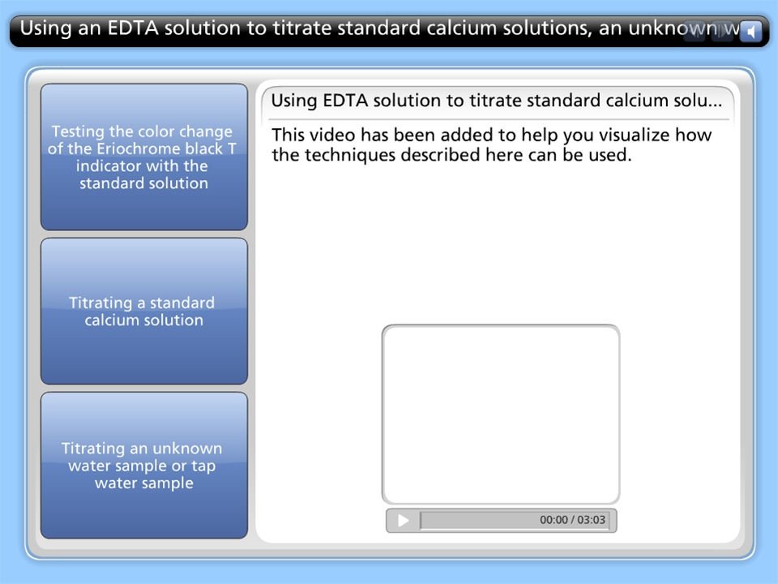
Using an EDTA solution to titrate standard calcium solutions, an unknown water sample and tap water

Slide 19
B. Spectroscopy-based on light absorption properties
UV-Vis
IR
MS
NMR

Slide 20
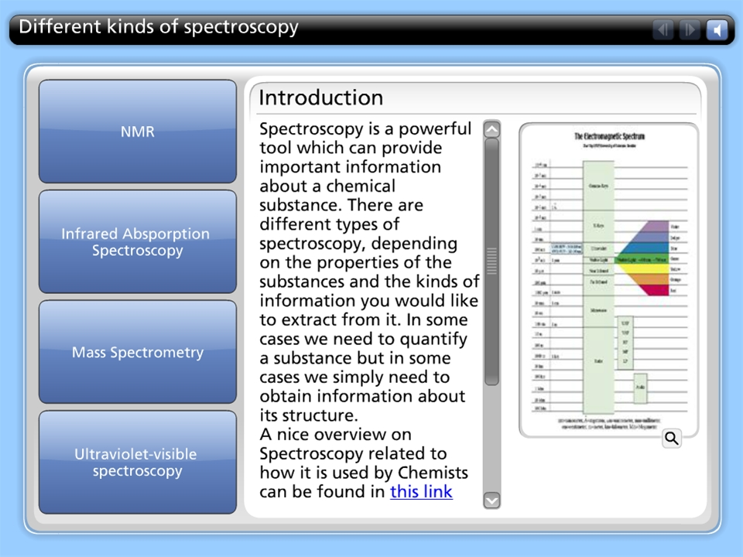
Different kinds of spectroscopy

Slide 21
HOW TO prepare solutions?

Slide 22
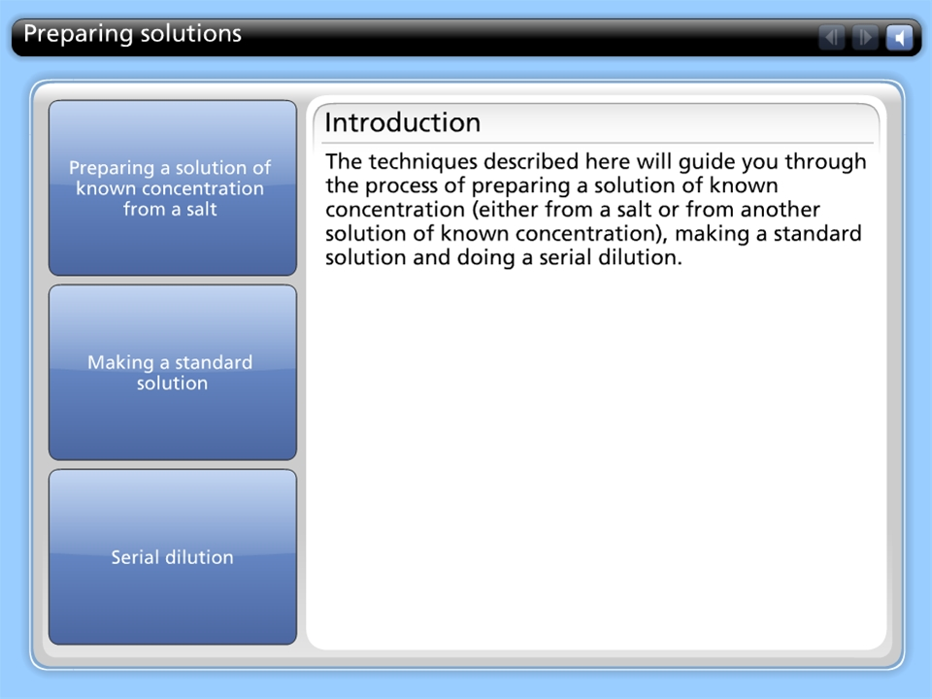
Preparing solutions

Slide 23
B. Dilution of available solutions
Going form a high concentration solution to a low concentration solution
  Serial dilution
  Parallel dilution

Slide 24
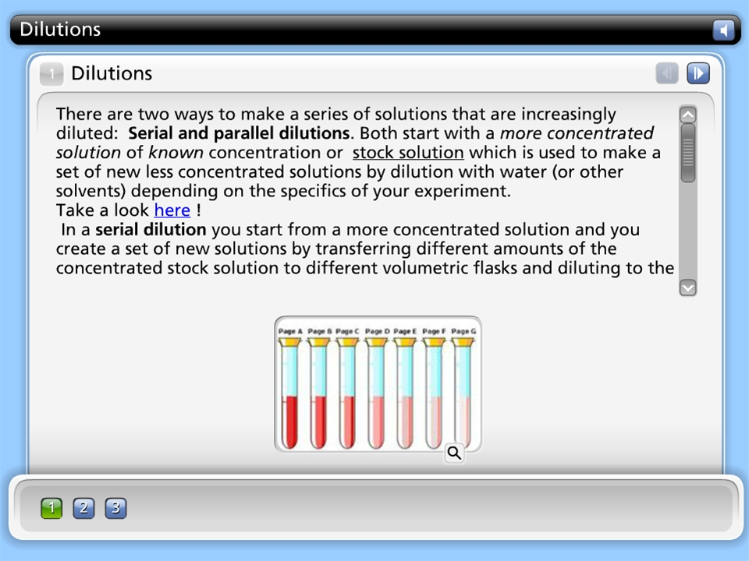
Dilutions

Slide 25
HOW TO: separate the components in a mixture?

Slide 26
Types of Separations
  Solid-Solid
  Solid-Liquid
  Liquid-Liquid

Slide 27
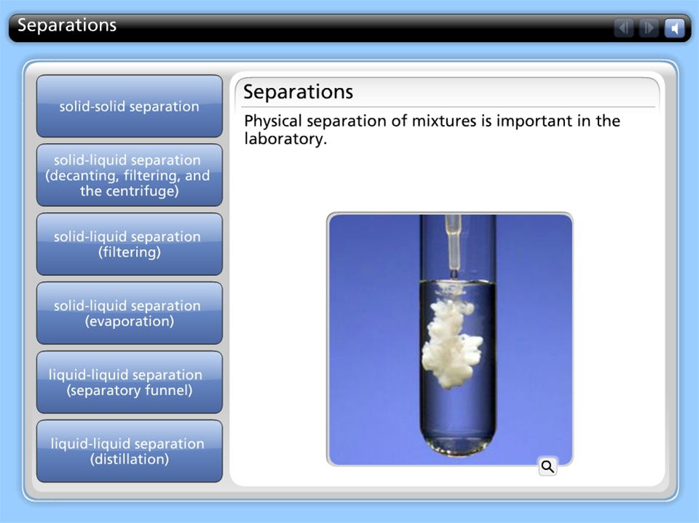
Separations

Slide 28
HOW TO: determine whether a solution is ionic or molecular?

Slide 29
A. Solubility
IN polar and non-polar solvents

Slide 30
B. Melting/Boiling Point

Slide 31
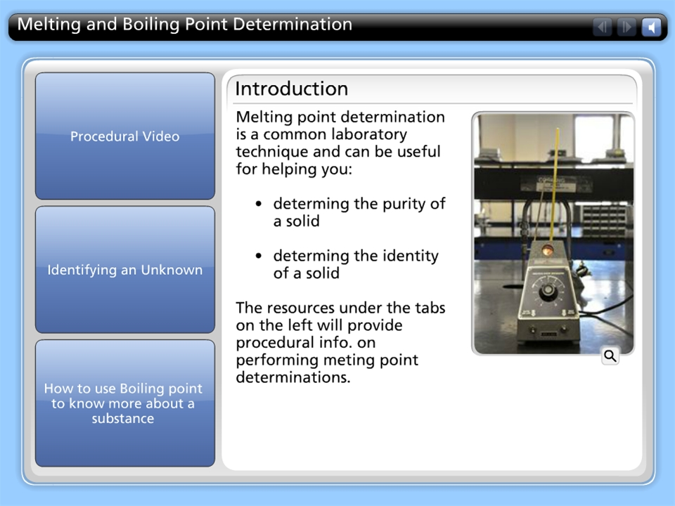
Melting and Boiling Point Determination

Slide 32
C. Conductivity
Does it conduct electricity?
  Conductivity meter

Slide 33
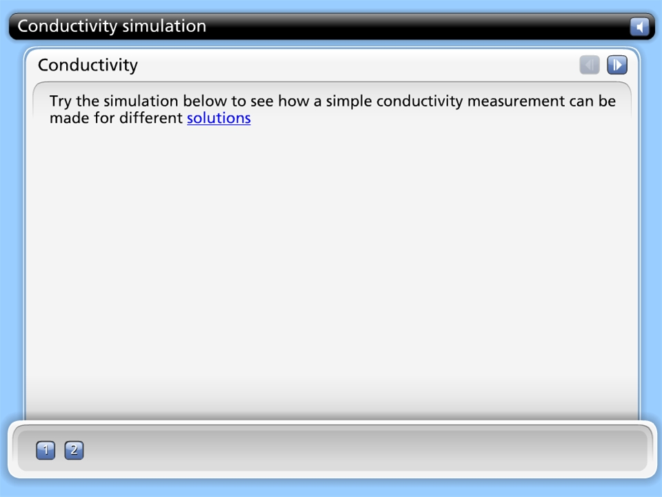
Conductivity simulation

Slide 34
HOW TO : identify ions in solution?

Slide 35
A. Aqueous chemical reactions
Based on solubility properties

Slide 36
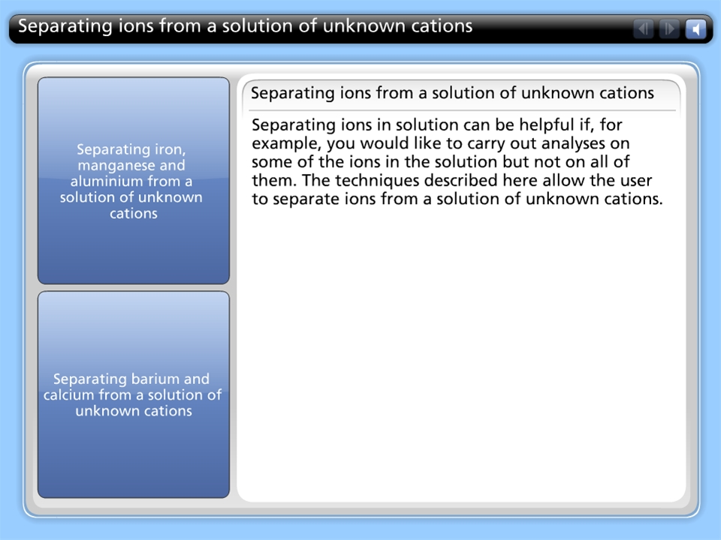
Separating ions from a solution of unknown cations

Slide 37
B. Flame test
What’s the emission spectra?

Slide 38
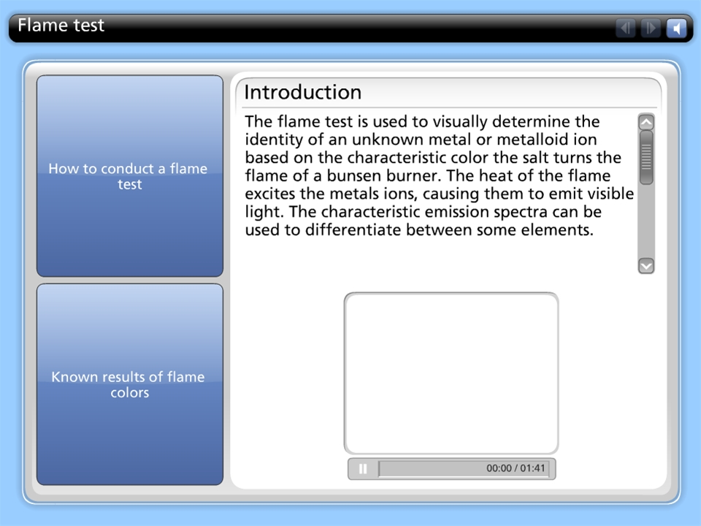
Flame test

Slide 39
C. Spectroscopy
Based on energy absorption properties
  UV-Vis
  IR
  MS
  NMR

Slide 40
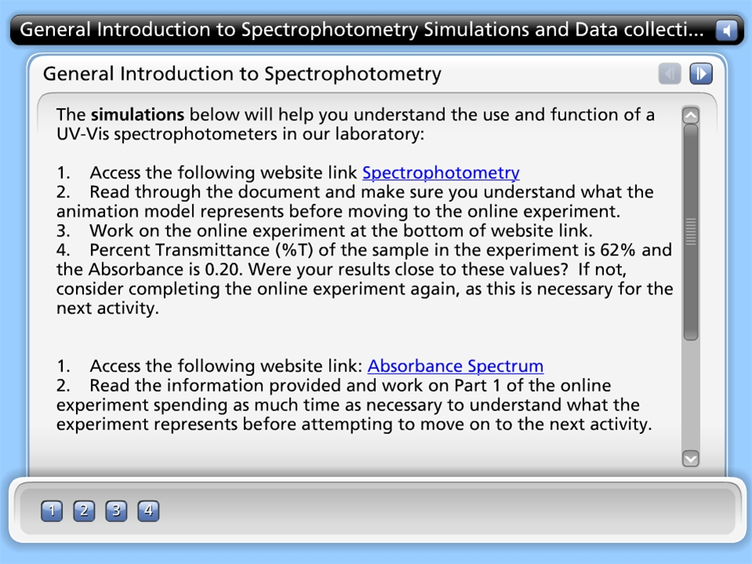
General Introduction to Spectrophotometry Simulations and Data collection

Slide 41
How do you determine the rate of chemical reactions?
HOW TO measure the ‘activity’ of a catalyst?

Slide 42
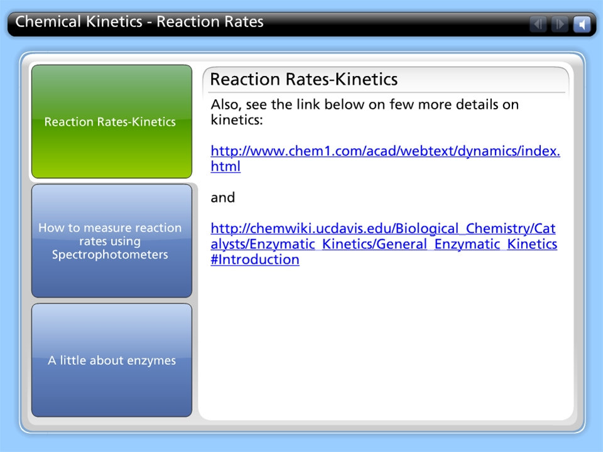
Chemical Kinetics - Reaction Rates

Slide 43
A. Example: progression of a reaction catalyzed by an enzyme
  Spectroscopy
  Reaction rates
  pH

Slide 44
HOW TO make and why to use Buffer solutions?
Why do you need buffers?
How do you prepare a buffer solution?
How do you select a buffer?
How does a buffer work?

Slide 45
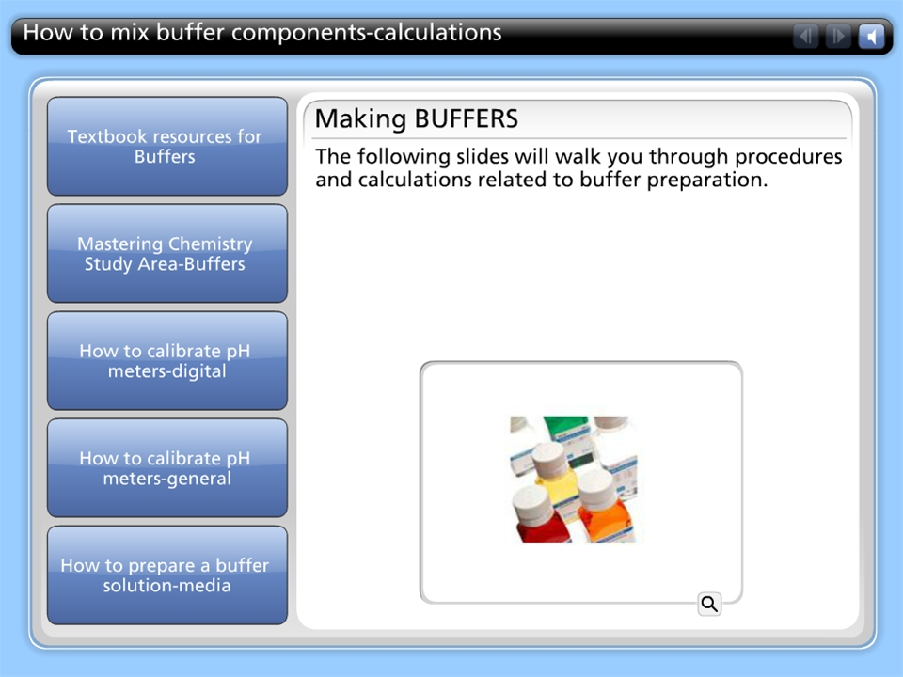
How to mix buffer components-calculations

Slide 46
HOW TO measure the heat exchange in a chemical reaction?

Slide 47
Calorimetry
  Constant-pressure calorimetry
  Constant-volume calorimetry

Slide 48
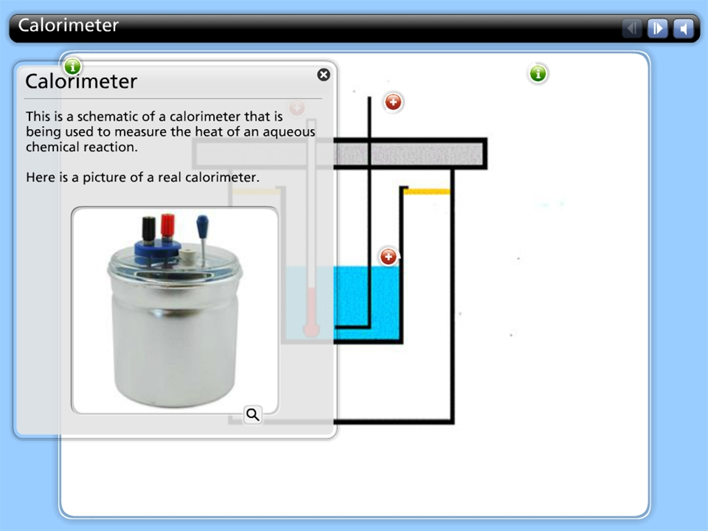
Calorimeter

