Slide 1

2015-2025
USF System
Campus Master Plan Update

Slide 2

Proposed 2015-2025 Campus Master Plan Update
Management of USF property
Updated every five years
Florida Statutes and BOG requirements
Master Plan Components:
  Evaluation and Appraisal Report
  Data Collection and Analysis
  Goals Objectives, and Policies updates
  Campus Development Agreement
Master Plan Elements:
    Introduction
    Strategic Plan
    Introduction to the Campus Master Plan
    Academic Program Overview
    Future Land Use
    Transportation
    Housing and Student Support Services
    Infrastructure and Utilities
    Conservation
    Recreation and Open Space
    Intergovernmental Coordination
    Capital Improvements
    Appendixes

Slide 3
2015-2025
USF System
Campus Master Plan Update
Sarasota-Manatee

Slide 4
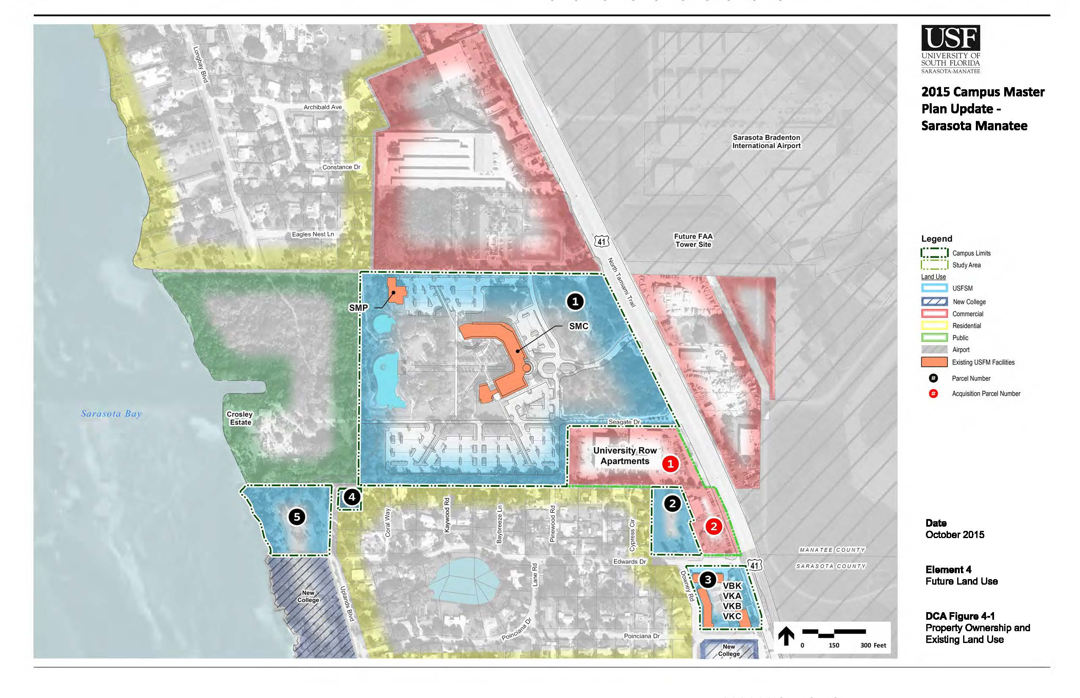
Proposed 2015-2025 Campus Master Plan Update
Campus Context Map
Sarasota-Manatee

Slide 5
Proposed 2015-2025 Campus Master Plan Update Primary Updates
Future Land Use:
  Reinforces mission, vision and goals of “USFSM Strategic Plan: Focus on Quality 2020”.
  Maintains currently adopted Campus Master Plan land acquisition strategy.
  No University development is proposed on land not currently owned.
  Continues emphasis to develop the campus core through strategic placement of buildings of compatible use, type and massing.
  Incorporates sustainability framework prescribed by FBOG Chapter 21.
Transportation: Includes high-priority safety improvements for campus pedestrian and bicycle routes, public transit, roadways and intersections by relocating the main campus entrance to Seagate Drive (USFSM Strategic Plan 2.8).
Housing: USFSM will actively promote student housing through affiliation agreements (USFSM Strategic Plan 2.3).
Student Support Services: USFSM will support student engagement and success through the addition of new facilities and repurposing existing facilities (USFSM Strategic Plan 2.1).
Sarasota-Manatee

Slide 6
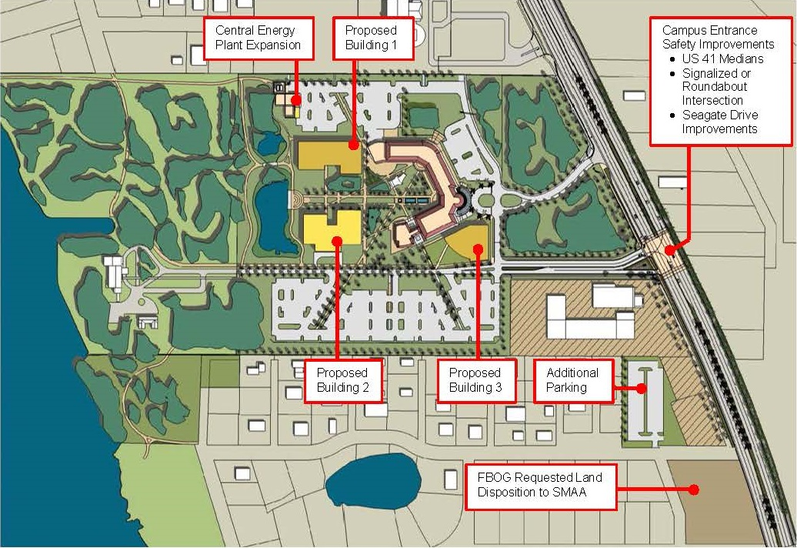
Proposed 2015-2025 Campus Master Plan Update
Proposed Updates
Sarasota-Manatee

Slide 7
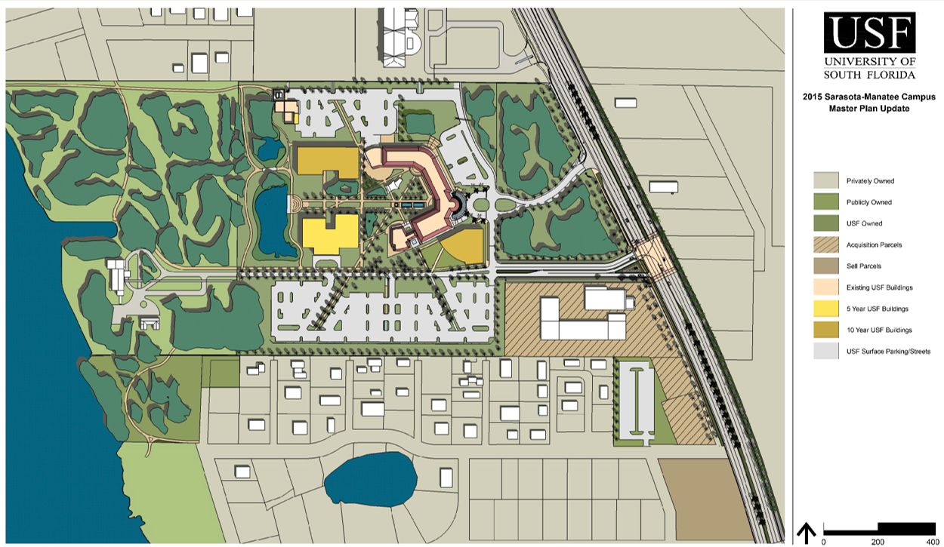
Proposed 2015-2025 Campus Master Plan Update
Illustrative 10-year Plan
Sarasota-Manatee

Slide 8
Proposed 2015-2025 Campus Master Plan Update
Extension of the Campus Development Agreement
The most recent Campus Development Agreement with Manatee County Government was based on the 2000-2010 Campus Master Plan. The Agreement expired in July 2013. Given the unused capacity projected through 2020, it is anticipated that the terms of the previous agreement will be extended for the five-year period.
Benchmarks to the Campus Development Agreement
Type | Development Allowed | Current Used | Remaining Balance | % Used
 | GSF | GSF | GSF
Academic and Support | 250,000 | 140,950 | 109,950 | 56%
Sarasota-Manatee

Slide 9
2015-2025
USF System
Campus Master Plan Update
St. Petersburg

Slide 10
Proposed 2015-2025 Campus Master Plan Update
Summary of Goals, Objectives, and Policies Updates
Executive Summary: A brief overview of the Campus Master Plan
Introduction to USFSP “An intimate campus nestled on the waterfront, steps from world-class cultural institutions.”
USFSP Strategic Plan: 10,000 annual student headcount in 10 years
Introduction to the Campus Master Plan: Align physical plant with Strategic Plan Goals: Distinctive Identity, Student Success and Culture; Faculty Excellence in Teaching and Research, Strategic Partnerships, Infrastructure to Meet Current, Future Needs and Sustainable Funding
Academic Program Overview: Significant focus on increasing undergraduate enrollment, retention and graduation
Future Land Use & Urban Design: Develop campus to align with downtown grid of streets defined by buildings and landscape
Transportation: Street closures to expand the pedestrian-oriented campus, supported by structured parking on periphery
Housing and Support Facilities: Freshman housing district and expanded student life facilities for a vibrant residential campus
Infrastructure & Utilities: New east campus chiller plant ultimately replaces central plant
Conservation & Coastal Management: LEED Gold standard for new buildings; Maintain and enhance access to Bayboro Harbor
Recreation and Open Space: Focus on unique bay front setting supported by recreational fields and pedestrian streets
Intergovernmental Coordination: Continue established partnerships with the community
Capital Improvements, Academic Facilities: Student Success at heart of campus; expand STG for STEM-based programs
Appendixes: Utilization Study Ample but densely furnished Classrooms, deficient in Teaching /Research Labs and Offices
St. Petersburg

Slide 11
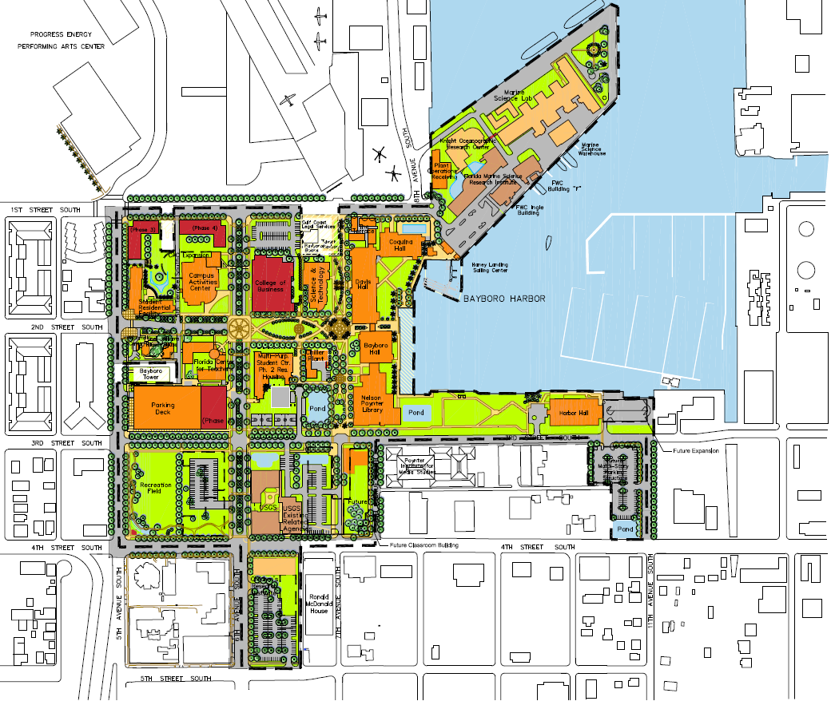
USF St. Petersburg 2015 – 2025 Campus Master Plan
10 YEAR PLAN – DRAFT RECOMMENDATIONS
SLC Addition
East Chiller Plant
STG STEM Addition
New Property as Support Services Building
Upper Division Housing
2nd Street South Closure
Repurpose BAY Ground Floor for Student Success
Union/ Housing Addition
Future Academics
Expand Parking Structure
New Parking Structure
3rd Street South Closure
New Dining, Residence Halls
New Property with Science Labs, Parking, Recreation Field and Future Academics
New Business Building plus Future Academics
Redefine Plan Boundary
6th Ave South Closure

Slide 12
St. Petersburg

Slide 13
Proposed 2015-2025 Campus Master Plan Update
Campus Development Agreement
The Campus Development Agreement with the City of St. Petersburg was based on the 2010-2020 Campus Master Plan Update. The Agreement expires in December 2016. Given unused development capacity to date, it is anticipated to be extended for another 5 years.
Benchmarks to the Campus Development Agreement
 | Development Allowed | Current Used | Remaining balance | % used
Academic GSF | 547,050 | 102,952 | 444,098 | 19%
Support GSF | 778,267 | 217,767 | 560,500 | 28%
Parking (in garages net) cars | 485,000 | 375,000 | 110,000 | 77%
Medical GSF | NA
Housing beds | NA | 541
Sports and Recreation GSF | NA
Outdoor Seating (seats) | NA
St. Petersburg

Slide 14
Proposed 2015-2025 Campus Master Plan Update
Schedule
Reviews
August 6 Review draft with President Genshaft
August 21 Faculty / Staff Presentation
August 26 City of St. Petersburg
October Student Government
Committee Reviews leading to USF UBOT Adoption:
October 20 USFSP Campus Board
October 21 Campus Development Committee
October 26 ACE Advisory Committee
November 12 ACE
November 23 St. Petersburg City Council
December 3 USF Board of Trustees
Campus Development Agreement - 2016
St. Petersburg

Slide 15
2015-2025
USF System
Campus Master Plan Update
Tampa

Slide 16
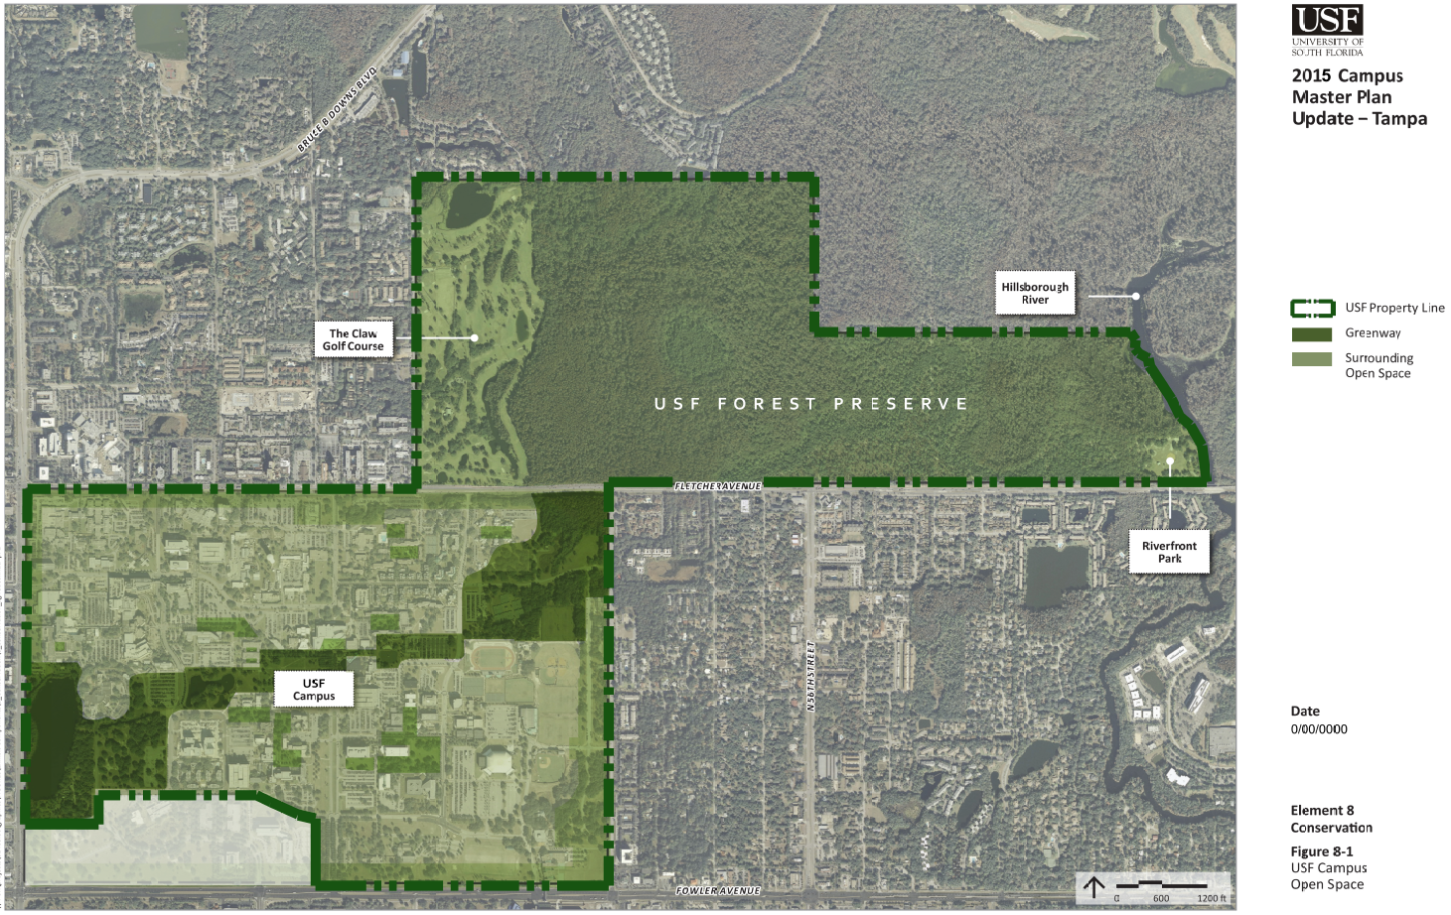
USF Campus Property
Tampa

Slide 17
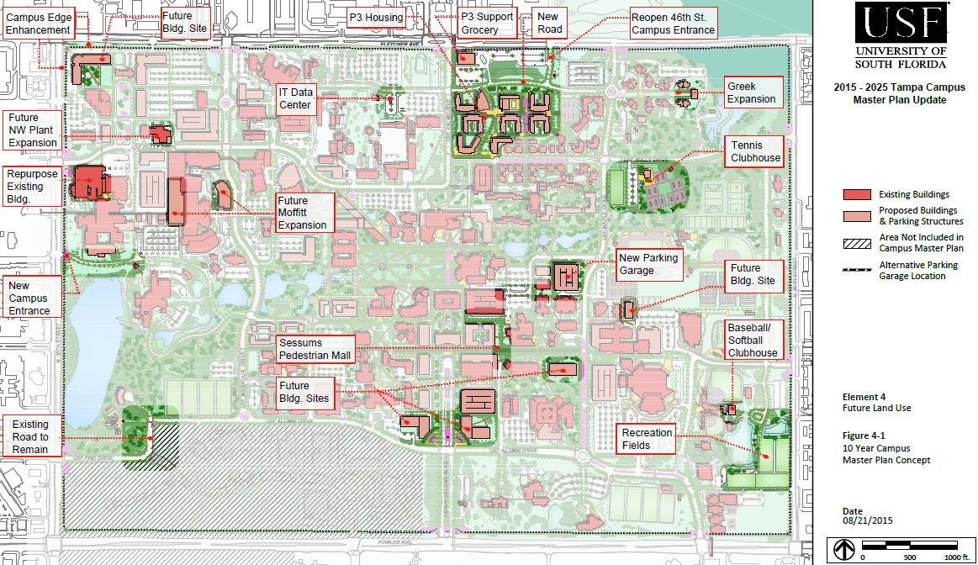
Proposed Updates to 2010-2020 Campus Master Plan
Tampa

Slide 18
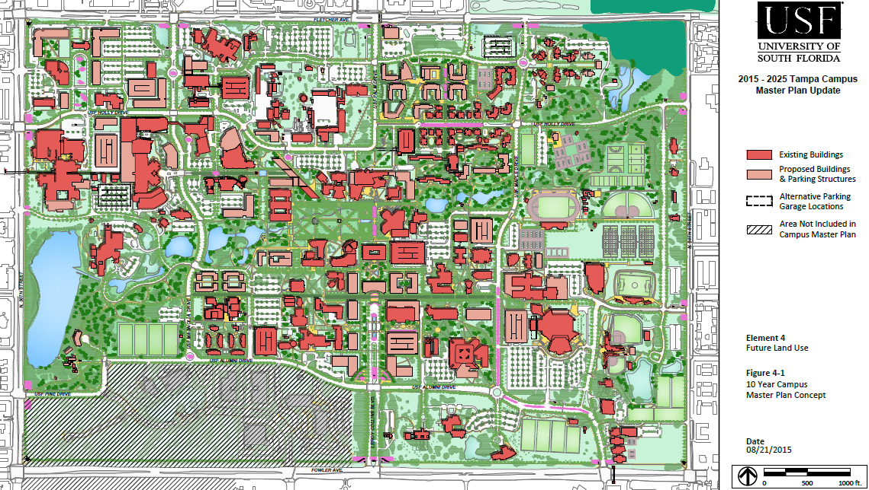
Illustrative 10 year Plan
Tampa

Slide 19
2015-2025 Campus Master Plan Update
Future Land Use: Continues emphasis on increased development density, funding decisions to support a vibrant integrated core campus, and completion and protection of the campus greenway. Establishes a minimum 3 story building height and 30 foot setback from property lines
Transportation: Promotes campus pedestrian, bike, transit, parking, and road system improvements.
  Create new USF Dogwood Dr. with connection to Fletcher/46th St.
  Close USF East Holly residential section to through traffic (allows transit, emergency, and move-in move-out).
  New campus entrance/exit at new signal at Bruce B Downs
  Re-route Shriners Access road to shorten Pine Dr. and connect Greenway/Botanical Gardens
Housing and Student Support Services: Includes P3 housing mixed use project, additional capacity, and other Student Support Services.
Infrastructure and Utilities: Existing aging campus utility systems are in need of critical deferred maintenance and capital renewal to support existing facilities and future growth. Capacity and technological upgrades will provide reliability of service and reduce consumption, waste, and cost.
Conservation and Sustainability: Continues to promote water, energy, and other resource conservation and the American College and University Presidents Climate Commitment
Recreation and Open Space: Includes revisions to Campus Recreation /Athletics facilities and open space.
  Tennis to remain, add clubhouse for Tennis and Baseball/Softball.
  Displaced future Campus Recreation fields moved to USF Sycamore cul-de-sac.
Intergovernmental Coordination: Continued coordination with the City for the extension of the USF Development Agreement and with the County for proposed new road connections and area pedestrian/bike safety improvement projects.
Capital Improvements: Includes current CIP, policy of automatic update when BOT approves CIP each year
Tampa

Slide 20
Campus Development Agreement
The Campus Development Agreement with the City of Tampa was based on the 2005-2015 Campus Master Plan. The Agreement expires in December 2015. Given current unused development capacity, the City of Tampa is in the process of approvals to extend the existing Agreement for 10 years to 2025.
Tampa

Slide 21
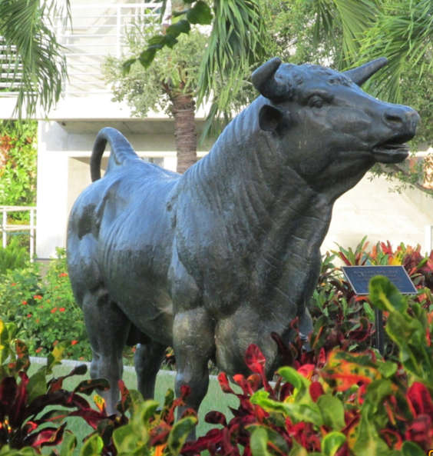
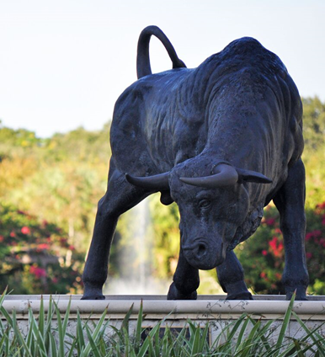
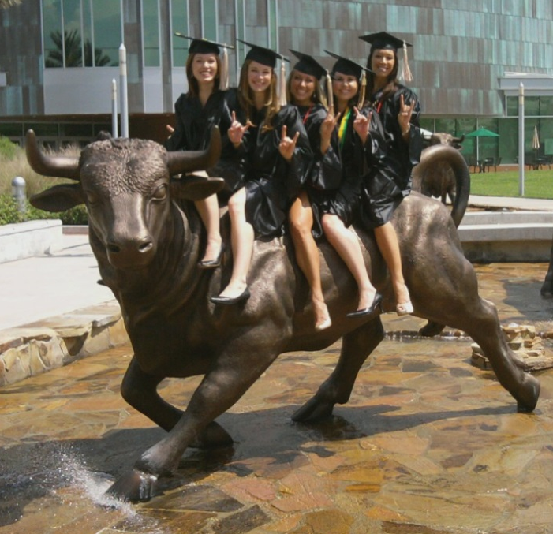
2015-2025
USF System Campus Master Plan Update
GO USF BULLS !

